Slide 1
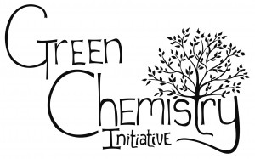
Sustainability Challenges of the Textile & Dyeing Industries – opportunities for innovation
Centre for Technical Textiles
SUSTAINABLE MATERIALS RESEARCH GROUP
Dr. Richard Blackburn
Sustainable Materials Research Group
University of Leeds
@RichardBlackb18

Slide 2
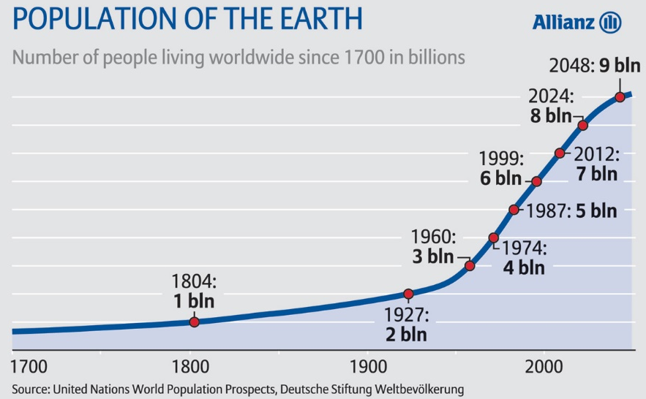
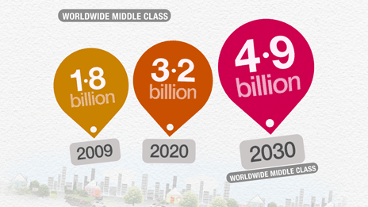
Necessity for Sustainable Products
2012 - world population 7 billion
2050 - expected to rise to over 9 billion
Increases demand
food, energy, water, resources, chemicals
Increases environmental burden
pollution
depletion of finite non-renewable resources (e.g. fossil fuels)
Synthetic chemical products and processes afford a significant improvement in quality of life
Growing middle class want these consumer products too

Slide 3
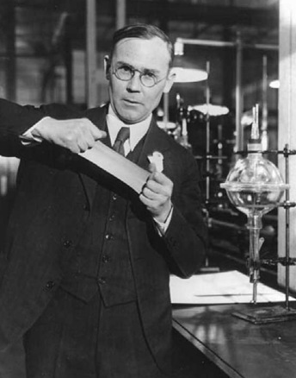
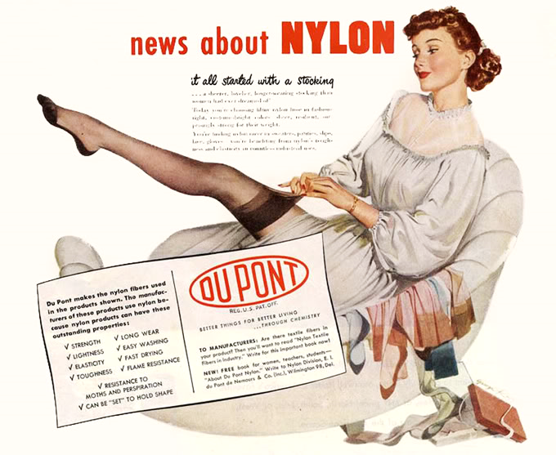
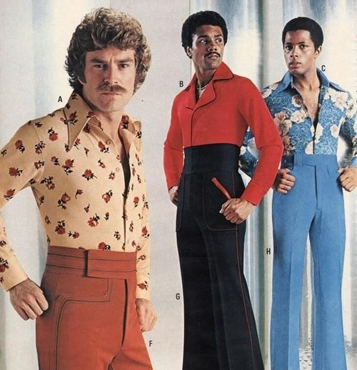
Synthetic fibre revolution
20th Century polymers
nylon, 1935
polyurethane, 1937
polyester
Terylene, 1941
Dacron, 1946
acrylic, 1944
polypropylene and HDPE,1951
Notes:
Many new polymers invented in 20th Century
Wallace Carothers and DuPont: nylon, 1935
Bayer: polyurethane, 1937
Whinfield, Dickson, Birtwhistle and Ritchie (ICI): first polyester fibre (Terylene), 1941
DuPont: acrylic, 1944
DuPont: Dacron (polyester), 1946
Banks and Hogan: polypropylene and high density polyethylene, 1951
Non-degradable and non-renewable
Their use increases oil consumption significantly
Polyester now has the highest consumption of all fibres
At the current rate of consumption, fossil fuels expected to last for another 50-60 years

Slide 4
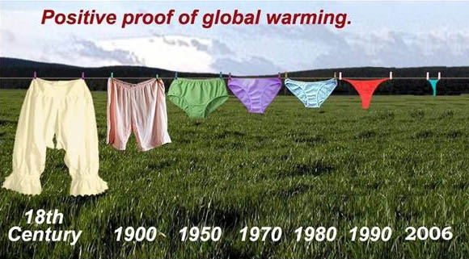
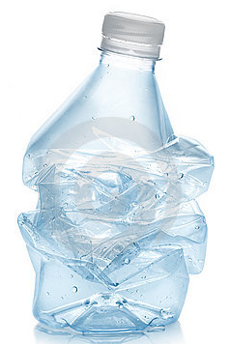
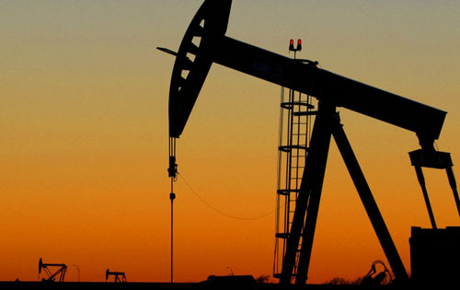
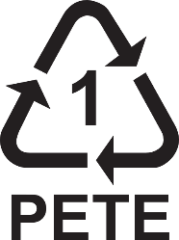
Synthetic fibre sustainability challenges
Non-degradable
Non-renewable
Increases oil consumption
Contribution to anthropogenic GHGs
Significant oil supply issues
But, polyester highest share of textile market (>50m tpa)
Raw materials for fibres must change
Recyclable – mechanical or chemical?
Notes:
Many new polymers invented in 20th Century
Wallace Carothers and DuPont: nylon, 1935
Bayer: polyurethane, 1937
Whinfield, Dickson, Birtwhistle and Ritchie (ICI): first polyester fibre (Terylene), 1941
DuPont: acrylic, 1944
DuPont: Dacron (polyester), 1946
Banks and Hogan: polypropylene and high density polyethylene, 1951
Non-degradable and non-renewable
Their use increases oil consumption significantly
Polyester now has the highest consumption of all fibres
At the current rate of consumption, fossil fuels expected to last for another 50-60 years

Slide 5
Definition of Sustainability
E
N
V
I
R
O
N
M
E
N
T
E
C
O
N
O
M
Y
S
O
C
I
E
T
Y
Notes:
5

Slide 6
Sustainability considerations
RAW MATERIALS
ENERGY
WATER
EMISSIONS
Notes:
6

Slide 7
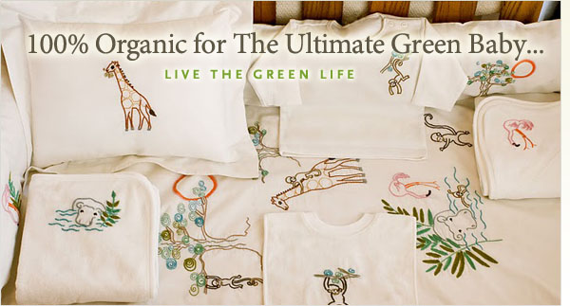
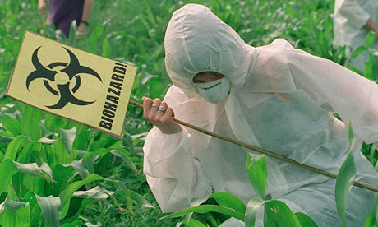
Public perception
Demand (and rejection) for consumer products can be driven by the public and the media
“Biodegradable”, “Natural”, “Organic”
perceived by the public to be good for the environment
“Synthetic”, “Non-organic”, “GM”
perceived by the public to be bad for the environment
“Chemistry”
Public perception of science…
Do the public understand what “Sustainable” means?
Physics
Chemistry
Notes:
Some industries use this to their advantage
Something purported as ‘green’ is often not so in reality

Slide 8
Ideal sustainable product
Provide an equivalent function to the product it replaces
Performs as well as or better than the existing product
Be available at a competitive or lower price
Have a minimum environmental footprint for all the processes involved
Be manufactured from renewable resources
Use only ingredients that are safe to both humans and the environment
No negative impact on food supply or water

Slide 9
RØADMAP TO ZERO DISCHARGE OF HAZARDOUS CHEMICALS (ZDHC)
Has involved stakeholders in development
Provides training to industry
Looks at hazards in the manufacturing supply chain, not just final products
Tests final textile products
But in the manufacturing supply chain it is largely based on a chemical inventory approach (overlooks impurities and by-products in chemical used)

Slide 10
RØADMAP TO ZERO DISCHARGE OF HAZARDOUS CHEMICALS (ZDHC)
Does not actually eliminate substances of concern to zero concentrations, but restricts to a limit of n ppm
Does not cover a wide range of chemicals on its MRSL
Only chemicals with very low limits are PFOA and PFOS at 2 ppm
Is the focus on these chemistries influenced by Greenpeace (Chemistry for any weather, October 2012)?
Creditable to reduce levels of PFOA and PFOS, but there is more concerning chemistry issues in the textile industry

Slide 11
Textile dyeing processes
Traditional dyeing processes use 5.8 trillion litres water p.a.
~3.7 billion Olympic swimming pools
10-20% dye remains after dyeing (plus other chemicals), leaving potential for wastewater pollution
One fifth of the world's industrial water pollution (World Bank)
391 billion kWh energy for dyeing processes
Innovative technologies needed to reduce, or eliminate, water, energy and auxiliary chemicals in dyeing

Slide 12
Treatment of textile dyeing effluent
Wastewater discharged from dyeing processes one of biggest contributors to textile effluent
Mainly residual dyes and auxiliary chemicals
>50,000 tpa dye discharged into effluent
Dye Class | Fibre | Loss to effluent (% applied)
acid | polyamide | 5-20
basic | acrylic | 0-5
direct | cotton | 5-30
disperse | polyester | 0-10
metal-complex | wool/polyamide | 2-10
reactive | cotton | 10-50
sulfur | cotton | 10-40
vat | cotton | 5-20

Slide 13
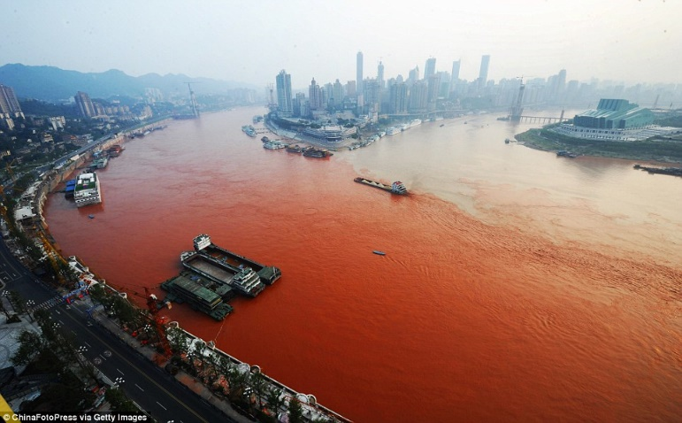
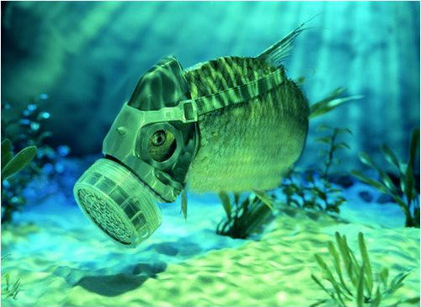
Treatment of textile dyeing effluent
Dyeing effluent in a watercourse aesthetically undesirable, but has a more serious environmental impact
High BOD combined with spectral absorption of dye
Can affect photosynthetic processes
Reduction in O₂ levels in the water → suffocation of aquatic flora and fauna
Dyestuffs may be also have aquatic toxicity (metals, AOX)
Several methods developed to remove colour from dyehouse effluent
Varying in effectiveness, economic cost, and environmental impact (of the treatment process itself)
Blackburn RS, Environ. Sci. Technol. 2004, 38, 4905.

Slide 14
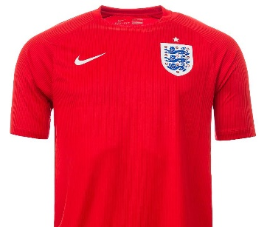
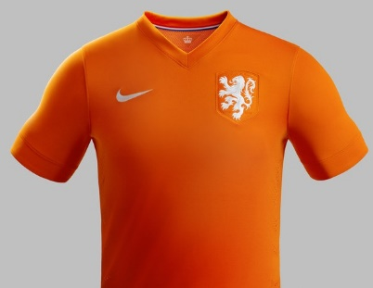
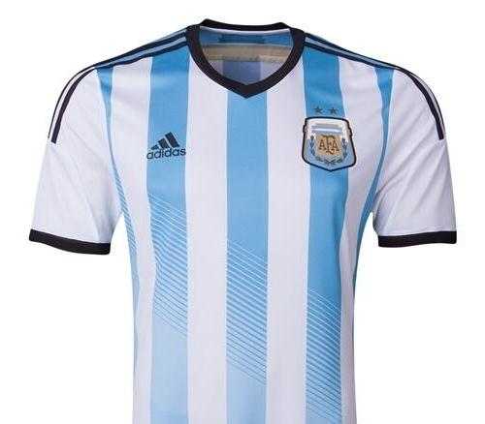
Polyester dyeing process
Hydrophobic fibre dyed with hydrophobic disperse dye
Traditional aqueous process requires dispersing agents/surfactants and high temperatures (typically 130 °C) under pressure
Other dyeing auxiliaries often required
Large amount of waste dye left over in effluent
Surface dye removed with surfactants and/or reducing agents
Innovation in scCO₂ dyeing to completely change polyester dyeing process

Slide 15
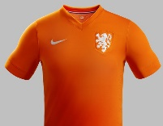
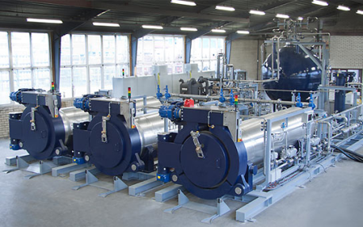
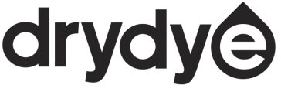
scCO₂ dyeing - timeline
Process further developed by Knittel et al.
1992
Dyeing of modified cotton in scCO₂ at Univ of Leeds
1998
1988
Schollmeyer et al. patent scCO₂ dyeing of polyester
1995
Pilot scale dyeing of polyester up to 30 L (Bach et al.)
Abel Kirui wins silver in London 2012 Marathon singlet in dyed using DyeCoo process
2012
2010
DyeCoo deliver first industrial-scale scCO₂ dyeing machine to factory in Thailand
2013
Nike opens dedicated waterless dyeing factory in Taiwan

Slide 16
scCO₂ dyeing
START
Fabric loaded
FINISH
Dyed fabric
STEP 1
Liquid CO₂ released into dyeing vessel
STEP 6
Pressure lowered and CO₂ leaves vessel as gas. 95% recovered
STEP 2
Heat + pressure liquid CO₂ → scCO₂
STEP 5
Separator evaporates CO₂ to remove excess dye and residue
STEP 3
scCO₂ and dye forced through fibre
STEP 4
Fresh CO₂ pumped through and used CO₂ to separator

Slide 17
scCO₂ dyeing
System comparison with traditional polyester dyeing
WATER
Zero water used
WASTEWATER
Nearly 100% dye used in process.
Zero waste
ENERGY
Reduces energy consumption by 63%
PROCESS CHEMICALS
No auxiliary chemicals required
FOOTPRINT
¼ of physical footprint to dye same amount of fabric
EFFICIENCY
40% faster than traditional dyeing processes

Slide 18
scCO₂ dyeing - limitations
Machines are more expensive than traditional water-dyeing machines
“costs will come down through scale and lower water and energy expenses“
Only works on polyester fabrics and can't be used to dye cotton
Cotton made up about 32% global fibre market in 2012
Some relatively unsuccessful work on modifying cotton
Significant opportunity to develop low or zero water dyeing systems for coloration of cellulosics

Slide 19
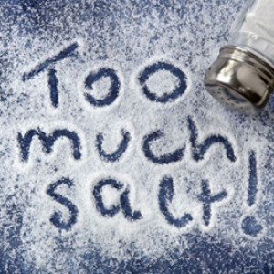
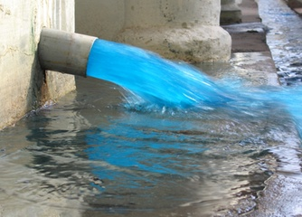
Coloration of cotton
Dyeing of cotton primarily conducted using reactive dyes
Despite development of dyes with high fixation, dyeing still uses high quantities of salt, water (and energy), and creates colour pollution
Soil too alkaline to support crops
Kills aquatic life
Fresh watercourses turned saline downstream from dyehouses
Difficult to remove from effluent
10-40% dyestuff hydrolysed
Goes down drain
Aesthetically unpleasant
Blocks sunlight
Kills aquatic life
Clean effluent
High cost
High level in dyeing
Incredible volume in wash-off
Up to 10 separate rinsings
High energy consumption
50% total cost dyeing procedure

Slide 20
Wash-off of reactive dyeings on cotton
Dye transfer inhibiting (DTI) polymers (used in laundry detergents) were employed to remove unfixed dyes
Much more efficient, economical and sustainable process developed
Significantly reduces operation time, water consumption and energy consumption
poly(vinylpyridine-N-oxide) polymers were the most effective
poly(vinylpyridine betaine) polymers also highly efficient
Procedure | Time (min) | Water (L/kg fabric) | Energy (MJ/kg fabric)
recommended wash-off | 250 | 60 | 9.21
DTI wash-off | 50 | 30 | 0.84
Amin MN, Blackburn RS, ACS Sus. Chem. Eng. 2015, 3, 725.

Slide 21
Bigger problems with cotton
NATURAL doesn’t necessarily mean sustainable
Cotton production >25 million tpa
High levels of pesticides (25% world total)
High levels of insecticides (11% world total)
Very high irrigation levels
1 kg of cotton fibre requires 20,000-40,000 L
Water average person consumes in a lifetime
Only grows in certain climates
Deforestation to grow cotton
High area of land for mass of useable fibre

Slide 22
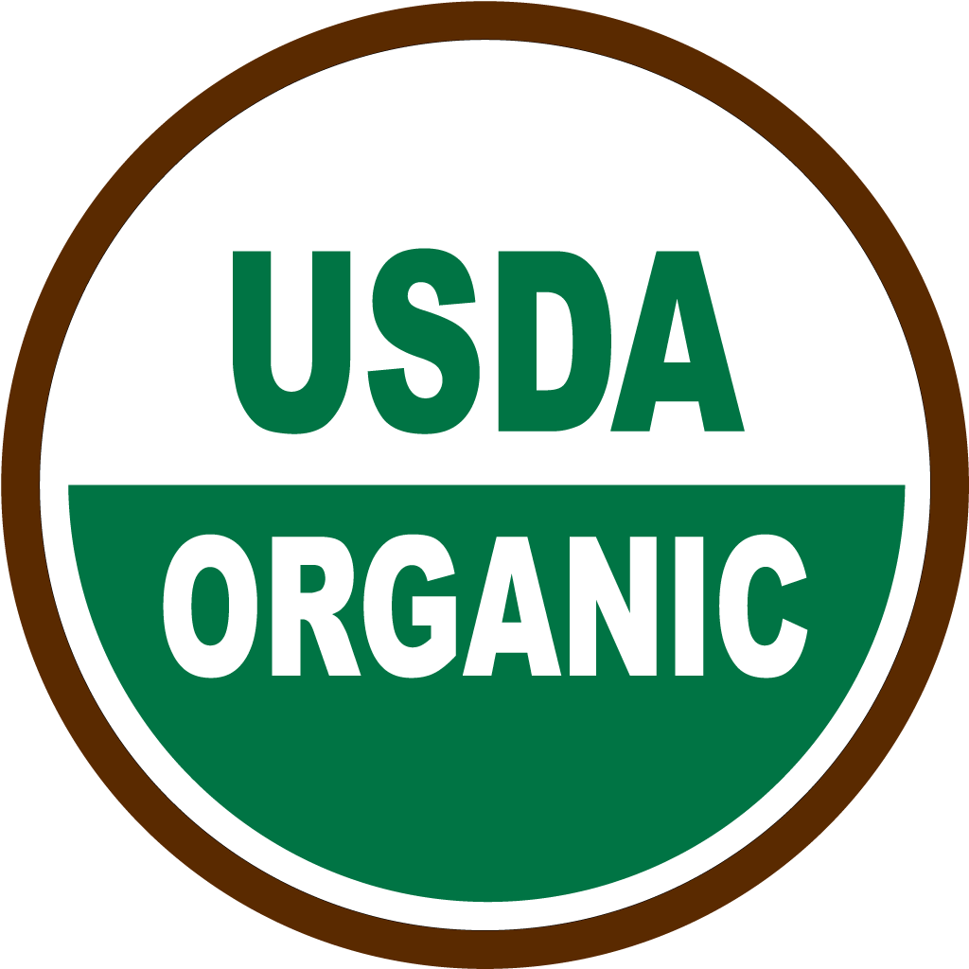
Sustainable cotton?
Organic cotton
Widely promoted as the answer to cotton’s problems
Global production (in over 20 countries, mainly India) only 1.1% of world cotton production
No genetically modified seed permitted
No herbicides or pesticides
Ethical labour employment standards
Requires approximately 1.4x area of land to produce same mass of fibre
Still has very high water consumption
Not a viable alternative on a global scale to completely replace non-organic cotton

Slide 23
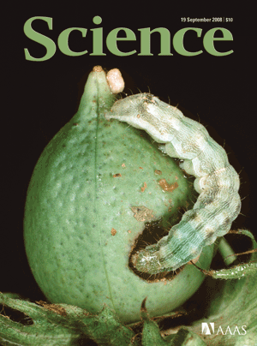
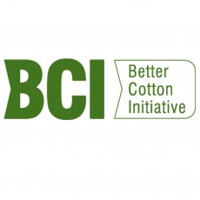
Sustainable cotton?
Better cotton
GM pest-resistant strain referred to as ‘Bt cotton’
Naturally occurring protein (used by organic gardeners) – kills bollworm pests (moth larva)
Reduces pesticide sprays from 5 sprays to 0
Poisoning of workers virtually eliminated
More productive, particularly in India
Bt cotton is regarded as less ‘natural’
Cannot be classed as ‘organic’
Better Cotton Initiative (BCI) set up to foster improvements in the sustainability of cotton production methods

Slide 24
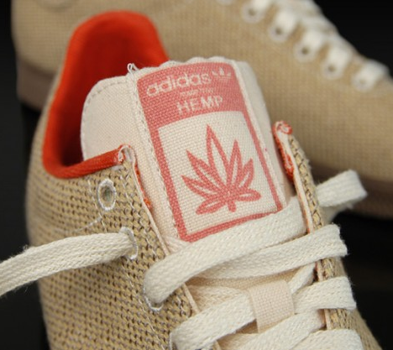
Sustainable Cellulosic Fibres
Bast Fibres
From stem of plants (flax, hemp, jute, ramie, nettle, kenaf, abaca)
Plants with opportunities for performance fibres (e.g. Himalayan nettle)
Processing to separate ultimate fibres is of concern
Opportunities for innovation into alternative separation techniques (e.g. enzyme-assisted technologies)
Lanzilao G, Goswami P, Blackburn RS, Mater. Letts., 2016, in press.
Blake AW, Marcus SE, Copeland JE, Blackburn RS, Knox JP, Planta, 2008, 228, 1.

Slide 25
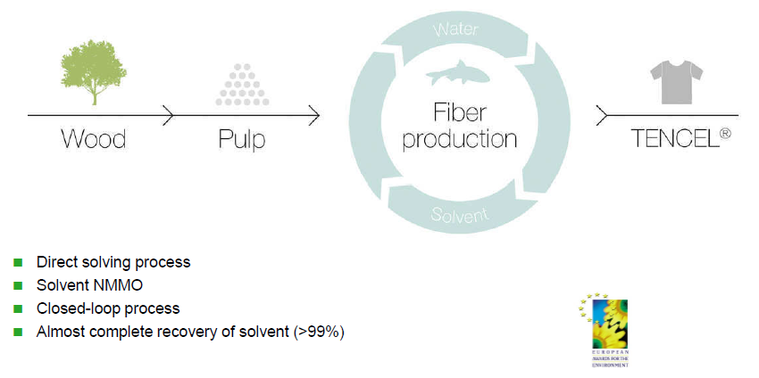
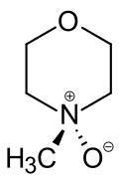
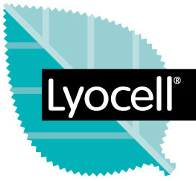
TENCEL (lyocell) – most sustainable fibre production process
Regenerated cellulosics made from trees
Lenzing manufactures lyocell
Fibre production
wood
pulp
Tencel®
Wood from certified forests
Direct dissolution process
N-methylmorpholine-N-oxide (NMMO)
Closed-loop process
>99% recovery of solvent

Slide 26
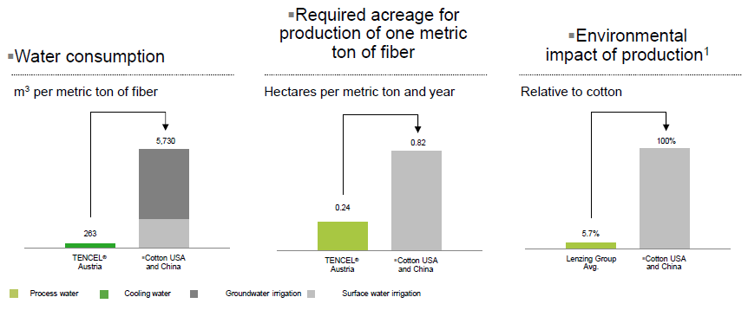
Green footprint: significantly more environmentally than cotton
More than 50% of Lenzing’s fuel consumption sourced from renewable resource

Slide 27
Sustainability challenges for the textiles industry
Sustainability issues in the textiles industry have often been tackled in industry by tinkering and incremental change
Step-change solutions are needed to bring about truly sustainable apparel and footwear products

Slide 28
Best way to mix colours?
Nano-level
Mixture of different dye molecules in dyebath to create desired shade
Micro-level
Mixture of different dyed fibres in yarn formation process to create desired shade

Slide 29
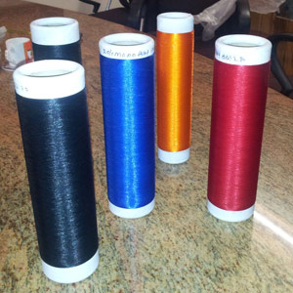
Does fibre coloration have to be through dyeing?
Dope-dyeing: incorporation of colorant into spinning process
Lyocell process makes this possible for cellulosics
Mixing dyed pulp with undyed pulp
Dissolution in NMMO
Fibre spinning and washing
Cellulose pulp
Dyeing pulp
Dope-dyed lyocell fibres

Slide 30
DyeCat Process
Catalytic process that allows colour to be integrated directly into polyesters
Eliminates need for conventional dyeing
Colour in fibre is generated at the same time the polymer is made
Colours ‘locked into’ fibre providing a technically superior product
No need for wasteful dyeing processes
DyeCat PLA fibre
Renewable
Technically superior
Saves chemicals and energy

Slide 31
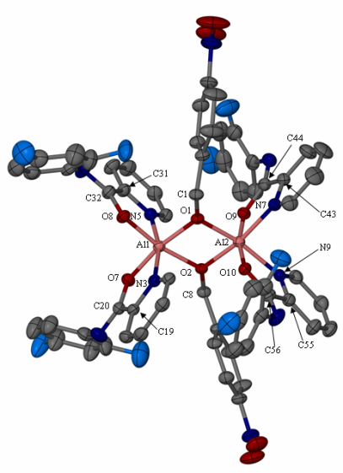
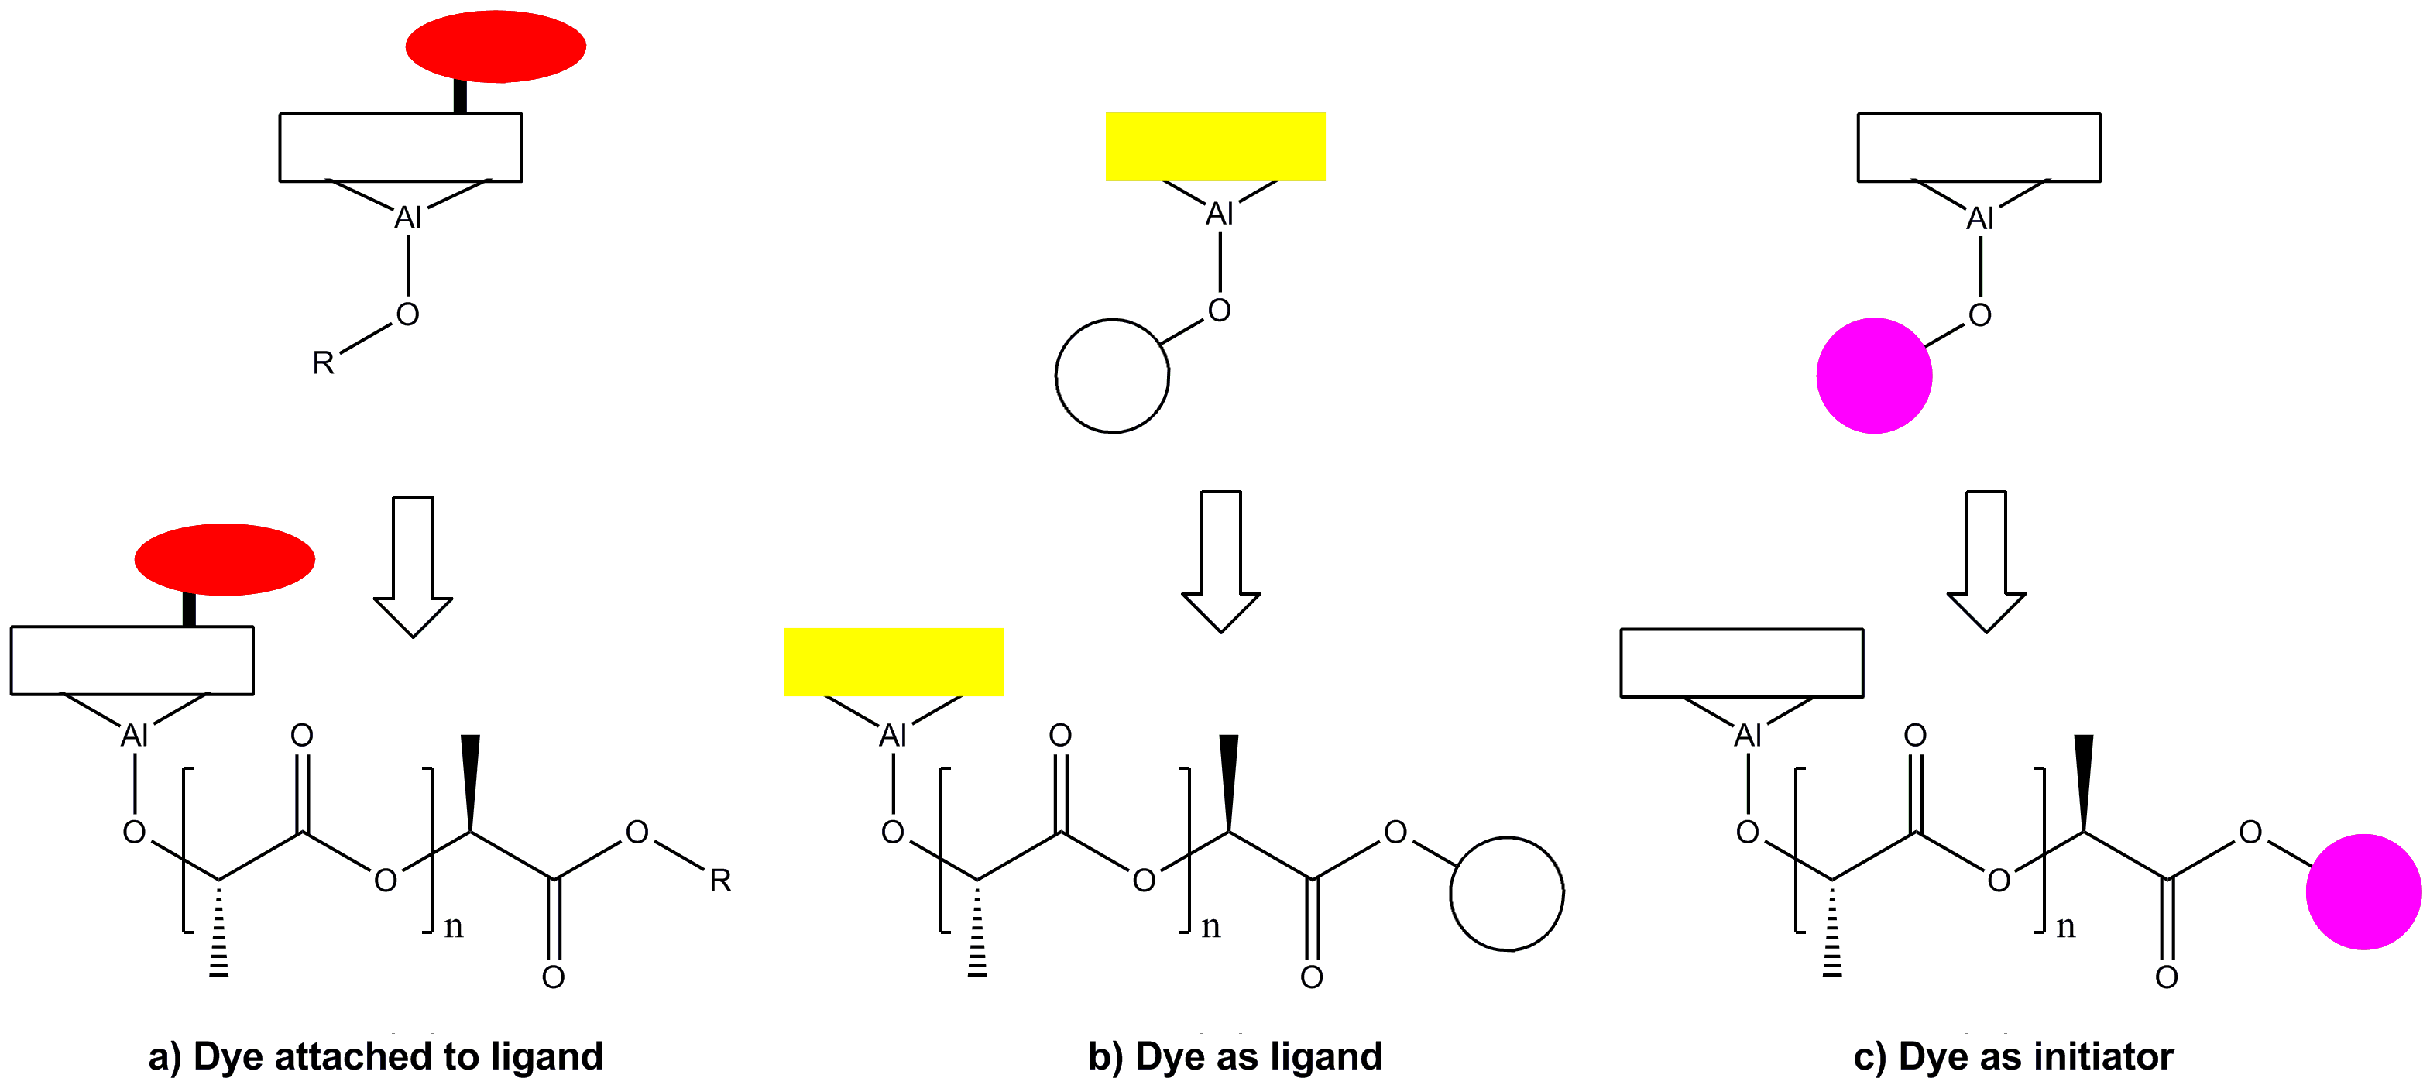
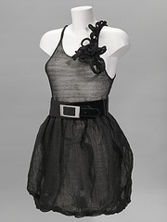
DyeCat Process
Coloration of polymer during synthesis
Demonstrated on PLA using coloured catalysts
MacRae RO, Pask CM, Burdsall LK, Blackburn RS, Rayner CM, McGowan PC, Angew. Chem. Int. Ed. 2010, 50, 291.

Slide 32
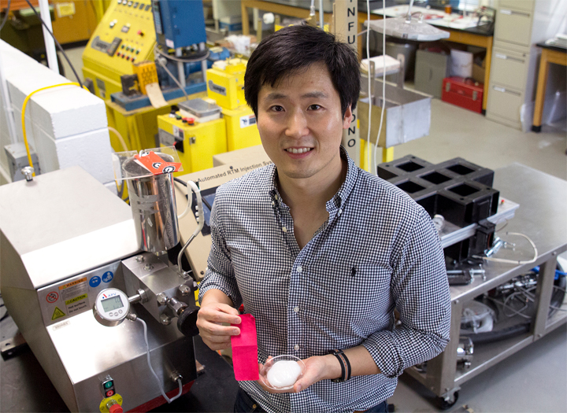
Novel, sustainable and cost-effective textile dyeing using nanocellulosic fibres
Dr. Yunsang Kim et al., University of Georgia
Innovative dyeing processes using coloured nanocellulose
Winner of Green and Sustainable Chemistry Challenge
nano-sized cellulose fibrils (wood pulp) + dye
→ dyed nanocellulose dispersion
Apply dyed nanocellulose dispersion onto the textile material using low water process
Coloured nanocellulose permanently binds to textile surface
Greatly reduces energy and water needed

Slide 33
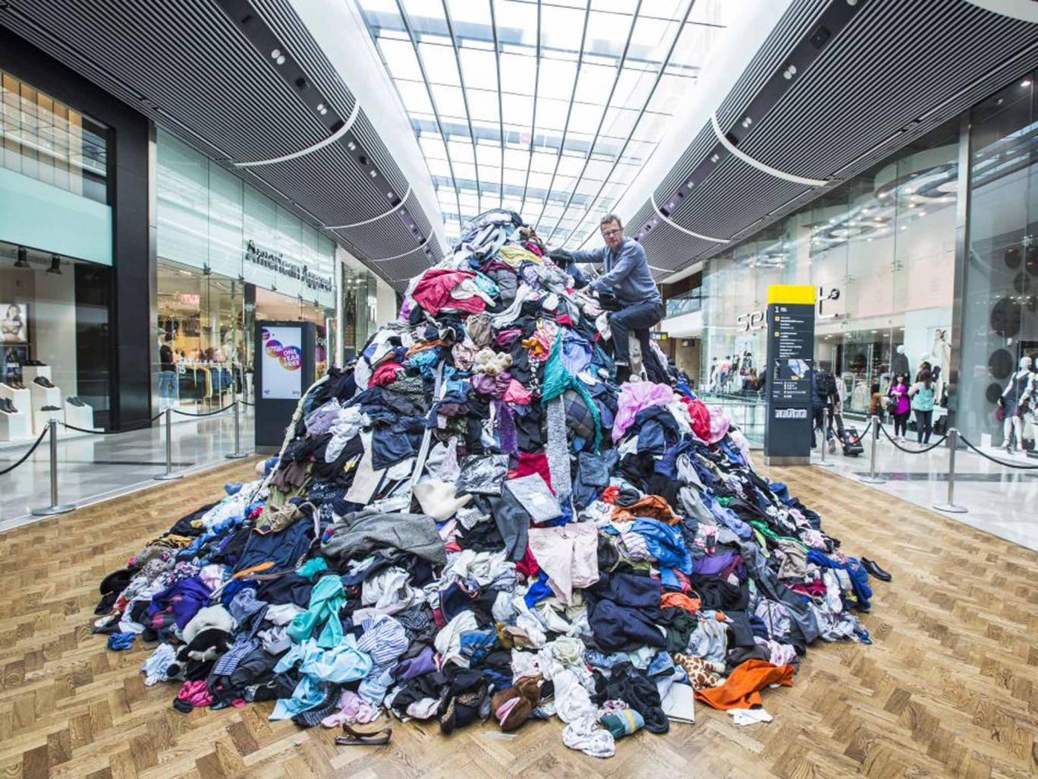
Fast Fashion
Consumption of new designs as close as possible to the point of creation
Fast, low price and disposable
Business model: reducing time cycles from production to consumption
"Supermarket" market
Environmental Impact
US imports >1 billion garments annually from China alone
Dramatic increase in environmental damage caused by the textile industry
Safety compromised in evermore cost-cutting supply chain
Human disasters (e.g. Rana Plaza)
An enormous change is needed in the minds and attitudes of retailers and consumers
7m tonnes clothing thrown away in UK every 10 minutes

Slide 34
Sustainable Urban Living – Textiles
Greater use of sustainable raw materials
Lower energy & water consumption and pollution generation in production
Lower impact in use
Water, energy, chemicals in cleaning/laundering
Design for easy disassembly/disposal/ recycling
DESIGN FOR REDUCED CONSUMPTION AND LONGER LIFE
‘Disposable’ products unsustainable

Slide 35
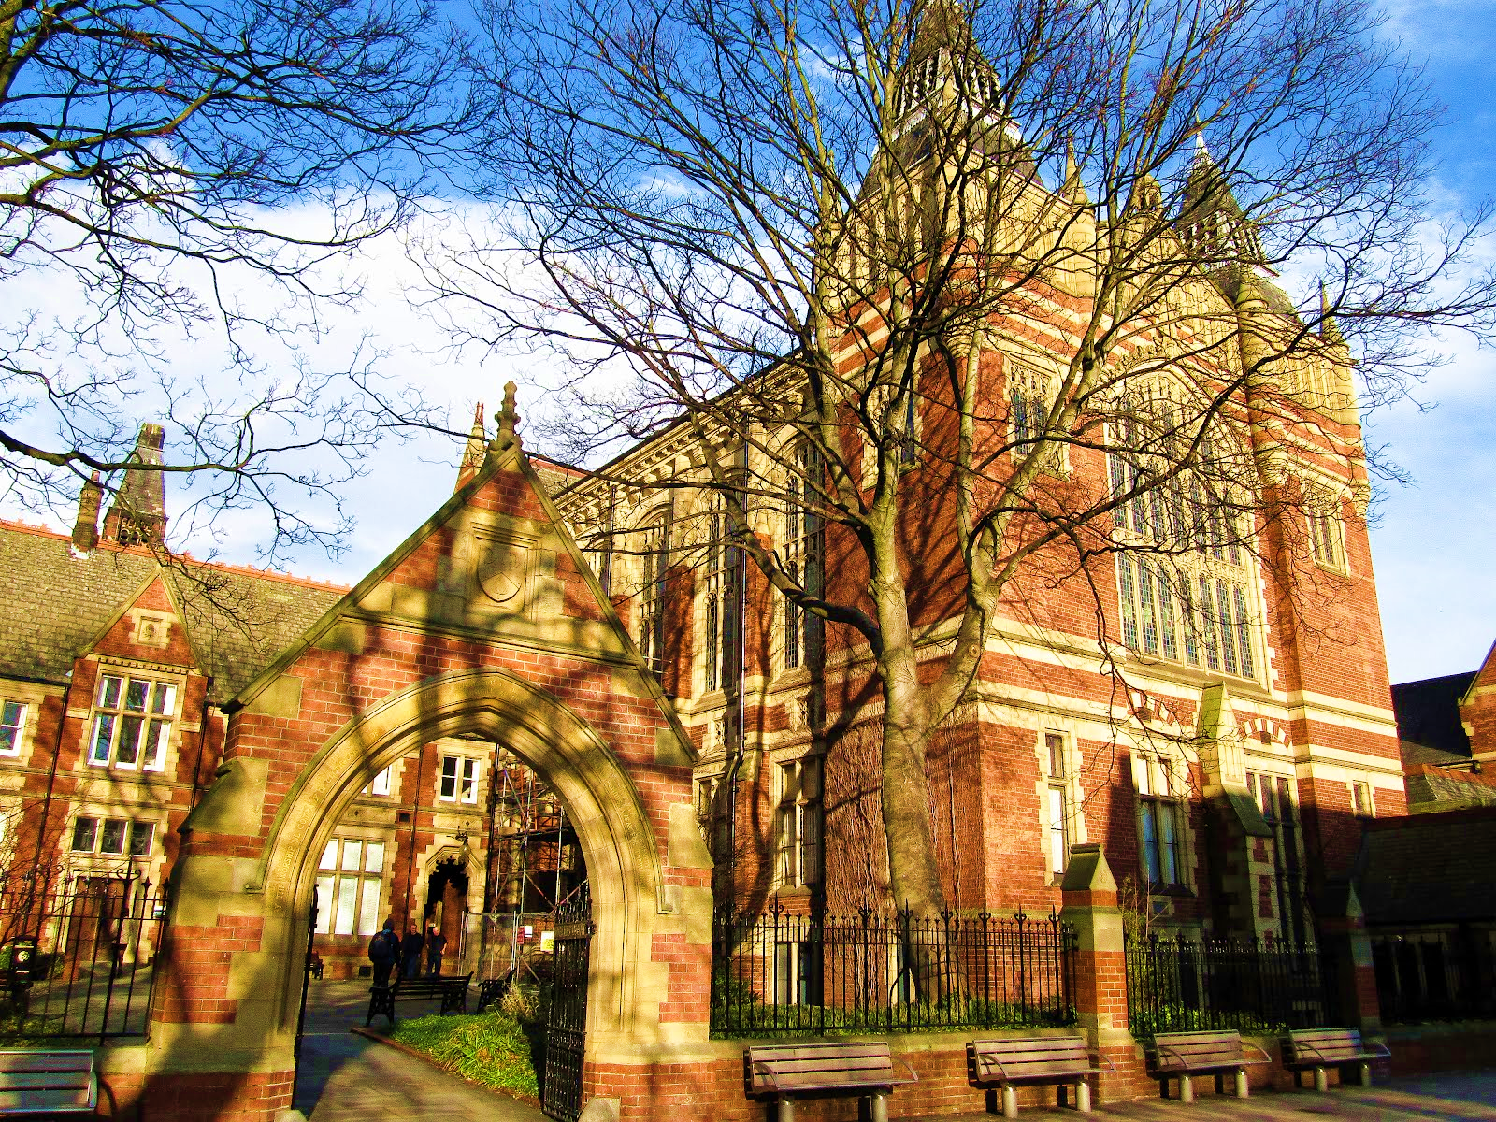
Dr. Richard S. Blackburn r.s.blackburn@leeds.ac.uk @RichardBlackb18
Centre for Technical Textiles
SUSTAINABLE MATERIALS RESEARCH GROUP
Thank you

