Slide 1

Open Access – What it is and why you want to do it!
Carmen O’Dell
Library Open Access Coordinator

Slide 2

Talk outline
DD Definitions
Benefits
Mandates
Making it happen
Benefits (again)
Help

Slide 3
Definition of Open Access
General principle that research articles should be freely available on the internet, permitting any users to read, download, copy, print, search, and link to the full text with the proviso that authors are properly acknowledged and cited.
Full definition: Budapest Open Access Initiative (2002)

Slide 4
Green or Gold?
GREEN: Authors deposit their articles in a subject or institutional repository such as White Rose Research Online subject to version and embargo conditions imposed by the publisher
GOLD: Authors publish in journals which offer free access to the Publisher’s Final Copy/Version of Record immediately on publication. Authors usually have to pay an Article Processing Charge (APC) of £100-£3000 to the publisher.

Slide 5
Open Access - Who benefits?
Authors
Readers
Libraries
Universities
Funding agencies
Governments
Citizens
(Publishers/Journals)
Notes:
- a worldwide audience larger than that of any subscription-based journal, no matter how prestigious or popular, and demonstrably increases the visibility and impact of their work.
OA gives them barrier-free access to the literature they need for their research, unconstrained by the budgets of the libraries they use
Universities: OA increases the visibility of their faculty and research, reduces their expenses for journals, and advances their mission to share knowledge.
Journals and publishers: OA makes their articles more visible, discoverable, retrievable, and useful.
Funders/Government - OA increases the return on their investment in research, making the results of the funded research more widely available, more discoverable, more retrievable, and more useful. OA also promotes democracy by sharing non-classified government information as widely as possible.
Citizens: But even those with no interest in reading this literature for themselves will benefit indirectly because researchers will benefit directly. OA accelerates not only research but the translation of research into new medicines, useful technologies, solved problems, and informed decisions that benefit everyone.
If a journal is OA, then it can use this superior visibility to attract submissions and advertising, not to mention readers and citations.

Slide 6
Open access – why do it
Benefits
Mandates
  HEFCE post-2014 REF OA policy (Green)
  Funders – RCUK, COAF/Wellcome (Gold)

Slide 7
HEFCE: post-2014 REF OA Policy
From April 2016, articles accepted for publication must be deposited in a repository within 3 months of the date of acceptance
The version deposited must be the Author Final Copy/postprint
Embargo periods of up to 1 year (STEM), 2 years (AHSS) post-publication are allowed

Slide 8
How to comply at UoS?
As soon as your article is accepted, create a record for each article in MyPublications and upload the Author Final Copy to WRRO

Slide 9
RCUK/COAF OA Policy
RCUK (Research Councils UK)
  AHRC, BBSRC, EPSRC, ESRC, MRC, NERC, STFC
COAF (Charities Open Access Fund)
  Wellcome Trust, Arthritis Research UK, Bloodwise, Breast Cancer Now, British Heart Foundation, Cancer Research UK, Parkinson’s UK
Notes:
Biotechnology and biological sciences
Engineering and physical science
Economic and social research
Natural Environment
Science and technologies facilities council

Slide 10
RCUK/COAF OA Policy
All funded papers to be available on an Open Access basis within 6 months of publication*
Block grant provided centrally to the University each year to cover costs of Gold open access
Gold open access papers must be published under a CC-BY licence
Notes:
Key points -

Slide 11
How to comply at UoS?
  Contact Library OA team on OAEnquiries@sheffield.ac.uk once your article has been accepted.
Notes:
Usual procedure

Slide 12
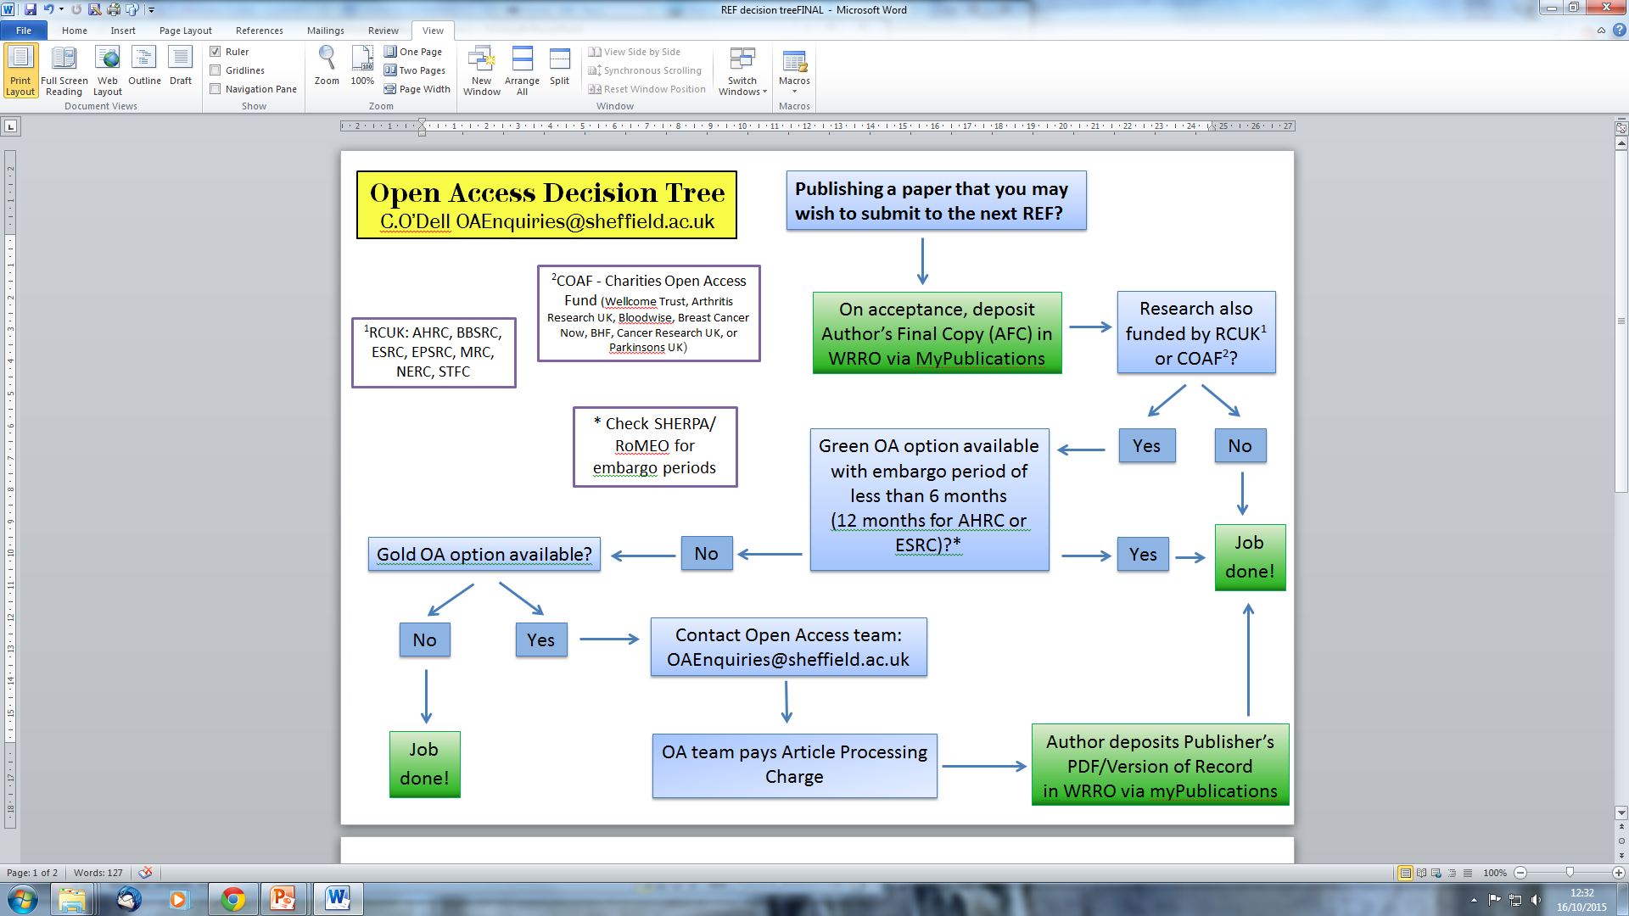

Slide 13
OA start to finish
On acceptance
Upload Author Final Copy to WRRO via myPublications
Contact OA team for Gold (RCUK/COAF authors)
On publication
Send DOI to OA team to update embargos in WRRO
Send invoice for APC to OA team (RCUK/COAF)
After publication
Check article IS open access (Gold)
Promote article!

Slide 14
Open Access – who benefits?
The Open Access citation advantage : studies and results to date. Swan, Alma (2010). http://eprints.soton.ac.uk/268516/
SPARC Europe – The Open Access Citation Advantage Service

Slide 15
Benefits - WRRO Statistics (Fri 16/10/15)
6108 items, 86% Full text, 72% OA, 1.4 million downloads
Most downloaded Sheffield article: 17,345 downloads
  Clark, C.D., Evans, D.J.A., Khatwa, A., Bradwell, T., Jordan, C.J., Marsh, S.H., Mitchell, W.A. and Bateman, M.D. (2004) Map and GIS database of glacial landforms and features related to the last British Ice Sheet. Boreas, 33 (4). pp. 359-375. ISSN 0300-9483
Most downloaded Sheffield author: D, Howe with 111,646 downloads

Slide 16
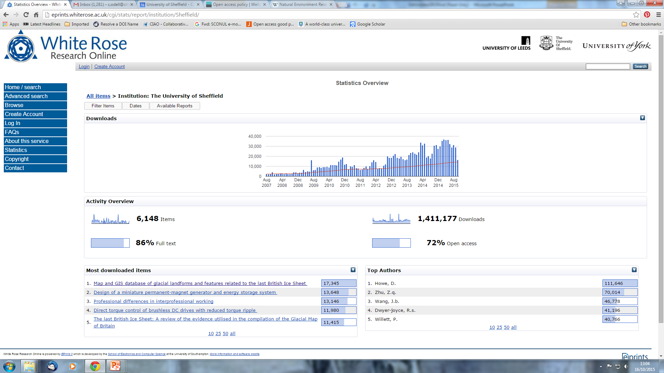

Slide 17
Open Access - Who benefits?
You Do!
Notes:
Higher downloads and citations according to The Open Access Citation Advantage Service provided by SPARC Europe.
Increased visibility leads to greater public engagement and accessibility. The Wellcome Trust report that open access articles they have funded were downloaded 89% more when compared with access-controlled content.
OA results in accelerated science. A study of open access and non-open access PNAS articles published between June 8, 2004, and December 20, 2004 supported the view that open access accelerates the process by which researchers built upon existing research, showing that open access articles are cited earlier and are, on average, cited more often than non-open access articles.
OA facilitates collaboration with the Human Genome Project often cited as an example of the ability of open access to transform publications and data “into a much more powerful resource for research, education and innovation”. This international, collaborative research project was enabled by the use of open data, with all the sequence data made openly available for other researchers to reuse.

Slide 18
Further Help and Advice
Library Open Access webpages http://www.sheffield.ac.uk/library/openaccess/index
MyPublications guidance
  http://www.sheffield.ac.uk/ris/systems/mypublications
University of Sheffield Open Access Position statement
  http://librarysupport.shef.ac.uk/OpenAccessPositionstatement.pdf
HEFCE Open Access Research Policy
  http://www.hefce.ac.uk/rsrch/oa/Policy/
Contact the library open access team
OAEnquiries@sheffield.ac.uk

Slide 19
Any Questions
???

