Slide 1
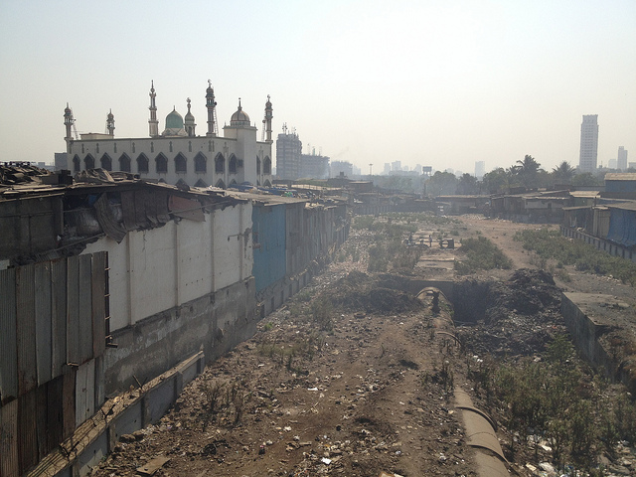
Image: Thomas Galvez, ‘Open Space in Dharavi Slum’, Creative Commons/Flickr
Developing E-tourism: Slumdog Millionaire’s Digital Realities
15 May 2015
Dr Rodanthi Tzanelli,
University of Leeds

Slide 2
Slumdog Millionaire (dirs. Danny Boyle & Loveen Tandan, 2008)
International accolade as cinematic artwork placed spyglass on some of its principal filmed sites, the mega-slums of Juhu and Dharavi in Mumbai (others being Maharashtran Nitin Desai Studios & Taj Mahal, Agra)
Greatest impact on development of slum tourism (a-la SM) with the development of digital profiling of philanthropically-oriented business
Reality Tours & Travel most influential business operator in Mumbai

Slide 3
From cinematic to digital (art)work
Film both embraced and contested by various government and activist agents as portraying the darkness of India’s post-Partition social conditions in slums BUT relevant tourism hit many obstacles
Reality Tours & Travel have been running since 2006 but their condemnation by a TV programme as ‘poverty tourism’ and the threats of Minister of Tourism, Kumari Selja, to have them shut down (Richardson, 22 January 2009) turning-points in their operation

Slide 4
Why? Managing multiple realities
That of cinema: Mumbai-India’s (=Jamal) route to modernisation/technological progress in line with Western image of civility
That of slum/volunteer tourist – a privileged outsider responding to personal need for ethical development or collective imperative for philanthropic (digital-come-proximate) involvement
That of slum communities in need of financial & political support (13th Compound)
That of Indian governance (2009, Selja unveiled plans to extend the ‘Incredible India’ campaign to the domestic tourism sector with US $12 million out of a total budget of US $200 million allocated to the campaign)
Meena Kadri ‘Dharavi Pipe Walk, I’, Flickr/Creative Commons

Slide 5
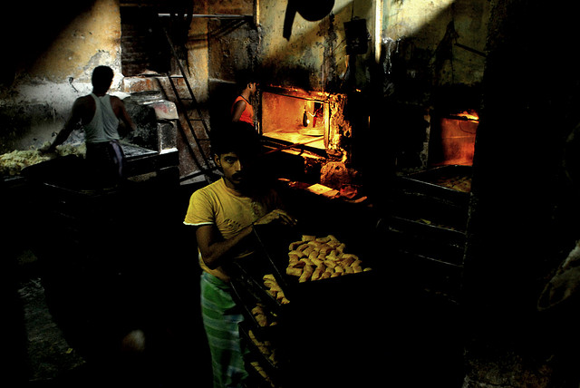
Response 1: Digital management of wrong impressions about Dharavi
Home to about 15,000 small businesses
Home of Mumbai’s sole efficient recycling industry
Home of multicultural communities: Tamils, Muslims, south Indians, Maharashtrians, Konkanis, potters, leather workers, plastic recyclers, goldsmiths, garment workers, craftsmen
Image Padmanaba01 (top) and Lececle (bottom), Flickr (Creative Commons)

Slide 6
Response 2: Collaboration with slum localities
Tour guides recruited also from slum localities
80% of profits donated to slum projects (education, hygiene, health etc…)
Photo Thomas Galvez, Flickr (Creative Commons)

Slide 7
Response 3: respecting localities’ ethical code of conduct
RECYCLING AREA Old computers, parts and plastics come from all over the world to Dharavi to be recycled. See the recycling plants in which separation and melting of plastics takes place.
ROOFTOP VISIT There is nothing like the view from a Dharavi factory rooftop. The tin hutments that house so many human lives stretch on as far as you can see, and birds screech overhead in the blue sky. You will never forget this view!
BISCUIT BAKERY Taste the tea biscuits that you can buy anywhere in Mumbai, hot and fresh at the source!
POPADDOM MAKING Watch the women of Dharavi make popaddoms, the essential appetizer of any Indian meal, by baking them on wooden baskets that are turned upside-down.
VISIT TO A RESIDENT’S HOUSE Gain an understanding of how the incredible people of Dharavi live.
KUMBHARWADA POTTERY COLONY Watch artisans create all types of pots out of unfired, sundried clay.
COMMUNITY CENTRE The Community Centre, supported by funds from the tour, provides education in English, computers and other soft skills to the teenagers and young adults of Dharavi. Other activities take place here such as a library and indoor games. Visitors experience what matters most to Reality Tours... the men, women and children that make this dynamic community one of the most vibrant places in Mumbai.
BUT NO CAMERA POLICY for the whole tour (really? ☹)

Slide 8
Overall venture provokes: Do we have the right to construct our own slum tourist realities?
Global boom in ‘slum tourism’: African slums, New Delhi (Saalam Bombay), Mumbai (Slumdog Millionaire), Rio de Janeiro etc…
Fascination with poverty leads to accusations of performing ‘poorism’: the affluent world gazing upon developing others (Urry 2002; Urry & Larsen 2011)
Slum tourism quintessentially connected to Western European (19th c) & American (early 20th c) urbanity (split between haves-gazers-tourists and have nots-gazed upon-vagabonds)

Slide 9
Extending the ‘counter-gaze’ in Dharavi
No photos policy and no covering nose demand of localities
Emphasis on local industriousness, lack of tips policy, and even cleanliness of children that are properly educated
Emphasis on family bonds and local camaraderie or guild consciousness also projected online (Reality Tours website, global journalists’ tours)
Image Padmanaba01, Flickr (Creative Commons)

Slide 10
Where does respect begin?: acknowledging the other’s intelligence
Slumdwellers self-conscious of foreign understandings of what is clean, proper, orderly and ‘civilised’ behaviour and environment
Prioritising ‘gaze’ sidelines Indian engagement with reality through multiple sensory inputs (rasas)
Banning photography allows some degree of control on slumdwellers BUT Reality T&T website needs imaging to advertise place
Is reverting to picture-friendly representations of Dharavi as space of utopian family sociality playing at the hands of nationalist networks? Does it truly help localities or only business?
Image: ‘Life goes on’, Creative Commons/Flickr

Slide 11
Multiple realities?
Slumdog Millionaire’s ‘multiple realities’ (of slums as terrestrial, political, historical, cinematic and now digital spaces) provide a series of different blueprints for making host-guest exchange work (or not) in cinematic tourist contexts:
Reality as temporarily present exchange (host-guest exchange without reciprocity)
Reality as exclusive contractual/cinematic agreement (India shining on international stage)
Reality as inclusive cultural/political communication (slums shining on their own developmental terms only)
Reality as tourist experience (focus on travel itineraries & educational development of visitors)
EACH VERSION WITH ITS OWN PROBLEMS (TO DISCUSS)

