Slide 1
BORDERING STRANGENESS WORKSHOP Dr Rodanthi Tzanelli University of Leeds (r.tzanelli@leeds.ac.uk) 2 April 2015

Slide 2
Slumdog Millionaire (2008)
Read as narrative of Mumbai’s modernisation/urbanisation through the story of a child from the slums (Jamal Malik)
First part: extermination of internal strangeness (Muslim slumdwellers) by means of governmentality (Hindu mobs)
Second part: assimilation/instrumentalisation of difference by governmobile means (insertion into tourist and media industries)

Slide 3
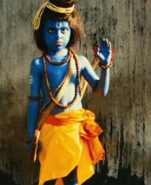
Inspiration of first part: Knowledge on slum politics?
Reference to The Bombay Riots (December 1992 and January 1993) by Vikas Swarup (Q & A), in which around 900 people died (275 Hindus and 575 Muslims). The riots were mainly due to escalations of hostilities after large scale protests (initially peaceful then turned violent) by Muslims
The riots were followed by a retaliatory 12 March 1993 Bombay Bombings, perpetuated by criminal groups with alleged help of ganglord Dawood Ibrahim and his D-Company syndicate, in which more than 300 people were killed
Screenwriter Beaufoy visited Mumbai’s slums three times, whereas directors Boyle & Tandan made conscious choice to include slumchildren in film and contribute to their welfare & education (poverty not excluded from cultural industrial glamour & profit-making)
Composer A.R. Rahman involved in global projects on elimination of poverty & human rights (A.R. Rahman Foundation)
Governmentality achieves the management of population by biological means (including extermination of the wrong cultural phenotype here defined on ethno-religious grounds)
Poverty-Islam-exclusion reflecting global politics on terror
Internal otherness/strangeness located in urban slums – often globally presented as sites of disorder, terrorism and symbolic dirt for the nation-state
India’s management of mentality in its infancy: God Rama

Slide 4
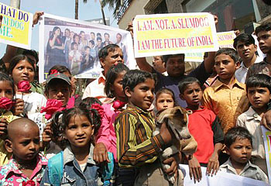
Text & context: reactions to film making it more ‘real’?
Slum protests with widely photographed children held up signs with the phrase ‘I am not a dog. I am the future of India’ (Kinetz, 22 January 2009).
Hindu organisation Janajagruti Samiti and Shiv Sena Party protested against the film’s portrayal of the Hindu god Rama, arguing that it hurts the sentiments of Hindus (The Times of India, 22 January 2009)
Kanchan Gupta wrote in the conservative Daily Pioneer that SM depicts Hindus as ‘rapacious monsters’ (25 January 2009).
Boyle made a film ‘structured…within the matrix of Western lib-left perceptions of the Indian “reality”’ which have little or nothing in common with the real India in which we live’

