Slide 1
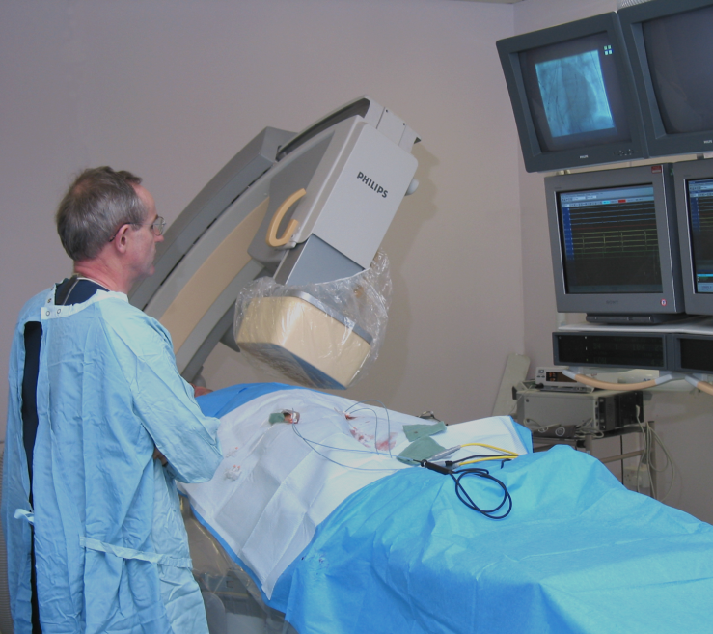
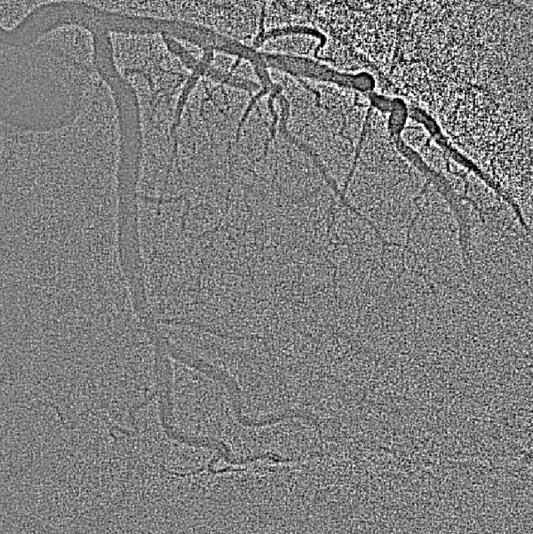
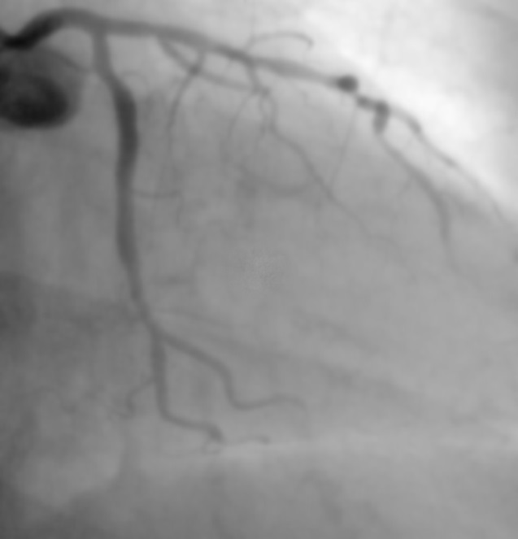
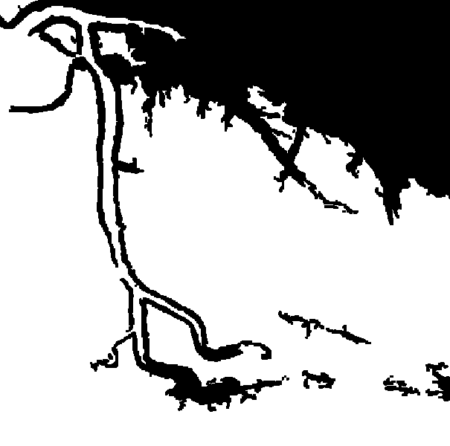
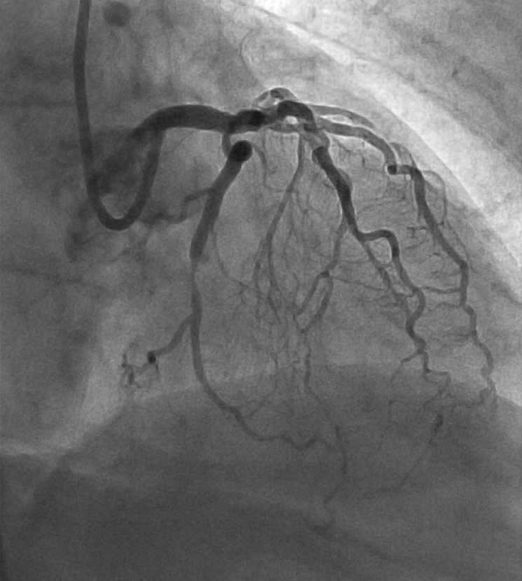
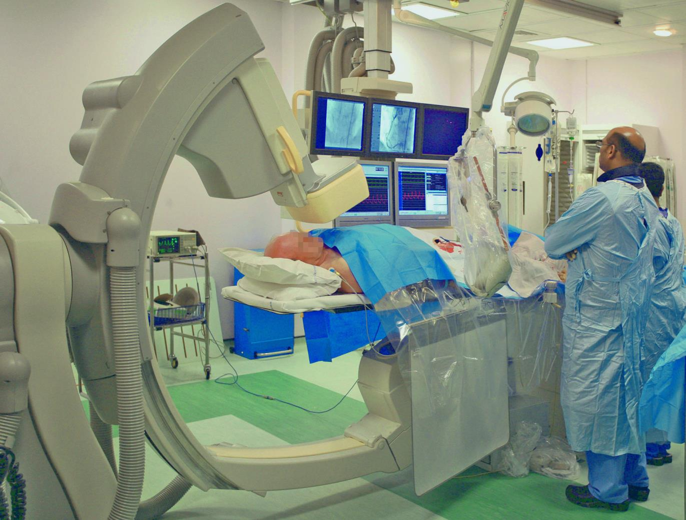
C
ardiac X-ray
ontext Sensitive
Image quality and X-ray dose control for
modern cardiac X-ray systems
Imaging
Stephen M. Kengyelics¹ MSc, Amber J. Gislason-Lee¹ MSc, Derek Magee PhD ², and Andrew G. Davies MSc ¹
1. Division of Medical Physics, University of Leeds, Worsley Building, Clarendon Way, Leeds LS2 9T
2. School of Computing, The University of Leeds, Leeds, LS2 9JT
Noise Estimation
An equidistant-bin histogram is constructed from the signal estimate image to identify all the unmasked pixels in the smoothed image that have a particular mean.
Introduction
Subtracting the signal estimate from the original image results in a noise image.
Modern cardiac X-ray imaging systems regulate their output in response to changes in patient attenuation by adjusting system parameters to maintain a constant average signal level from the X-ray detector using a feedback control loop as shown¹.
Noise in X-ray images may obscure clinically important anatomical details and principally arises from the quantum nature of electromagnetic radiation.
Noise Image
Unmasked Values Histogram
Counts
Average Detector Output Signal
X-ray Flat Detector
Signal Estimate Image
Pixel Value
System Mode Selection
Requested Output Signal
Anti-scatter Grid
Difference Signal
Patient
Compute kVp, mA, ms
Patient Table
Mask Image
Update Factors
Beam Filtration
Noise Estimate
Generator
X-ray Tube
One approach to noise estimation³ is to first estimate the signal content by filtering (smoothing) the image.
Variance
The X-ray attenuation properties of a patient are not fixed, and depend on a number of variables such as the specific anatomy being imaged, the angle of the projection, the area being imaged, and the geometry of the X-ray source, patient and detector.
A mask image is used to select only those areas in the noise image that originate from “flat” areas and is calculated
This control scheme is limited as it does not provide any information about the content of what is being imaged, nor what is clinically relevant and may lead to patients receiving more radiation dose than that required for the examination.
This study intends to investigate methods for automatically monitoring the content of real-time cardiac image sequences such that this information can be used to control the X-ray system settings according to the clinical task being performed
Mean Signal
Using the unmasked values histogram and the corresponding noise image a noise estimate can be calculated as a function of the mean signal
Combined IQ Metric
Signal Estimation
A key feature, or signal, of interest in cardiac X-ray images is the contrast of blood vessels which is how well they standout from their background when injected with a special dye that is opaque to X-rays.
Frangi Scale Image
$$IQM=\frac{Vessel Contrast}{Noise ∗ Patient Dose}$$
Estimates of the signal and noise in a cardiac X-ray image can be combined to produce an image quality metric (IQM) that represents the signal-to-ratio per unit of X-ray radiation dose to the patient. By actively monitoring image IQ in real-time system parameters can me adjusted to optimise image quality.
To automatically assess contrast the vessel must first be located. A Frangi “vesselness” filter² provides magnitude and orientation responses at a number of defined scales.
Future Work
Vessel Profile
Correlate the IQ metric with the experience of clinical users
Using the orientation information from the scale that provides the maximum response at a particular location any number of profiles orthogonal to the principle component of the blood vessel can be constructed
Vessel Profile
Pixel Value
Estimation of patient radiation dose from system parameters
Displacement
Vessel Contrast
Active monitoring of scattered X-ray radiation
Contrast
From an ensemble of profiles average vessel contrast can be calculated as a function of the vessel diameter
Automatically regulate system parameters to optimise image quality
Vessel Diameter
Acknowledgements
References
This work has been performed in the project PANORAMA, funded by grants from Belgium, Italy, France, the Netherlands, and the United Kingdom, and the ENIAC Joint Undertaking.
Gislason-Lee AJ, McMillan C, Cowen AR, and Davies AG. Dose optimization in cardiac x-ray imaging. Med. Phys., 40:091911, 2013.
Frangi A, Niessen W, Vincken K, and Viergever MA. Multiscale vessel enhancement filtering. Medical Image Computing, 1496:130-137, 1998.
Gravel P, Beaudoin G, and De Guise, JA. A method for modeling noise in medical images. IEEE Trans Medical Imaging, Vol. 23(10), pp. 1221-1232, 2014.

