Slide 1
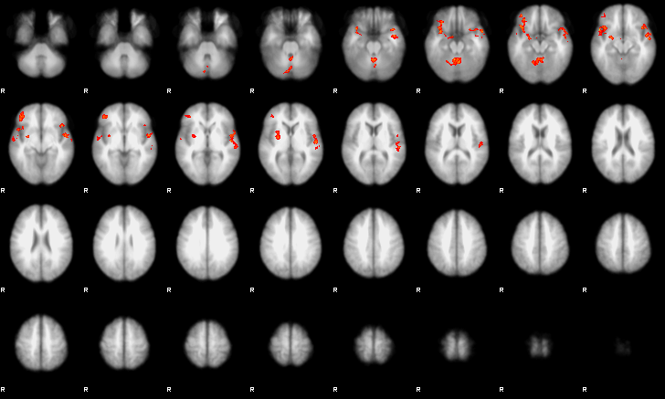
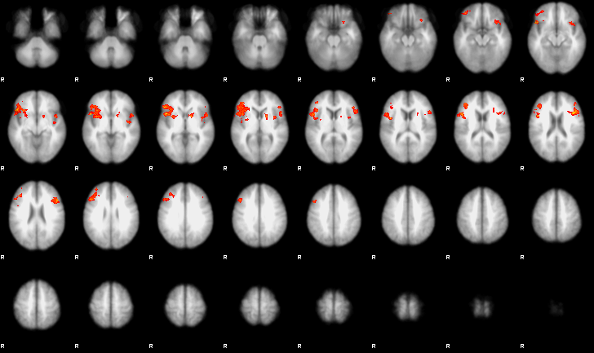
WS-H group activation Pain > Warm
Inferior frontal gyrus
Amygdala
Anterior insula
Putamen
Secondary somatosensory cortex
WS-L group activation Pain > Warm
Inferior frontal gyrus/anterior insula
Inferior frontal gyrus
Putamen

