Slide 1


Coherent imaging and sensing
using the self-mixing effect
in THz quantum cascade lasers
Paul Dean, James Keeley, Alex Valavanis, Raed Alhathlool, Suraj P. Khanna, Mohammad Lachab, Dragan Indjin, Edmund H. Linfield, and A. Giles Davies
School of Electronic and Electrical Engineering, University of Leeds, Leeds, LS2 9JT, UK
Karl Bertling, Yah Leng Lim, and Aleksandar D. Rakić
The University of Queensland, School of Information Technology and Electrical Engineering, QLD, 4072, Australia
Thomas Taimre
School of Mathematics and Physics, The University of Queensland, QLD, 407, Australia

Slide 2
Overview
Introduction
- Terahertz radiation, applications
- Terahertz quantum cascade lasers (THz QCLs)
- Imaging using THz QCLs
Self-mixing in THz QCLs
- 2D imaging
Coherent imaging using self-mixing:
  - 3D coherent imaging
  Swept-frequency coherent imaging for material analysis

Slide 3
Terahertz radiation: Properties
Frequency = 100 GHz – 1 THz – 10 THz;
Wavelength = 3 mm – 0.3 mm – 0.03 mm;
Energy = 0.4 meV – 4 meV – 40 meV
Non-polar material are transparent to THz radiation
    - plastics, paper, semiconductors, (fabrics)
Many long-range inter-molecular vibrational modes correspond to THz frequencies
- spectral absorption features
- alternative contrast mechanisms?
Non-ionising (safer)

Slide 4
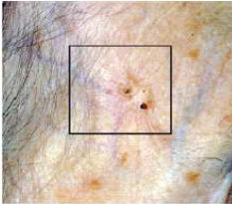
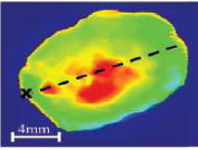
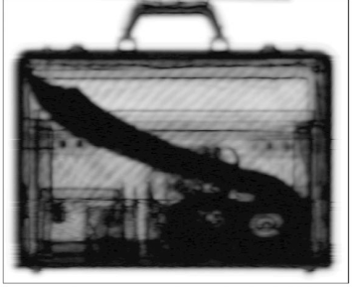
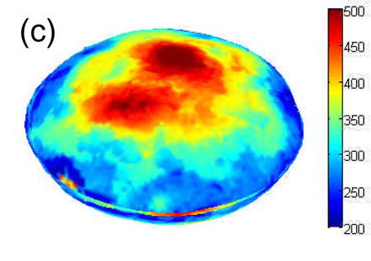
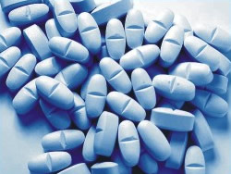
Terahertz radiation: Applications
Physical Sciences
(condensed matter, spectroscopy)
Atmospheric Science
Astronomy
Chemical sensing
Industrial Inspection
Security
Pharmaceutical monitoring
Biomedical imaging
V. P. Wallace et al., British Journal of Dermatology 151, 424 (2004)
N. Karpowicz et al., Appl. Phys. Lett. 86, 054105 (2005)
Y. C. Shen et al., IEEE J. Sel. Top. Quantum Elec. 14, 407 (2008)
M. Tonouchi, Nature Photonics, 1, 97 (2007)

Slide 5
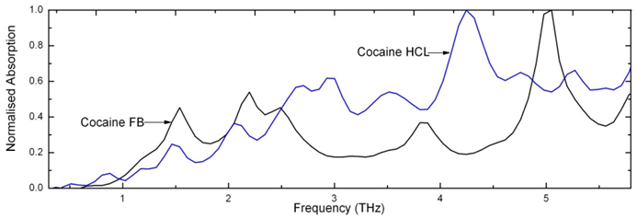
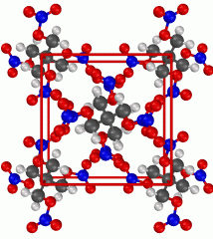
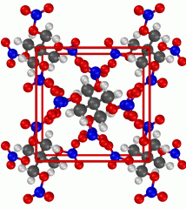
Molecular vibrations
THz absorption sensitive to chemical and structural properties
A. G. Davies et al., Materials Today 11, 18 (2008)
48.07 THz 1602.39 cm⁻¹
Mid-IR – localised internal mode
1.91 THz 63.94 cm⁻¹
THz – long range external mode

Slide 6
Overview
Introduction
- Terahertz radiation, applications
- Terahertz quantum cascade lasers (THz QCLs)
- Imaging using THz QCLs
Self-mixing in THz QCLs
- 2D imaging
Coherent imaging using self-mixing:
  - 3D coherent imaging
  Swept-frequency coherent imaging for material analysis

Slide 7
Terahertz radiation sources
IMPATT – Impact Ionization Avalanche Transit-Time diode
HG – Harmonic Generation
RTD – Resonant-Tunnelling Diode
TPO – THz Parametric Oscillator
PCS – Photoconductive Switch
QCL – Quantum Cascade Laser
At room temperature:
for f < 6 THz
electronic
optical
M. Tonouchi, Nature Photonics, 1, 97 (2007)

Slide 8
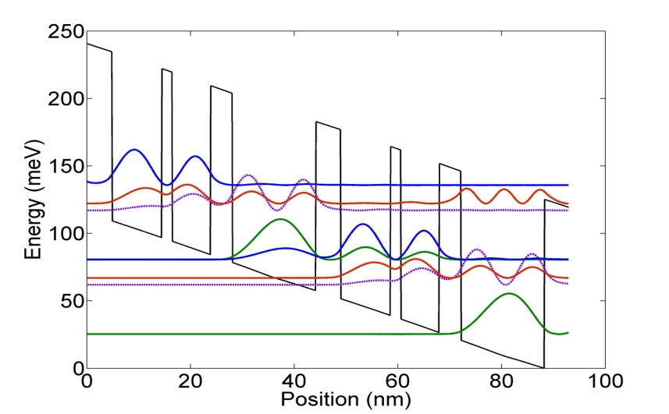
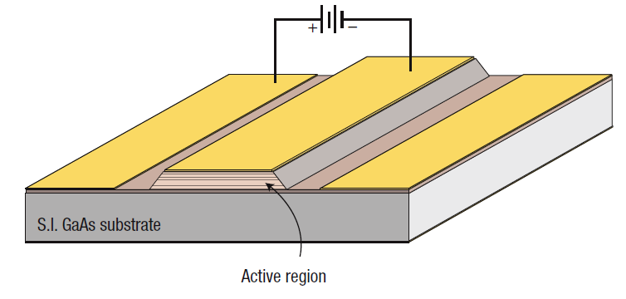
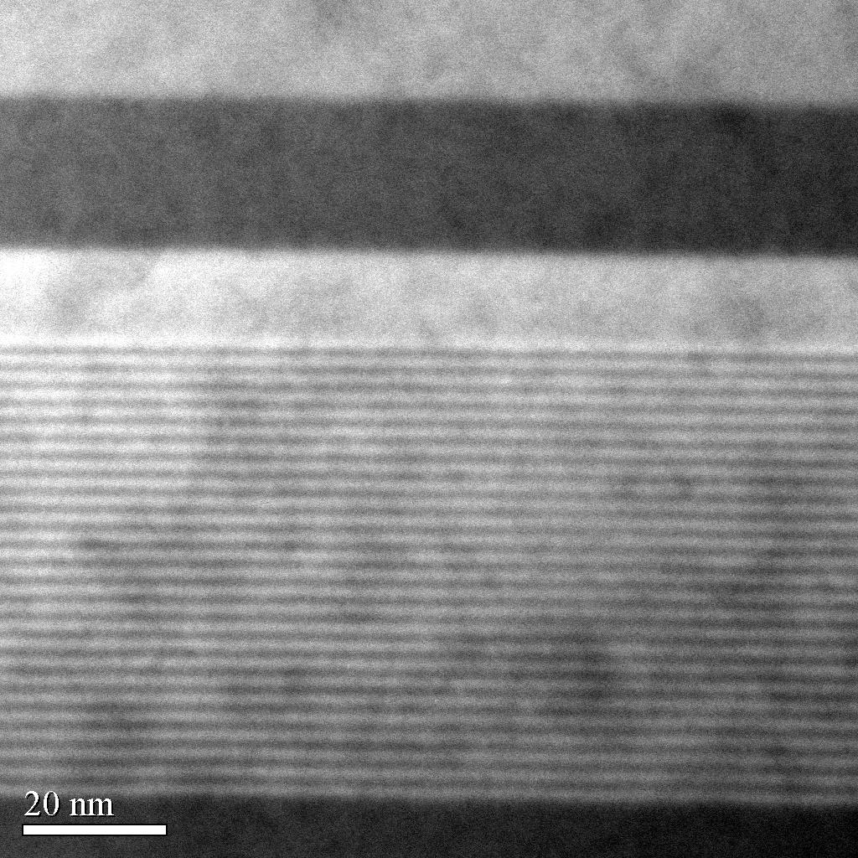
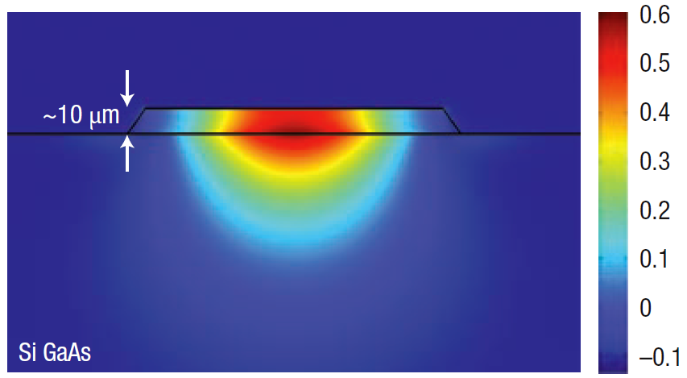
Terahertz quantum cascade laser (THz QCL)
Use electron transitions between conduction band states in a series of coupled quantum wells (typically GaAs/Al_{0.15}Ga_{0.85}As system) :
Au/Ge/Ni contacts
Ti/Au
overlayer
S.I. GaAs
Active region
n+ GaAs
A unipolar device
Photon energy engineered by well thicknesses
Electrons cascade through repeated (>100) units
B. Williams, Nature Photonics, 1, 518 (2007)

Slide 9
Overview
Introduction
- Terahertz radiation, applications
- Terahertz quantum cascade lasers (THz QCLs)
- Imaging using THz QCLs
Self-mixing in THz QCLs
- 2D imaging
Coherent imaging using self-mixing:
  - 3D coherent imaging
  Swept-frequency coherent imaging for material analysis

Slide 10
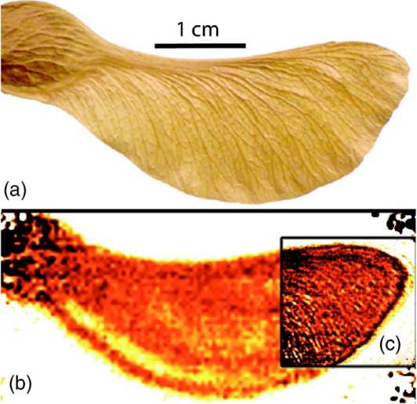
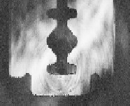
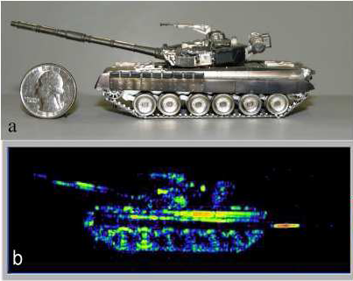
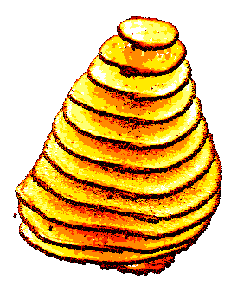
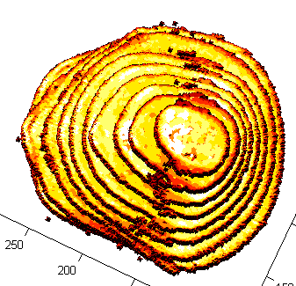
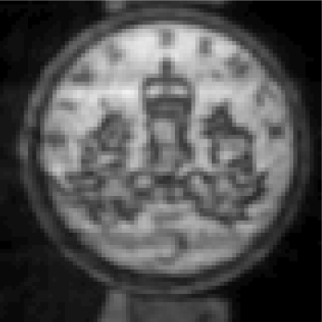
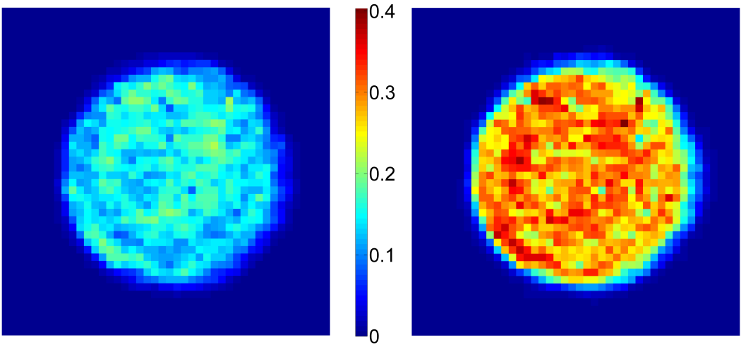
Detectors for THz QCL imaging
Microbolometer array
A. W. M. Lee et al.,
Appl. Phys. Lett. 89, 141125 (2006)
Schottky diode
S. Barbieri et al.,
Opt. Express 13, 6497 (2005)
A. Danylov et al.,
Optics Express 18, 16264 (2010)
Golay cell
K. L. Nguyen et al.,
Opt. Express 14, 2123 (2006).
Pyroelectric detector
P. Dean et al.,
Opt. Express 16, 5997 (2008)
Bolometer
P. Dean et al.,
Opt. Express 17, 20631 (2009)

Slide 11
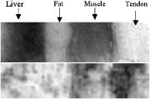

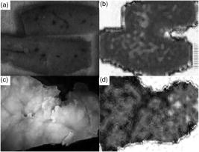
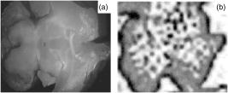
Biomedical imaging using THz QCLs
S. M. Kim et al., Appl. Phys. Lett. 88, 153903 (2006) Stanford University
Contrast based on water/fat content (3.7 THz):
Rat brain (in formalin):
Rat liver (in formalin):
healthy
7 mm
optical
THz
malignant
White matter
(higher fat content)
Grey matter
optical
THz
Tumour shows higher absorption
(higher water content) and more inhomogeneity

Slide 12
Overview
Introduction
- Terahertz radiation, applications
- Terahertz quantum cascade lasers (THz QCLs)
- Imaging using THz QCLs
Self-mixing in THz QCLs
- 2D imaging
Coherent imaging using self-mixing:
  - 3D coherent imaging
  Swept-frequency coherent imaging for material analysis

Slide 13
Laser self-mixing
The ‘Self-mixing’ effect can be observed when a fraction of the light emitted from a laser is injected back into the laser cavity from an external target
Sensitive to amplitude and phase of reflected field
Causes perturbation to:
    - threshold gain;
    - emitted power;
    - junction voltage
R_{c}
R_{ext}
G(N)
τ_{c}
(a)
τ_{ext}
3 mirror Fabry-Perot cavity model
S. Donati, Electro-Optical Instrumentation, Sensing and Measuring with Lasers (Prentice Hall Professional Technical Reference, New Jersey, 2004).
^{(a)}G. P. Agrawal and N. K. Dutta, Long-Wavelength Semiconductor Lasers (Van Nostrand Reinhold, 1986)

Slide 14
Self-mixing equations
ω₀ = Laser cavity frequency
G(N) = Gain
γ = Cavity losses
External feedback
R_{ext} = external reflectivity
R_{c}
R_{ext}
R_{c} = Laser mirror reflectivity
G(N)
τ_{c}
τ_{ext}
τ_{s} = carrier lifetime
Injection
S. Donati, Electro-Optical Instrumentation, Sensing and Measuring with Lasers (Prentice Hall, New Jersey, 2004).
R. Lang and K. Kobayashi, IEEE J. Quant. Elec. 16, 347 (1980)

Slide 15
Self-mixing equations
Phase condition:
R_{c}
R_{ext}
G(N)
ω₀ = Laser frequency
ω = Perturbed laser frequency
κ = Feedback parameter
α = Line-width enhancement factor
τ_{c}
τ_{ext}
Threshold gain perturbation:
Self mixing signal:
- emitted power
- junction voltage
Amplitude
Phase
Frequency modulation
Mechanical modulation
S. Donati, Electro-Optical Instrumentation, Sensing and Measuring with Lasers (Prentice Hall, New Jersey, 2004).
R. Lang and K. Kobayashi, IEEE J. Quant. Elec. 16, 347 (1980)

Slide 16
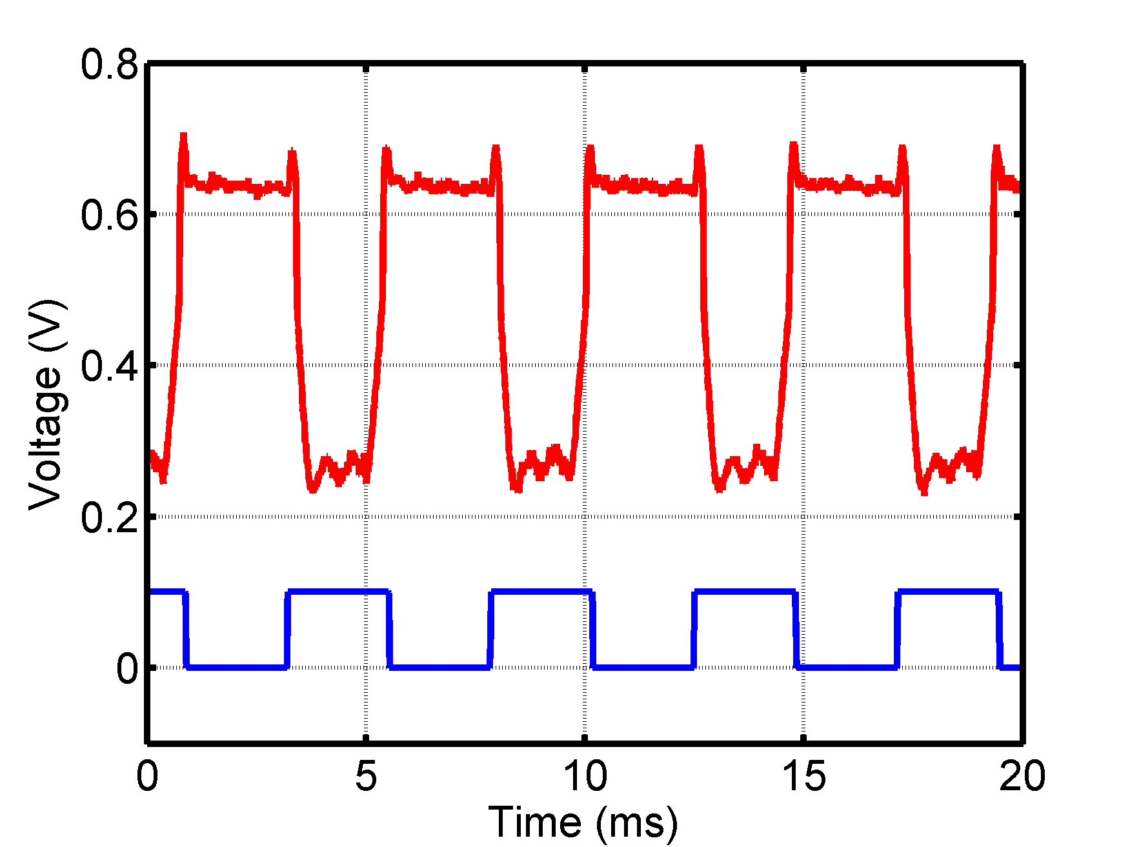
Self-mixing in THz QCLs
Monitor SM via voltage modulation:
- No need for external detector!
- Extremely simple, compact configuration
- High sensitivity
- Fast (laser dynamics ~ps)
2.6 THz BTC QCL
Current
Source
x100
Oscilloscope
QCL
P. Dean, Y. L. Lim, A. Valavanis, R. Kliese, M. Nikolić, S. P. Khanna, M. Lachab, D. Indjin, Z. Ikonić,
P. Harrison, A. D. Rakić, E. H. Linfield and A. G. Davies
Opt. Lett. 36, 2587-2589 (2011)

Slide 17
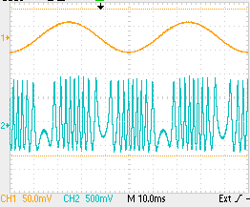
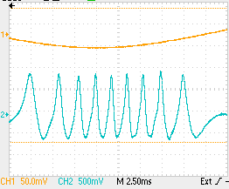
Self-mixing in THz QCLs
Current
Source
x100
Oscilloscope
QCL
~20 Hz
Driver
Speaker coil
Fringe spacing = λ/2
QCL acting as compact interferometer!

Slide 18
Overview
Introduction
- Terahertz radiation, applications
- Terahertz quantum cascade lasers (THz QCLs)
- Imaging using THz QCLs
Self-mixing in THz QCLs
- 2D imaging
Coherent imaging using self-mixing:
  - 3D coherent imaging
  Swept-frequency coherent imaging for material analysis

Slide 19
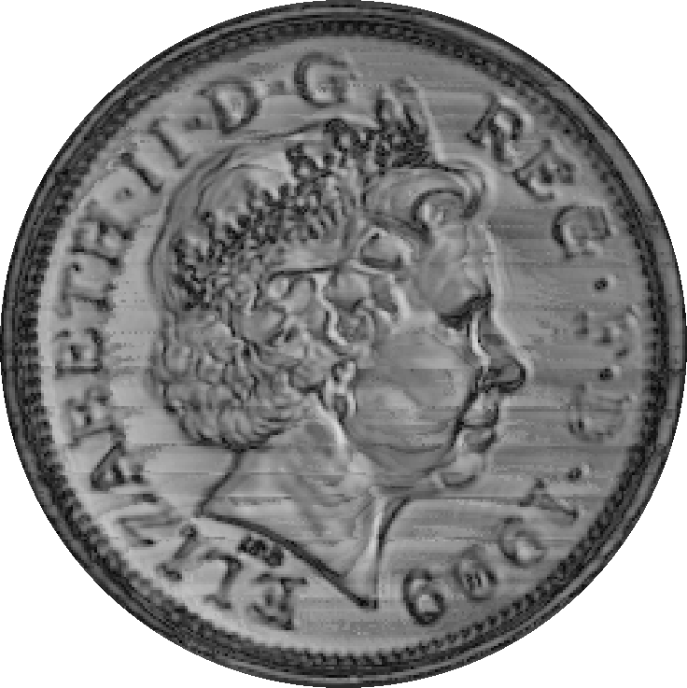
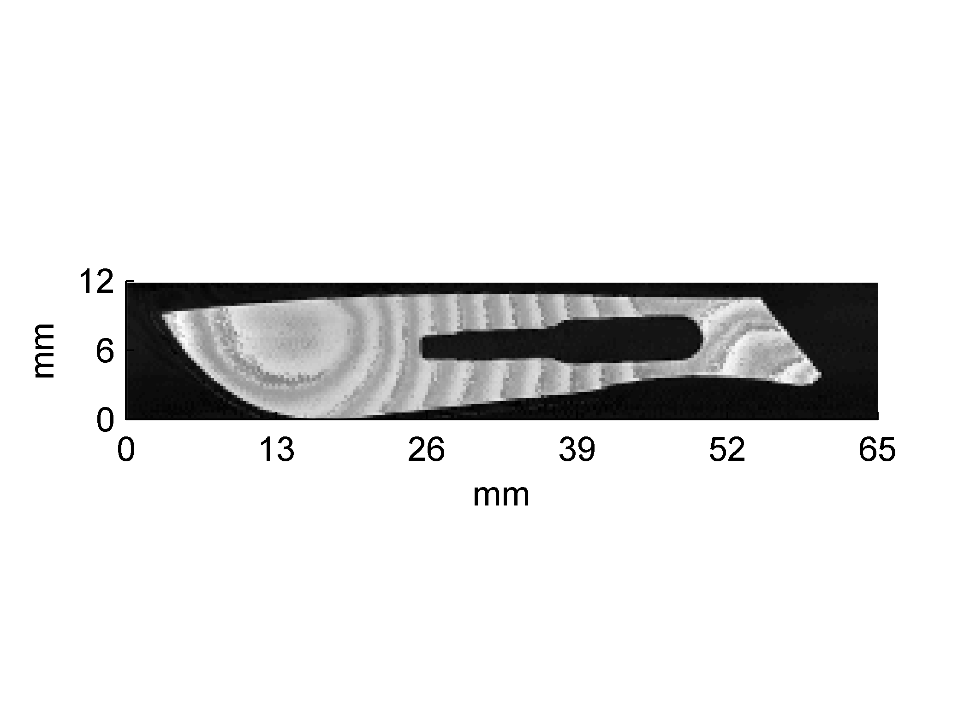
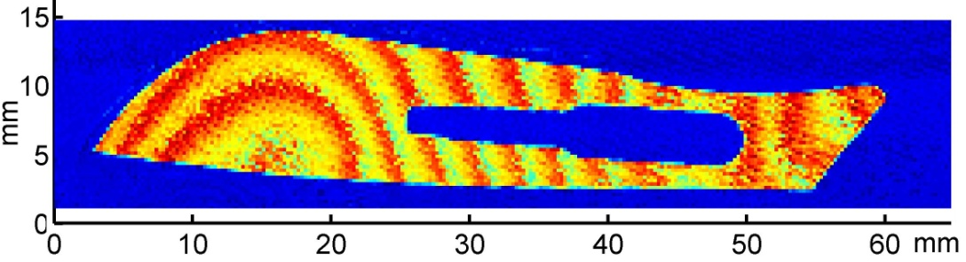
Imaging by self-mixing in THz QCLs
Current
Source
x100
High-resolution imaging
Lock-in amp
QCL
x-y scanning
Imaging through packaging
Image contrast arises from reflectivity and surface morphology of sample
(fringes at ~58 μm)
Long-range imaging over >10 m
P. Dean et al., Opt. Lett. 36, 2587-2589 (2011)
A. Valavanis et al, IEEE Sensors 13, 37 (2013)

Slide 20
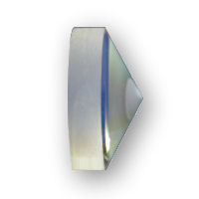
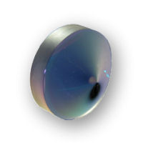
Surface profiling
SM image
PTFE cones
2D FFT
Self mixing fringes correspond to surface profile of objects
Ring spacing gives cone angle :

Slide 21
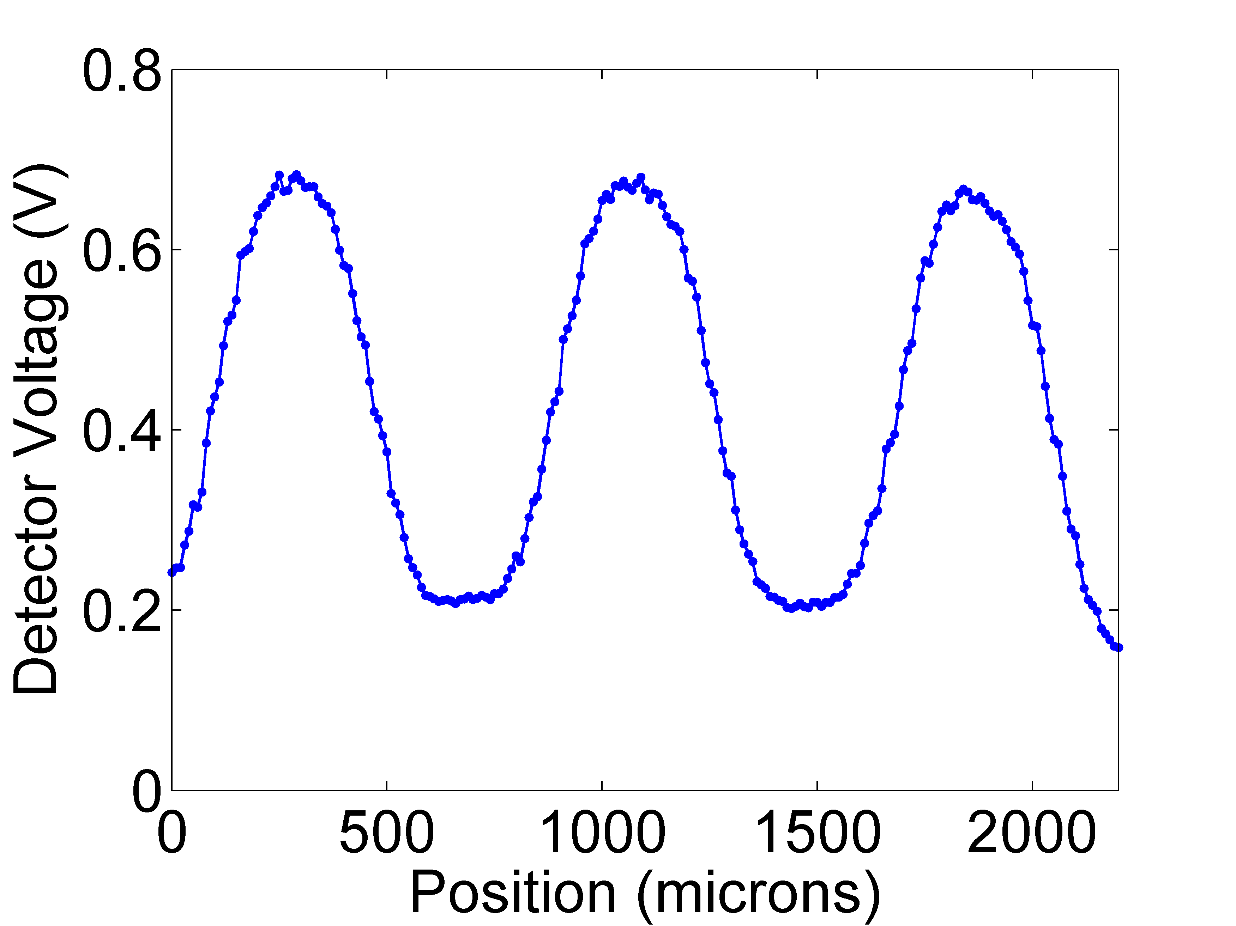

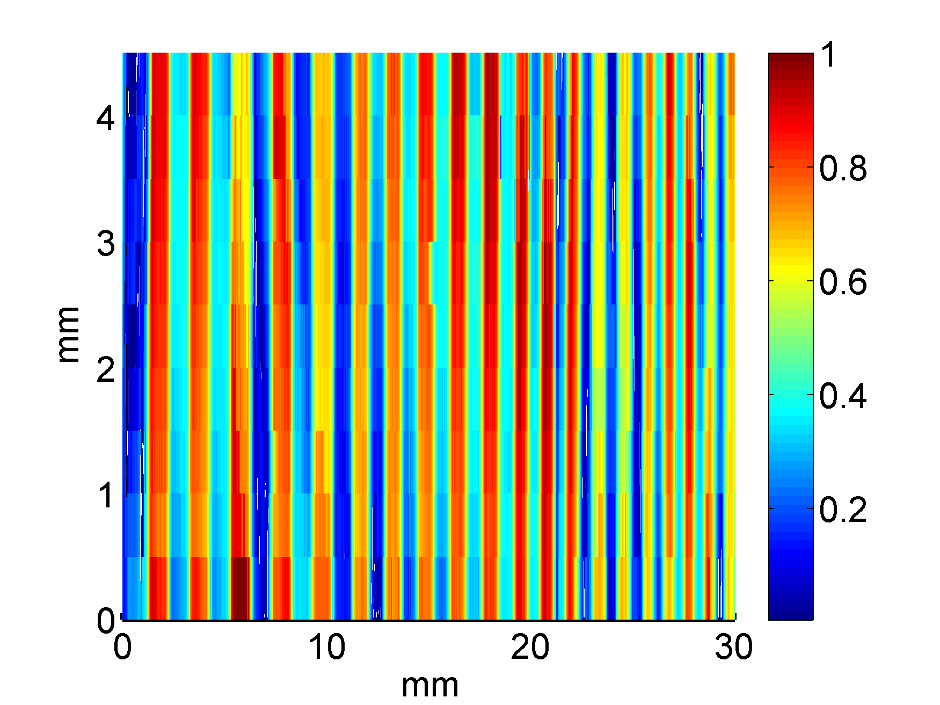
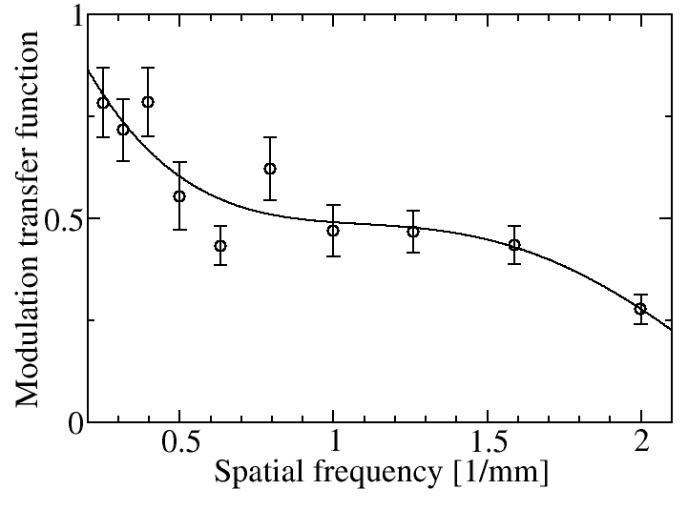
Imaging by self-mixing in THz QCLs
V_{A}
V_{B}
Resolution < 250 μm
P. Dean et al., Opt. Lett. 36, 2587-2589 (2011)

Slide 22
Overview
Introduction
- Terahertz radiation, applications
- Terahertz quantum cascade lasers (THz QCLs)
- Imaging using THz QCLs
Self-mixing in THz QCLs
- 2D imaging
Coherent imaging using self-mixing:
  - 3D coherent imaging
  Swept-frequency coherent imaging for material analysis

Slide 23
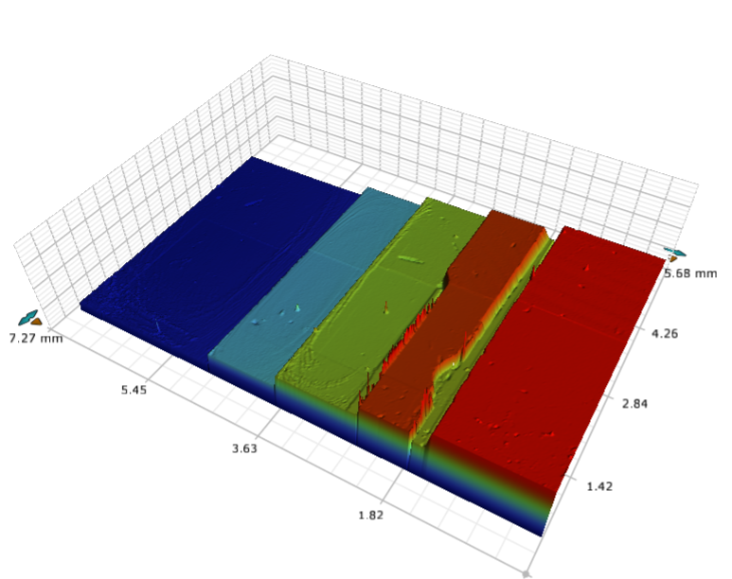
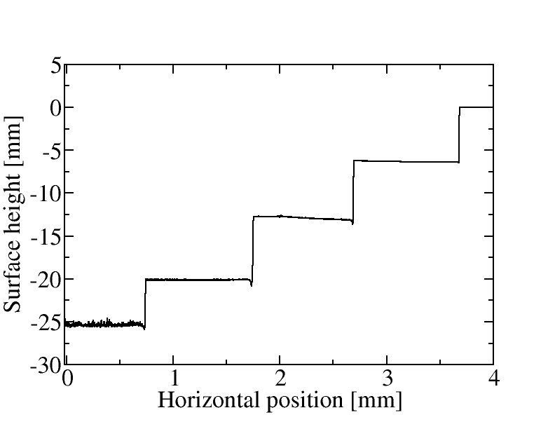
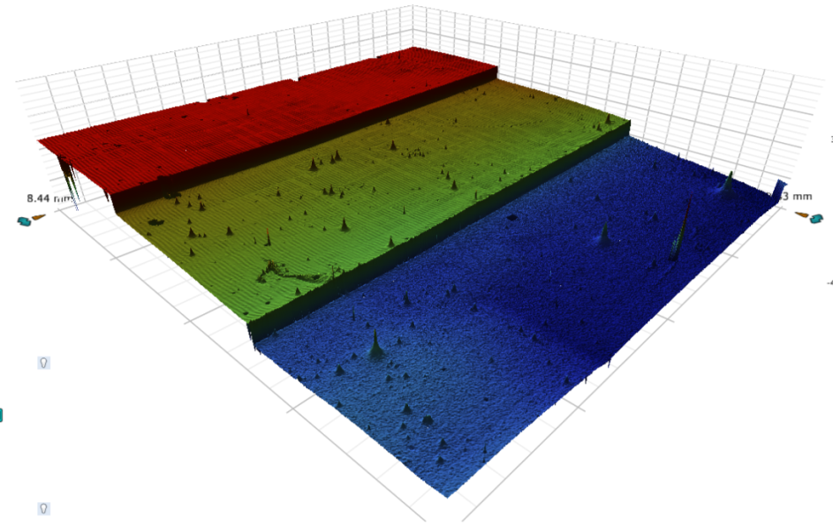
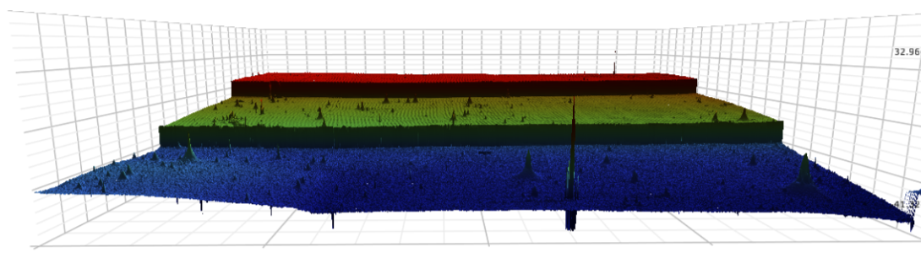
Coherent imaging: 3D structures
GaAs structures fabricated by wet chemical etching
Sample A: Step height ~5 μm
Ti/Au
~3 mm
SI-GaAs
~6 mm
Sample B: Step height ~10 μm

Slide 24

Coherent 3D imaging: SM waveforms
QCL driven at constant current; Sample scanned longitudinally
QCL acts as interferometric sensor
Current
Source
x100
Lock-in amp
QCL
x-y scanning
z scanning
L₀ = 41 cm
Amplitude
Phase
ω is function of δL and feedback strength κ (hence non-sinusoidal fringes)

Slide 25
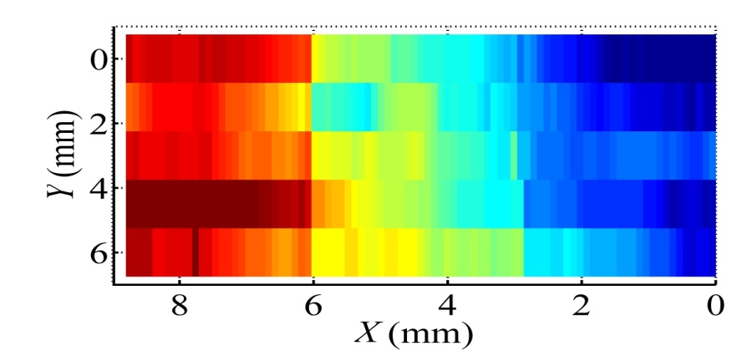
Coherent 3D imaging: Depth profiles
Sample B
3D reconstruction (sample B)
THz
THz
Optical profilometry
Sample A
THz
Optical
Sample tilts: ~+0.4º and ~−0.2º

Slide 26
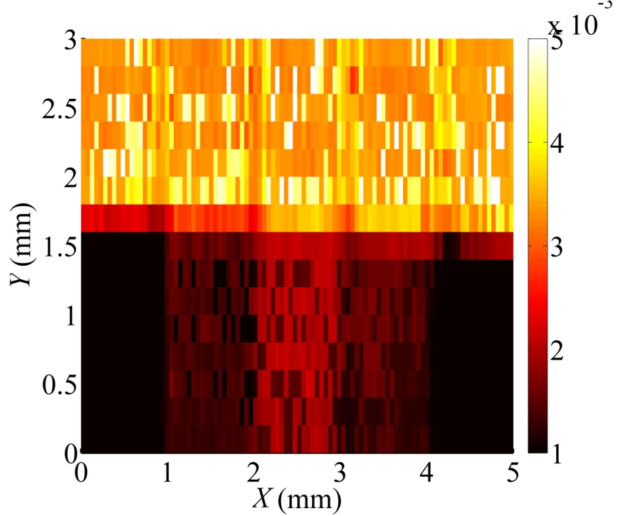
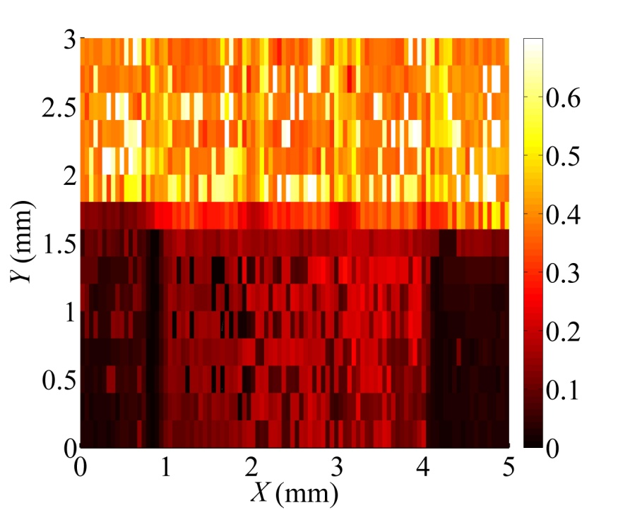
Coherent 3D imaging: Reflectance maps
We can also obtain reflectance map of sample (→ refractive index, n)
Amplitude
(Amplitude)²
Gold-coated
Uncoated

Slide 27
Overview
Introduction
- Terahertz radiation, applications
- Terahertz quantum cascade lasers (THz QCLs)
- Imaging using THz QCLs
Self-mixing in THz QCLs
- 2D imaging
Coherent imaging using self-mixing:
  - 3D coherent imaging
  Swept-frequency coherent imaging for material analysis

Slide 28
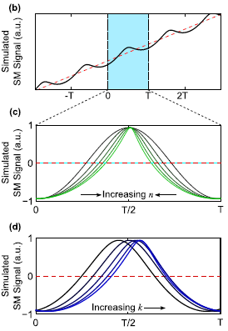
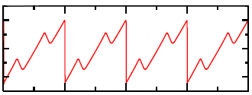
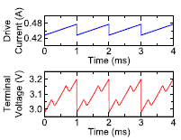
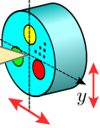
Swept-frequency coherent imaging
Swept-frequency delayed self-homodyning:
Current
Source
DAQ
QCL
Modulation
x-y scanning
Refractive index
Reflection coeff.
  Driving current I_{d}=430 mA
  Current modulation ΔI=50 mA at 1 kHz
  Frequency modulation Δf=600 MHz
Increasing n Waveform narrowing
(Refractive index)
Increasing k Temporal shift
(Absorption)

Slide 29
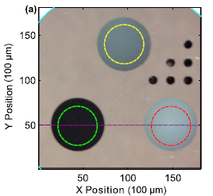
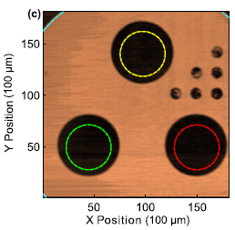
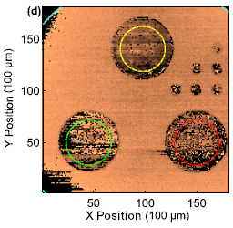
Swept-frequency coherent imaging
Time domain traces
PA6
(polycaprolactam)
Aluminium
THz Amplitude
THz Phase
PVC
(polyvinylchloride)
POM
(acetal)

Slide 30
Swept-frequency coherent imaging: Analysis
Phase change on reflection
Phase chirp:
Phase equation:
SM voltage:
Calibrate using 2 known materials:
Determine unknown material parameters (refractive index n, absorption k):

Slide 31

Swept-frequency coherent imaging: Material analysis
 | n (meas.) | n (lit.) | k (meas.) | k (lit.)
POM | 1.65 | 1.66 | 0.011 | 0.012
PVC | 1.66 | 1.66 | 0.063 | 0.062
PA6 | 1.66 | 1.67 | 0.11 | 0.11
PC | 1.62 | 1.62 | 0.011 | 0.011
HDPE1 | 1.58 | 1.58 | 0.019 | 0.018
HDPE2 | 1.54 | 1.54 | 0.0022 | 0.0020
Excellent agreement between measured parameters and literature
Aleksandar D. Rakić, Thomas Taimre, Karl Bertling, Yah Leng Lim, Paul Dean, Dragan Indjin, Zoran Ikonić, Paul Harrison, Alexander Valavanis, Suraj P. Khanna, Mohammad Lachab, Stephen J. Wilson, Edmund H. Linfield, and A. Giles Davies, Optics Express 21, 22194-22205 (2013)

Slide 32
Summary
Demonstrated coherent imaging using self mixing in a THz QCL
- a fast and sensitive technique that removes the need for an external THz detector
Demonstrated 3D imaging using a THz QCL, enabling sample depth and reflectivity to be measured across 2D surface
Demonstrated novel swept-frequency coherent imaging approach, enabling complex index of materials to be measured

Slide 33


Acknowledgements
The author(s) acknowledge support from MPNS COST ACTION MP1204 and BMBS COST ACTION BM1205, and also:
EPSRC (UK)
Australian Research Council’s Discovery Projects funding
ERC ‘NOTES’ and ‘TOSCA’ programmes
The Royal Society
The Wolfson Foundation

