Slide 1
Disrupting the Fashion Archive: The Serendipity of Manufacturing Mistakes
Teaching into Research: Research into Teaching

Slide 2
The research describes a case study that asked design students to identify mistakes in manufacture, in selected garments from the Yorkshire Fashion Archive held at University of Leeds.
Publication: Almond, K (2020) Disrupting the Fashion Archive: The Serendipity of Manufacturing Mistakes. Fashion Practice: The Journal of Design, Creative Process and the Fashion Industry

Slide 3
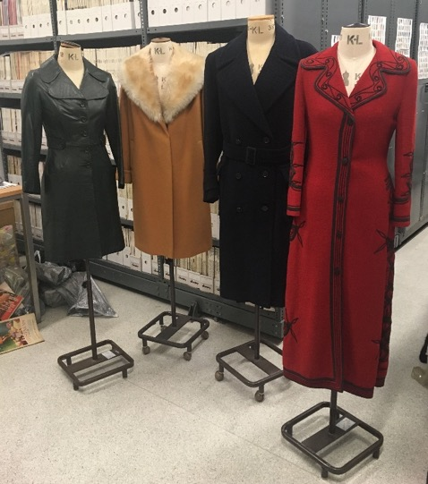
Vintage garments photographed in the Yorkshire Fashion Archive. Photograph Kevin Almond.

Slide 4
The documentation of this process provides an important reference point for garment creators to disrupt conventional approaches to fashion design and technology and supports the development of innovative skills. These can be utilised to create new and novel clothing designs with which to enrich the global fashion industry.

Slide 5
Aim
To discover the extent to which the practices of garment creation can be the subject of the serendipity of mistake.
Objectives
To explore if new conceptual and technical skills for garment creation can be developed from identifying mistakes in the construction of historical dress.
To investigate how this knowledge can be promulgated in both fashion education and the industry to sustain an environment of risk taking that promotes creativity.
To situate the practice of risk taking through garment creation within the
parameters of the fashion archive, fashion education and the global fashion
industry.

Slide 6
Risky Design Practice - MakeUse zero waste dress by Holly McQuillan. Photograph courtesy of Holly McQuillan.

Slide 7
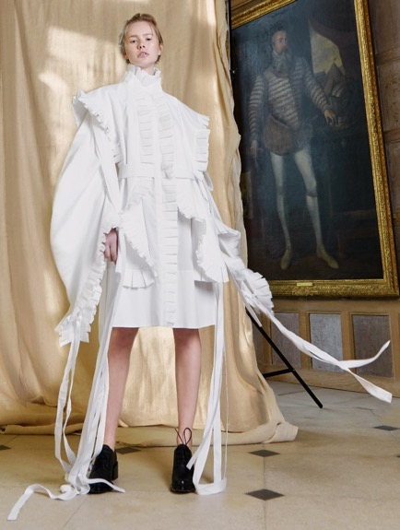
Dress by designer Nabil Nayal inspired by Elizabethan costume from the Elizabethan Sportswear IV (A/W17) collection. Photograph courtesy of Luca Trevisani.

Slide 8
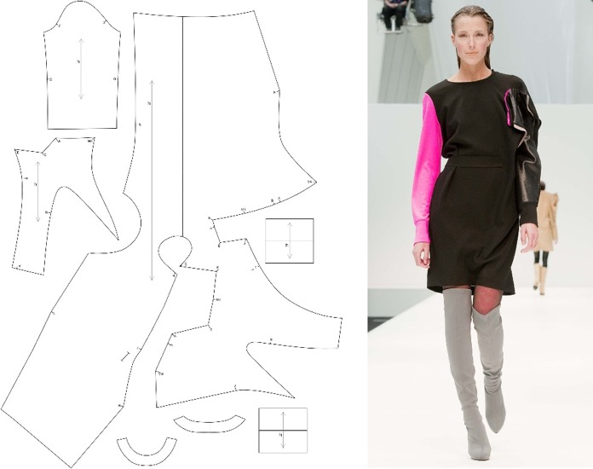
Pattern and dress using the accidental cutting method pioneered by Eva Iszora, Fall/Winter 2011-2012. Pattern photograph courtesy of Eva Iszoro. Dress photograph courtesy of Valencia Fashion Week.

Slide 9
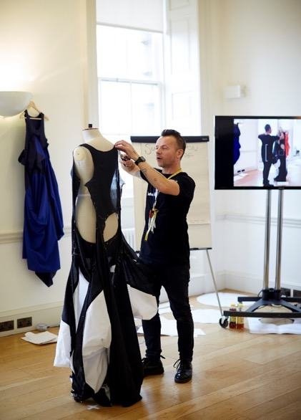
Pattern Cutting Workshop by Julien Roberts. Photograph courtesy of The British Fashion Council.

Slide 10
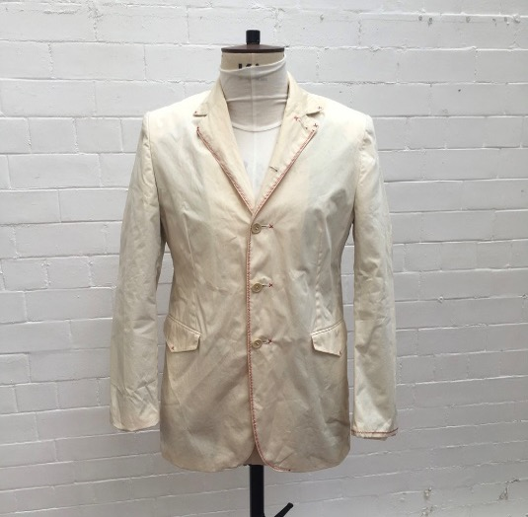
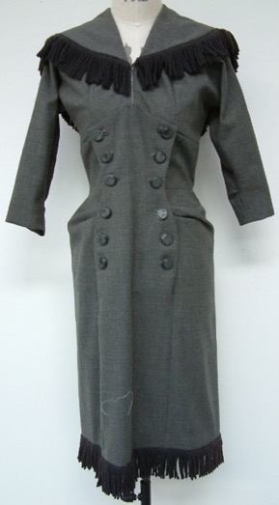
Holland Esq jacket c. 2000, Wool fringe dress c. 1945. Photograph Kevin Almond.

Slide 11
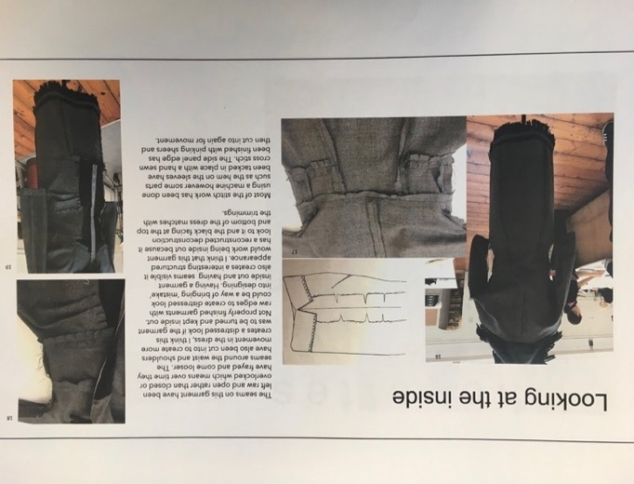
Wool fringe dress c. 1945, photographed inside out. Photograph Kevin Almond.

Slide 12
Garments were manipulated on the stand. Photograph Kevin Almond.

Slide 13
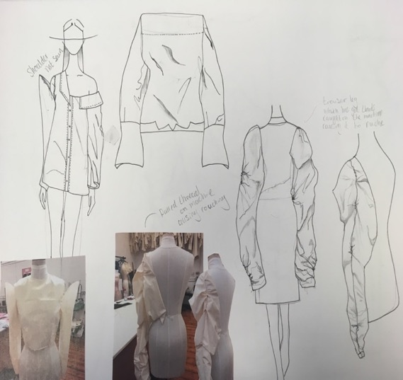
Ideas sketched from stand experiments. Photograph Kevin Almond.

Slide 14
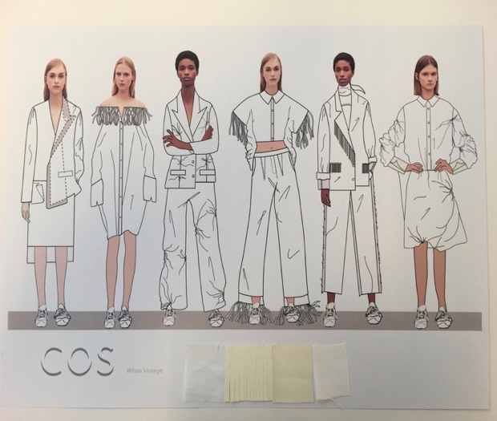
Mistake, womenswear collection for COS by Annabel Williams. Photograph Kevin Almond.

Slide 15
Student Questionnaire
1. Making mistakes teach us valuable lessons.
“Even the knowledge of my own fallibility cannot keep me from making mistakes. Only when I fall do I get up again” - Vincent Van Gogh (Blackie and Son, 2008, 117). Question – What lessons have you learnt from the approach in this project?
2. Mistakes help us let go of our fears.
“You can only go forward by making mistakes” - Alexander McQueen (Fulla, 2017, 202). Question – How could what you have learnt in the mistake project be best communicated to foster an environment of risk taking in fashion education and the fashion industry?
3. Mistakes inspire us.
“Nobody made a greater mistake than he who did nothing because he could do only a little” - Edmund Burke (Gleditsch, 1996, 432). Question - What benefits can you identify for the fashion industry from exploring mistakes in the construction of historical dress and what new knowledge do you think can arise from this?
4. Mistakes serve as a warning.
Never interrupt your enemy when he is making a mistake anonymously.” – Napoleon Bonaparte (Brainy Quote, 2018,1) – Question – Mistakes can serve as a warning - from your experiences, describe any ways that error and mistake inhibited your development with the project and how did you overcome this?

Slide 16
This results of this research present a direction for encouraging much greater creativity in the classroom, as well as for practicing designers within the fashion industry.

Slide 17
Finished garments from the White Vintage Collection 2018. Photograph Kevin Almond.

Slide 18
Acknowledgments:
We would like to acknowledge help of the following people:
Kevin Almond
David Backhouse
Jeffrey Thorpe
Elaine Evans
Catherine Malkin
Deborah Fowler
Faye Hindle
Annabel Williams
Isabella Pearson

