Slide 1
Durability, Desirability, and Garment Maintenance: An Empirical Analysis of Clothing Donated to the Marks & Spencer Archive
Dr Kevin Almond
Dr Judith Simpson

Slide 2
Abstract
This research examines garment maintenance and repair practices within UK fashion consumption through a case study of clothing donated to the Marks & Spencer Archive at the University of Leeds. The archive comprises menswear, womenswear, and childrenswear dating from the 1940s to the early 2000s. Donor narratives accompanying each garment document provenance, perceived value, and instances of maintenance or repair, offering insight into historical attitudes towards durability, desirability, and adaptation over time. These archival perspectives are contextualised within contemporary debates through a focus group exploring current consumer attitudes to clothing longevity and domestic repair. Discussion was prompted by Marks & Spencer’s sustainability statement, “M&S clothing is made to be loved. Not just for a single season or outing, but year after year” (M&S, 2024), enabling examination of how such claims are interpreted in everyday practice. The analysis draws on literature examining the relationship between durability and desirability and considers the practical skills required for garment maintenance and repair by consumers today. It situates these as a meaningful factor in value, use, and sustainability within contemporary fashion systems and consumption cultures.

Slide 3
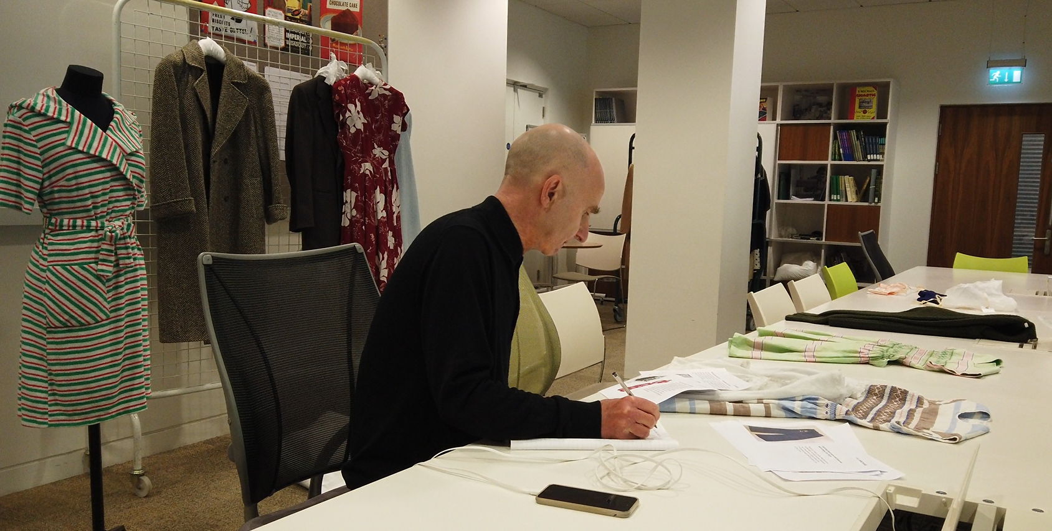
Dr Kevin Almond examining garments in the Marks and Spencer Reading Room

Slide 4
Aim and Objectives
Aim
To investigate the historical and contemporary factors that encourage the retention, maintenance, and re‑use of clothing, using the Marks & Spencer Archive and consumer perspectives to identify strategies that could help reduce overconsumption in the UK fashion industry.
Object-Based Inquiry
To analyse garments within the Marks & Spencer Archive to identify material, behavioural, and emotional factors that contributed to their long-term retention, maintenance, and value.
Consumer Perspectives
To explore contemporary consumer attitudes toward garment maintenance, value, longevity, and re‑use through a focus group informed by themes emerging from the archive study.
Sustainability Evaluation
To evaluate how insights from past and present practices of maintaining and valuing clothing can inform strategies—both consumer-facing and industry-led—that aim to extend garment lifecycles and reduce overconsumption in the fashion sector.

Slide 5

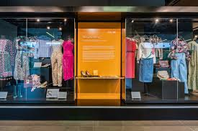
Marks and Spencer Archive
https://www.google.com/search?sca_esv=4ae20d8bd47daad1&rlz=1C1GCEJ_enGB972GB972&sxsrf=ANbL-n7H2tGJBxelItWqmtL6JXf8V7ZZiw:1773758875133&q=marks+and+spencer+archive+image&udm=2&source=univ&fir=voDMYaXHrIp6rM%252CyB6leYEgG-j2rM%252C_%253BilJySL-6g73FHM%252CX0eBZMjNvHWrmM%252C_%253BraqUI8d3WvKlDM%252CyB6leYEgG-j2rM%252C_%253BTvVUchsNAYsBAM%252CDI3sTFtE8p5IGM%252C_%253Bbdm5bTfsmJB6yM%252CyB6leYEgG-j2rM%252C_%253BPElLOTOZ7hur8M%252Cv1yPPsgTZASddM%252C_%253BzmMclHUrpG4CsM%252Cv1yPPsgTZASddM%252C_%253Br6BR-7F2K6BljM%252Co0Xqjw1dErtXLM%252C_%253B79OLgF7dIOAbbM%252CSZBJ_TtpEQsrDM%252C_%253BYNXPzJiVcSBHrM%252CDI3sTFtE8p5IGM%252C_%253BqZmOyv7ExJwcCM%252Cnd-DG-6uGLrp0M%252C_%253B8s3dS6CCKKmmrM%252C4fEu1D4E5bUVlM%252C_&usg=AI4_-kSkoI7u0_WUGzCIbzZnwiGGXdaWMQ&sa=X&ved=2ahUKEwjolq3dlqeTAxWgXEEAHXuuAbEQ7Al6BAhbEAU&biw=1920&bih=945#sv=CAMSVhoyKhBlLWlsSnlTTC02ZzczRkhNMg5pbEp5U0wtNmc3M0ZITToOWDBlQlpNak52SFdybU0gBCocCgZtb3NhaWMSEGUtaWxKeVNMLTZnNzNGSE0YADABGAcgmMis_gEwAkoIEAIYAiACKAI
https://www.google.com/search?sca_esv=4ae20d8bd47daad1&rlz=1C1GCEJ_enGB972GB972&sxsrf=ANbL-n7H2tGJBxelItWqmtL6JXf8V7ZZiw:1773758875133&q=marks+and+spencer+archive+image&udm=2&source=univ&fir=voDMYaXHrIp6rM%252CyB6leYEgG-j2rM%252C_%253BilJySL-6g73FHM%252CX0eBZMjNvHWrmM%252C_%253BraqUI8d3WvKlDM%252CyB6leYEgG-j2rM%252C_%253BTvVUchsNAYsBAM%252CDI3sTFtE8p5IGM%252C_%253Bbdm5bTfsmJB6yM%252CyB6leYEgG-j2rM%252C_%253BPElLOTOZ7hur8M%252Cv1yPPsgTZASddM%252C_%253BzmMclHUrpG4CsM%252Cv1yPPsgTZASddM%252C_%253Br6BR-7F2K6BljM%252Co0Xqjw1dErtXLM%252C_%253B79OLgF7dIOAbbM%252CSZBJ_TtpEQsrDM%252C_%253BYNXPzJiVcSBHrM%252CDI3sTFtE8p5IGM%252C_%253BqZmOyv7ExJwcCM%252Cnd-DG-6uGLrp0M%252C_%253B8s3dS6CCKKmmrM%252C4fEu1D4E5bUVlM%252C_&usg=AI4_-kSkoI7u0_WUGzCIbzZnwiGGXdaWMQ&sa=X&ved=2ahUKEwjolq3dlqeTAxWgXEEAHXuuAbEQ7Al6BAhbEAU&biw=1920&bih=945#sv=CAMSVhoyKhBlLXJhcVVJOGQzV3ZLbERNMg5yYXFVSThkM1d2S2xETToOeUI2bGVZRWdHLWoyck0gBCocCgZtb3NhaWMSEGUtcmFxVUk4ZDNXdktsRE0YADABGAcg14f-_wMwAkoIEAIYAiACKAI

Slide 6
The Marks and Spencer Archive was established in 1984, which coincided with the 100th anniversary of the business (M&S Archive, 2025; Protheroe, 2005; Scott, 2008).
It is currently housed at the University of Leeds since 2012 (M&S Archive, 2025).
The collection includes over 72,000 items including clothing. This includes physical items as well as photographic, written and digital records that document the company’s history and key aspects of their development (M&S Archive Collection Guide, 2024).
‘The Marks & Spencer Company Archive represents one of Britain’s most important corporate archival collections – owing to the key position of Marks & Spencer in British high street retailing; the scope and extensiveness of the holdings; and the exceptional quality of analysis provided in many of the documents’ (M&S Archive Collection Guide, 2024, p. ii).

Slide 7
Methodology
A qualitative approach—archival research, object-based analysis, and focus groups—enabled triangulation and detailed insight. This allowed close examination of beliefs, attitudes, and contextual background. Qualitative methods support in‑depth analysis of objects and artifacts to understand how ideas and opinions form. This approach suited the study’s examination of garments from the Marks and Spencer Archive and subsequent discussion of these findings with a focus group.

Slide 8
Examining the Garments
The object-based analysis was conducted in the Reading Room of the Marks and Spencer Archive.
Each garment was displayed alongside an accompanying information sheet that detailed its provenance, production context, and any notable repairs or alterations. The researchers were encouraged to handle the garments, allowing for tactile examination of fabric, construction techniques, and signs of wear and repair, while also photographing them for further study.
Significant themes related to their durability, desirability, maintenance and repair began to emerge. The garments, together with their documented histories, are subsequently described and interpreted in relation to these emergent themes.

Slide 9
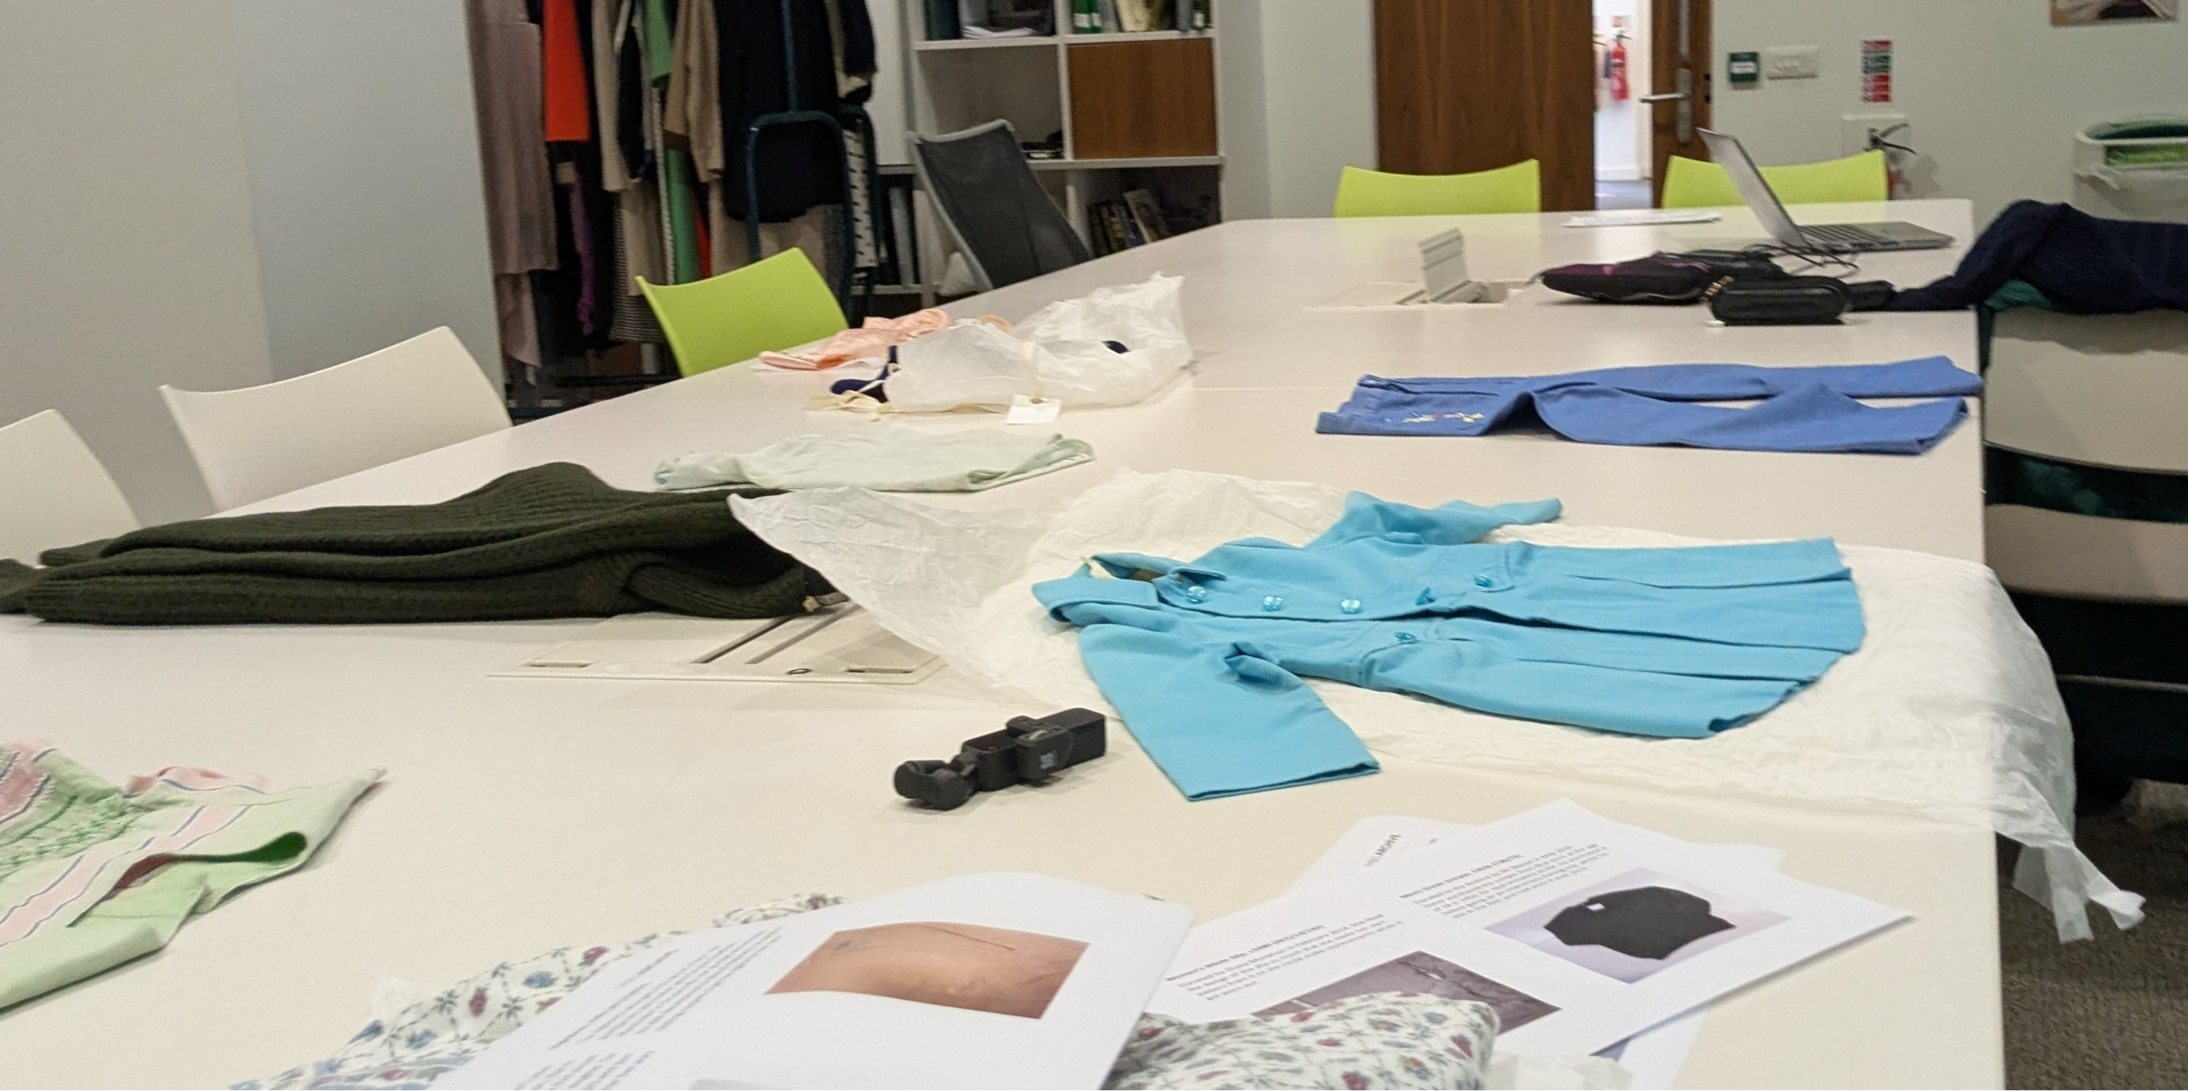
The object-based analysis was conducted in the Reading Room of the Marks and Spencer Archive.

Slide 10
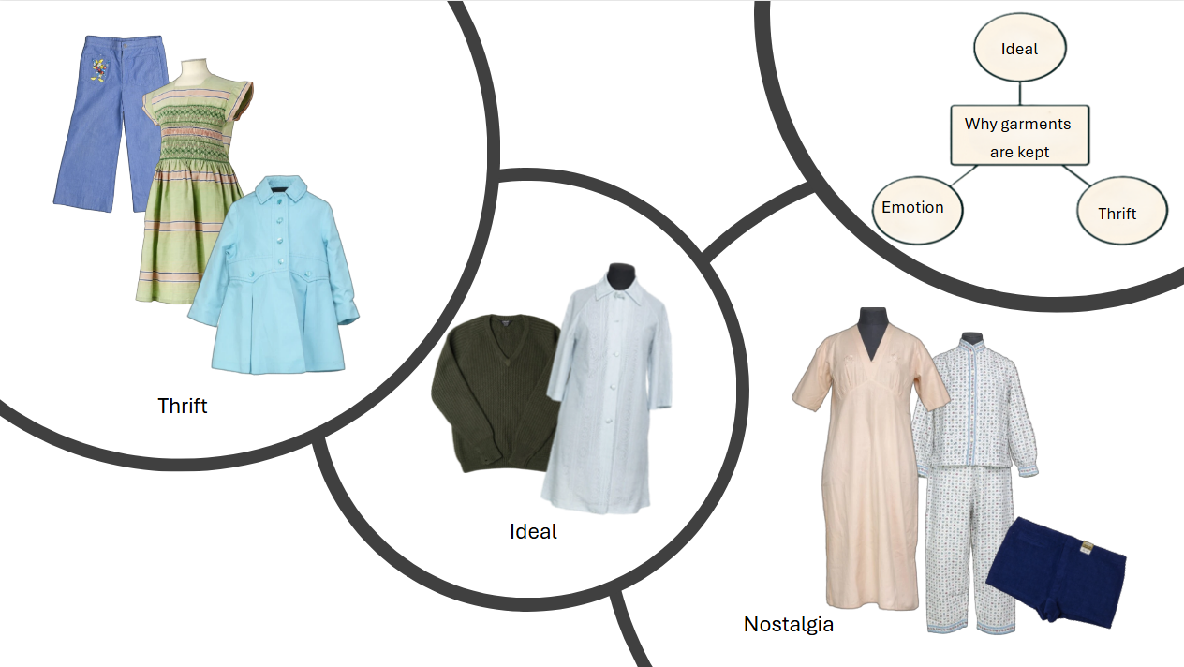
Step 1 Outcome
In our object analysis session, we identified 3 reasons for keeping clothes:
Idealness
Nostalgia
Thrift
And 3 strategies for preserving them
Retention
Repair
Re-use
We considered these might be important themes. So, we explored them through further rounds of research.
Images courtesy of the M&D Archive
Notes:
In our object analysis session, we identified 3 reasons for keeping clothes:
Ideal objects – some objects were just claimed by their previous owners to be ideal. One example was a man’s jumper that had been worn for over 30 years, because it did exactly what was expected of it – it kept its owner warm, looked relatively tidy, and had proved extremely durable. Another was a blue dressing gown that had travelled round the world with its owner. She thought it was beautiful and had received many compliments on it. She even suggested that it should be part of an exhibition of the most beautiful garments that M&S ever made. This demonstrates that ideas of beauty are intensely personal because I think it’s hideous!
Emotion – some objects were kept because of the memories associated with them. The men’s swimming trunks shown here were purchased by a man who intended to learn to swim for his holiday. He never learnt to swim, but the trunks were taken on every family holiday for over 20 years and became a running joke in the family. When he died, they were cherished as memory object.
Thrift – finally some garments had kept so that they could be used by other family members, presumably in order to save money. This was particularly the case with children’s clothes.
There were also 3 strategies for keeping clothes in circulation
Retention – this tended to involve keeping them rather than actively using them. The swimming trunks were retained, and so too were the flannel pyjamas. They were bought for the owner when she was 12 because she was going to boarding school and the school was cold and draughty. She kept them until she was in her 60s because she always thought that she might have a need for really warm pyjamas in the future, but it turned out she never did.
Repair – many of the clothes had been repaired or altered – again this was particularly true of children’s clothing. They had been patched and darned, hems had been taken up and lowered, and minor alterations had been made to change the fit.
Re-use – some of the clothes had had many owners. The little blue coat had been worn by five different children across two different families. In most cases re-use was through hand me downs. Occasionally as with the blue coat, what was happening might have been a little more like a series of loans, because the item returned to the original owner at the end. Although we recognized that the two strategies for re-use were quite different, we couldn’t distinguish between them in the data we were looking at.
Having studied the objects, we thought that these might be important themes. So, we explored them through a focus group. This provide us with a second data set on which to perform thematic analysis.

Slide 11
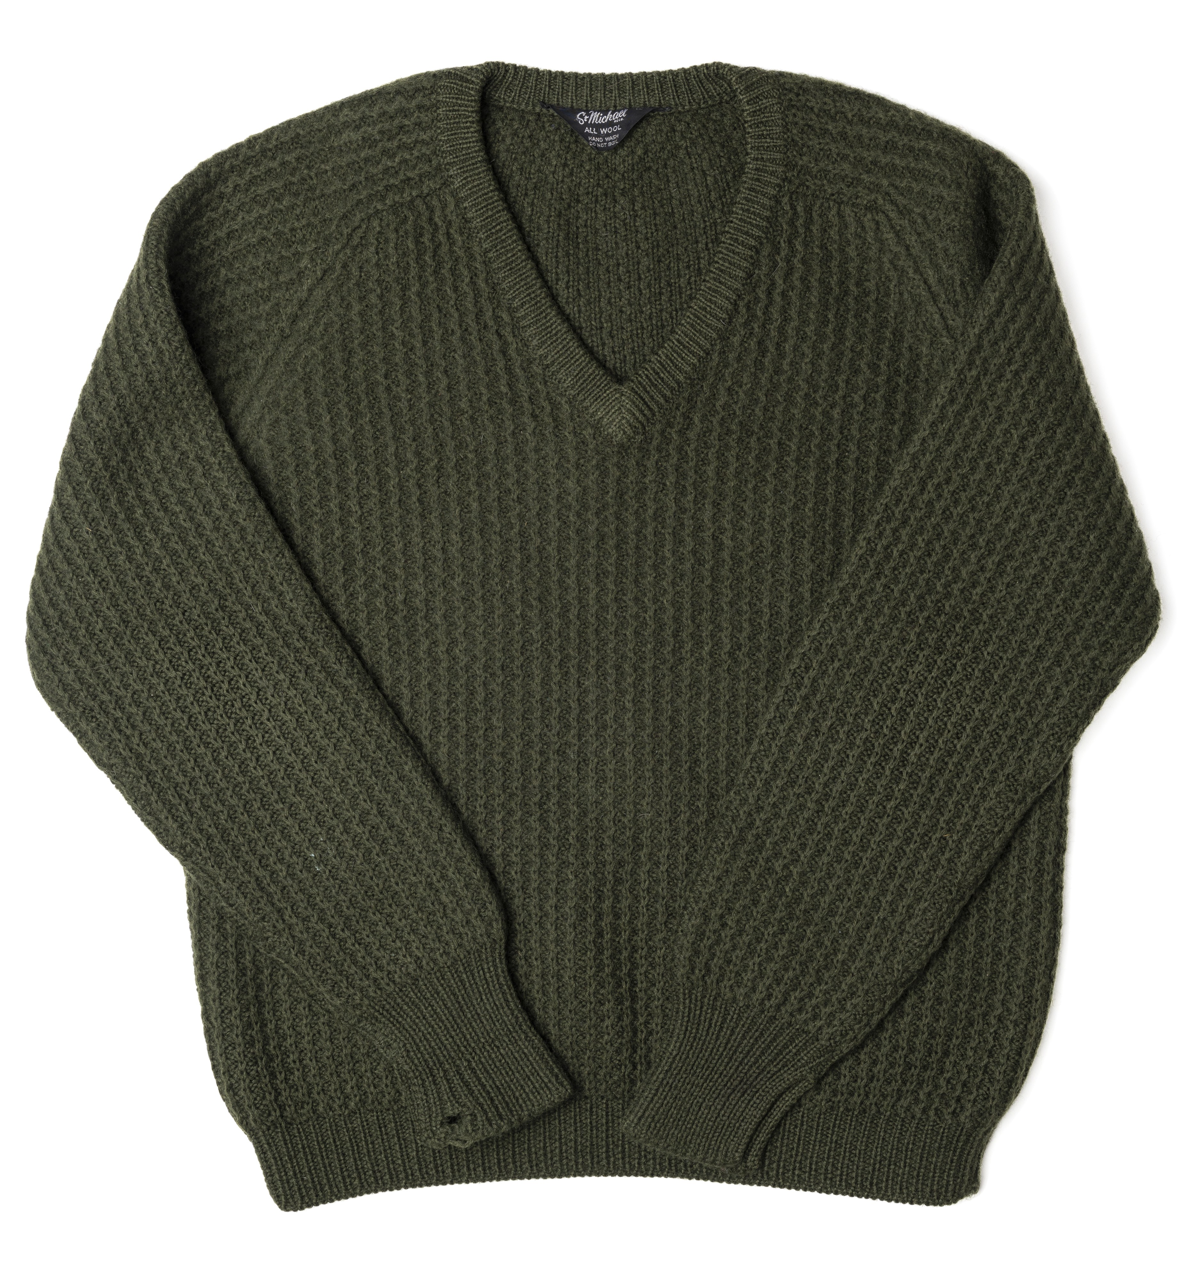
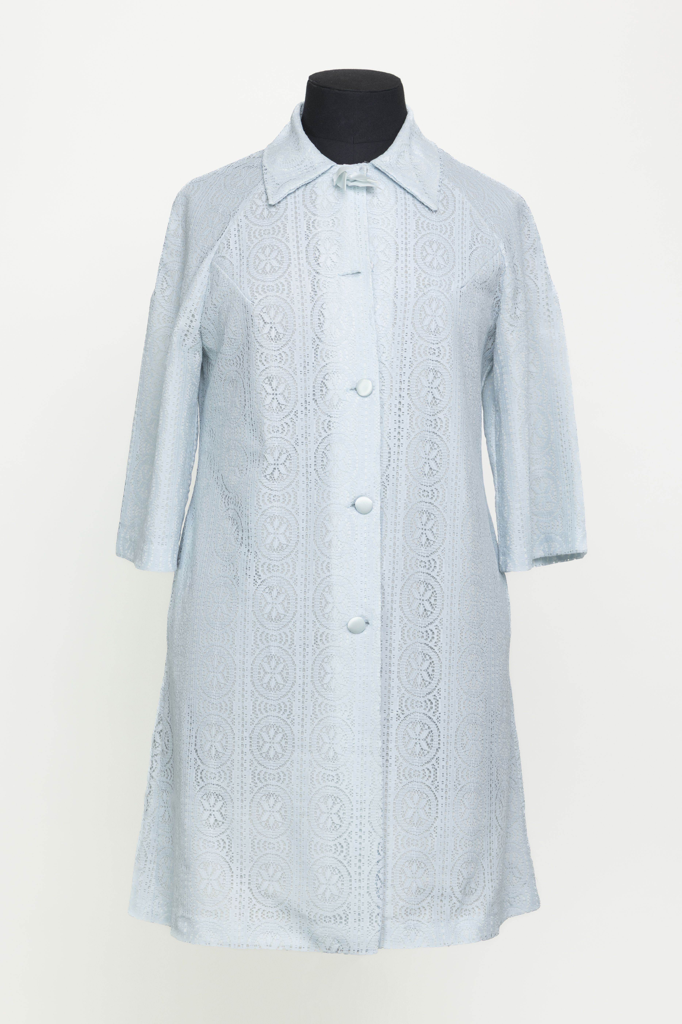
IDEAL ITEMS
A man’s green wool jumper purchased from the Rhyl store in 1950 (Figure 2). The donor acquired it during his time in the RAF for an impromptu fishing trip—a practical choice at the time, yet a garment that became a constant companion for decades. Remarkably, he continued to wear the jumper for over sixty years, only parting with it when donating it to the archive in 2016
Image courtesy of The M&S Archive
A dressing gown made from a manmade fibre which was purchased in 1969. The donation had been accompanied by a letter saying it had been washed and dried, ‘in the open air and the afternoon sun in Athens, Greece’ (anonymous donor, Catalogue Entry T38/41, 2025). After a long period of continuous use, the dressing gown hung in the donor’s wardrobe for 20 years where she looked at it every day because it was ‘the most beautiful garment I have ever bought in M&S’.
Image courtesy of The M&S Archive

Slide 12
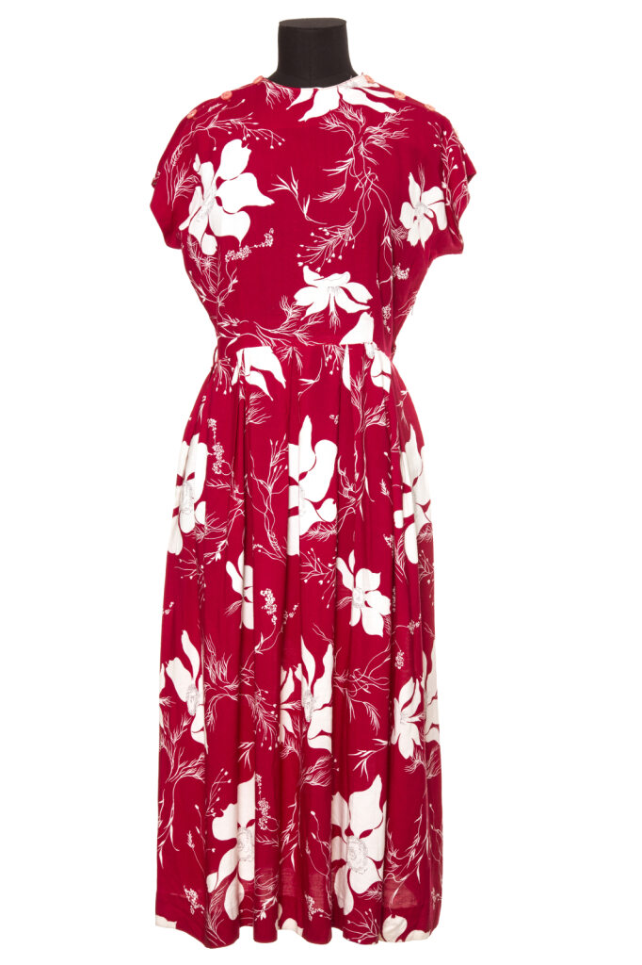
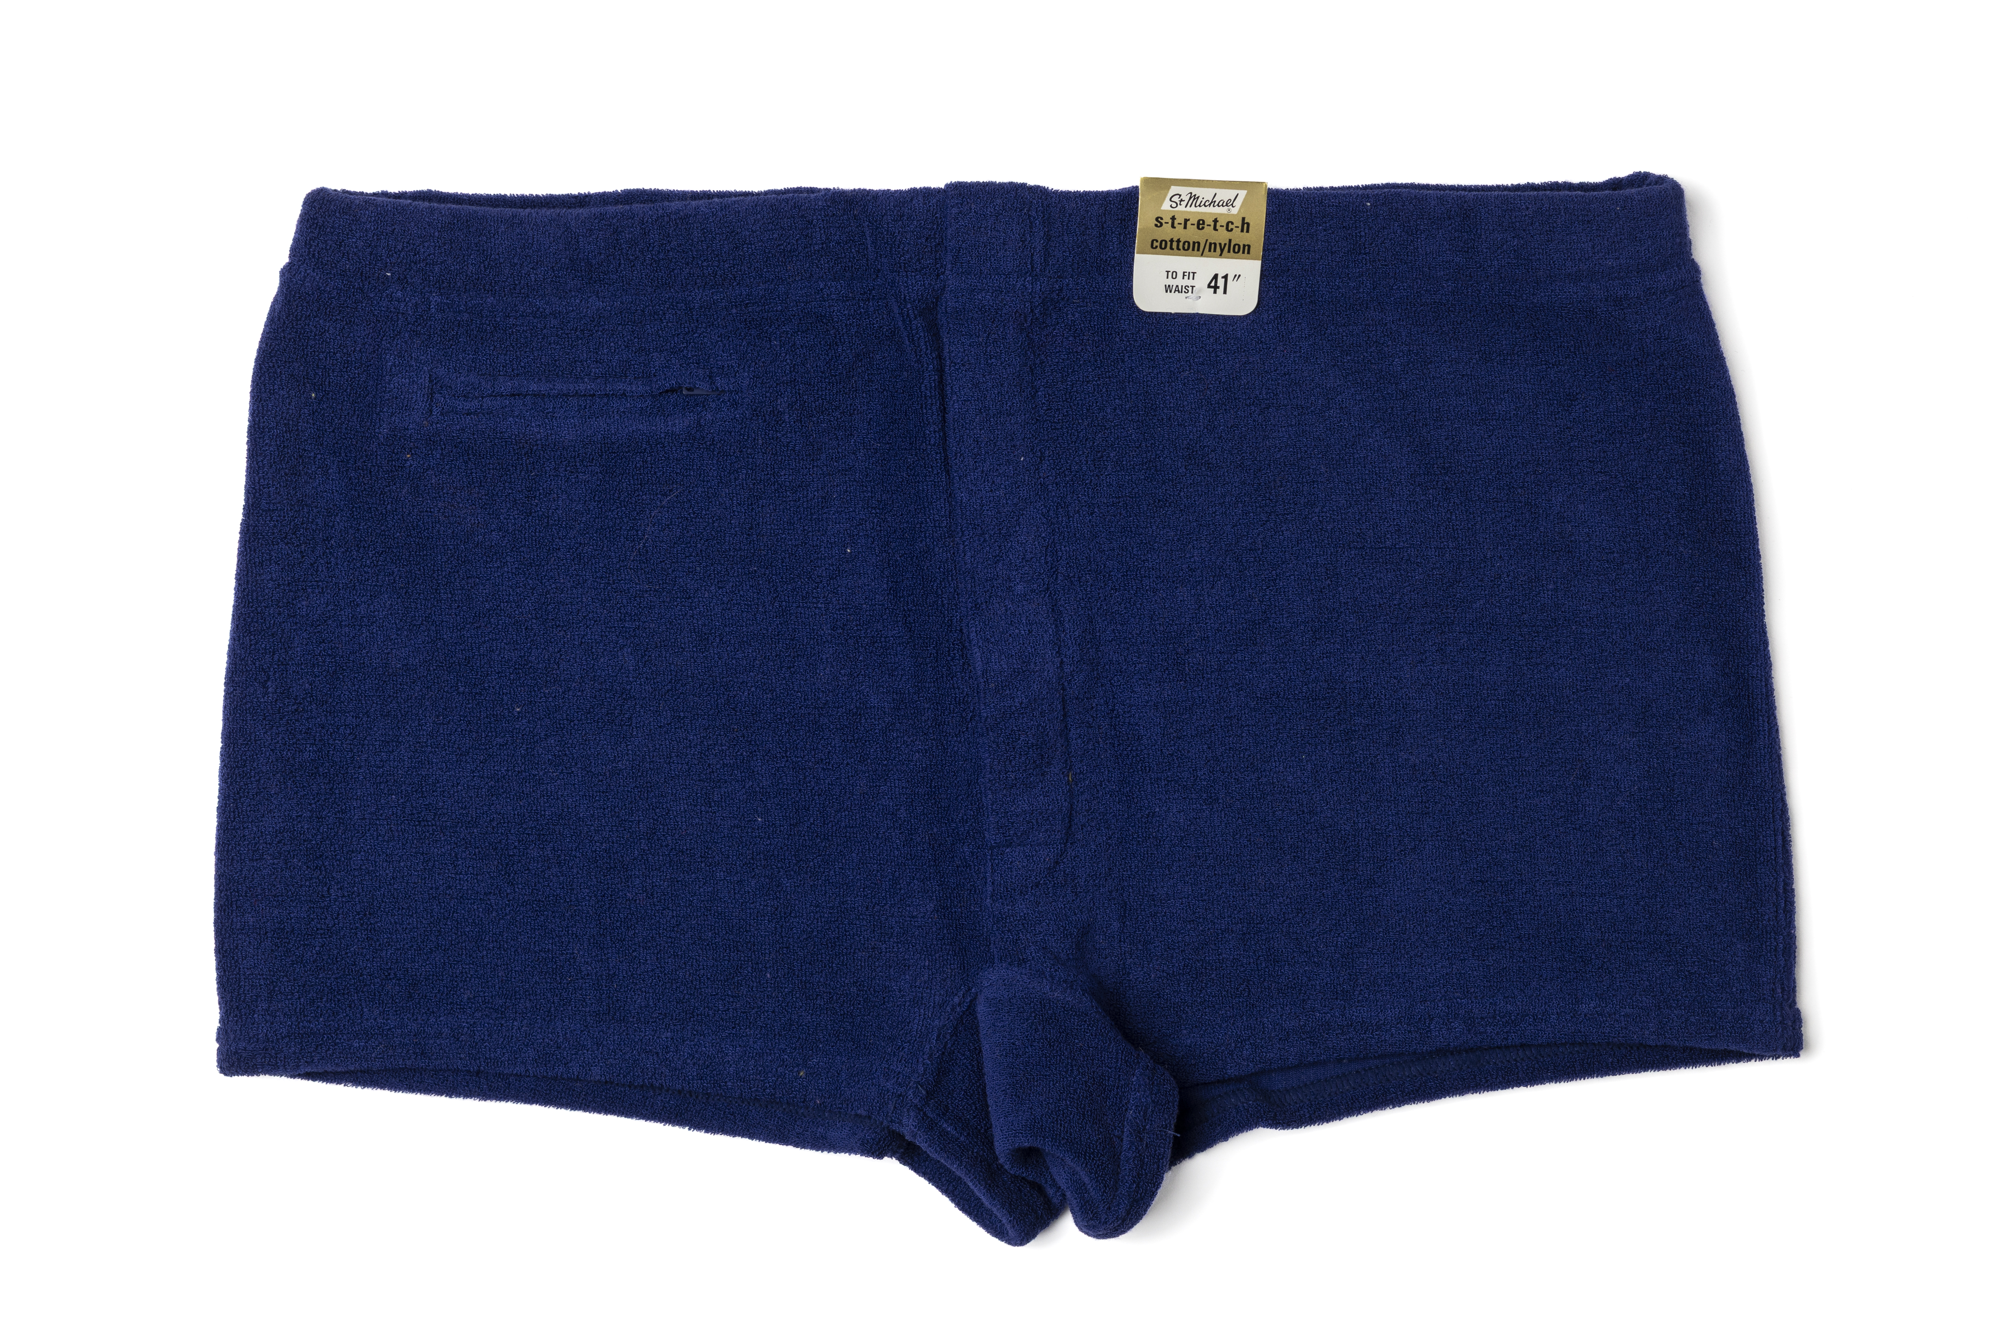
NOSTALGIA
A red and white dress purchased in 1947 and donated in 2012 was retained for decades because of its association with positive memories. The dress was purchased using clothing coupons, from the Dudley store, by a donor who had worn it on her first date with her future husband. The timeless elegance of the dress meant that she was able to wear it again on many later occasions, suggesting that in this case too, the themes of nostalgia and ideal object overlap.
Image courtesy of The M&S Archive
A pair of men’s swimming trunks had been purchased by a donor when he decided to learn to swim. Even though he never did learn, the trunks were packed for every family holiday but came home unworn – indeed the labels were never removed! This gave rise to a family joke and the trunks themselves became the vessel for affectionate family stories about this man’s character and eccentricities.
Image courtesy of The M&S Archive

Slide 13
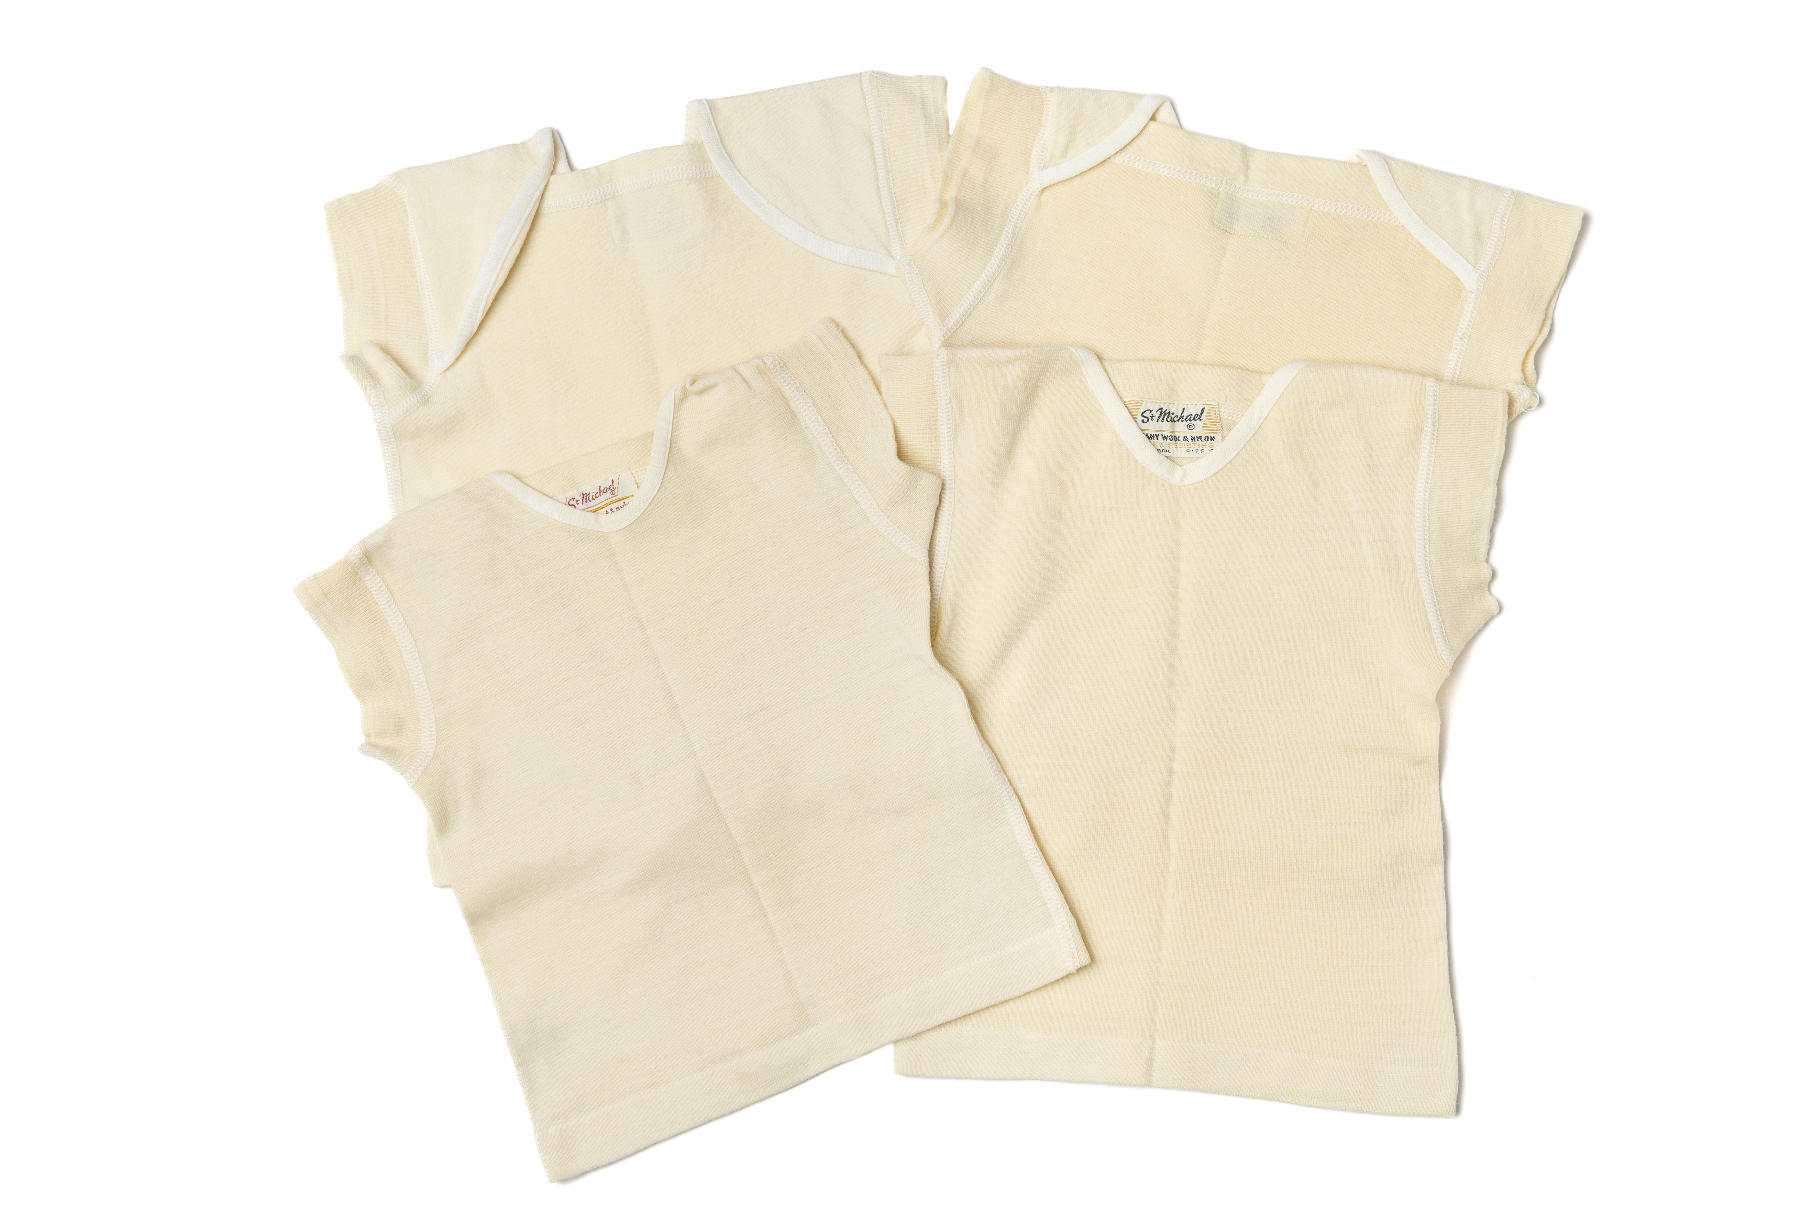
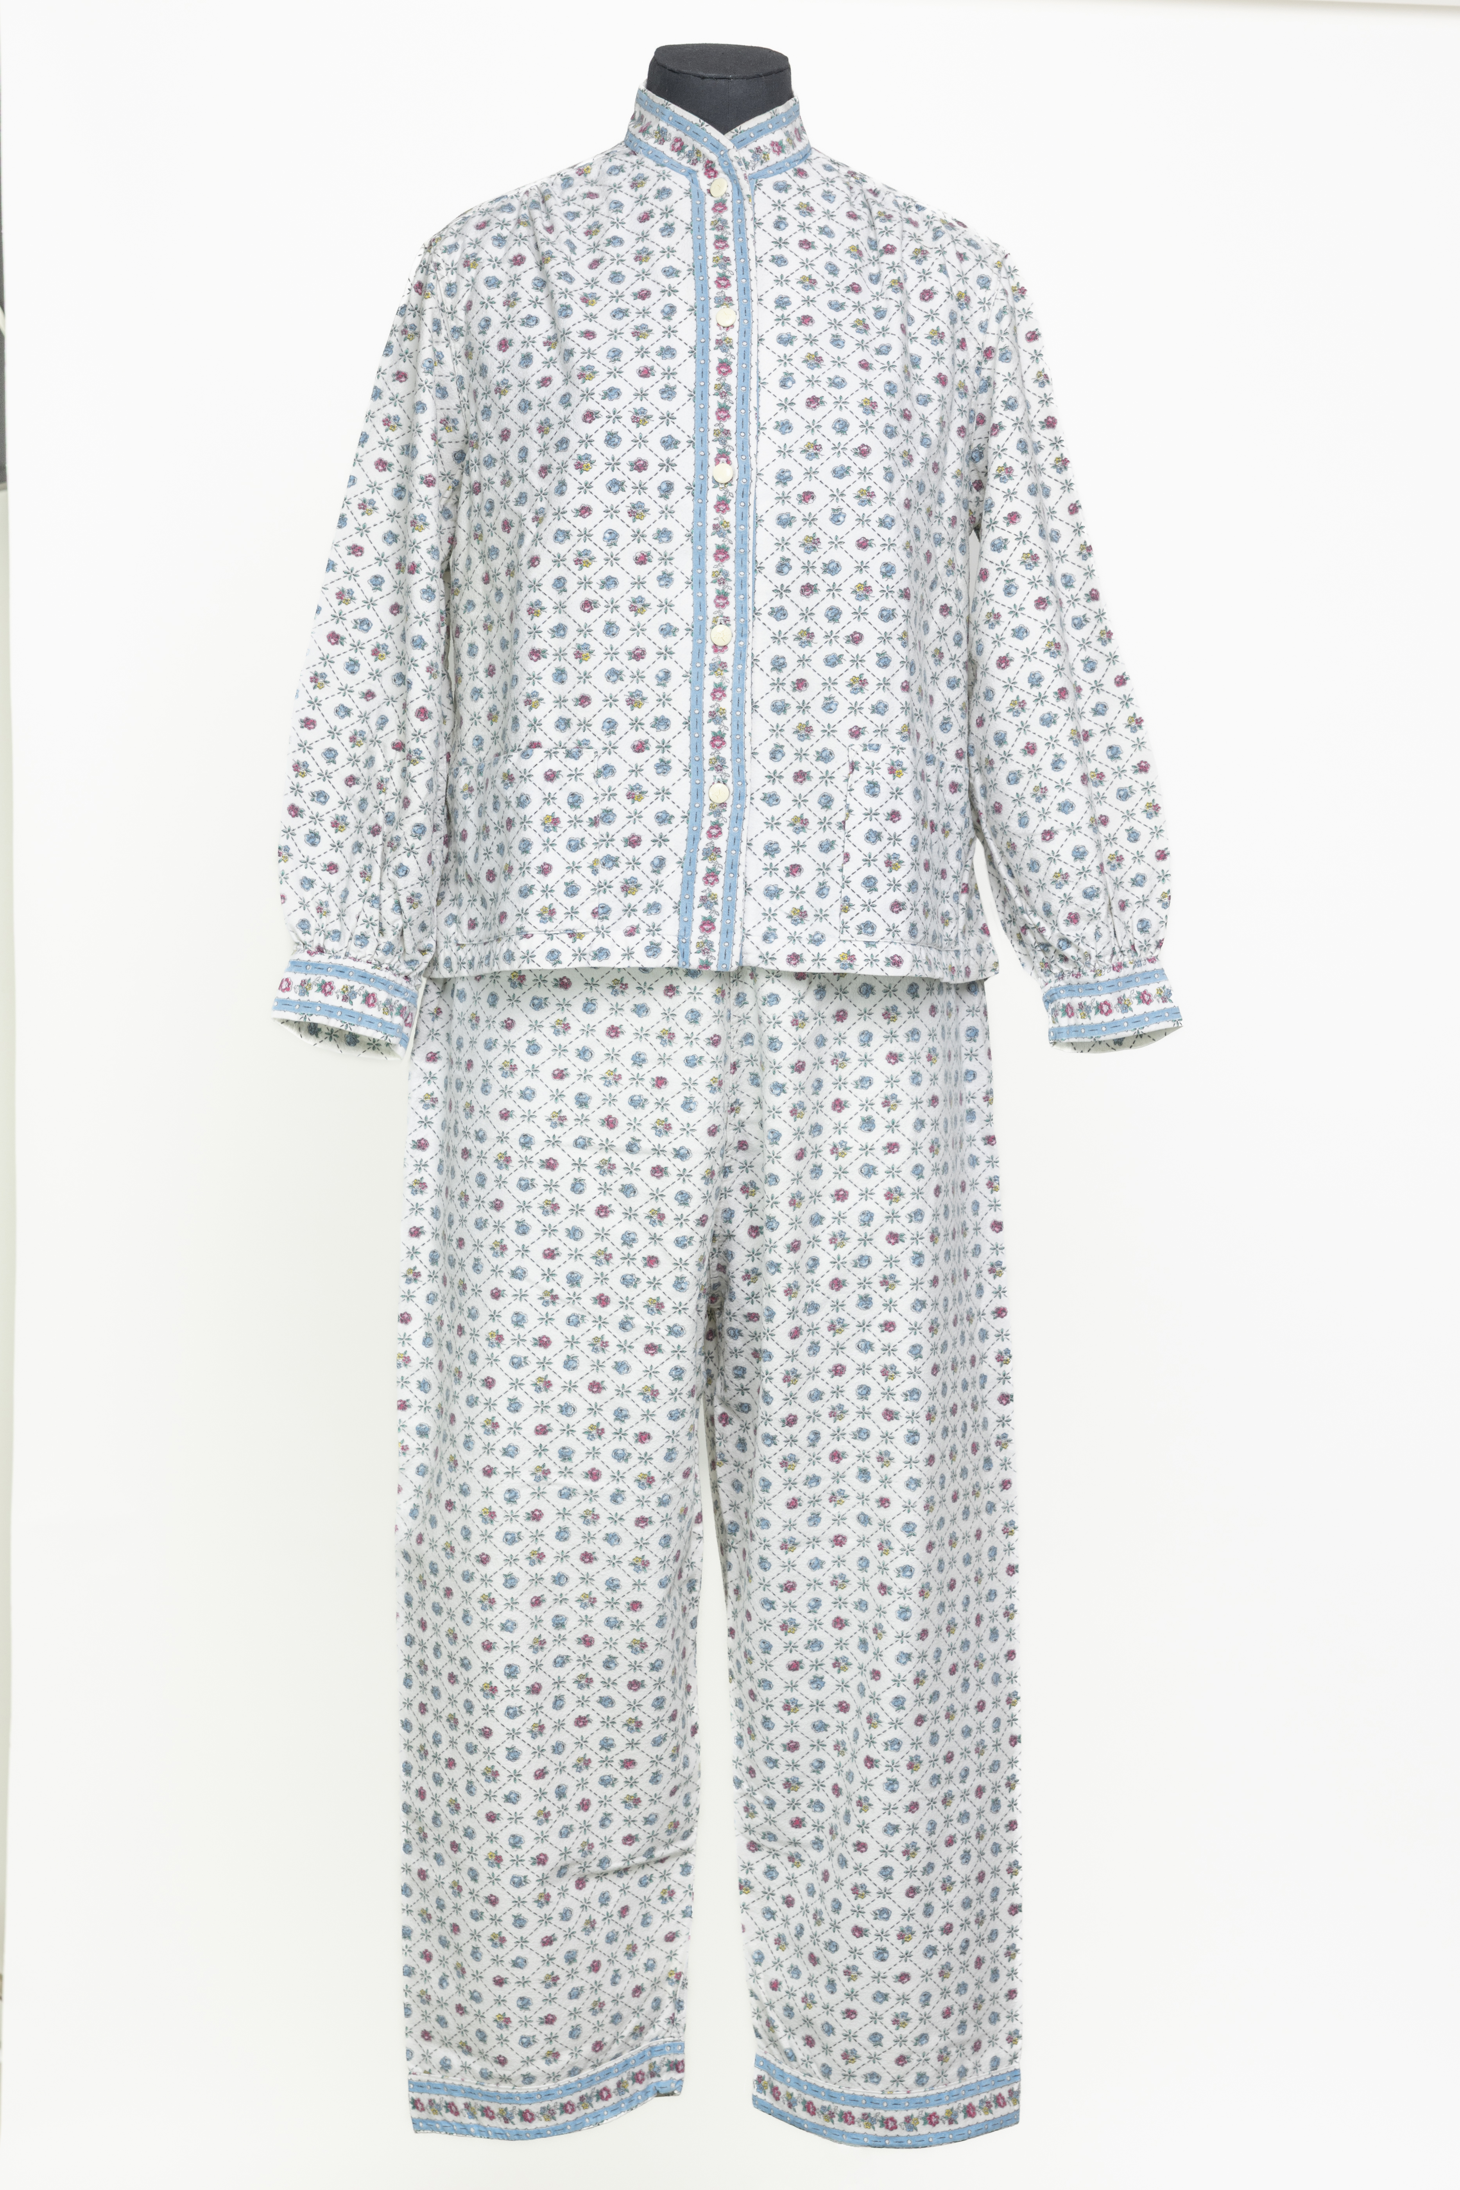
THRIFT
Some of the items in the archive had been kept to avoid having to purchase a replacement. Examples include woollen baby vests, presumably stored in the anticipation of future babies, and floral winceyette pyjamas which were purchased by the donor’s mother in the 1950s to keep her warm at boarding school. The donor then stored them in case she ever needed warm pyjamas again.
Images courtesy of The M&S Archive

Slide 14
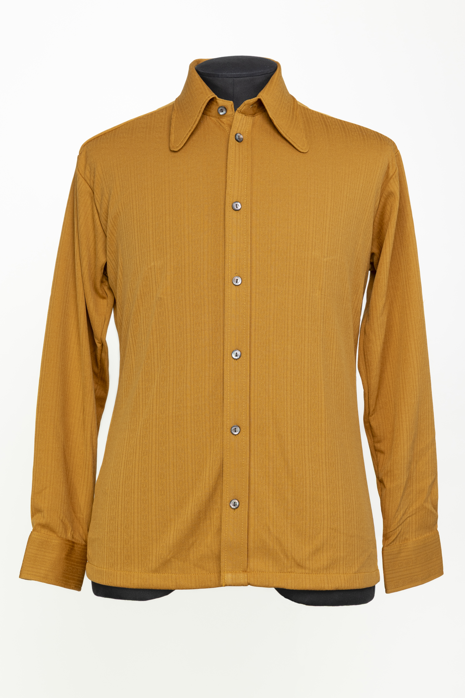
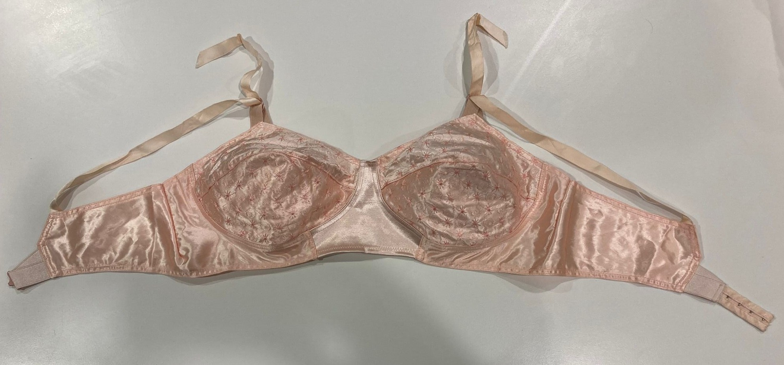
RETENTION
A collection of M&S lingerie from the Ceriso, Salon Rose and Autograph collections. The owner had bought it, loved it, but was unable to wear it after she put on weight. However, unwilling to part with any of it, she kept it bagged up in the loft ‘just in case’ (anonymous donor, 2025).
Image courtesy of The M&S Archive
A man’s crimplene shirt from the 1970s. This was stored by the purchaser for nearly 30 years before she gave it to her nephew for Christmas in 2001. (It was not to his taste, and he planned to return it to his local M&S before he realised, he would not receive a refund on a shirt that was over 30 years old!) Arguably this is a case of “anticipated future use”, but it is a very unusual story.
Image courtesy of The M&S Archive

Slide 15
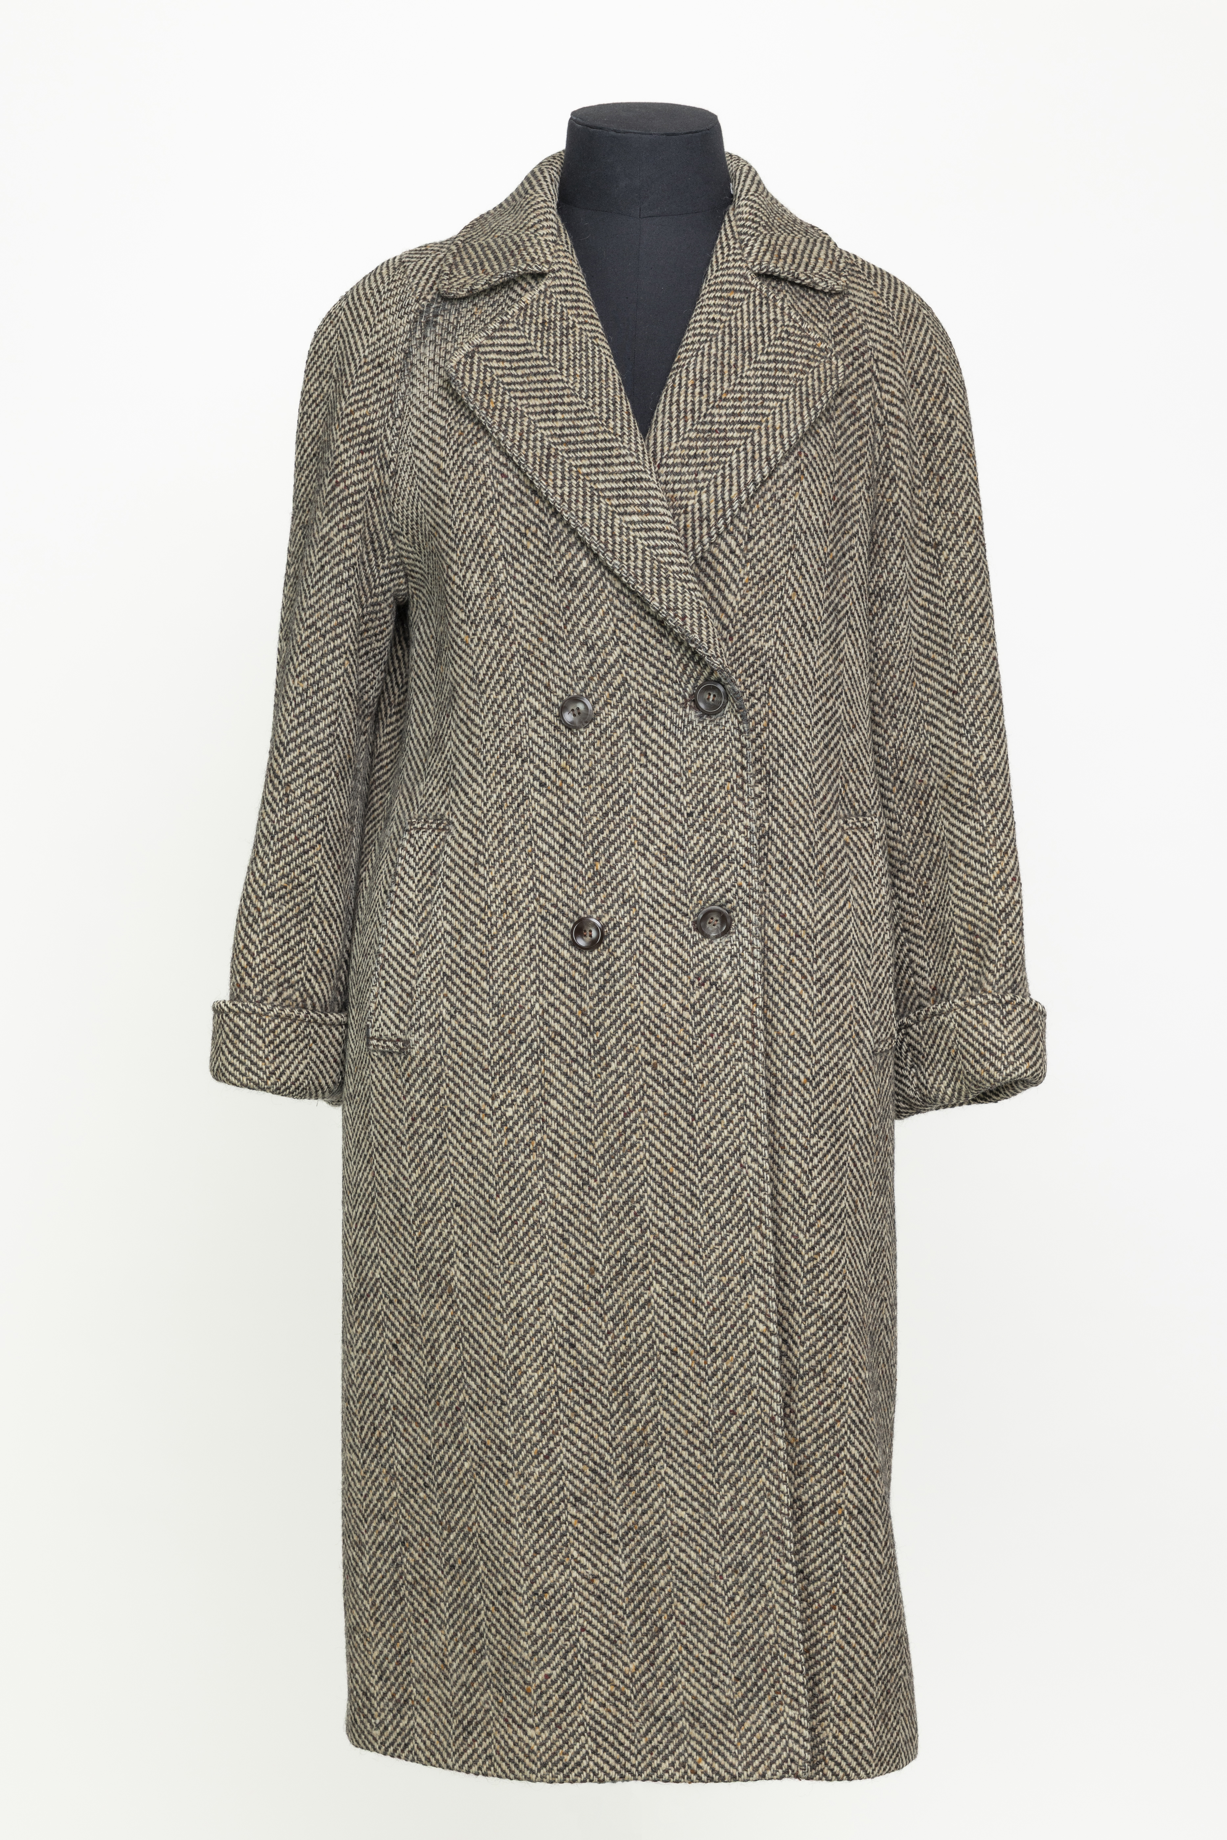
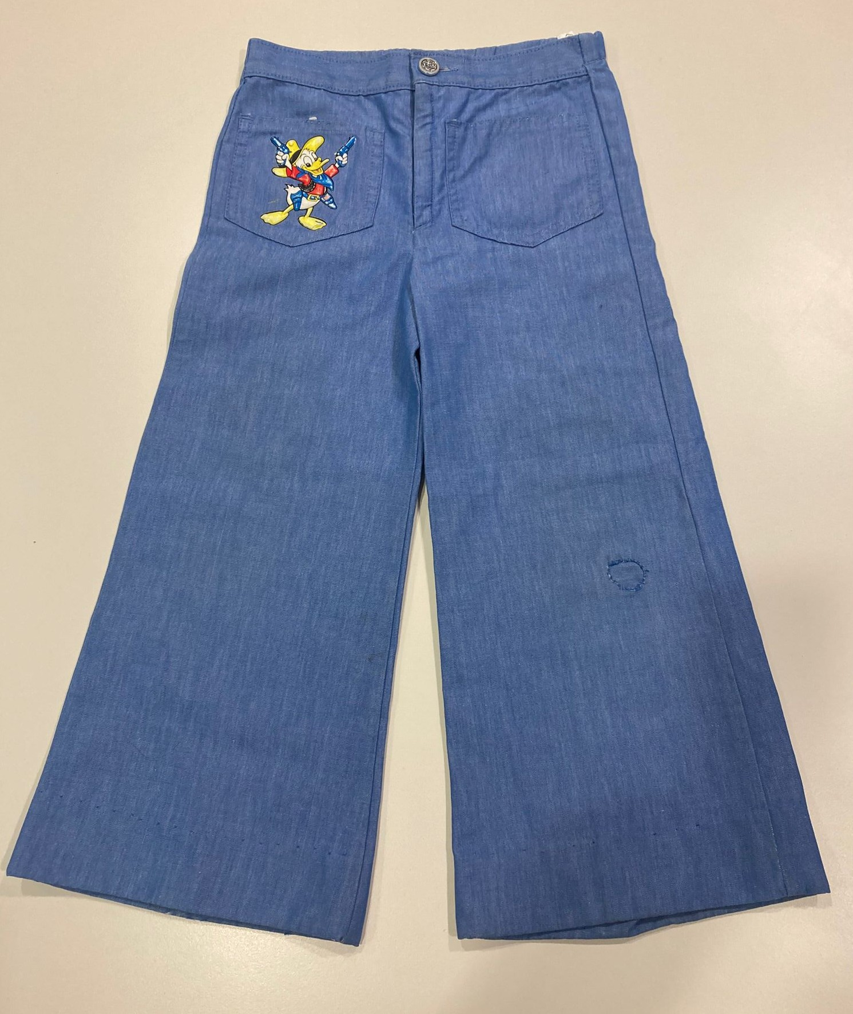
REPAIR
The belted tweed coat had been very expertly patched on the shoulder using material from inside one pocket.
Image courtesy of The M&S Archive
A pair of children’s denim flared trousers with Donald Duck motif on the pocket were noted to have been worn and loved by two brothers in the 1970s. Their durability had been enhanced by a visible patch on one knee with external stitching, and the hem had clearly been adjusted or restitched on more than one occasion.
Image courtesy of The M&S Archive

Slide 16
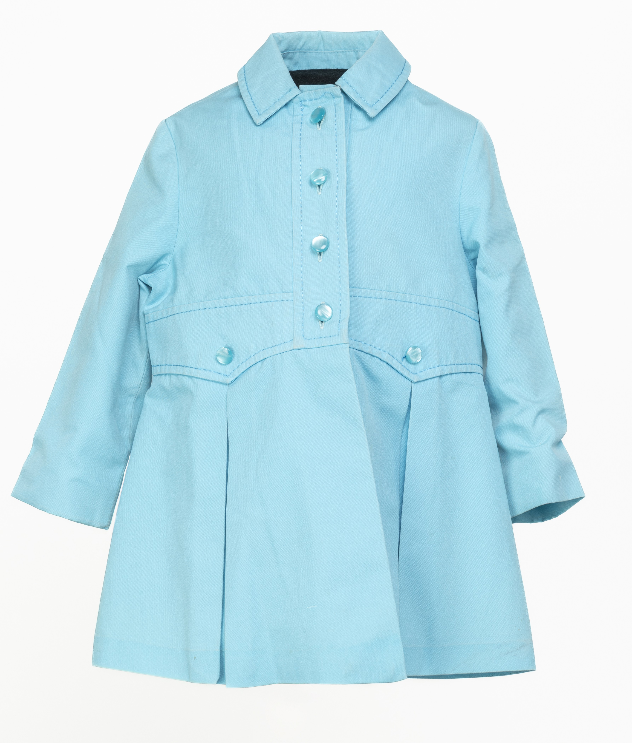
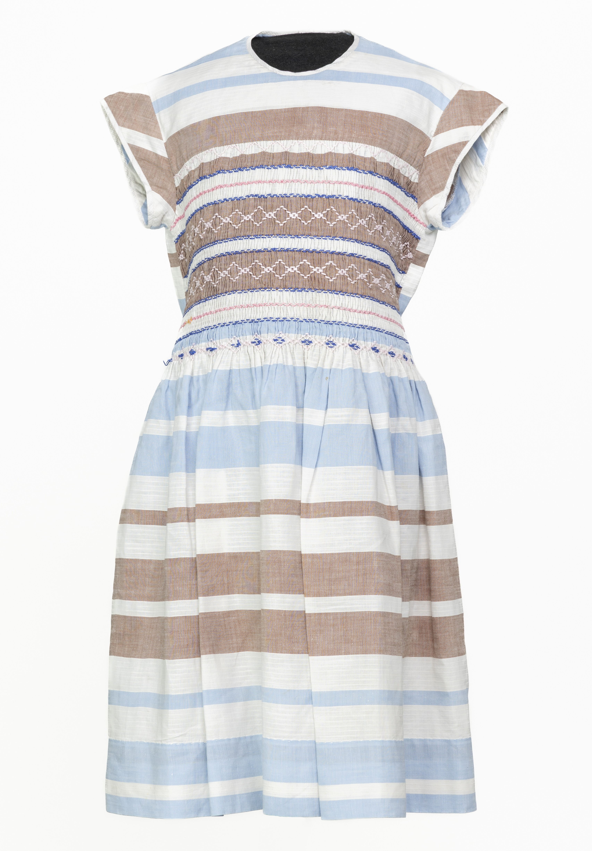
REUSE
In most cases re-use was through hand me downs. The little blue coat had been worn by five different children across two different families. Occasionally as with the blue coat, what was happening might have been a little more like a series of loans, because the item returned to the original owner at the end. The blue dress had been worn by various sisters, and the hem had been adjusted several times.
Images courtesy of The M&S Archive

Slide 17
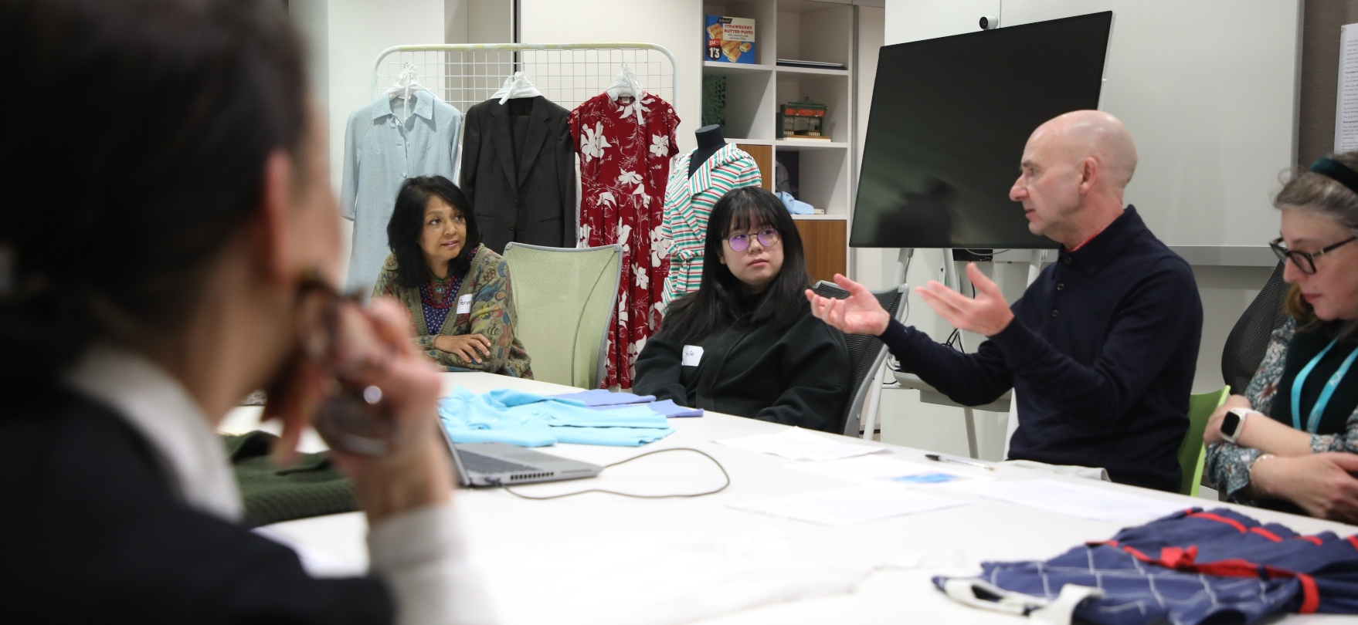
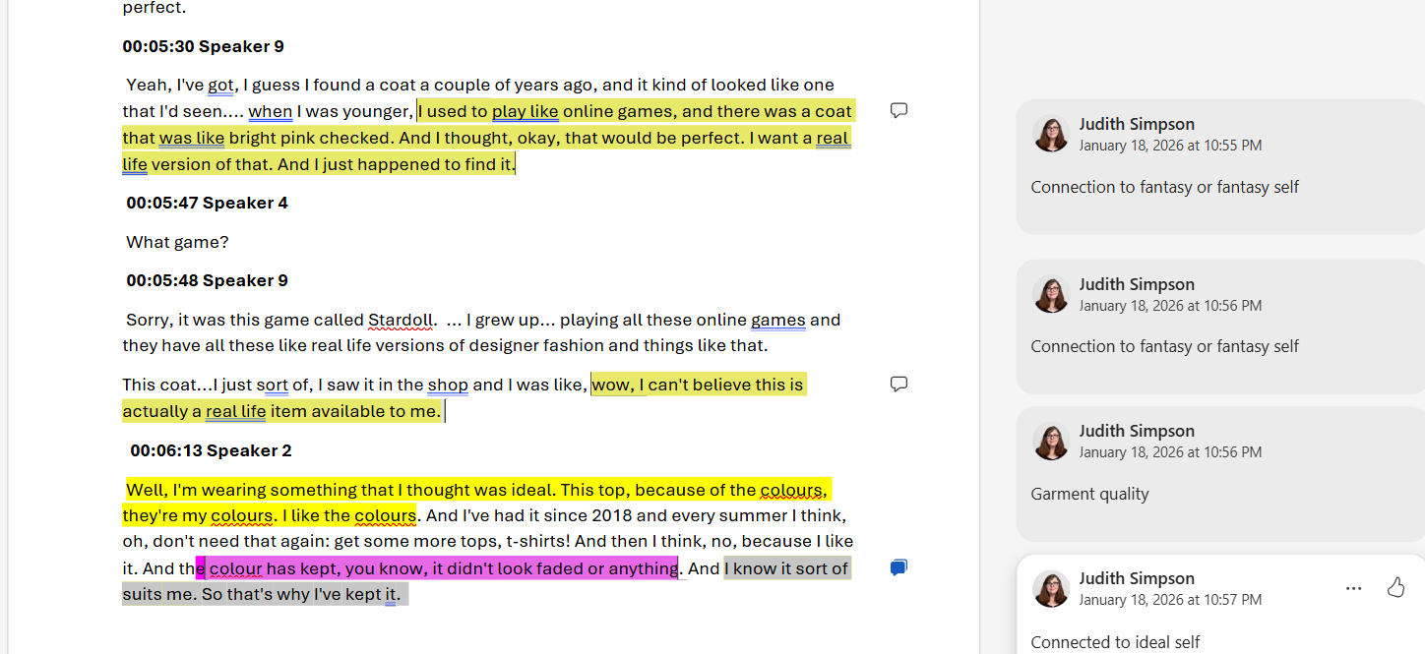
Step 2. Coding
Transcripts from the focus group were first coded in word, using the highlight and comment function.
Remember, codes represent repeated ideas that really seem to crystallise the experience of participants.
Notes:
Transcripts from the focus group were first coded in word, using the highlight and comment function.
Remember, in looking for codes, we were looking for repeated ideas that really seem to crystallise the experience of participants. The section of transcript that you can see on screen shows the focus group participants discussing what made a garment ideal. Some participants mentioned garment quality, for which we used the code “quality”, or the fact that they knew the colours suited them. In this case the code “ideal self” was used, to capture the fact that they liked the garment and thought it helped them to look their best. There was also an interesting discussion about clothes that might be ideal because they were connected with fantasy worlds or a fantasy self. One participant had purchased a real life version of a coat she had seen in an online game, another had bought a coat after seeing something similar worn by the heroine in a tv series. This was a completely unexpected finding and we coded it as “fantasy self”

Slide 18
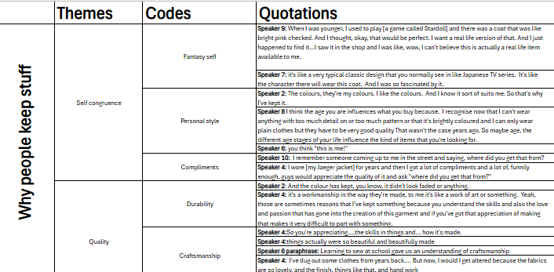
Step 3. Generating Themes
Step 4. Refining Themes
As codes emerged, they were first “bundled” into groups of similar items, which were named as themes.
As the patterns began to emerge from the data, codes and themes were organised in a spreadsheet.
Notes:
As codes emerged, they were first “bundled” into groups of similar items, which were named as themes. Ultimately, we were able to arrange our themes and codes in a spreadsheet.
This is a little bit like Naeem et al’s big diagram, but instead of representing a process where you start with quotations, and from there draw out keywords, codes and themes, this is our attempt to break down big questions like why people keep things into a set of motivations. The quotations are there as evidence that the theme is valid. One important step when you are checking the value of your themes is to check that you have got plenty of quotations that you could use to prove that the theme existed.
By the time we had got this far, we were getting a bit excited about a theme that we called “self congruence”. Self congruence means that an item fits with somebody’s sense of their own style and identity and often that it is linked to their ideas about their fantasy self, to the best self they could ever be. People often reported that when they wore an item that was “my colour” or “just me” then they felt good and received lots of compliments. Some participants felt that their sense of who they were and what they liked meant that they could choose “self congruent” garments that would be “investment pieces” because they would wear them with price for many years. Potentially self- congruent garments are sustainable garments, but it is a bit more complicated than that, because sometimes you don’t really know whether a garment is self-congruent or not until you have worn it and lived with it for a bit.

Slide 19
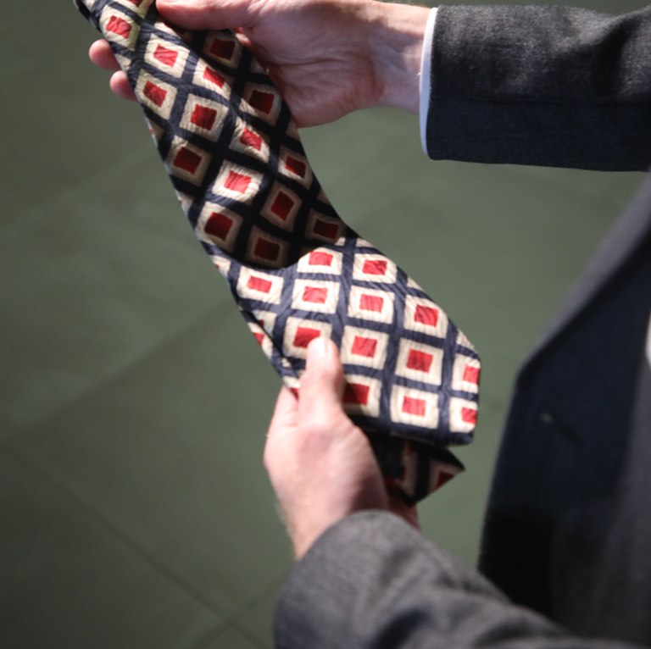
Step 5 . Conceptualisation
Conceptualisation involves:
Refining themes
Deciding which are most important
Comparing them with the literature
Working out how themes are connected to each other
Conceptualisation creates
Definitions
Tentative models
Draft hypotheses
Notes:
Conceptualisation involves:
Refining themes
Deciding which are most important
Comparing them with the literature
Working out how themes are connected to each other
Conceptualisation creates
Definitions
Tentative models
Draft hypotheses
The most important themes will be those mentioned most frequently and/or those mentioned with passion, and which are relevant to your research question.
In our project this meant that we had to discard one of the strongest themes because it just didn’t help us answer our research question. There had been some very passionate discussions about garments being kept and treasured because they had belonged to someone else. Often someone who had died. One participant brought in his father’s tie. He had salvaged this when the rest of his father’s clothes went to a charity shop and he had paid quite a lot of money to have it professionally mended and cleaned. For him the tie really summed up the kind of person his father was and evoked a lot of happy memories. He said that he wore the tie occasionally and it made him feel special. However, the common theme with this kind of garment retention is that it doesn’t really have a sustainability impact. Cherishing the clothes of someone who has died does not seem to reduce the purchase of new clothes at all.

Slide 20
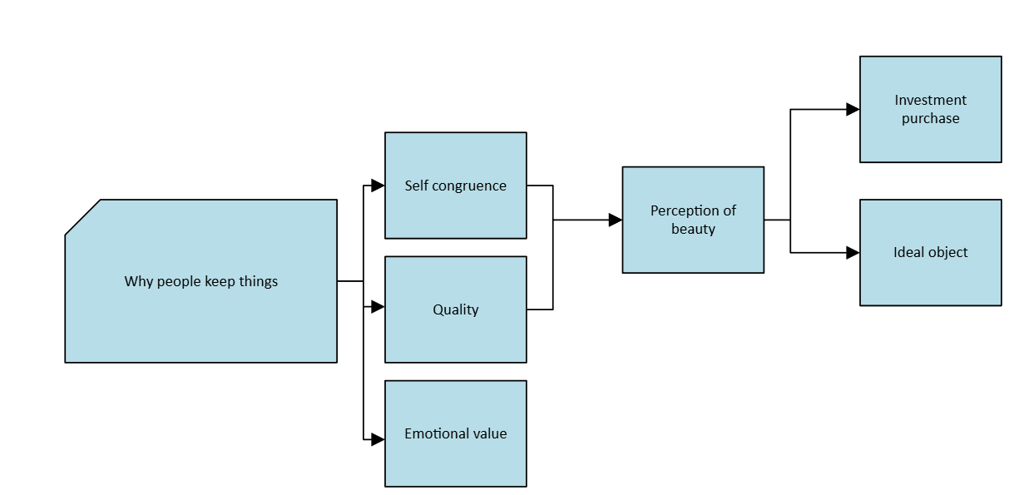
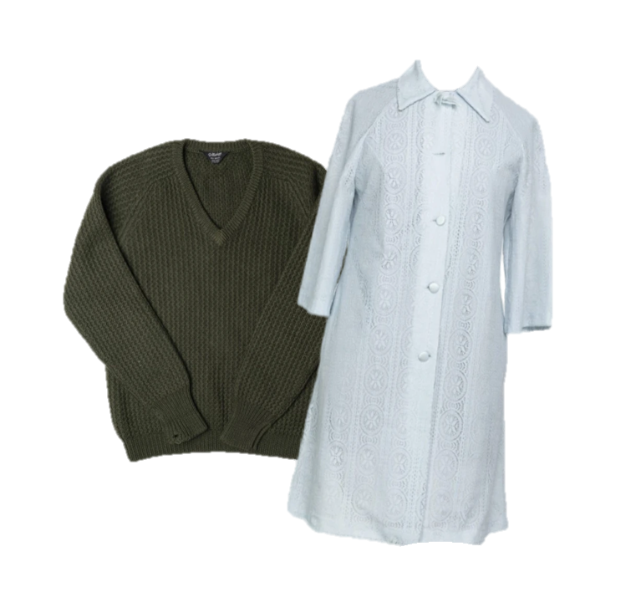
Step 5 Outcome (1)
Im
Images courtesy of The M&S Archive
Notes:
At the end of our conceptualisation phase we had three little diagrams. One explained why people keep things, one summarised retention strategies, and one looked at the things that Marks and Spencers might do to promote sustainability and reduce over consumption.
We concluded that people keep garments because they are self congruent (a good fit with their own ideas about who they are), because they are high quality or because they carry emotional value. Now emotional value does not seem to be relevant to our research question, but the other elements are. If an object is both self congruent and good quality, its owner tends to perceive it as beautiful. Beautiful items can become the ideal object that is kept for years like the jumper here, or they can be the investment purchase which is purchased with the intention to wear it for years. Ideal objects and investment purchases may limit the amount of garments that are bought.

Slide 21
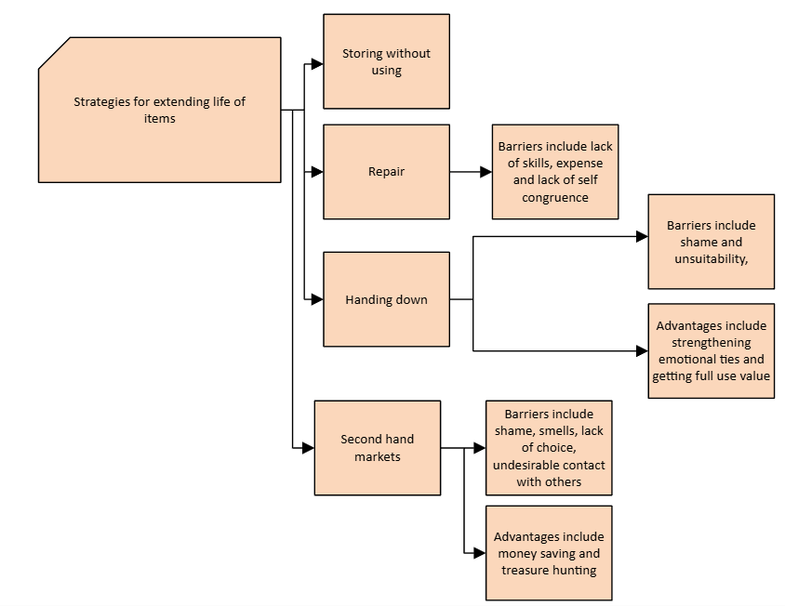
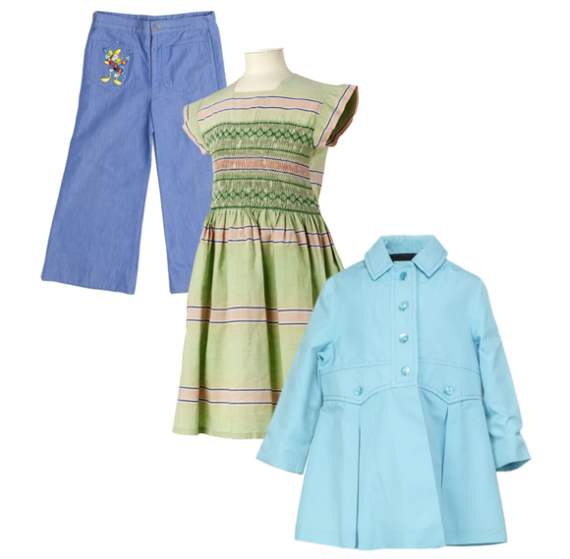
Step 5 Outcome (2)
Images courtesy of The M&S Archive
Notes:
Our focus group suggested that there were four key strategies for extending the life of garments: storing without using, which has no sustainability impact. Repair, handing down items within the family, and the use of second-hand markets. They also talked us through the advantages of each strategy and the barriers that might be encountered.
The focus group noted that repair was infrequently used because it required skill, was quite expensive and also the result might not be self-congruent. There was a really interesting conversation about the decorative mending offered by some luxury brands like Toast: it might be absolutely beautiful, but if it didn’t fit with an identity that favoured casual or conservative clothing then it just wouldn’t be wearable.
Several of the focus group participants had experienced the hand me down phenomenon – whether this was through giving their own garments to others, or by being given garments by others. Although some of the experiences were positive (people understood that being given a garment by its previous owner was often an expression of affection or care and could strengthen emotional ties) the handing down of garments was also associated with shame in some contexts. A Chinese participant explained that in her culture offering someone a garment that you had finished with was likely to cause offence. Similarly an older British participant described a situation where she had seen another girl in the school playground wearing a dress that used to be hers. She remembered thinking “oh, you poor thing!” Equally, the things that were passed down might not be suitable, or might not meet the actual needs of the recipient. One member of the focus group explained that she was often given school uniform items for her daughter – but her daughter would only wear them if they were cotton, and most of them weren’t.
One interesting idea that emerged from the discussion of hand me downs was the idea of “use value”. Garments are often passed on with statements of “you will get more use out of it than I will” almost as if once a garment is purchased there is an obligation to get a certain number of “wears” out of it. We were particularly interested in this theme because it had appeared in other conversations too, particularly when people discussed shopping for “investment pieces”: they were willing to pay a high price because they saw a garment as offering them a great many “wears” in the future.
The discussion of second hand markets indicated that second hand shopping was becoming more acceptable in the UK. Many participants discussed how they enjoyed it. Some loved charity shops, because you could find surprising or historical items and it offered the pleasures of both a treasure hunt and a historical investigation. Others preferred using online platforms like Ebay and Vinted. Indeed shopping on Vinted was described as both a hobby and an addiction. People enjoyed finding luxury items or items that fulfilled their exact needs at a reasonable price. However, there were still some objections to second hand shopping. You couldn’t always find exactly what you wanted. It was frustrating to find something beautiful in the wrong size, and second hand clothing can smell funny and not be entirely hygienic. There were also concerns about the way in which second hand clothing might connect you to the previous owner in an undesirable way. Whether it was bringing your skin into connection with the traces of their body, or the idea that you might meet the previous owner and they would recognise their clothes. If secondhand clothes were cleaned and were sold far from the area of donation, that would presumably make them more attractive.

Slide 22
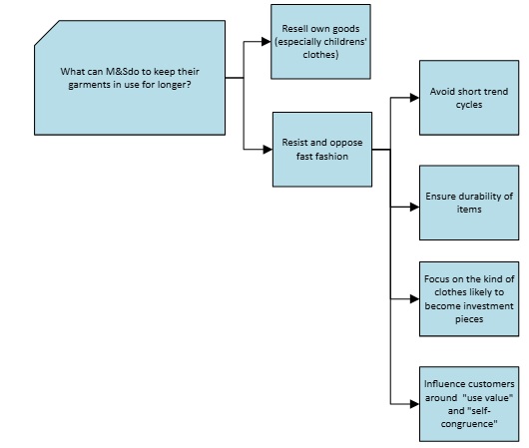
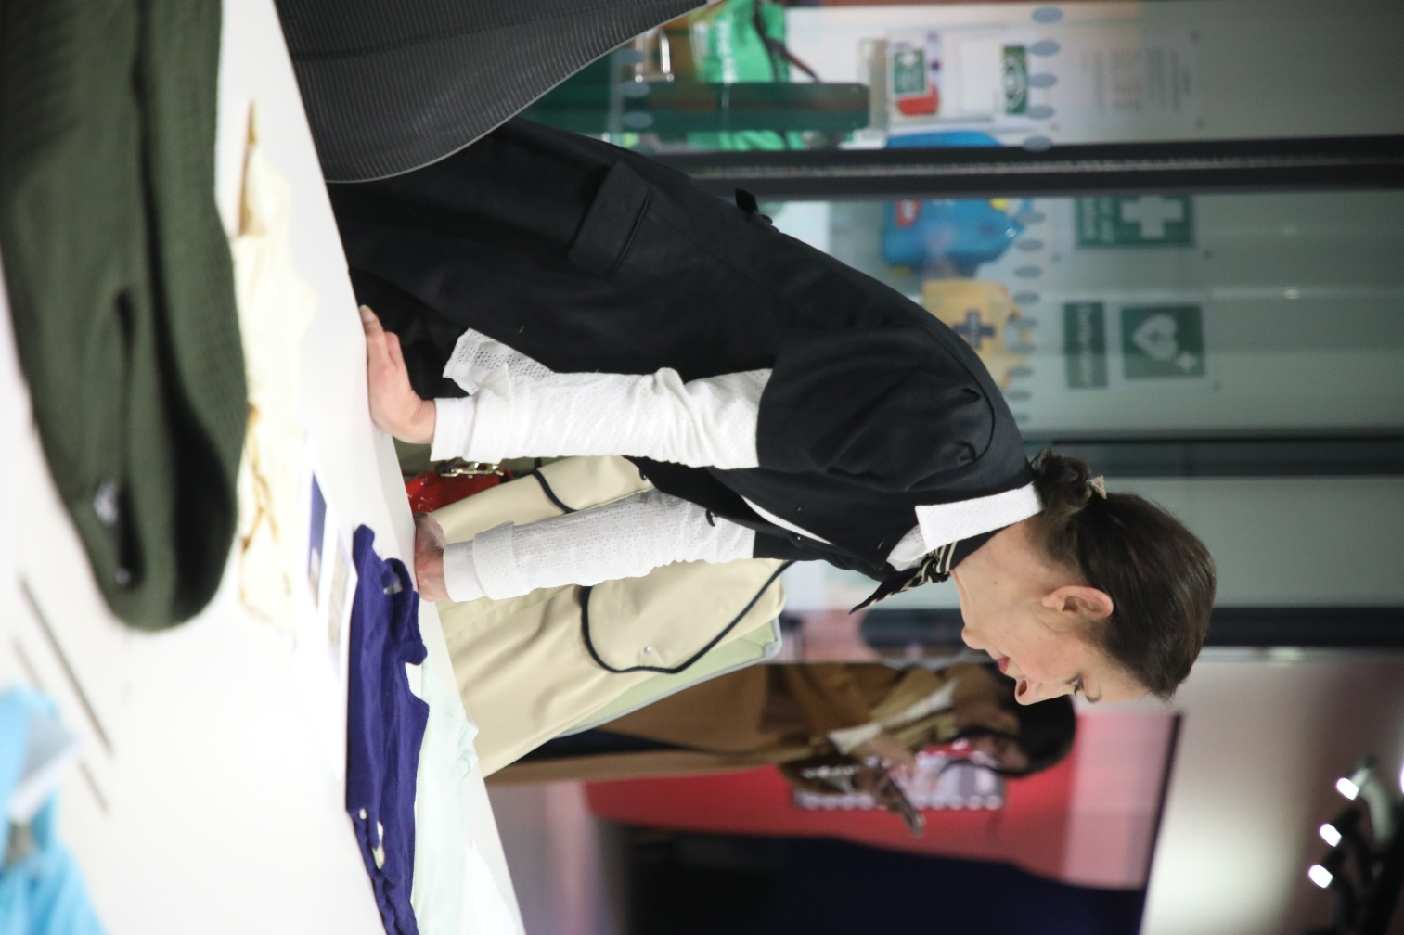
Step 5 Outcome (3)
Notes:
When we discussed what opportunities Marks and Spencers had to promote sustainability and reduce over consumption we naturally discussed the conflict between sustainability goals and capitalism. Marks and Spencers has to produce and sell garments to survive, and garment production is highly unsustainable!
However, the focus group felt that if Marks and Spencers were to resell their own garments (those donated through Shwopping schemes) there would be significant interest in both retro pieces and children’s wear. One focus group member got quite passionate about children’s party clothes. “Imagine you buy a party dress for a 5 year old girl: how many parties is she going to go to before she grows out of it? 2?” This type of clothing was felt to have “surplus use value” that ought to be used up, and the resale of children’s wear could have a genuine impact on the amount of new clothing produced.
More generally, the focus group argued that Marks and Spencers should resist and oppose fast fashion. They could do this by avoiding short trend cycles, by focussing on the kind of clothes likely to be investment pieces and by ensuring the durability of items. It is also possible that if M&S might be able to change purchasing behaviours by promoting the idea of “exhausting the use value” and helping customers to identify “self congruent items” perhaps through in store stylists or online styling advice.

Slide 23
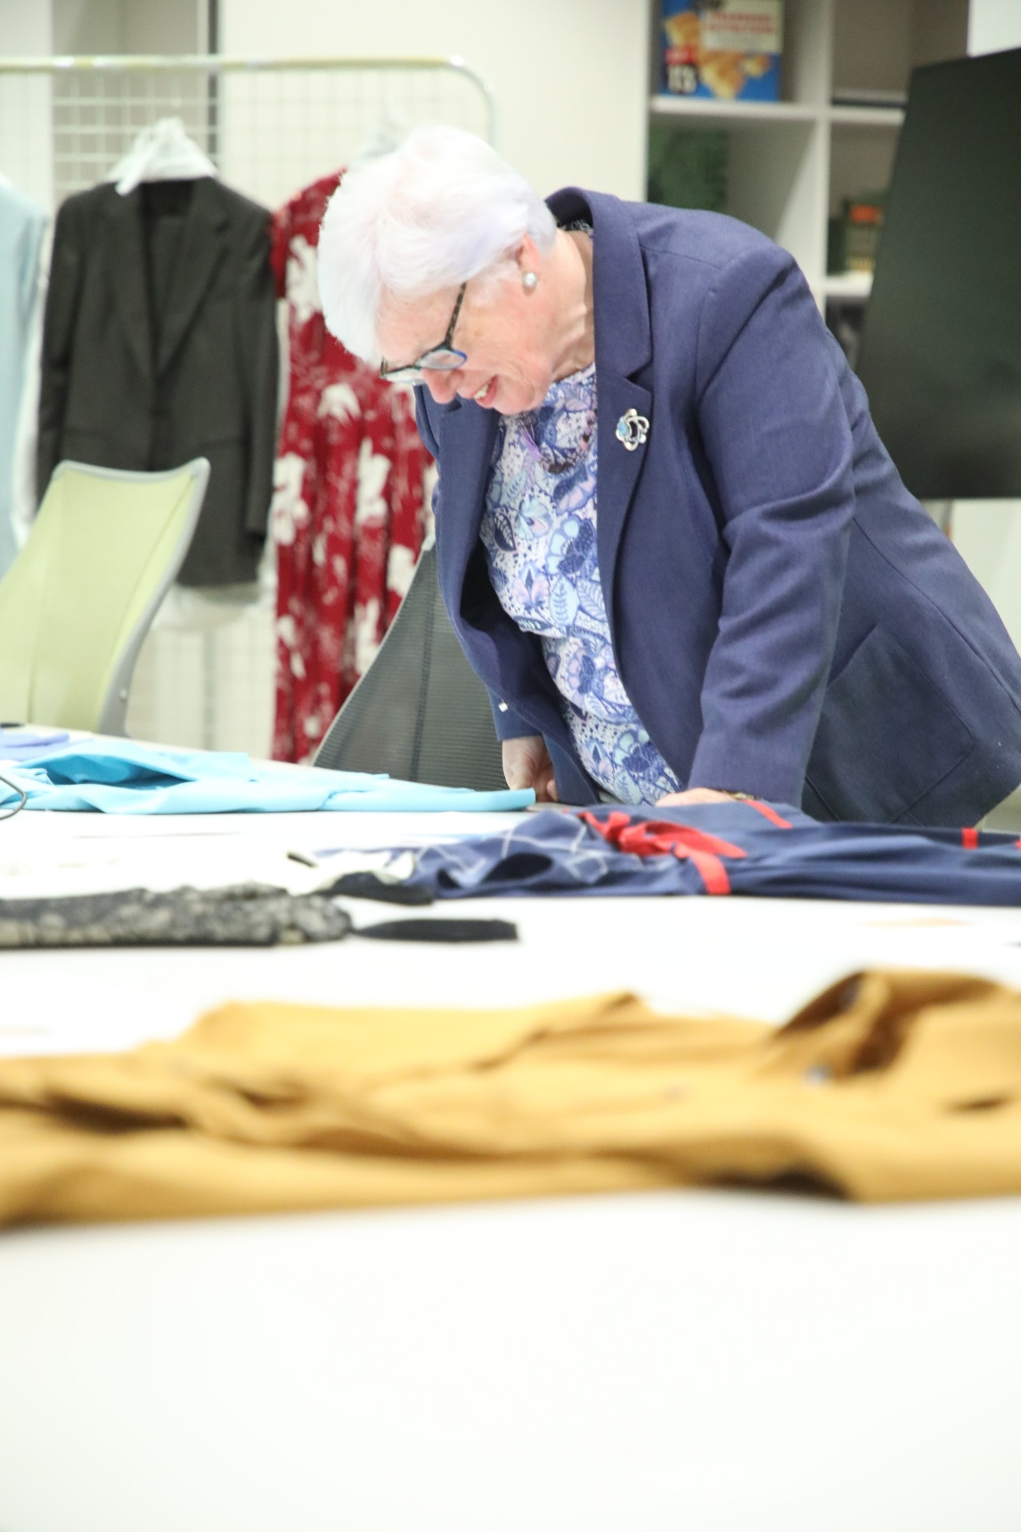
Project Findings
We started with the assumption that clothing sustainability is maximised if garments stay in use for a long period of time
Our research suggested that
People treasure and continue to use items because they are “self congruent and high quality”
Garment life can be extended through either repair or reuse.
There are significant barriers to repair: it’s expensive, people may not have the skills, and the resulting repair may not be self congruent.
Re-use within a family or peer group is complex and associated with both shame and obligations, however, re-sale is becoming increasingly acceptable.
Suggestions for Marks & Spencer Ltd include
  online resale of their own brands (they’re doing it!)
  resisting fast fashion (they are doing this too!)
  Helping shoppers identify self-congruence
  Popularising the idea of “getting the use value” out of an item.

Slide 24
Where to Next
The presentation of the paper represents the first of a three-stage research process that aims to investigate how UK fashion consumers engage in the domestic maintenance and repair of clothing. It seeks to understand the cultural, technical, and behavioural factors influencing clothing repair practices and their role in promoting sustainable fashion consumption.
Publish finding as a journal paper.
The second stage of the research will involve the Marks and Spencer Archive, who will part fund a one-year MRes student, supervised by the team.
The third stage would be to utilse the findings from the first and second stage of the research to write a larger funding application for AHRC.

