Slide 1

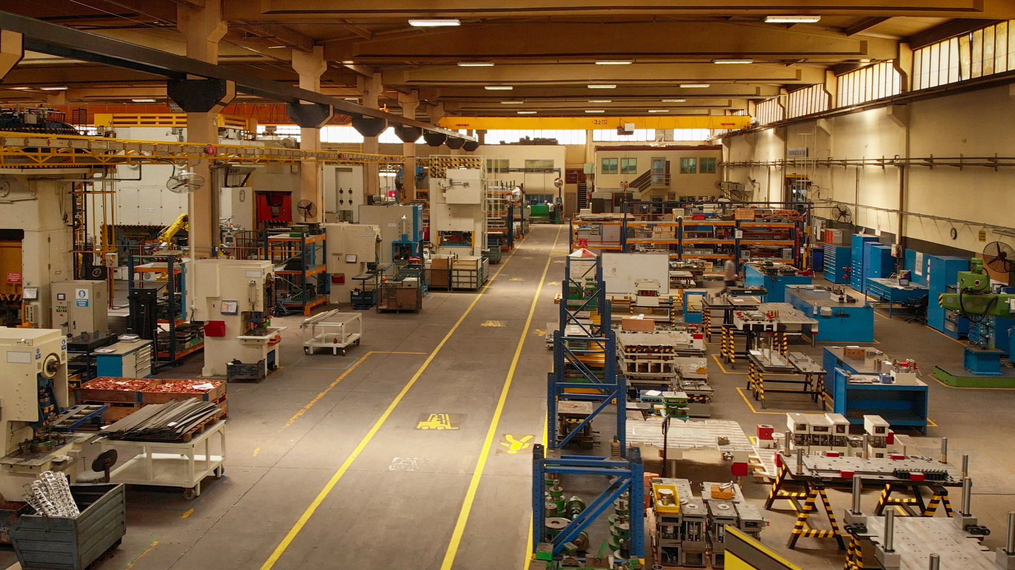

THE 21ST INTERNATIONAL MANUFACTURING CONFERENCE (IMCC 2025)
GUANGZHOU, CHINA
Industry 5.0 and the Future of Sustainable Manufacturing:
Human-centric Innovation, Circularity and Resilience
DR. JACQUELINE YOU
SCHOOL FOR BUSINESS AND SOCIETY
UNIVERSITY OF YORK, UK
24 OCTOBER 2025

Slide 2
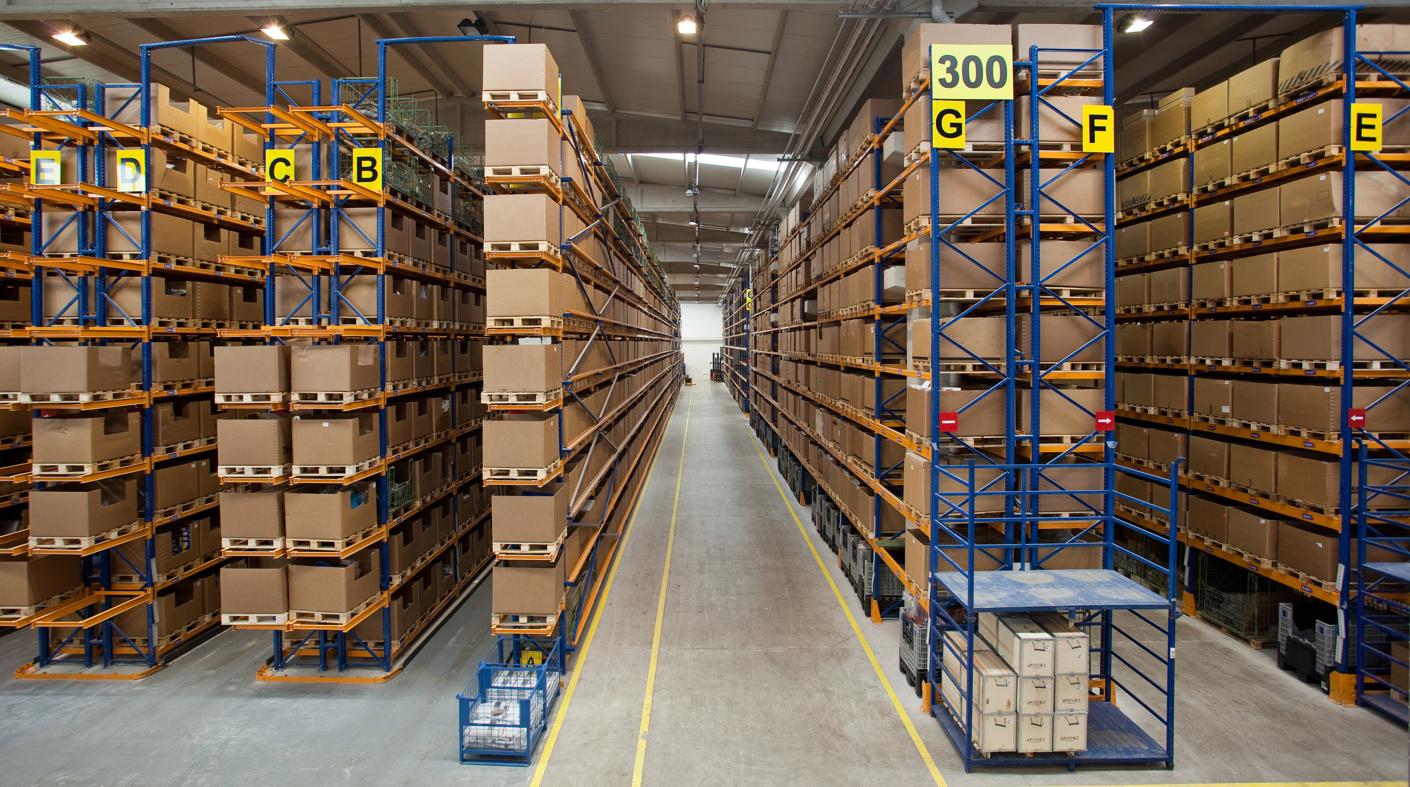
01
Historical View : Industrial Revolutions
05
04

Slide 3





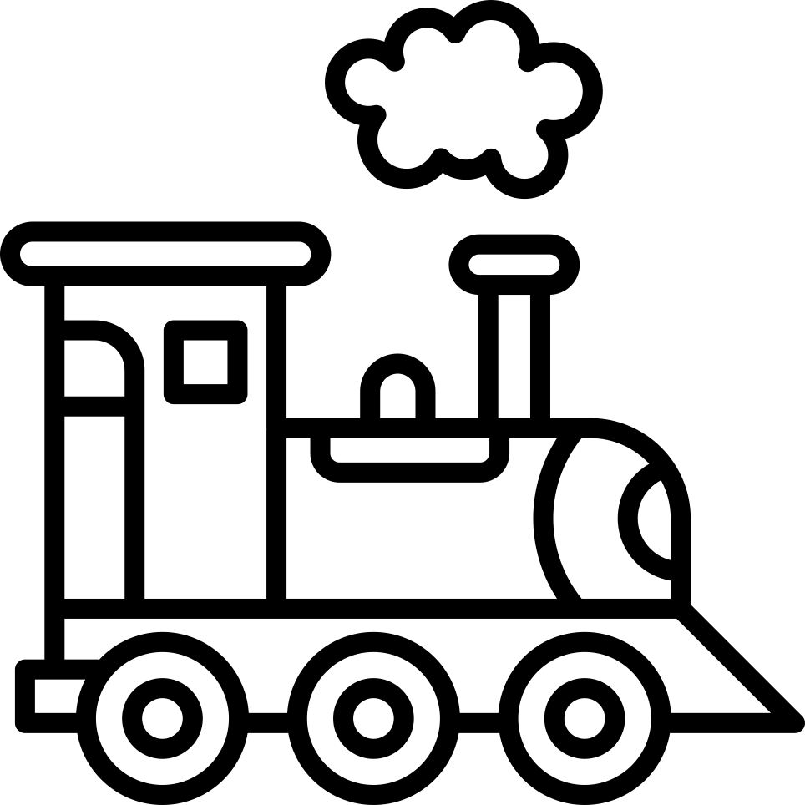




Industrial Revolutions: From Mechanization to Human-Centric Collaboration
INDUSTRY 1.0
(1760S)
INDUSTRY 2.0
(1870S)
INDUSTRY 3.0
(1960S)
INDUSTRY 4.0
(2010S)
INDUSTRY 5.0
(2020S)
Steam Power
Mechanization
Electricity
Assembly Lines
Electronics
Computers
IoT, AI
Digital Twins
Cobots, Human Digital Twins, Sustainability Tech
Human Role:
Manual Operators
Human Role: Assembly Workers
Human Role:
System Supervisors
Human Role:
Data Analysts
Human Role:
Collaborative Partners
80 years to 50% market penetration
90 years to 50% market penetration
50 years to 50% market penetration
15 years to 50% market penetration
10 years to 50% market penetration

Slide 4
Control and Collaboration Across Industrial Revolution
EVOLUTION
Industry 1.0
Provider 1
Industry 3.0
Industry 4.0
Industry 5.0
Industry 2.0
Human Control
90%
70%
50%
30%
50%
Machine Autonomy
10%
30%
50%
70%
50%
Collaboration Level
Low
Low
Medium
Medium-High
Very High
Industry 1.0–2.0:
Replacement Paradigm
Industry 3.0:
Supervision Paradigm
Industry 4.0:
Augmentation Paradigm
Industry 5.0:
Collaboration Paradigm
PARADIGM SHIT

Slide 5
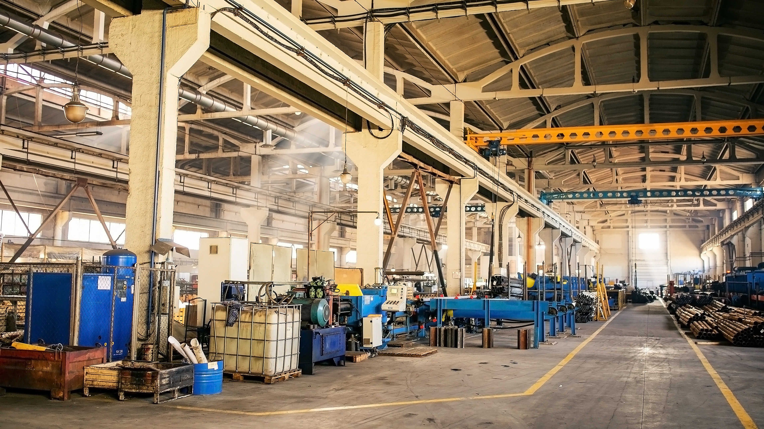
02
Transformative Value in Industry 5.0
05
04

Slide 6

What is Industry 5.0?
Industry 5.0 is
a collaboration paradigm, blending human creativity and advanced technologies
a continuation of Industry 4.0, adding ethical and sustainable dimensions
a value-driven framework, focusing on human-centrality, circularity, and resilience
a social-technical system, aligning technological innovation with human and environmental well-being
Notes:
Bridge technology, humanity and environment, e.g., how we use technology to empower humans, enhance creativity, promote sustainability

Slide 7







Industry 5.0: Value Propositions and Core Principles
Means
Human–Technology Interaction
Purpose
Context
Human–Centricity
Sustainability and Circularity
Outcome
Capacity
Value-driven Innovation
Resilience and Adaptability
Industry 5.0 operates as a collaborative ecosystem in which human–technology interaction supports human-centric design, leading to sustainable and resilient systems that enable value-driven innovation.
Notes:
Interaction → Human-Centricity → Sustainability → Resilience → Value-Driven Innovation

Slide 8
INDUSTRY 5.0 AND MANUFACTURING
PRACTICAL IMPLICATIONS
03
05
04

Slide 9






Human-Centric Manufacturing:
Empowering people through intelligent collaboration
Human-in-the-loop design
Cobots, AR/VR and adaptive interfaces integrate human creativity with machine precision
Workers become decision-makers and innovators, supported by AI-driven insights and ergonomic systems
Operator 5.0
Human Digital Twins
Simulate cognitive load, safety, and training needs – technology adapts to people, not vice versa
Inclusive Innovation
Reskilling, wellbeing, and participatory design embed trust and acceptance in smart factories
Efficiency is improved through empathy and engagement

Slide 10



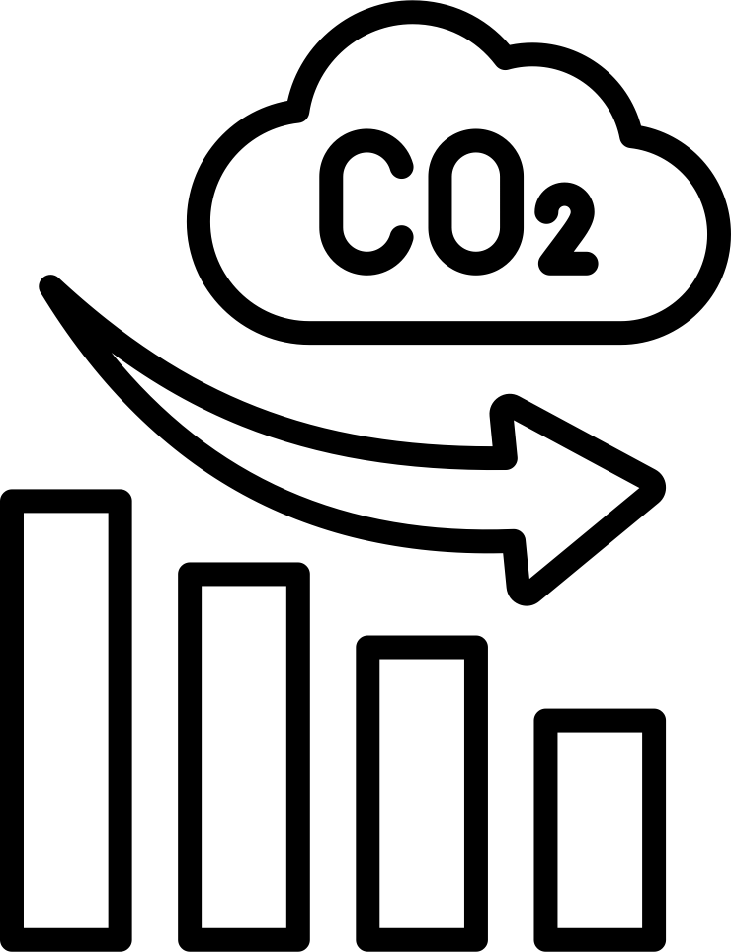
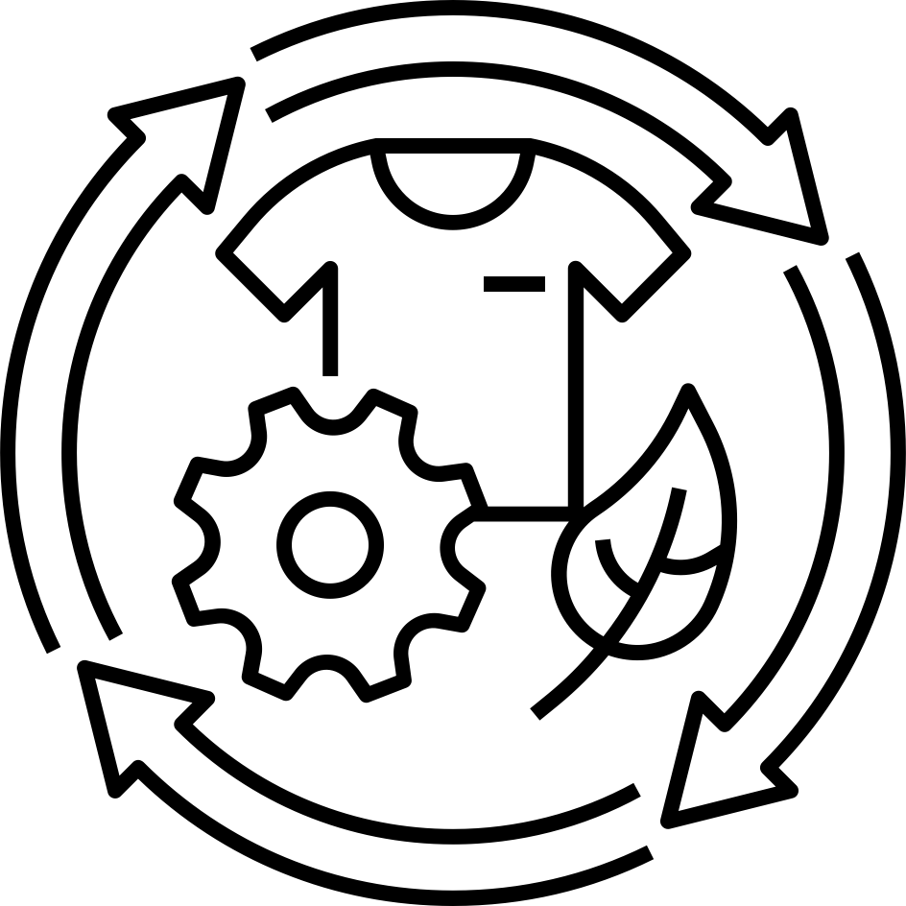
Circular Manufacturing:
Designing regenerative intelligent production systems
Closed-loop production
IoT and digital twins enable traceable material and energy flows across the lifecycle
Generative, sustainable design
AI optimizes materials, durability, and recyclability at concept stage
Additive & distributed manufacturing
On-demand, localized production reduces transport, waste, and emissions
Data-driven sustainability
Sensors and analytics turn resource efficiency into a controllable engineering variable
Circularity makes sustainability measurable, manageable and manufacturable

Slide 11
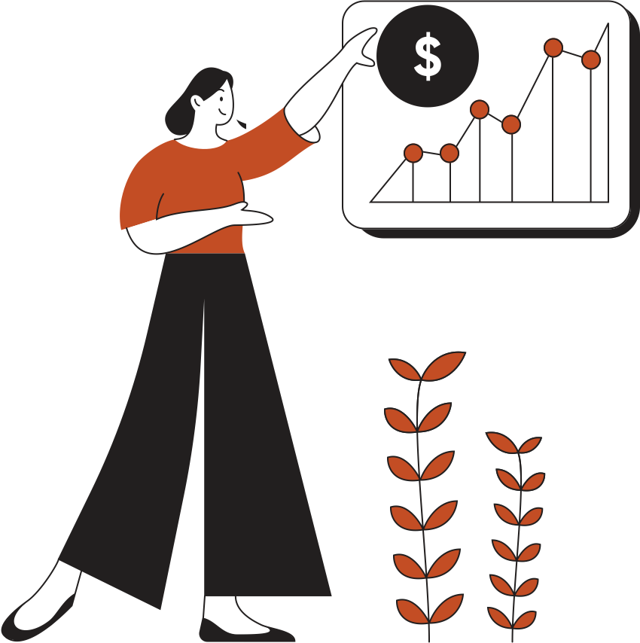
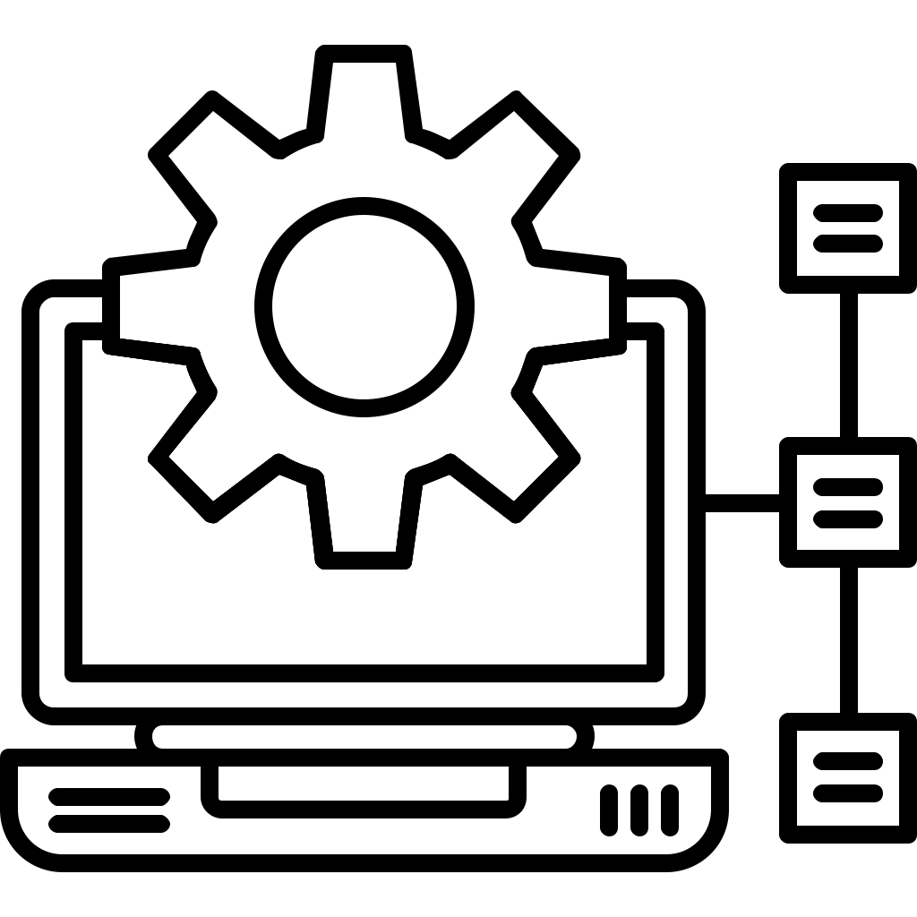



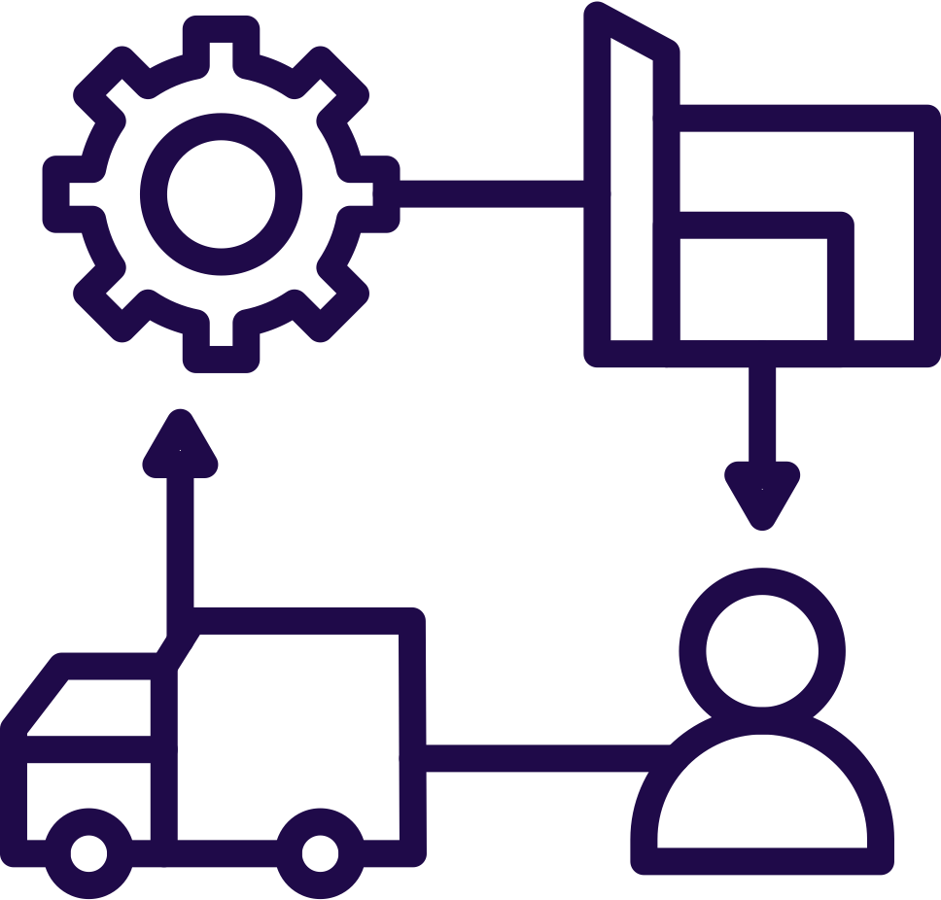


Resilient Manufacturing:
Building adaptive and trustworthy industrial ecosystems
Adaptive systems
Collaborative resilience
self-diagnosis
predictive repair
dynamic reconfiguration
human oversight
moral accountability
creative recovery strategies
Network resilience
Ethical assurance
distributed manufacturing
blockchain infrastructures
local robustness, traceability and coordination
cybersecurity
data governance
explainability
core governance
Resilience is not just about bouncing back – it is about bouncing forward with integrity, coherence, and adaptive learning across human–machine–environment systems.
Notes:
Resilience in Industry 5.0 moves beyond redundancy and risk management — it becomes a dynamic capability embedded within interconnected systems.

Slide 12
04
ENGINEERING SUSTAINABLE FUTURES
05
04

Slide 13





Principal Challenges and Opportunities
Cybersecurity and privacy risks
Skills and social adoption
Standards and measurement
Technology maturity and commercialization
Cybersecurity-centric design
Updated OT/IT governance
Public-private upskilling programs
Participatory deployment
Multicriteria assessment tools
Prioritize interventions
Sequence investment strategically
Phased roadmaps to measure readiness

Slide 14
Future Trends and Predictions
01
Human Digital Twins & Immersive Learning
02
Advanced Human-in-the-Loop Ecosystems
03
Generative AI for Sustainable Design
02
04
04
Governance and Ethical Frameworks

Slide 15
Design for collaboration. Manufacture for regeneration. Engineer for wellbeing
Email: jacqueline.jingyou@york.ac.uk
Thank You

