Slide 1




TikTok Marketing research: A Systematic Review of Trends, Theories and a Proposed Future Agenda
British Academy of Management Conference 2025
Kent Business School
Primary Track: Marketing and Retail-Development Paper
Jiazheng Nie ^{1*}: University of Leeds
Dr Rubab Ashiq² : University of Leeds
Dr. Eunsuk Hur³ : University of Leeds
*Presenter E-mail: sdjn@leeds.ac.uk
Presentation date: 4th September, 2025
Dr Nahid Ibrahim
October 2024

Slide 2
Outline
Research Aim & Objectives
Methodology
Preliminary Results & Key Trends
Discussions of key findings
Future Research Agenda
Contributions

Slide 3
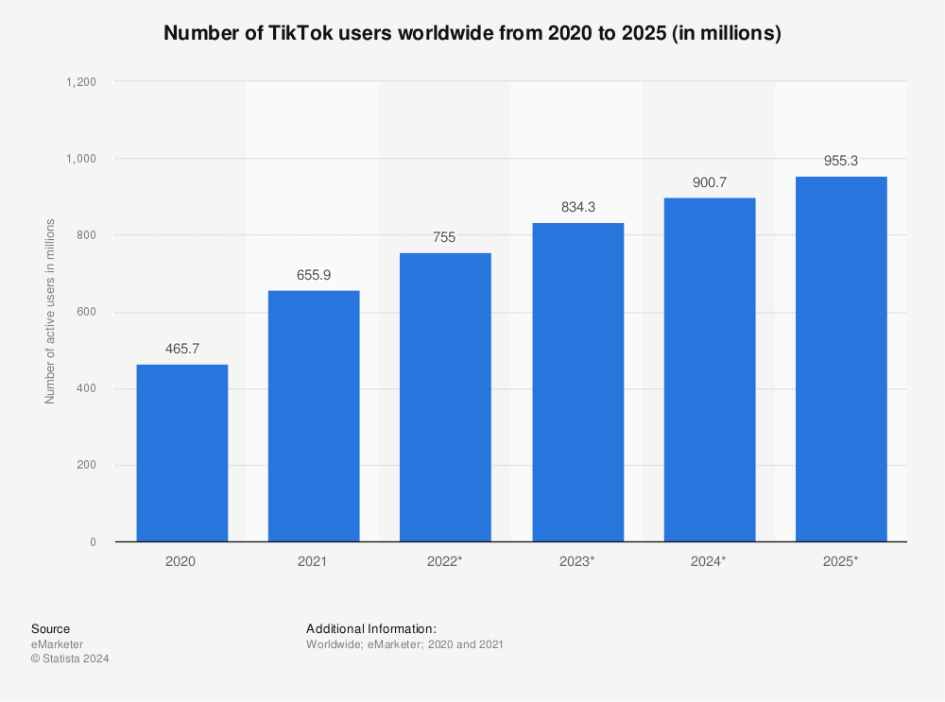
Research Context
TikTok's Rapid Rise
Global launch in 2018, rapidly becoming a transformative social media platform.
Gen Z user dominance (60%) → marketing potential(Smith and Anderson, 2023)
Algorithm-driven content enhances user engagement.→ high commercial potential(Zhang and Mao, 2023).
Significant Commercial Potential
Short-form video and trend-driven participation lead to high conversion rates.
Seamless integration of content and commerce, exemplified by Douyin's $200 billion GMV in 2022(Ma, 2022)
.
Figure 1: Number of global TikTok users from 2022 to 2025 (Ceci, 2024)

Slide 4
Research Gap
Fragmented Existing Research: Despite growing attention, academic research remains fragmented, lacking a holistic understanding of previous studies.
Limited Integration: Previous studies overlook platform-specific features like TikTok's algorithm, failing to integrate its unique affordances with consumer behavior theories.
Strategy-Practice Gap: Rapid feature iteration (e.g., livestreaming, TikTok Shops, AR filters) outpaces academic validation, creating a gap between marketing strategies and platform realities.

Slide 5
Aim & Objectives
Research Aim
This study identifies research priorities and suggests directions for TikTok marketing by mapping trends and gaps.
Objectives
1) To provide an overview of TikTok marketing research by identifying key trends in publication patterns, regional focus, and journal types through bibliometric analysis.
2) To critically evaluate the methodological and theoretical frameworks employed in TikTok marketing studies, highlighting their strengths and limitations in addressing the TikTok marketing issues.
3) To explore the dominant themes and methodologies in TikTok marketing research, identifying gaps in current literature using co-word analysis.
4) To propose a future research agenda for TikTok marketing, advocating for the adoption of advanced methodologies to address emerging challenges in TikTok marketing.

Slide 6
Data collection and screening
Table 1. Selection Criteria for Included Studies
Time Span: Publications from 2016 to 2024.
Databases:
Primary: Web of Science and Scopus.
Supplementary: EBSCO Business Source Premier and Emerald Insight.
Search Strategy:
Keywords: "TikTok," "Marketing," and "Brand" along with their synonyms.
Employed advanced Boolean search (AND, OR, NOT).
Inclusion Criteria:
Themes: Marketing research focused on brand image, awareness, or promotion.
Article Types: English-written, peer-reviewed journal articles, conference papers.
Quality: Published on SCImago journal ranking Q1-Q3.
Non-duplicated: Unique articles only.
Dimension | Inclusion criteria
A Themes | Only marketing research that focuses on brand image and awareness building or product or service promotion will be included.
B Article types | English written; Peer-reviewed journal articles, conference papers;
C Time span | From 2016-2024
D Quality | Articles published on SCImago journal ranking Q1-Q3
E Non-duplicated | Only non-duplicated articles will be included
Dimension​ | Exclusion criteria​
Accessibility​ | Non-full text available​
B. Theme​ | Articles beyond the scope of marketing research topics​
C. Keywords​ | No keywords "TikTok or Douyin" found​

Slide 7
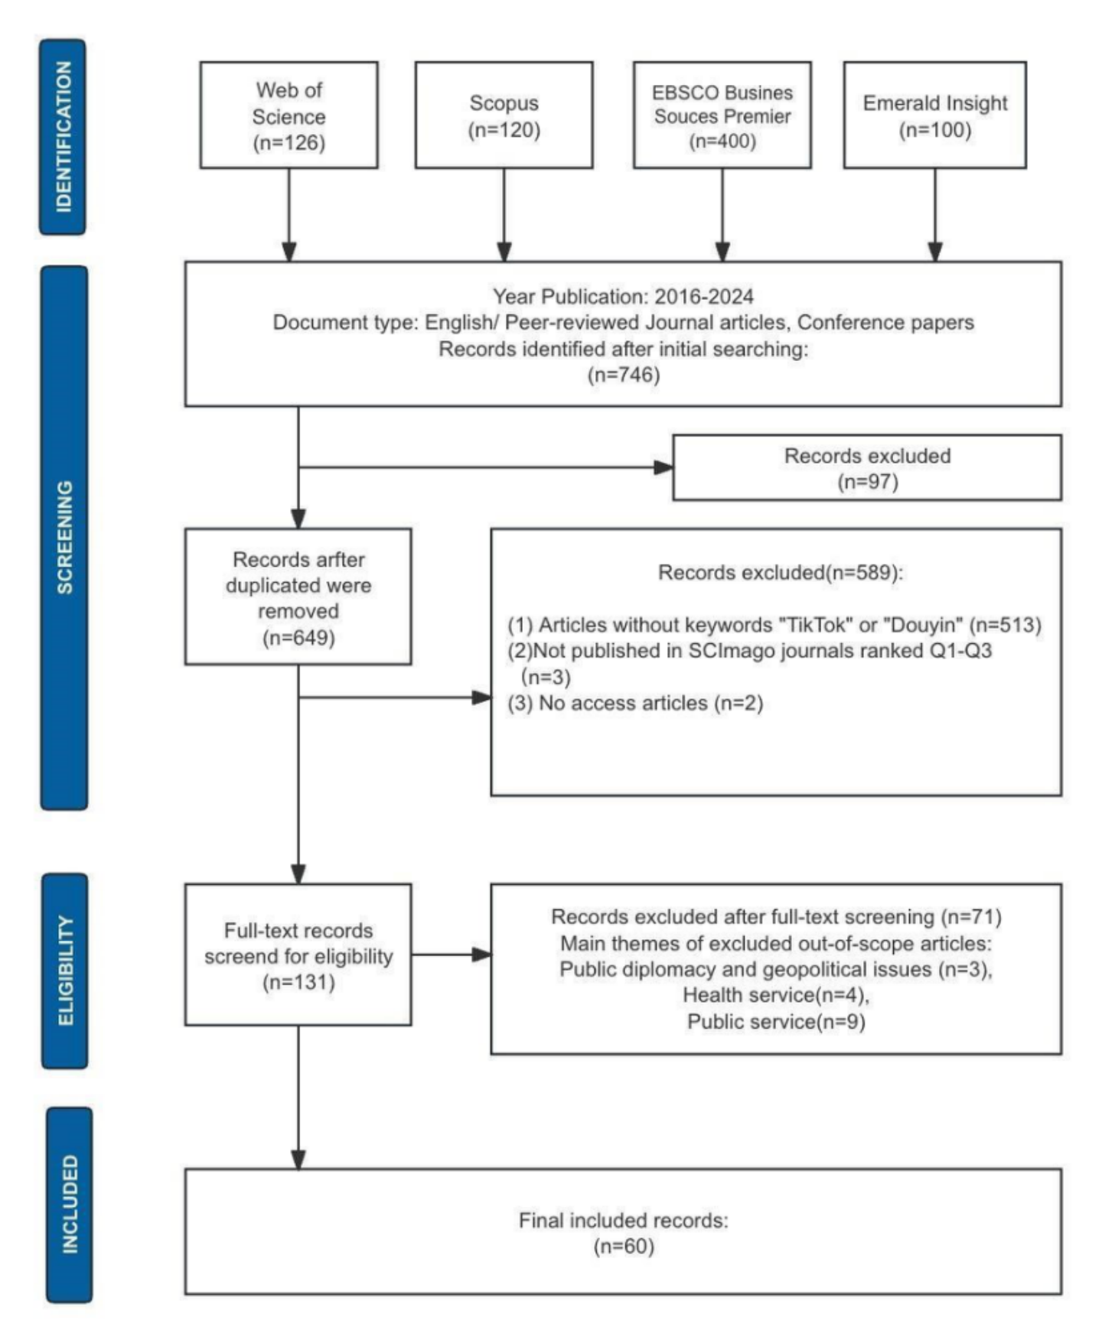
Methodology
Figure 2: PRISMA-based reference searching and screening process

Slide 8
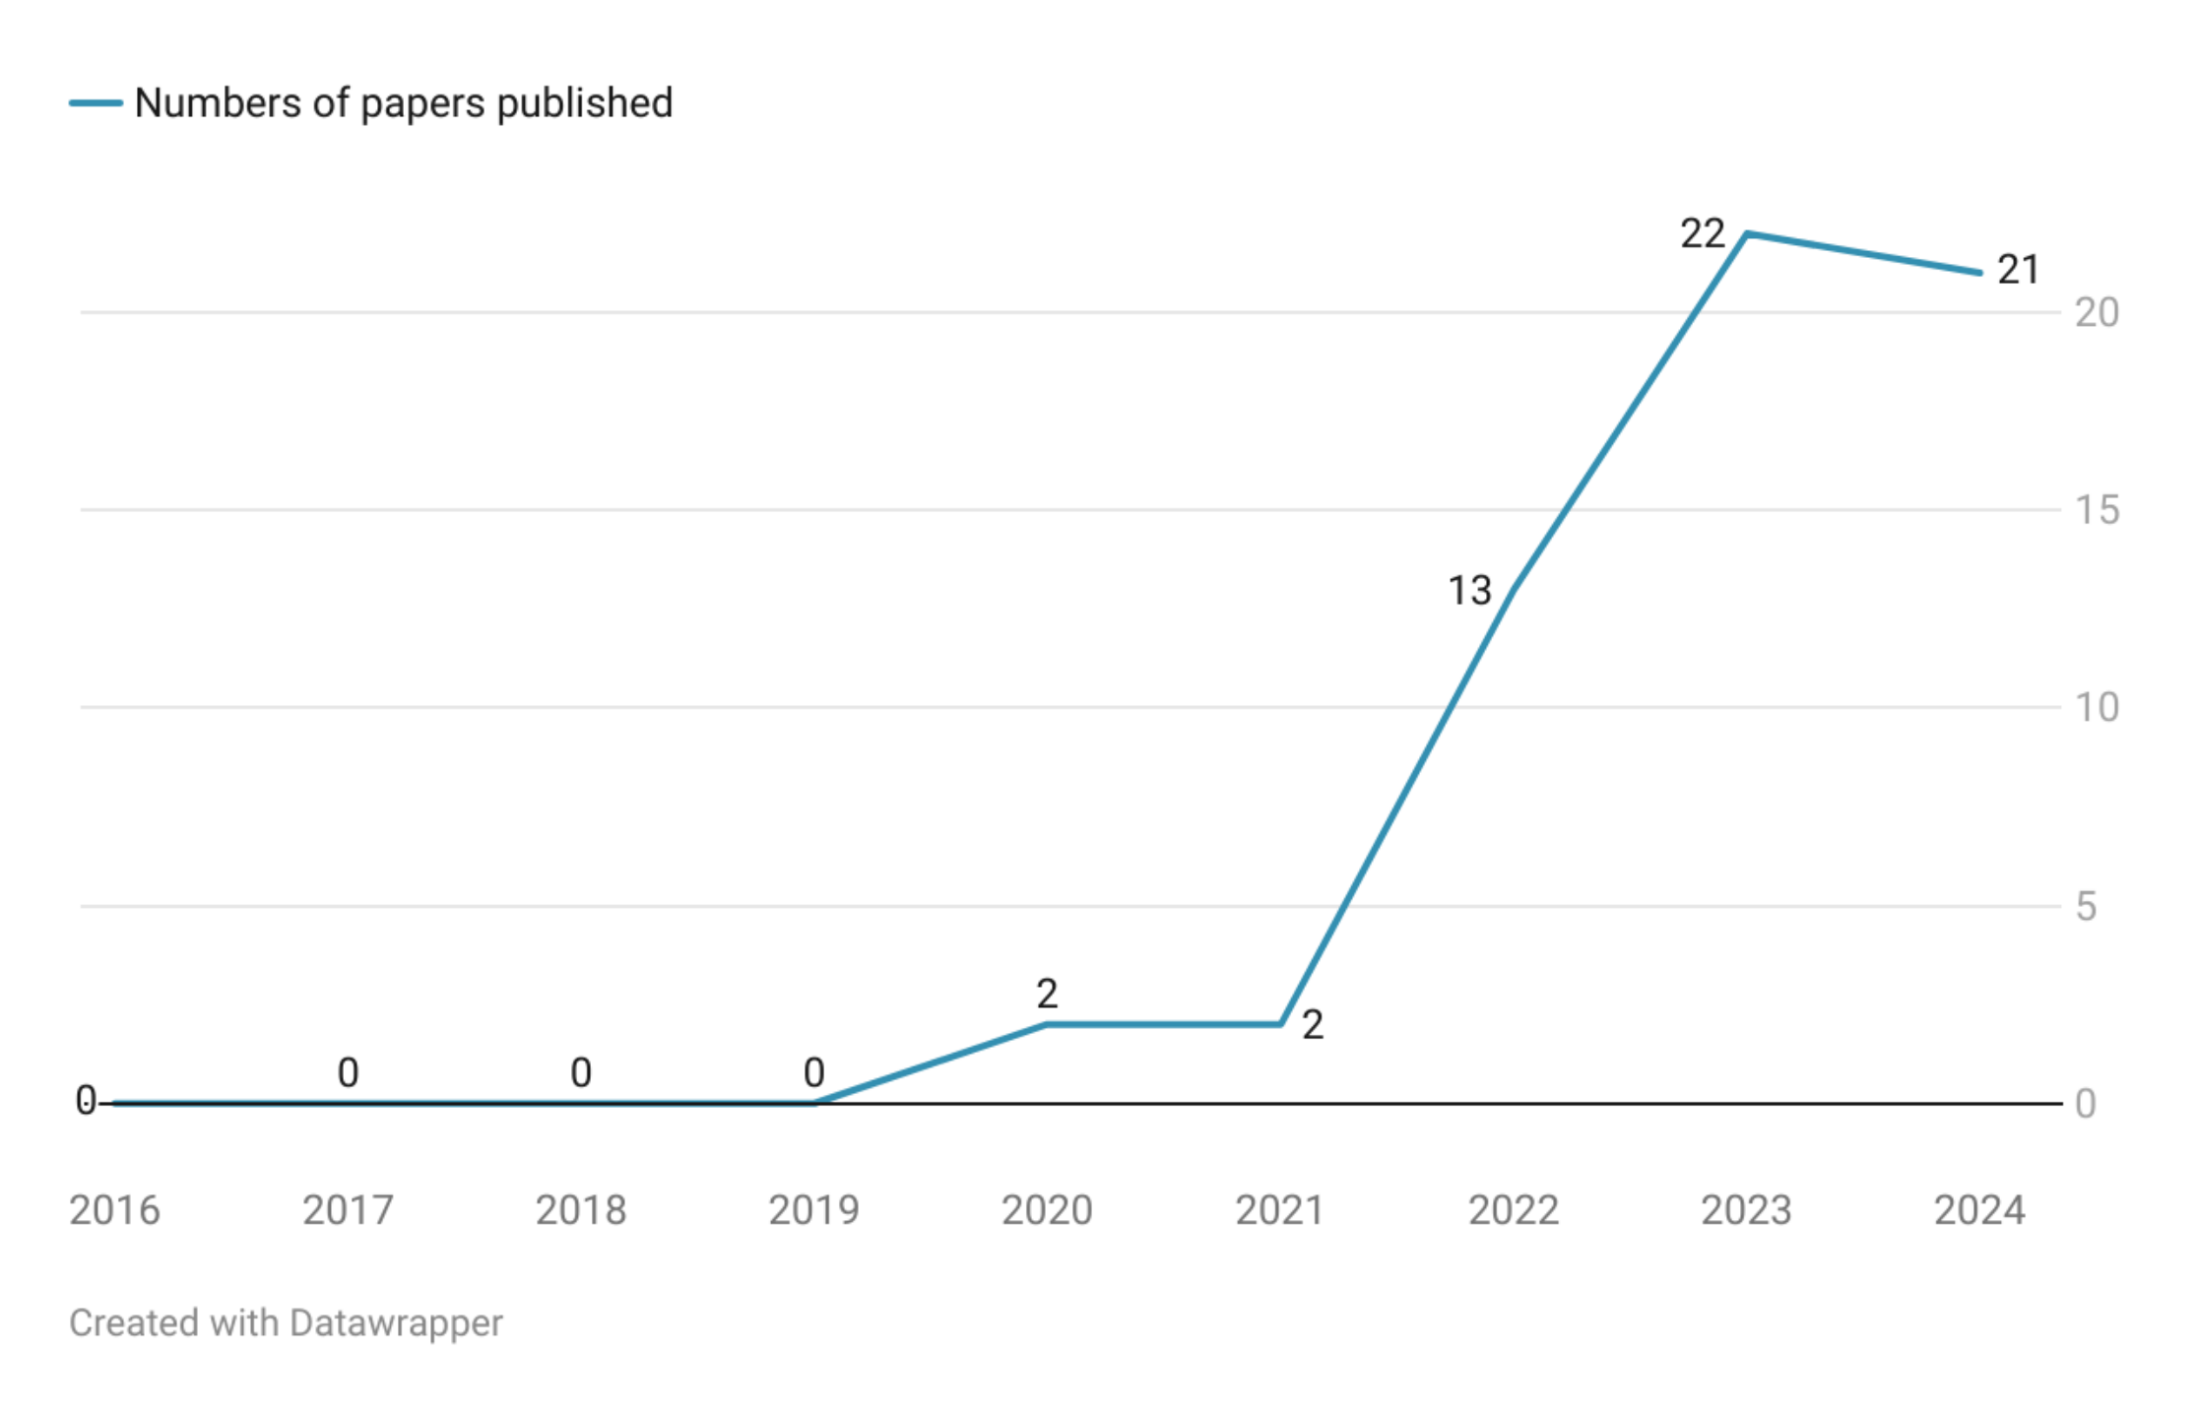
Publication Trends
36.6%
35%
Key trends
Surge after 2020
Peak in 2023 (post-COVID academic interest)
Highest number of publications appeared in 2023, reflecting increased academic interest.
21.6%
3.3%
3.3%
Figure 3. Trends in the growth of publications from 2016 to 2024 (as of the first quarter)

Slide 9
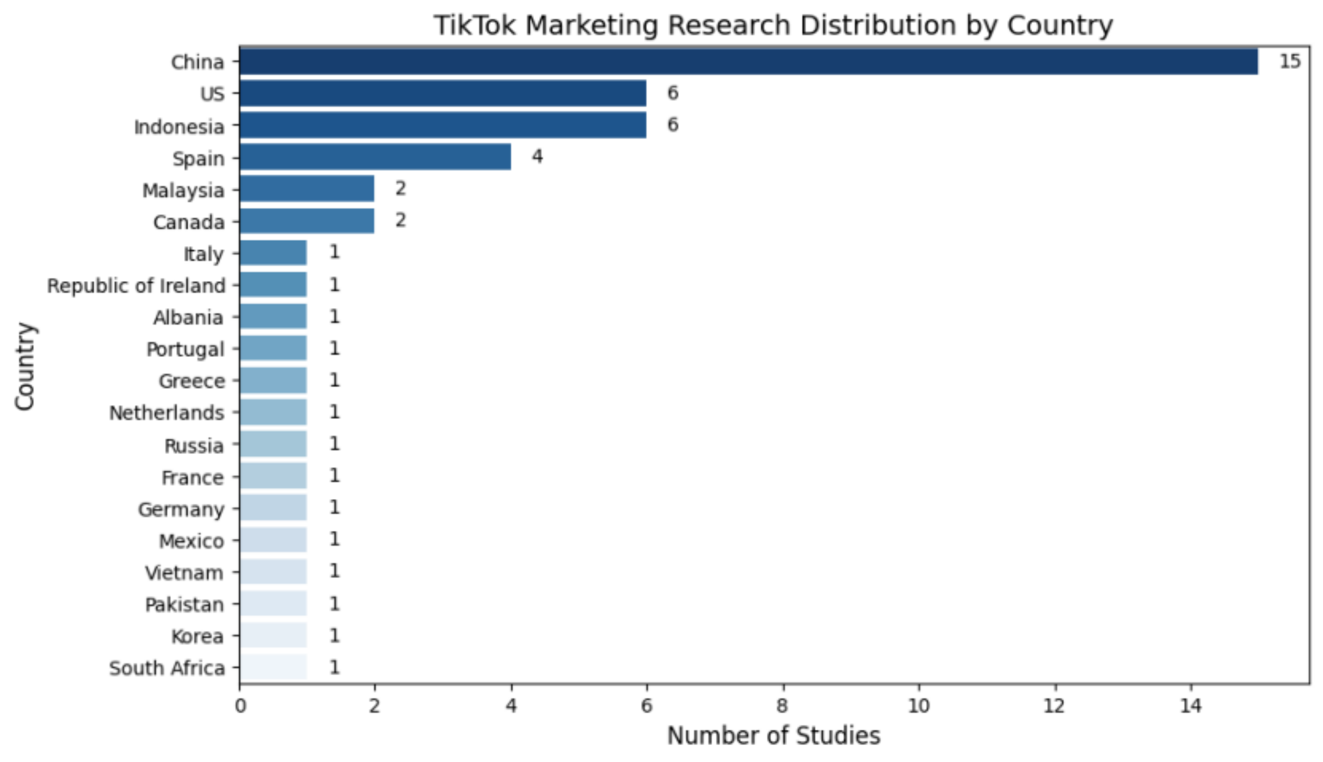
Geographical Trends
25 %
10 %
10 %
6.7 %
3.3 %
Top regions: China 25%, Indonesia 10%, USA 10%
Underexplored Regions: Africa, South America, West Asia and North Africa (WANA)
3.3 %
1.7%
1.7%
1.7%
1.7%
1.7%
1.7%
1.7%
1.7%
1.7%
1.7%
1.7%
1.7%
1.7%
1.7%
Figure 4. Geographical Trends in TikTok Marketing Research

Slide 10
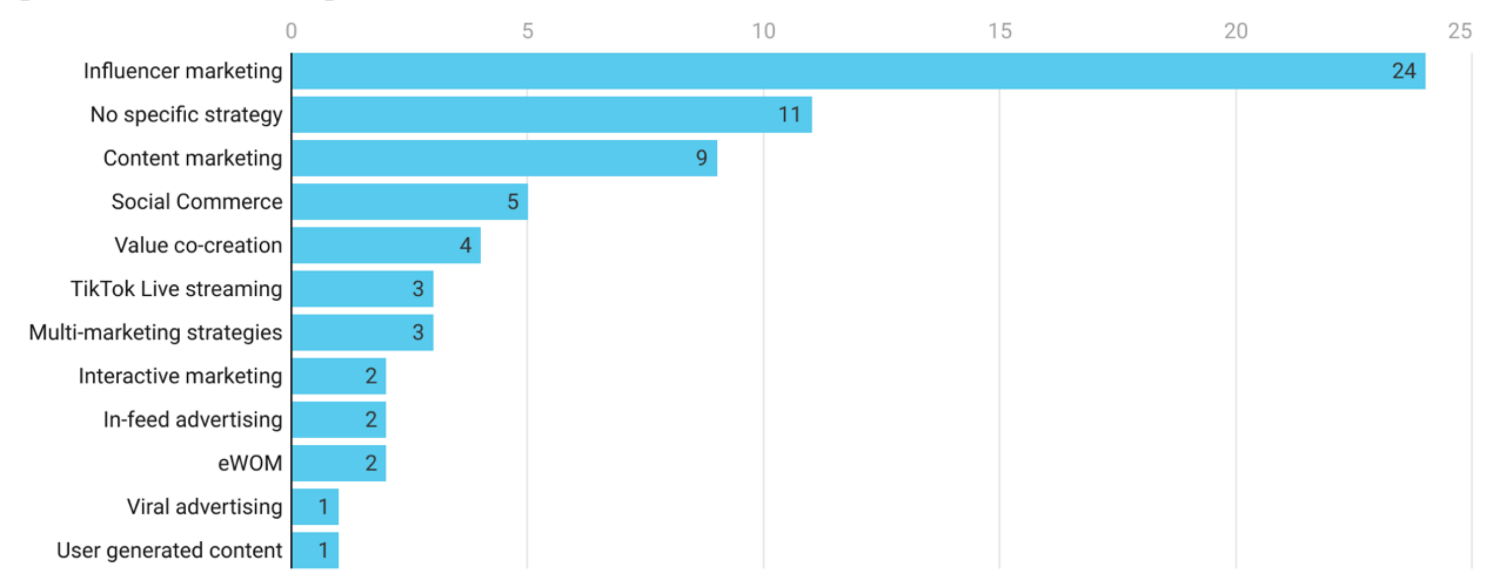
Dominant Research Themes
40%
18.3 %
15 %
8.3%
6.7%
5%
5%
3.3%
3.3%
3.3%
1.7%
1.7%
Figure 5. Frequency of occurrence of marketing strategies
Influencer Marketing is the most dominant theme, with 24 out of 60 articles focusing on this topic.
Other marketing approaches, such as content marketing strategies and data-driven personalization, are significantly underexplored.

Slide 11
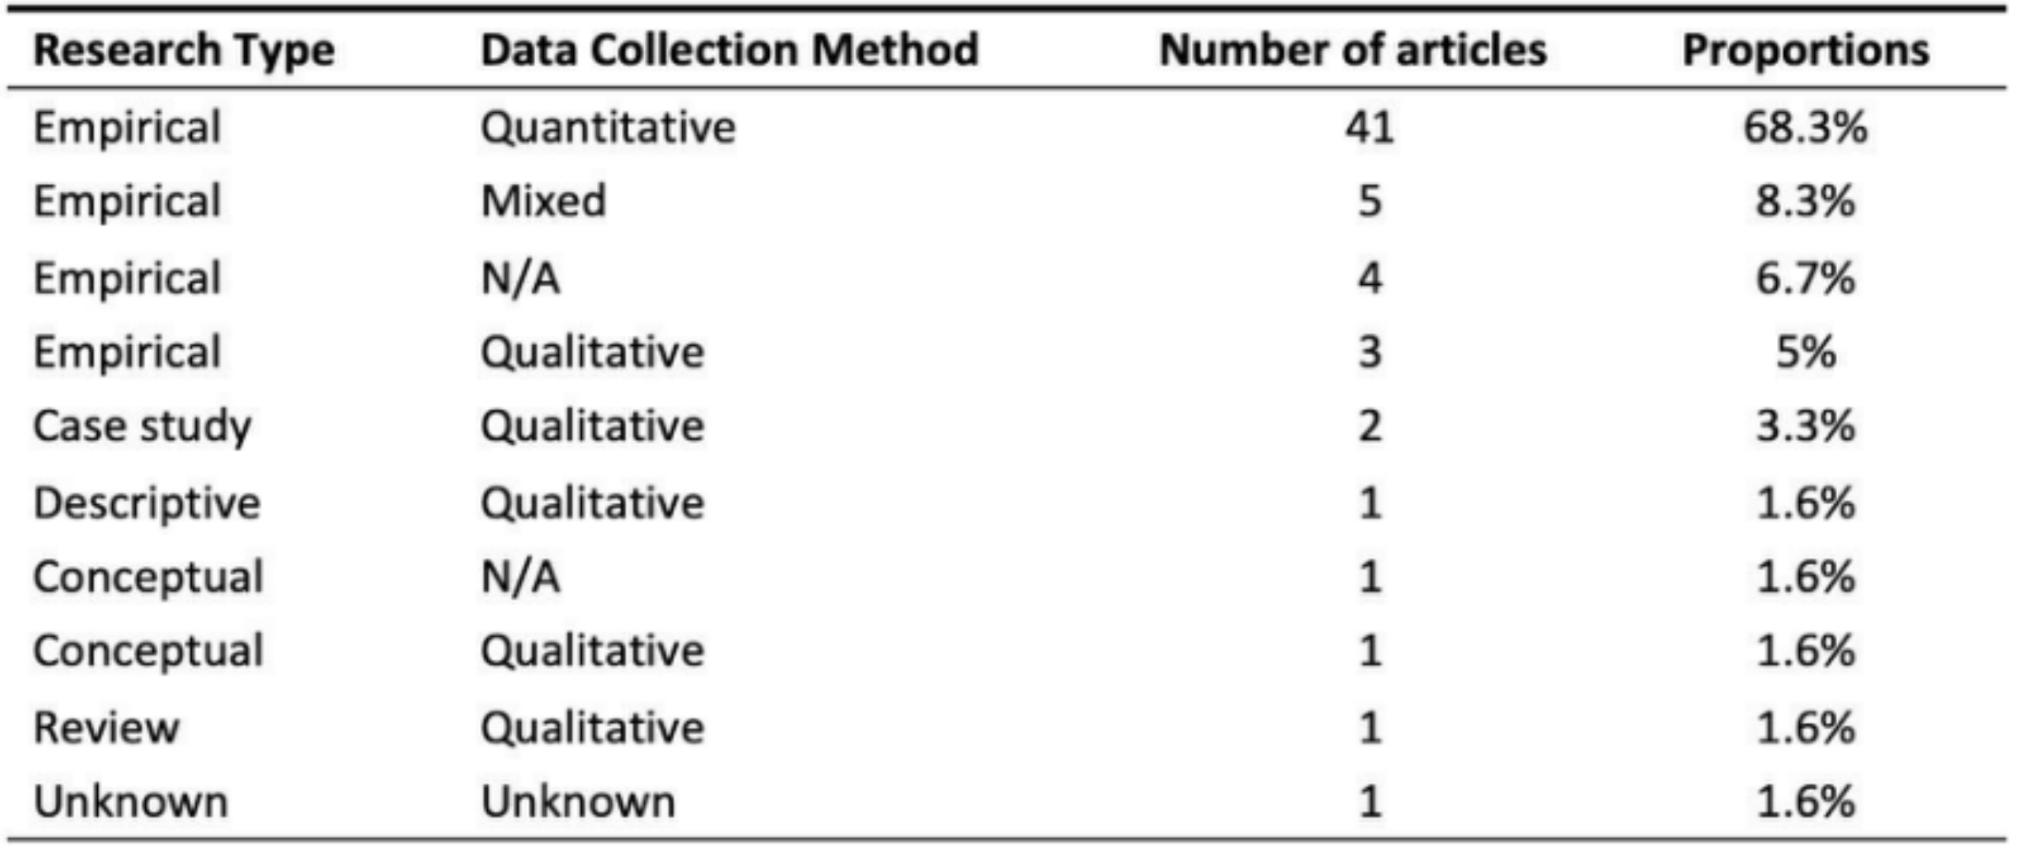
Methodological & Theoretical Gaps
Methodological Trends:
Quantitative methods dominate (68.3%), especially surveys and field experiments.
Qualitative (5%) and mixed methods (8.3%) are underutilized.
Theoretical Trends:
Uses and Gratifications Theory (UGT) and Elaboration Likelihood Model (ELM) are core frameworks.
Their application remains fragmented and underdeveloped.
Table 2: Research types and data collection method of articles

Slide 12
Discussions of key findings
Theoretical :
Lack of theoretical framework integration.
Traditional models fail to capture the fast-paced, emotionally engaging nature of TikTok.
Requires a reconceptualization of persuasion mechanisms.
Practical :
Scarcity of cross-platform and cross-country comparative analyses.
Overreliance on quantitative methods, which miss emotional and cultural drivers.
Narrow concentration of research in specific industries (e.g., fashion).

Slide 13
Future Research Agenda
Dimension | Research Question | Proposed Research Directions
Geographical Gaps | How do marketing dynamics operate in under-researched emerging markets? | Ethnographic studies of platform adoption in emerging markets like West Asia and North Africa (WANA) and African contexts
Cross-cultural Studies | What cross-platform and cross-cultural variation exist? | Comparative qualitative analysis of user engagement across platform (e.g., TikTok/Instagram Reels) in cross-cultural contents
User segmentation | How to further specify user engagement of TikTok? | Conduct a qualitative follow-up of pre-identified users who engage with algorithmic recommendations and who are keen followers.
Platform Features Focus | How do features like duets and hashtag challenges shape marketing outcomes? | Investigate how platform features and user-generated content drive engagement and trust.
Measurement Bias | How can we capture the emotional and cognitive drivers behind TikTok marketing engagement? | User qualitative methods to explore psychological factors influencing user behaviour
Ethical considerations | What are the ethical implications of TikTok marketing effectiveness? | Investigation of ethical considerations (e.g., appearance anxiety) through practitioner interviews and user focus groups
Integrated theoretical framework | How do TikTok’s algorithmic features impact users’ decision and behaviour? | Exploring the conceptual framework and integrated theoretical framework for investigating user behaviour within the specific context of short video algorithm recommendation mechanisms

Slide 14
Expected contributions
Academic Contribution:
Conducts a structured and multi-method literature review.
Identifies key research patterns, knowledge gaps, and an essential starting point for future research.
Practical contributions
Summarise and synthesise research trends and landscapes for practitioners and researchers in social media marketing, laying the groundwork for future innovation in the industry's TikTok/ marketing strategies.

Slide 15
Conclusion
Future research should treat TikTok as a space with its own unique cultural practices and user behaviors.
This requires a deeper understanding of how content spreads, how value is co-created, and how persuasion operates in peer-driven environments.

Slide 16
Reference
Ceci, L. (2024). Number of TikTok users worldwide from 2020 to 2025. [online] Statista. Available at: https://www.statista.com/statistics/1327116/number-of-global-tiktok-users/.
Ma, R. 2022. China’s livestream shopping craze hits a ceiling. Rest of World. [Online]. Available from: https://restofworld.org/2022/tiktok-e-commerce-shift-china/.
Smith, A. and Anderson, M. (2023) Social Media Use in 2023. Pew Research Center. Available at: https://www.pewresearch.org [Accessed 03 February 2025].
Zhang, Y. and Mao, Y. (2023) ‘TikTok Marketing and Consumer Purchase Intention: The Mediating Role of User Engagement’, Journal of Retailing and Consumer Services, 72, p. 103230. doi:10.1016/j.jretconser.2023.103230.

Slide 17
Thanks for listening! Any questions?
Presenter Contact:
Jiazheng Nie
E-mail Address: sdjn@leeds.ac.uk

