Slide 1
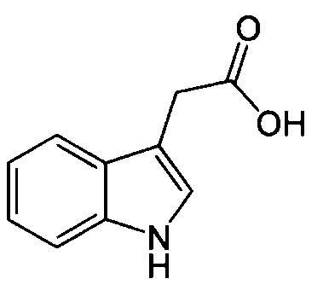
Degraded Aux/IAA
- Intrinsic developmental cues
- Extrinsic environmental stimuli
(light, temperature, pathogen attack
etc.)
Auxin
Class B
ARF
Aux/IAA
Degraded Class B ARF
Class A
ARF
AuxRE
Auxin-responsive gene
Figure 1. Class A and B Auxin Response Factors (ARFs) can compete for binding to auxin response elements (AuxRE) in the promoters of auxin responsive genes. AuxRE-bound class B ARFs repress transcription while class A ARFs typically activate transcription, unless they are bound by Aux/IAA transcriptional co-repressor proteins. Aux/IAAs are degraded in response to auxin in a dose-dependent manner, allowing class A ARFs to promote transcription.

