Slide 1
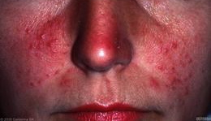
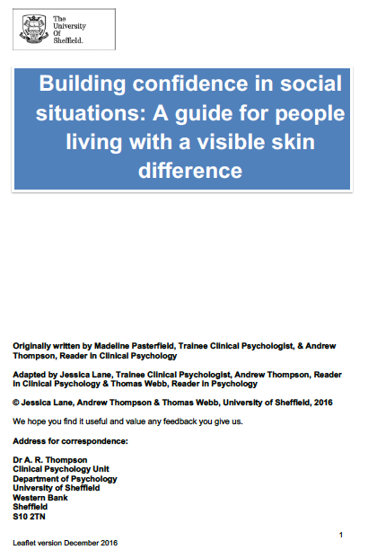
Enhancing self-help with implementation intentions for individuals with visible skin conditions Jessica Lane, Thomas Webb, & Andrew R Thompson* The University of Sheffield, United Kingdom *a.r.thompson@sheffield.ac.uk @DrARThompson
Introduction and Aim
People with visible skin conditions commonly fear being negatively evaluated by others during social interactions. Online self-help interventions tailored to this population may be beneficial; however, the effectiveness of such materials can be limited by failure to undertake recommended exercises or deploy learned techniques. The present research aimed to examine the effectiveness of a self-help intervention incorporating implementation intentions (II) designed to promote the use of the materials.
What are implementation intentions (IIs)?
IIs are ‘if-then’ plans that connect opportunities to act with cognitive or behavioural responses that are effective in achieving one’s goals. To form an II, the individual must (i) identify the response that that will promote goal attainment and, (ii) anticipate an appropriate occasion in which to initiate that response. A meta-analysis of 94 studies be Gollwitzer and Sheeran (2006) indicated that IIs had a medium-to-large effect (d = 0.65).
Method
326 individuals who reported lowered confidence due to their skin condition were recruited online through skin charities and organisations predominantly through social media. Participants completed questionnaires measuring fear of negative evaluation (Brief Fear of Negative Evaluation Scale –II; BFNE-II, Carleton, Collimore, Asmundson, 2007), symptoms of anxiety (GAD-7, Spitzer, Kroenke, Williams, & Löwe, 2006) and depression (PHQ-9, Kroenke, Spitzer, & Williams, 2001). Participants were then randomly assigned to one of three conditions:
Standard condition: received CBT-based self-help
Enhanced condition: received CBT based self-help enhanced throughout with implementation intentions
Wait-list control group: did not receive self-help.
The self-help was delivered as a PDF document and consisted of an introduction and five sections:
1. Understanding why people worry about their appearance and how loss of social confidence develops
2. Beginning to change unhelpful thoughts
3. Breathing and relaxation
4. Tackling avoidance
5. Dealing with comments and negative reactions from others
Results
Participants were predominantly female (80.06%), White British (61.04%) and single (43.56%). The mean age was 35.
Skin conditions reported by participants were alopecia (24.85%), psoriasis (14.72%), eczema (13.80%), vitiligo (10.43%), acne (5.21%), birth mark (3.07%), scarring (2.45%), rosacea (0.92%), ichthyosis (0.92%), two or more (18.40%), other (5.21%).
In total, 157 of the 326 participants (48.16%) completed the follow up survey.
Participants scores at baseline gave an indication of clinically significant levels of social anxiety, mild symptoms of generalised anxiety, and moderate symptoms of depression.
A series of ANCOVAs controlling for baseline scores indicated no significant difference between the standard, enhanced and control groups on outcome measures at four week follow up despite positive feedback from the participants who received the self-help intervention. There was no significant effect of condition on fear of negative evaluation (F(2,322) = .29, p = .745), symptoms of anxiety (F(2,322) = .35, p = .706) or depression (F(2,322) = .09, p = .912).
Conclusions
In contrast to our previous research (Shah et al., 2014), the findings suggest (i) the self-help materials were not effective at reducing fear of negative evaluation, anxiety or depression and (ii) IIs did not promote the use of these materials.
Points for dermatology practice
Routinely assess for psychosocial distress in the visible skin condition population. Consider using measures of social anxiety to aid assessment, such as the Brief Fear of Negative Evaluation Scale II (BFNE-II).
Consider offering guided self-help or consider referral for psycho-education groups, one to one therapy or applied relaxation as required (Lavda et al., 2012).
The present study did not objectively measure, and thus control for, changes in skin conditions which may have impacted on results.
The present study is also limited by a high level of participant attrition and warrants replication.
Select references
Carleton, R. N., Collimore, K. C., & Asmundson, G. J. G. (2007). Social anxiety and fear of negative evaluation: Construct validity of the BFNE-II. Journal of Anxiety Disorders, 21, 131-141. doi:10.1016/j.janxdis.2006.03.010
Gollwitzer P. M., & Sheeran, P. (2006). Implementation intentions and goal achievement: A meta-analysis of effects and processes. Advances in Experimental Social Psychology, 38, 69-119. doi:10.1016/s0065- 2601(06)38002-1
Kroenke, K., Spitzer, R. L., & Williams, J. B. W. (2001). The PHQ-9: Validity of a brief depression severity measure. Journal of General Internal Medicine, 16, 606-613. doi:10.1046/j.1525-1497.2001.016009606.x
Lavda, A., Webb, T., & Thompson, A. (2012). The effectiveness of psychological interventions for adults with skin conditions: A meta-analysis. British Journal of Dermatology. 167, 970-979 DOI: 10.1111/j.1365-2133.2012.11183.x
Shah, R., Hunt, J., Webb, T., Thompson (2014). Starting to develop self-help for social anxiety associated with vitiligo: Using clinical significance to measure the potential effectiveness of enhanced psychological self-help. British Journal of Dermatology, 171, 332-337. DOI: 10.1111/bjd.12990
Spitzer, R. L., Kroenke, K., Williams, J. B. W., & Löwe, B. (2006). A brief measure for assessing generalized anxiety disorder. Archives of Internal Medicine, 166, 1092-1097. doi:10.1001/archinte.166.10.1092

