Slide 1
Yanbian in the Great Leap Forward
Adam Cathcart, University of Leeds

Slide 3
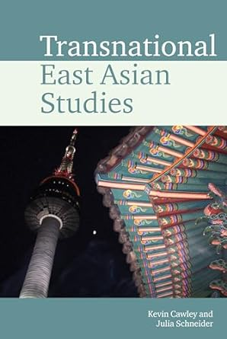
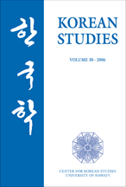
Preliminary Works
Part 1
Part 2
(2010). “Nationalism and Ethnic Identity in the Sino-Korean Border Region of Yanbian, 1945-1950,” Korean Studies, Vol. 34 (December) 25-53.
(2023). “From Liberation to the Great Leap Forward: Ethnic Koreans and Assimilation in Northeast China, 1945-1962,” in Kevin Cawley and Julia Schneider, eds., Transnational East Asian Studies (Liverpool University Press, 2023), 255-269.

Slide 5
1957-1965
Anti-Rightist campaign, 1957
Great Leap Forward, 1958
Anti-Local Nationalism campaign, 1959
Hunger and Floods, 1960
The Empty Year, 1961
Rebalancing / Correcting, 1962-1965

Slide 6
Questions
1. What are we missing in the recent wave of Korean Studies treatments of the topic?
2. What can be gained from a closer focus on the topic via the prism of studies of Maoist China?
3. To what extent did cross-border movement of foodstuffs and people from or into North Korea mitigate hunger in Yanbian?
4. On what evidentiary basis can further work be done?

Slide 7
Korean Studies and the Great Leap
Hyun Ok Park, Jaeeun Kim, Miya Qiong Xie, Dong Jo Shin

Slide 8
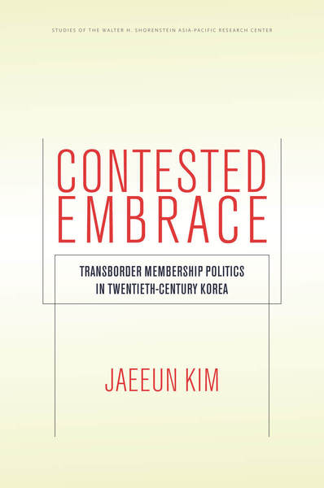
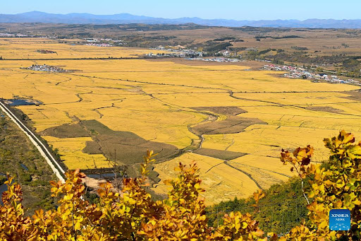
Jaeeun Kim Korea Foundation Endowed Associate Professor of Sociology, University of Michigan
University of Michigan (Korea Foundation Endowed Associate Professor of Sociology)

Slide 9
Hyun Ok Park Professor of Sociology, York University (Toronto)
University of Michigan (Korea Foundation Endowed Associate Professor of Sociology)

Slide 10
Dong Jo Shin Assistant Professor of History, College of St. Rose (Albany, New York)
Revised dissertation (Central Washington University, 2018) under review: The Cultural Enemy to Socialism: The Ethnic Koreans in Mao’s China

Slide 11
The Great Leap in Yanbian reflected Maoist ideology, economic improvisation, and ethnic assimilation.
For centre/periphery discussion, see David Goodman, Chris Bramall,

Slide 12
“The great Chinese famine did not kill, proportionally, more minority than Han people.”
Lucian Bianco (2021). “The 1958-62 Chinese Famine and Its Impact on Ethnic Minorities.” East/West: Journal of Ukrainian Studies Vol. 8, No. 1, 173-191.

Slide 13
Frank Dikotter, Yang Jisheng, Felix Wemheuer

Slide 14
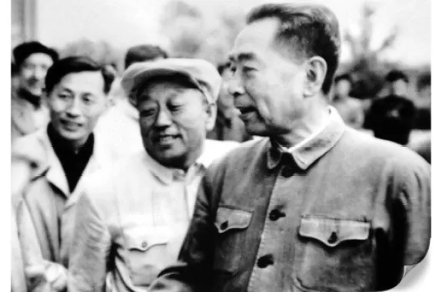
Zhu Dehai / Chu Dok-hae

Slide 15
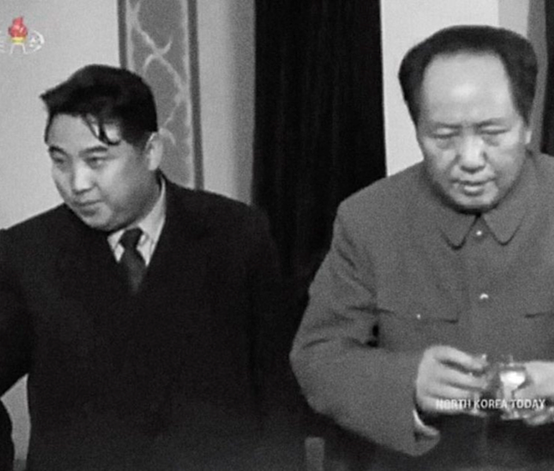
Cross-Border Trade, Aid, and Movement
National Level
Provincial/Local
Subtitle
. Kim Il Sung in Beijing, November 1958
Chinese People’s Volunteers in DPRK until March 1958
Trade agreements
Foreign Ministry delegations
Trade agreements renegotiated annually
Yanbian and North Hamgyong
Changbai and Hyesan/Ryanggang
Ji’an and Kanggye/Jagang
Open the Design Ideas pane for instant slide makeovers.
When we have design ideas, we’ll show them to you right there.

Slide 16
Future Sources
-County-level Wenshi Ziliao
-Yanbian Chaoxianzu zizhizhou zhi [延边朝鲜族自治州志
-Riwi Alley, China’s Hinterland

