Slide 1
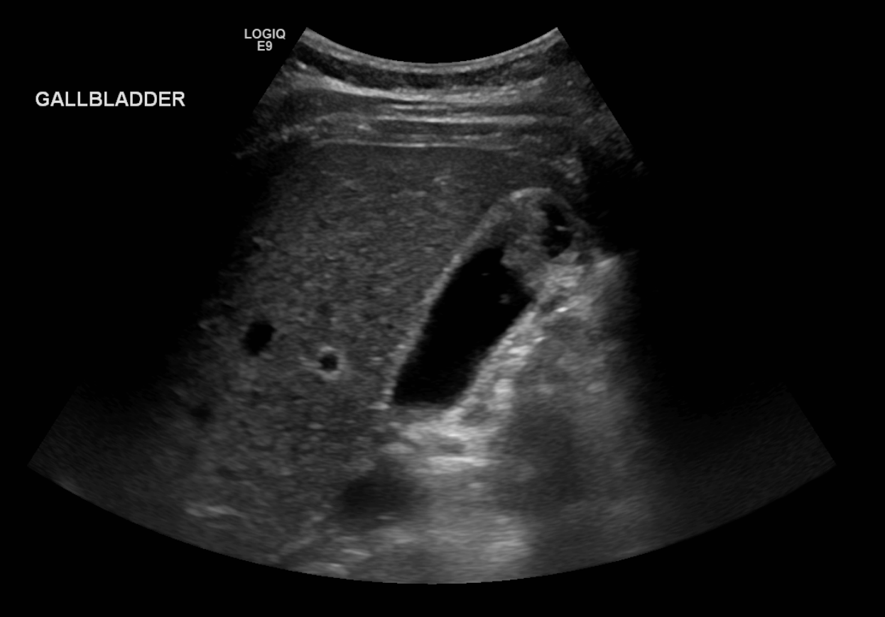
May 2024
An audit of the adequacy of gallbladder surveillance in PSC at our institution: are we following the guideline and what were our findings?
Samantha Buelu, Sophie Curran, Dr Katie Hoyles, Prof Dermot Gleeson, Dr Benjamin Rea
Presented by Samantha Buelu
Department of Clinical Radiology, Sheffield Teaching Hospitals, Sheffield UK
Notes:
Thank you. Good morning everyone. My name is Samantha Buelu, I am a final year student soon to start working as a doctor in Sheffield UK and today I will be presenting the results of our audit on gallbladder surveillance adequacy in patients with Primary Sclerosing Cholangitis, or PSC, at our institution. – Sheffield teaching hospitals.

Slide 2
CCA = cholangiocarcinoma
HCC = hepatocellular carcinoma
INTRODUCTION
Primary Sclerosing Cholangitis (PSC) is a chronic inflammatory condition that impacts bile ducts, causing scarring of the tissue and narrowing of the ducts.
This increases the likelihood of developing hepatobiliary cancers, including CCA, HCC, and gallbladder cancer.
Malignancy is the leading cause of mortality in this population
Therefore, the BSG recommends 12 monthly ultrasound surveillance of the gallbladder to look for gallbladder polyps
1 Venkatesh et al. Eur Radiol. 32(2): 923-937, 2022
Notes:
Primary Sclerosing Cholangitis is a chronic inflammatory disease that affects the bile ducts, leading to scarring and narrowing of these ducts. This condition significantly increases the risk of hepatobiliary cancers, including cholangiocarcinoma (CCA), hepatocellular carcinoma (HCC), and gallbladder cancer. Malignancy is the leading cause of mortality among PSC patients.""Given these risks, the British Society of Gastroenterology (BSG) recommends annual ultrasound surveillance of the gallbladder to detect polyps, which can be a precursor to cancer

Slide 3
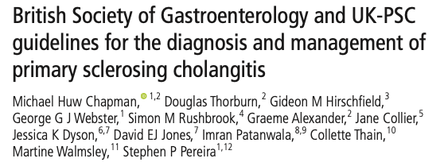
PURPOSE
Audit US surveillance of target population adherence
Review findings
Review histology of removed polyps, and cholecystectomies performed for other purposes
Notes:
The main objectives of our audit were to evaluate whether we are adhering to the recommended annual ultrasound surveillance for PSC patients and to review the findings of these scans. We also aimed to examine the histological outcomes of any polyps that were removed, as well as cholecystectomies performed for other reasons.
As you can see, according to the British Society of Gastroenterology written by Michael Chapman et al. It is recommended for US of the gallbladder should be performed in patients with PSC if polyps are identified this should be escalated and investigated further.

Slide 4
Methods
Data Collection
138 Patients
Polyps
2012-2022
Cholecystectomies
Annual Ultrasound – NOT MRCP
Histology Reports
Chapman MH, Thorburn D, Hirschfield GM, et al. Gut 2019;68:1356–1378.
Notes:
138 patients were identified from our PSC database. Their US surveillance rate between 2012-2022 was assessed against our standard that all patients should have an annual US of the gallbladder (100%). Cross sectional imaging including MRCP was deemed unsuitable for gallbladder surveillance and was excluded. The presence of polyps and their size was noted, and any cholecystectomies and subsequent histology reports were recorded.
References for table = BSG guidelines

Slide 5
RESULTS
The percentage of the population scanned showed a positive trend over the 10-year timespan (mean=66.1%, median=68.4% (27.6%-90.2%)).
9.4%
Only 13 patients (9.4%) had regular and complete annual surveillance (one US per year if eligible).
41.3%
Of all scans that should have been performed over the 10 years for all patients, 41.3% were conducted.
Notes:
Our data shows a positive trend in the percentage of patients receiving annual ultrasound scans over the 10-year period, with an average surveillance rate of 66.1%.
However, only 13 patients, or 9.4%, had complete annual surveillance as recommended.
Of all scans that should have been performed over the decade for all patients, 41.3% were conducted.

Slide 6
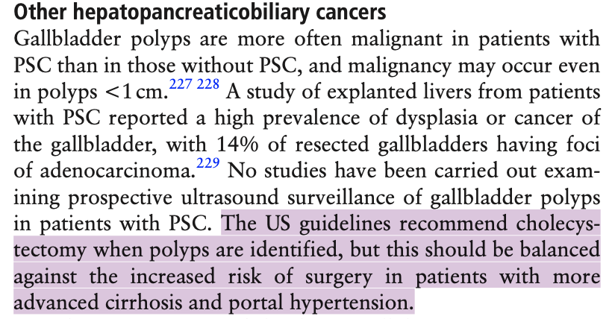
RESULTS
7 POLYPS
4 Cholecystectomies (10-30mm) | 3 not removed (4-7mm)
3 = adenocarcinomas 1 = High Grade Dysplasia
Mean = 17.3mm Median 14.5mm | Mean = 4.7mm Median = 5mm
25
Cholecystectomies
Predominately for Liver Transplantation (n=14)
Or Benign Pathology e.g. gallstone disease.
Chapman MH, Thorburn D, Hirschfield GM, et al. Gut 2019;68:1356–1378.
Notes:
We identified seven polyps in total, with four being removed. All excised polyps had significant histological findings, including three cases of adenocarcinoma and one case of high-grade dysplasia.
The mean size of these polyps were 17.3mm with the range being 10-30mm.
25 other choleysectomies were perfomed, 14 for liver transplantation or benign pathology e.g. gallstone disease
Sort animarion

Slide 7
Limitations
Small Population
Small Sample
Radiology Reports
Our database only had 138 patients; This may potentially limit the generalizability of the findings
With only 7 polyps detected and only 4 resected, it may limit the ability to draw conclusions
Gallstone identified on US were not reviewed in case of misdiagnosis
Notes:
Our audit had several limitations. Firstly, the relatively small sample size of 138 patients may limit the generalizability of our findings. Additionally, the small number of detected polyps m. Lastly, the records on cholecystectomies lacked detail, which may have impacted our results. –
No imaging review – gallstones identified on US were not reviewed in case of misdiagnosis

Slide 8
Discussions
All polyps excised had significant findings
2 polyps lost to follow up
1 incorrectly discharged
Surveillance has improved over the years
Increased awareness of the guidelines?
MR vs US
Cholecystectomies
Improvement
Practice varies
- MR
Polyps
All 25 cholecystectomies showed no incidental polyps
- Histopathology macroscopic inspection
Notes:
Space the points out
2, Practise between different clinicians vary and not everyone may stick to that which is recommended by BSG. Some clinicians use MR as a mode of surveillance for gallbladder polyps.
3. All polyps excised had significant findings –although I mentioned hard to draw conclusion on previous slide - still worth noting 4 had high dysplasia or malignancy.
2 polyps lost to follow up
1 incorrect advise given – 1 person was incorrectly discharged from surveillance
4. All 25 cholecystectomies performed for benign pathology showed no significant findings –For patients who had cholecystectomy for transplantation, histology reports often lacked extensive deatil and said no gross abnormality. However after speaking to the histolpathologists we were informed they do a macroscopic inspection of removed gallbladders, and would comment on any polyps identified so we are confident no extra polyps were missed.

Slide 9
Conclusion
Improved Surveillance
Although the percentage of scans has improved annually,
With only 41.3% of scans having been performed, the surveillance of gallbladder polyps remains suboptimal.
Polyps
Over 10 years, 7 patients (5%) developed gallbladder polyps and of the four removed, all showed malignancy.
Notes:
- Make bigger
In conclusion, while there has been an improvement in surveillance, the adherence to the recommended annual ultrasound scans remains inadequate. This underscores the need for better compliance to improve early detection and management of gallbladder polyps in PSC patients.

Slide 10
Thank You
RSMUNYEBVU1@SHEFFIELD.AC.UK

