Slide 1





Mapping the Archive:
Investigating the Value of UK Higher Education
Fashion and Textile Collections
Professor Amanda Briggs-Goode, Nottingham Trent University, UK
Professor Andrew Groves, University of Westminster, London, UK
Dr Kevin Almond, University of Leeds, UK
Dr Helena Britt, The Glasgow School of Art, Glasgow, UK

Slide 2
There are, at the time of writing, over twenty colleges in Britain which offer degree-level courses in textile design or technology. Many have collections of original material which serve to inform the history of the practice…The collections can be divided broadly into two categories: those which were consciously sought to serve the needs of a course and those which exist as a result of bequests and gifts, often from a range of sources. The first category is the smallest as few courses have had the time, less so the finance, to enable them to establish or pursue coherent collecting policies…
Clarke, H. (1988) Textile Collections in British Colleges, Journal of Design History, 1(1): 73-74.
Notes:
- Uniqueness of archives and collections in higher education
- Change of position, change of education since 1988 – HE landscape in UK has change dramatically – fees, increasing student numbers, time and funding for creative education subjects in schools, government policy towards STEM.

Slide 3
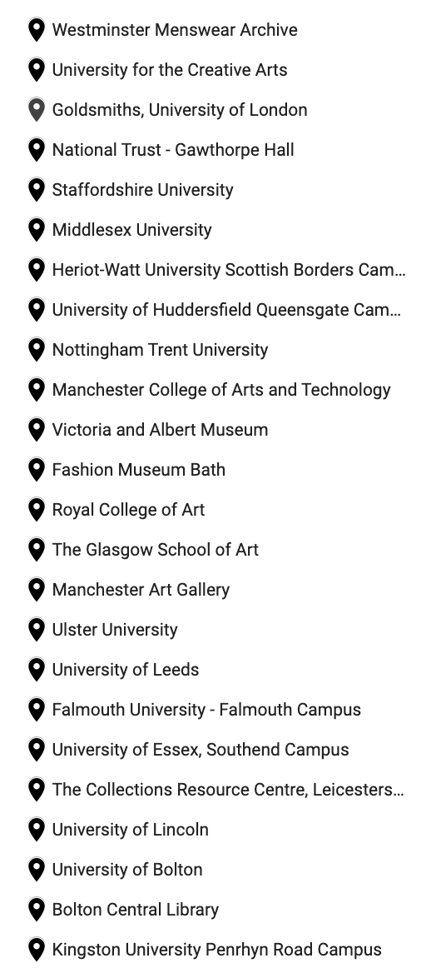
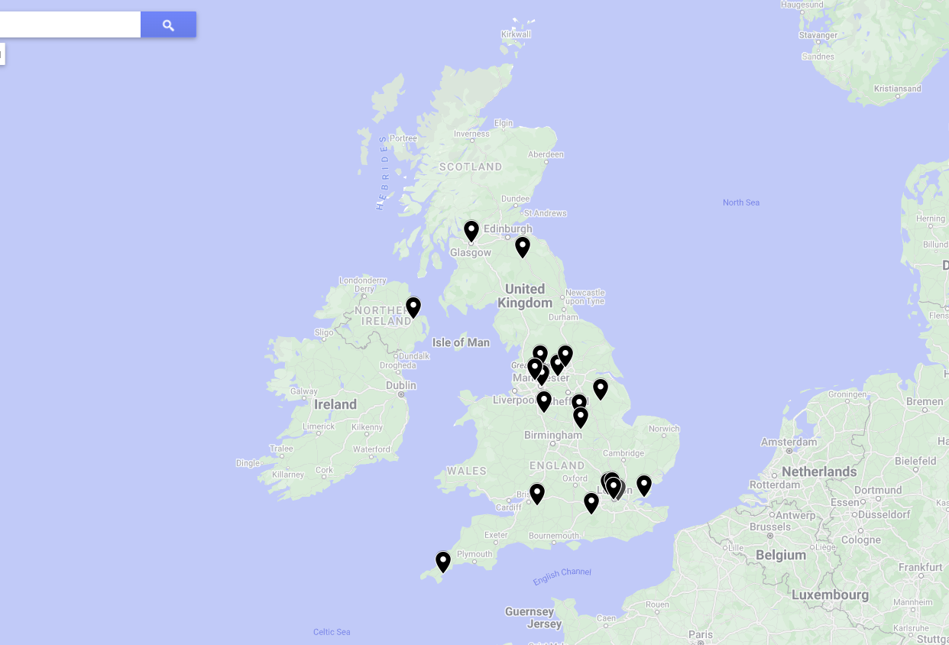
Mapping UK Higher Education Fashion and Textile Collections 2023
Notes:
- this is where we are now. Research assistant compiled a list as a first scoping exercise – this is not an exhaustive list.
- outline mapping exercise - collections there location and relationship to HEI can be problematic to work out through purely online searching?
- Collections are starting to fold? MODA (including Silver Studio)
- Brighton Archive

Slide 4
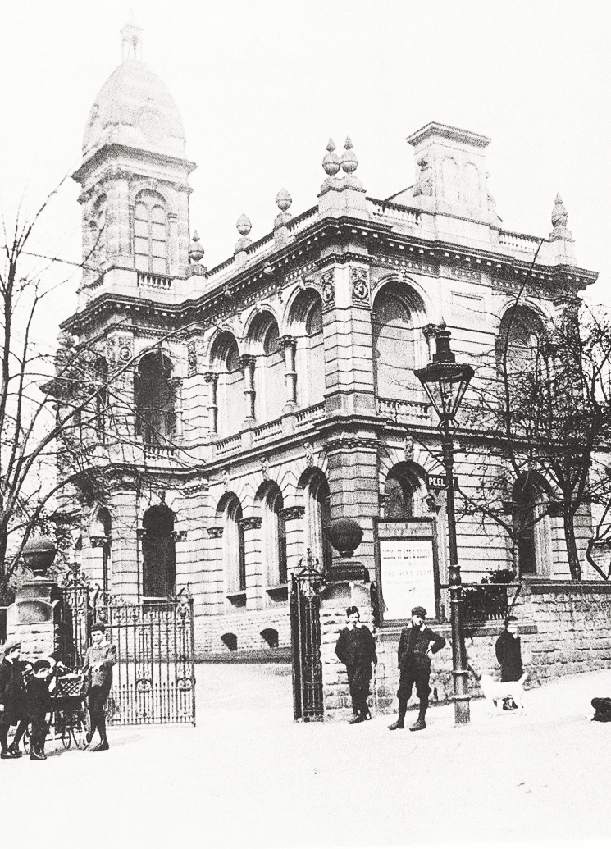
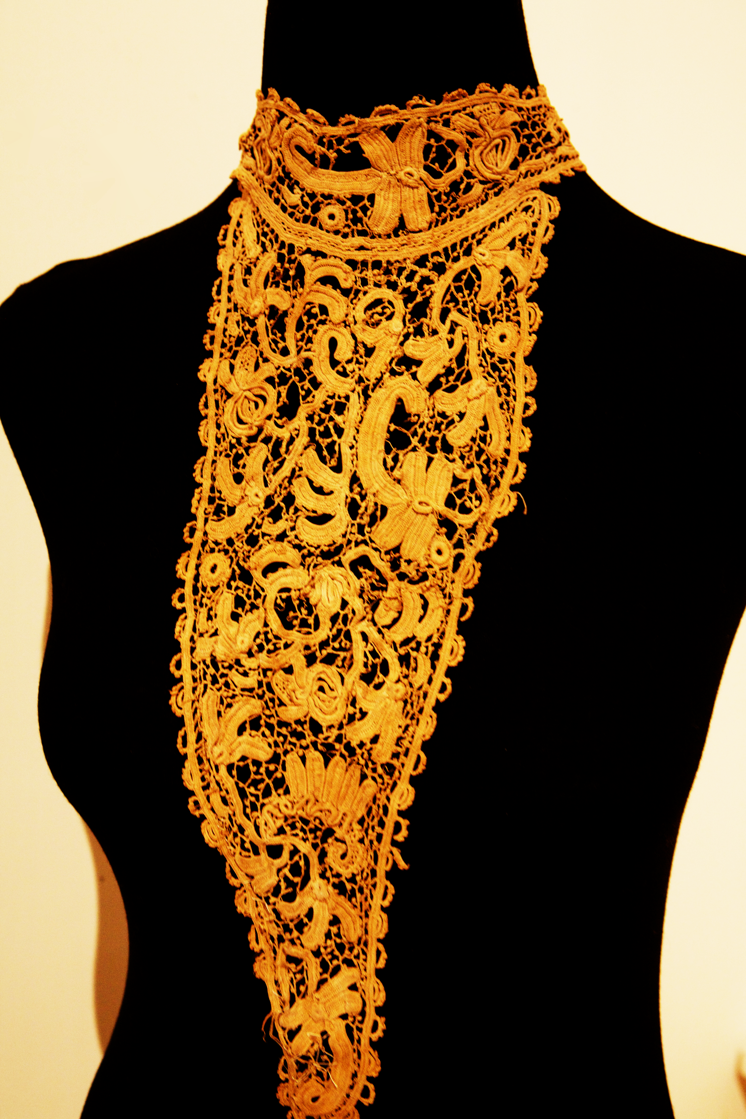
Nottingham Trent University Lace Archive
Established as a teaching collection with the beginnings of the Art School in Nottingham in 1843
Result of donations from local lace manufacturers until circa 1940s
75,000 items – lace, sample books, portfolios, designs, garments, photographs, books, business records, reports, student work
A teaching resource accessible by students from across the globe – NTU, UK-wide, Brazil, US, France, China and others
As a resource for national and international researchers
Community engagement and local heritage
Commercial practice

Slide 5


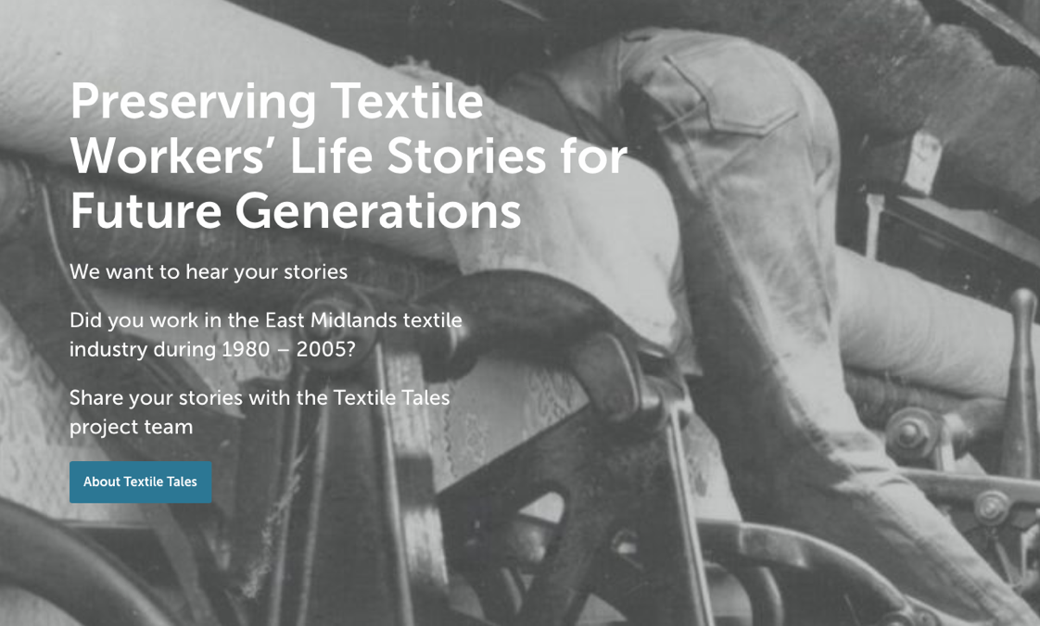
Nottingham Trent University Lace Archive
Outputs:
Nottingham Lace: Stories of Industrial Decline and Textile Heritage, Architecture, Media, Politics and Society
Lace Legacies: How partnerships enhance understanding of craft and heritage, Craft Research Journal: Intellect
Principles and Pilfering, Textile: The Journal of Cloth and Culture, Taylor and Francis. Vol 17, Issue 11
Lace, Archives and The Body, in Crafting Anatomies, Bloomsbury
PhDs:
5 PhDs (3 completions/ 2 currently active) Art practice, Women’s design education, De-industrialization, Decolonization
Community Engagement:
Textile Tales an oral history funded project (Heritage Lottery Fund)
Lace Unarchived Exhibition
Lace: Here: Now
Commercial Activities:
5 year relationship with an international textile/garment manufacturer
UK high street retailer collection - Oasis

Slide 6
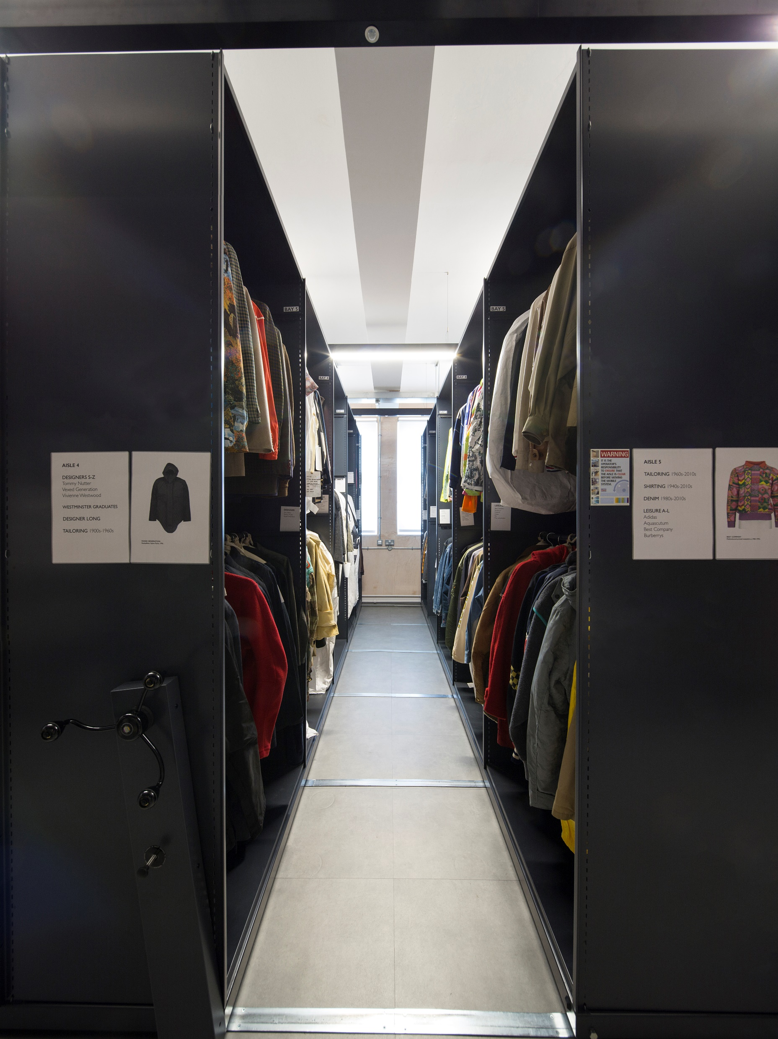
Established: 2016
Collection held by the University of Westminster, London.
Content: Menswear from 1750 to present day, but primarily 20th and 21st century
A non-hieratical collection policy mixing, everyday dress, uniforms, utilitarian and designer clothing.
Access: Open access for students nationally, fees apply to industry
Funding: University of Westminster and industry hire of garments

Slide 7
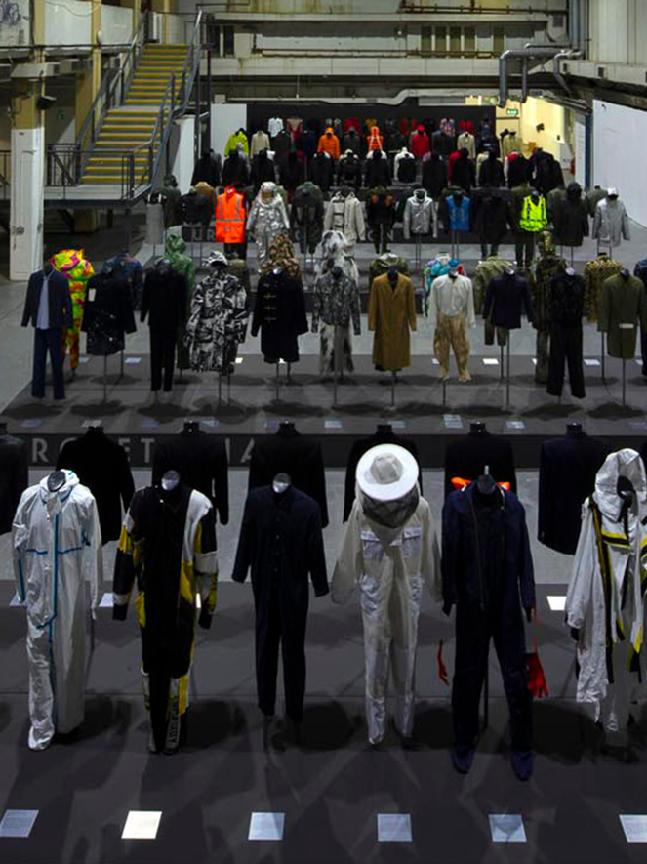
Impact
Addressing a substantial gap in fashion history
1,319 hours of in-person contact and teaching and 1,150 visitors in 2022/23.
Invisible Men exhibition (2019) largest exhibition of menswear to have been staged in the UK
Loans to other exhibitions including Dandy Style (2022), Manchester; C.P. Company Cinquanta (2022), Milan; Tartan (2023), V&A Dundee; Workwear (2023), Nieuwe Instituut, Rotterdam; Fashion City. Museum of London (2023)

Slide 8
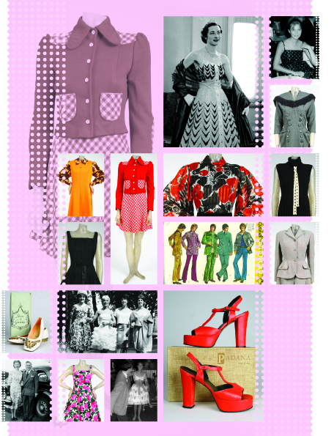

The Yorkshire Fashion Archive is used:
As a resource for teaching.
To engage with local and wider communities through exhibitions and talks.
For academic and professional research.
The collection is made up of mainly 20th Century clothing and accessories, but we also collect photographs, oral histories and reminiscences about Yorkshire life in the 20th century.
The YFA has a large percentage of womenswear (approximately 90%), but also some menswear and childrenswear.

Slide 9
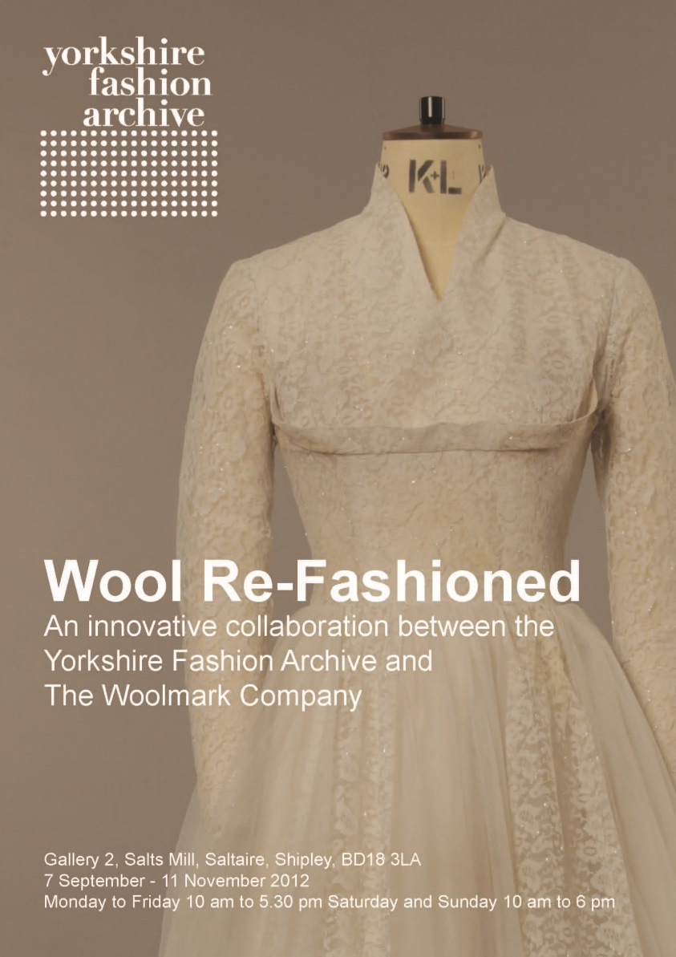
Impact
- Yorkshire Fashion Archive is one of three important archives at University of Leeds utilised as a teaching and research resource by the international fashion industry and education. The other archives are University of Leeds Textile Archive and Marks and Spencer Archive.
- Used as major case study in two PhD programmes as well as in other PhD and research projects.
- Used as a case study disseminating research findings in a variety of publications in international journals including: Catwalk: The Journal of Fashion, Beauty and Style; Fashion Practice: The Journal of Design, Creative Practice and the Fashion Industry; Costume – The Journal of the Costume Society; Uniarte Grafica, S.A.; Art Libraries Journal.
- Wool Re-Fashioned a collaborative exhibition between the Yorkshire Fashion Archive and The Woolmark Company, 2012 - Received the largest number of visits to an exhibition at Salts Mill.
- A unique record of fashion in Yorkshire that documents the social history of the region through items manufactured by dressmakers and industry.
- Accessible to members of the general public.

Slide 10
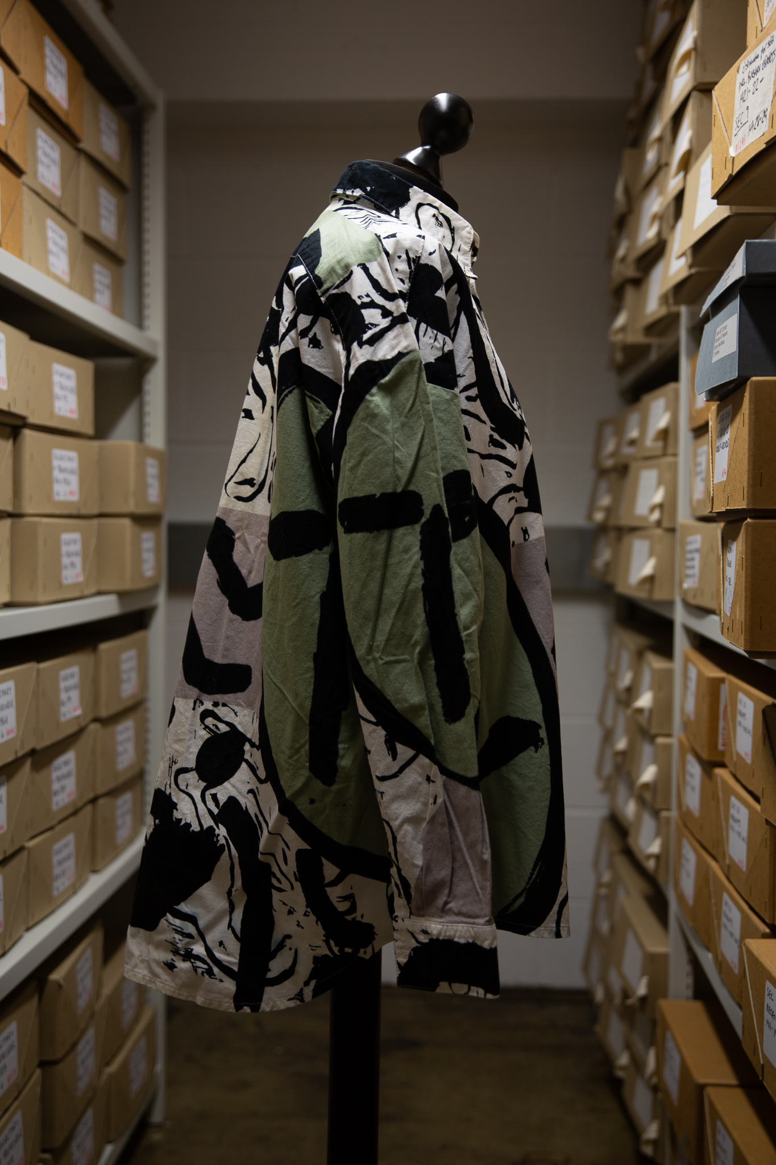

GSA’s Archives and Collections – contain wide range of items connected to the history of the School, its activities, students and staff.
GSA Archives and Collections are located off-campus at The Whisky Bond.
This resource has a bookable search room used as a teaching resource; accessed by staff, students, researchers, public and other groups.
Within the GSA archive, examples of textile collections include the Needlework Development Scheme, Sylvia Chalmers, Stoddard Templeton carpets, Records of Donald Brothers, Textiles and Papers of Fraser Taylor.
Taylor’s collection is largest related to an individual, approx. 560 items including textiles, garments sketchbooks, design work, photos, ephemera.
Donated by Taylor in 2014 when he returned from the USA to the UK.
The collection represents Taylor’s time as student at GSA (1977-1981), and at the Royal College of Art (1981-1983) and as part of the creative collective, The Cloth (1983-1987).

Slide 11
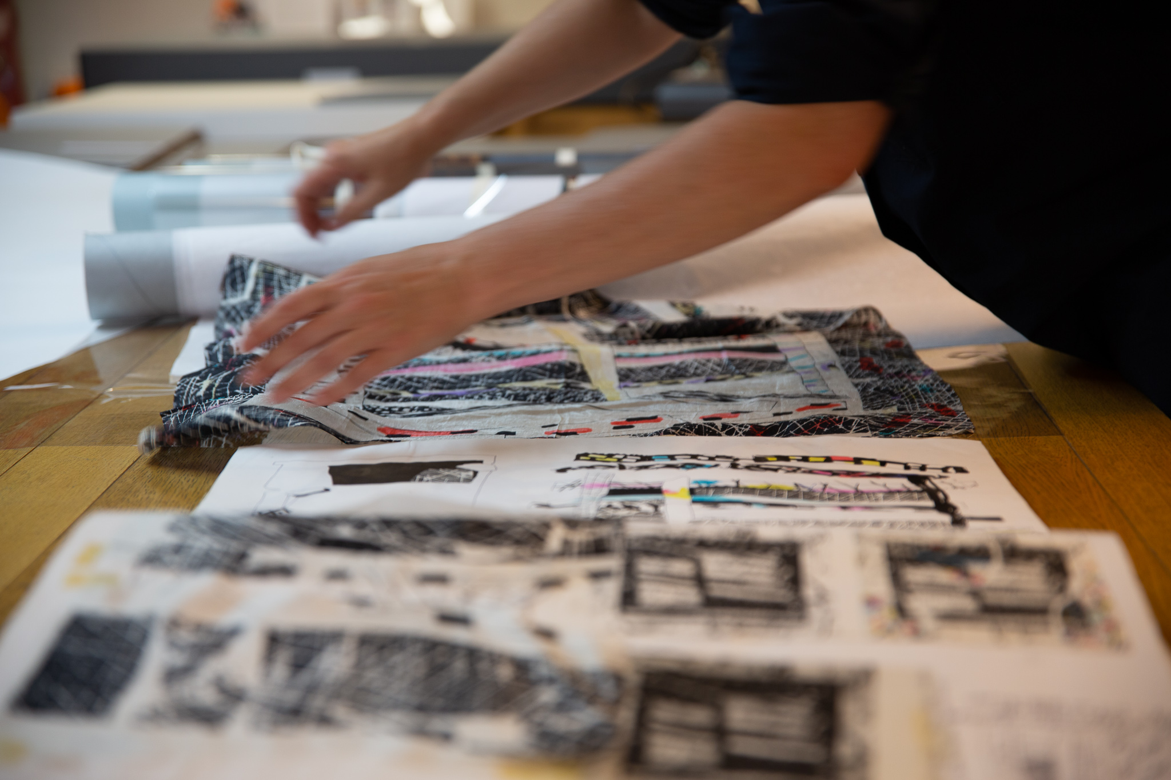
Impact
Academic, educational, cultural, social and on occasion economic impacts.
Conference and public presentations, articles and online features.
Opening the archives events to the public and invited groups.
New donations, adding to the archive.
Current collaborative project towards an exhibition, publication and outreach activities.
New creative practice and commercial opportunities for new work.

Slide 12
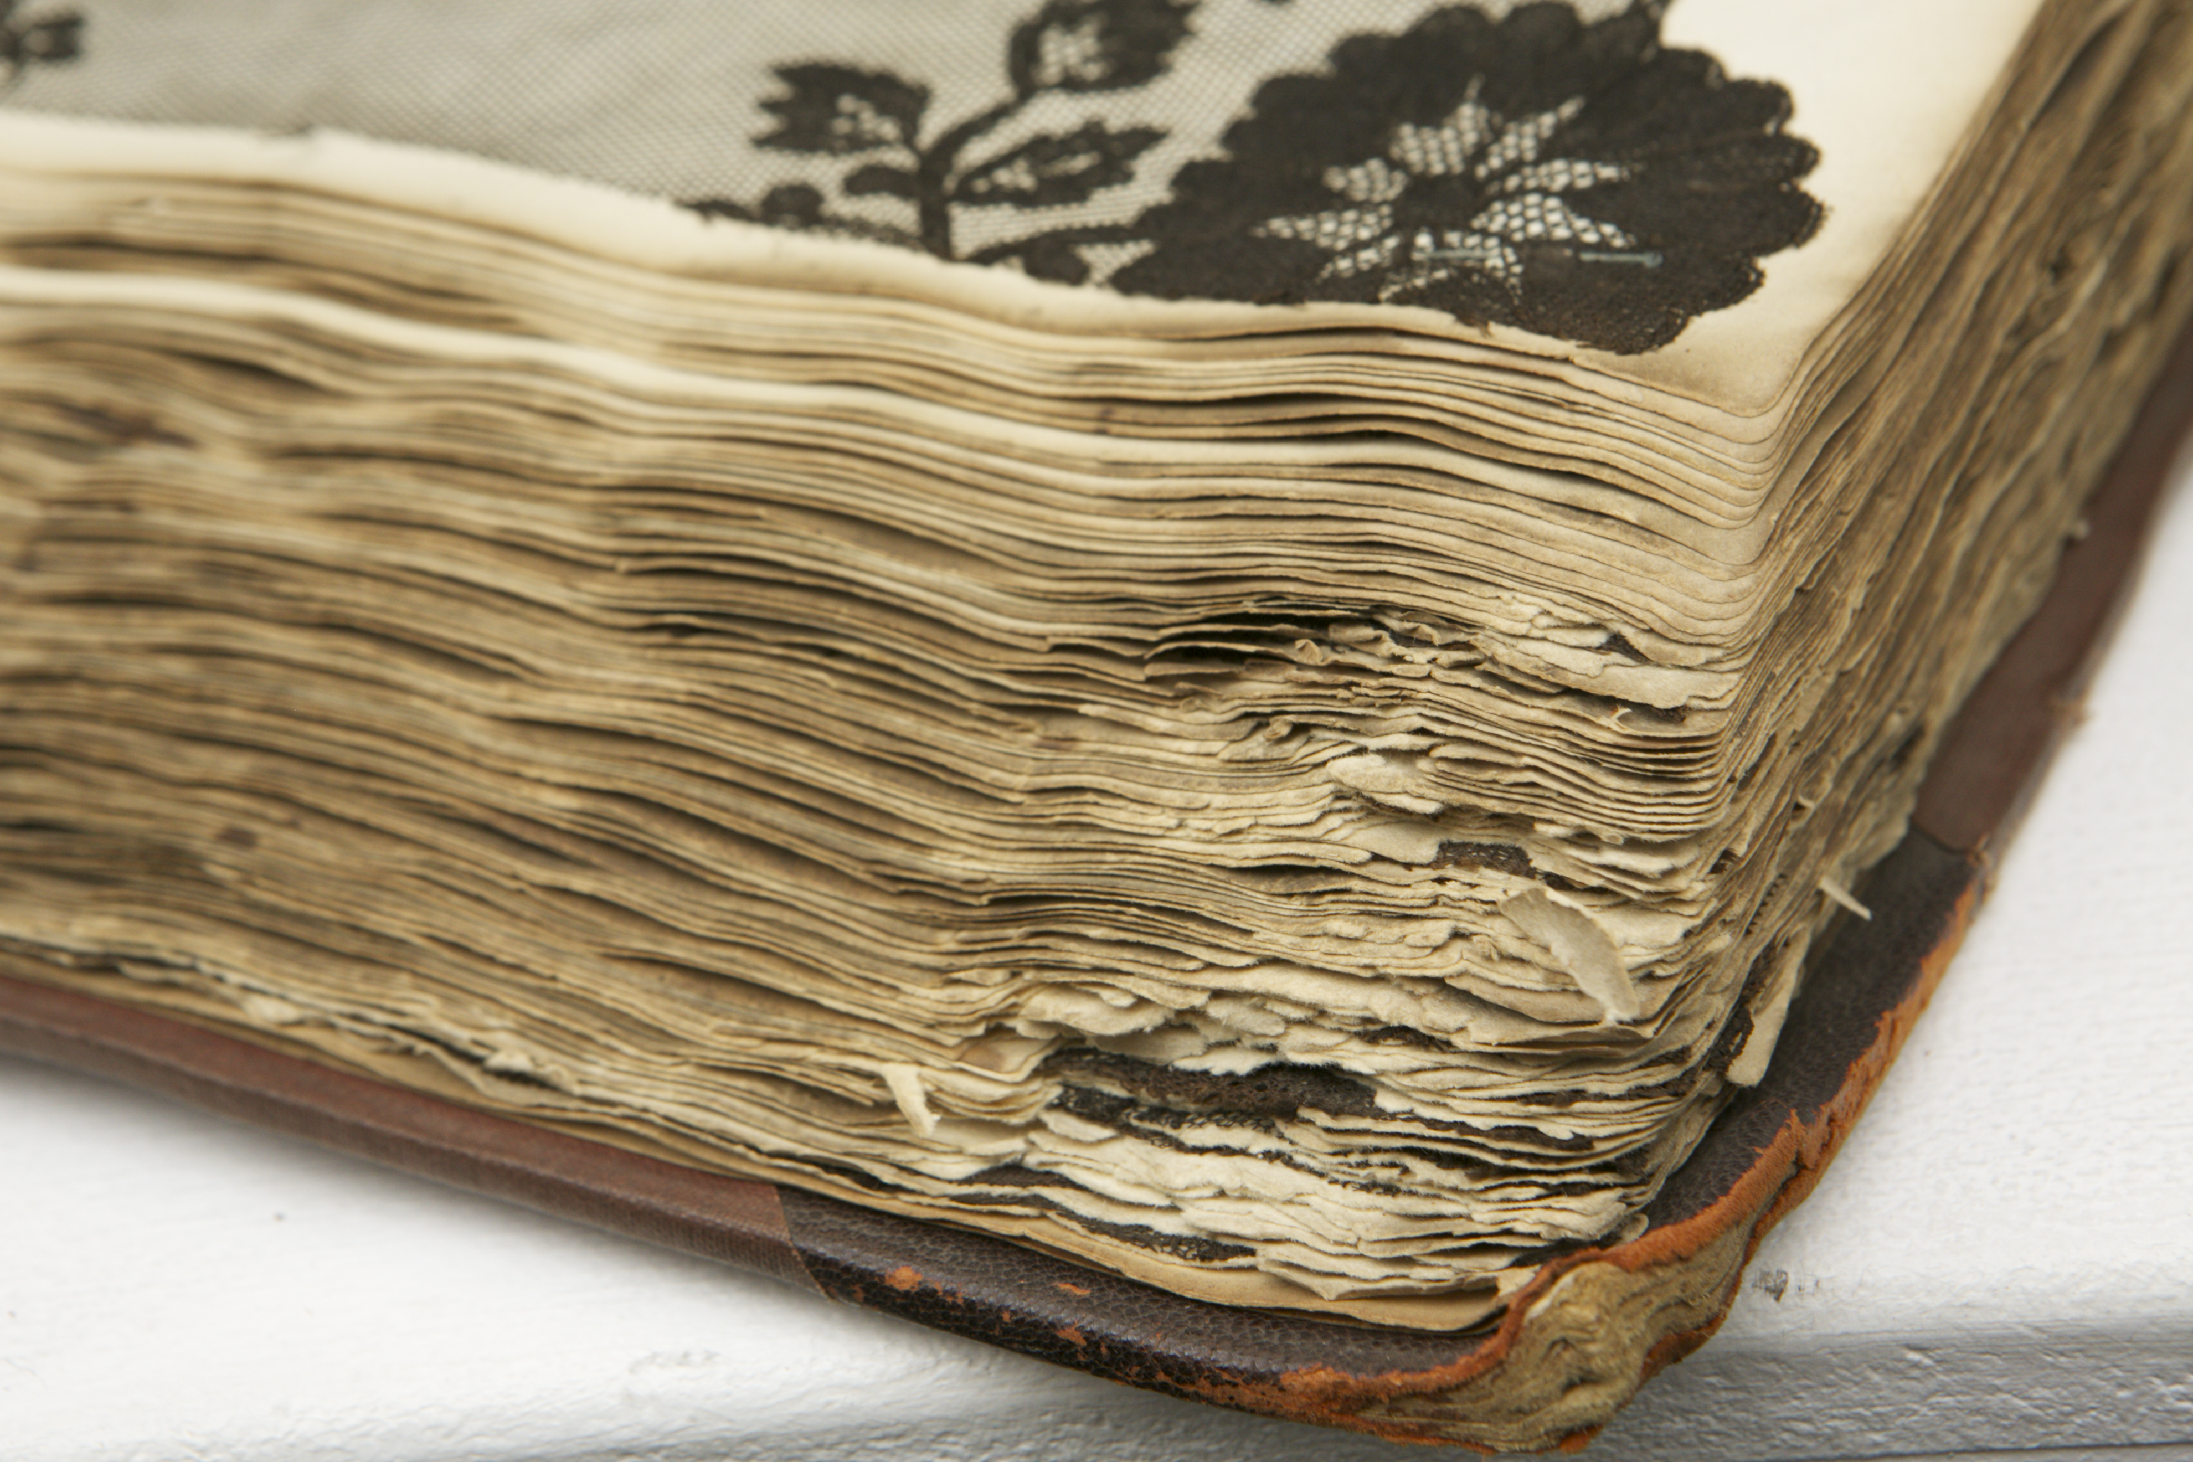
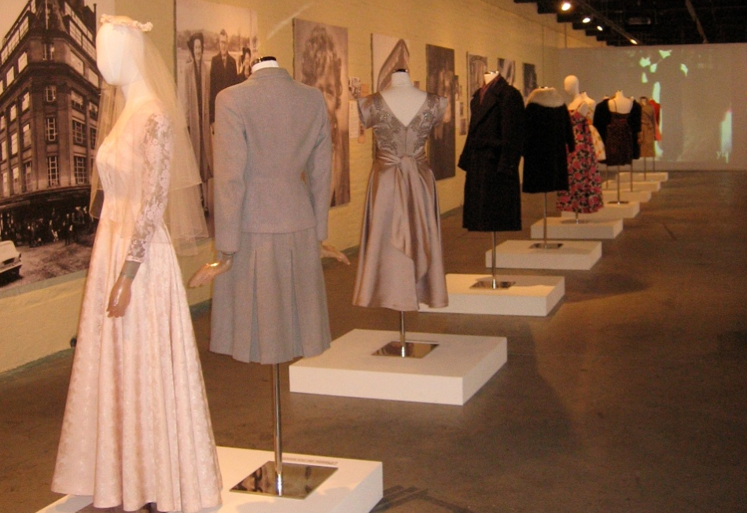
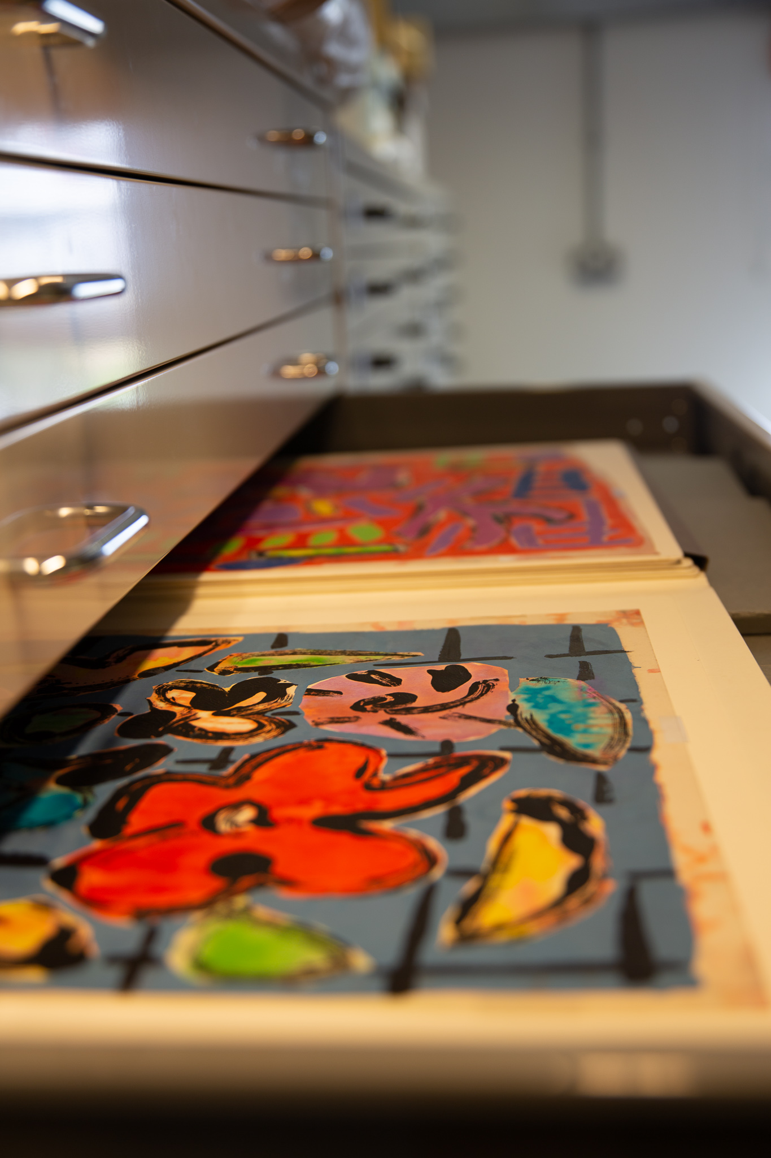
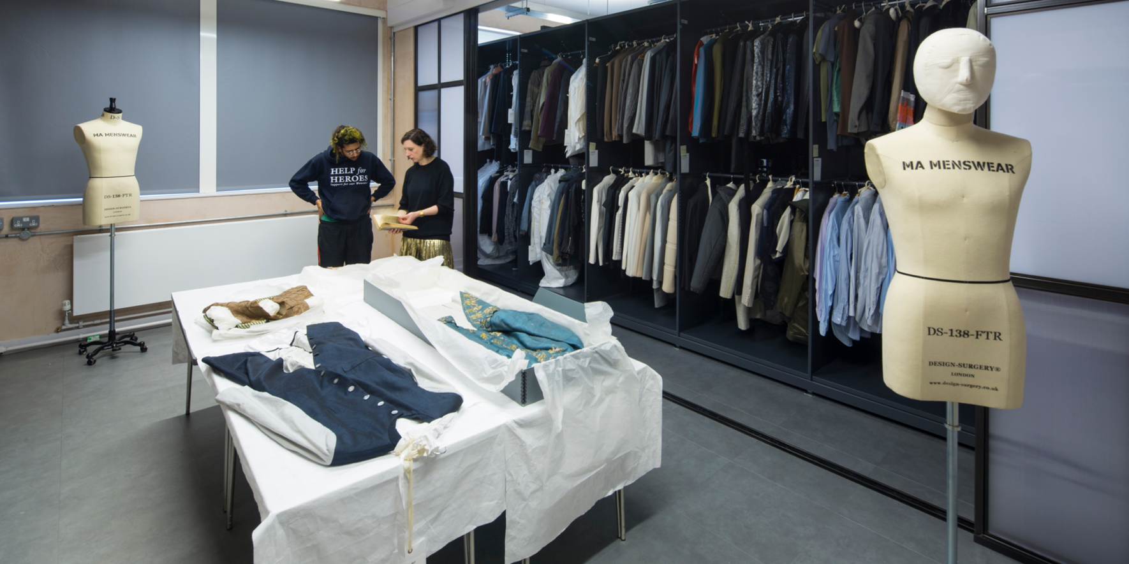
Investigating the Value
V
Challenges:
Funding & Access
Expectations
Ownership & Copyright
Opportunities:
Ambition
Collaboration
Knowledge Exchange

Slide 13
Nottingham Trent University Lace Archive
https://www.ntu.ac.uk/research/groups-and-centres/groups/lace-heritage
Westminster Menswear Archive
https://www.mensweararchive.com/
Yorkshire Fashion Archive
https://ahc.leeds.ac.uk/homepage/254/yorkshire_fashion_archive
http://www.yorkshirefashionarchive.org/
The Glasgow School of Art Archives and Collections / Textiles and Papers of Fraser Taylor
https://gsaarchives.net/
https://gsaarchives.net/catalogue/index.php/dc-089

Slide 15
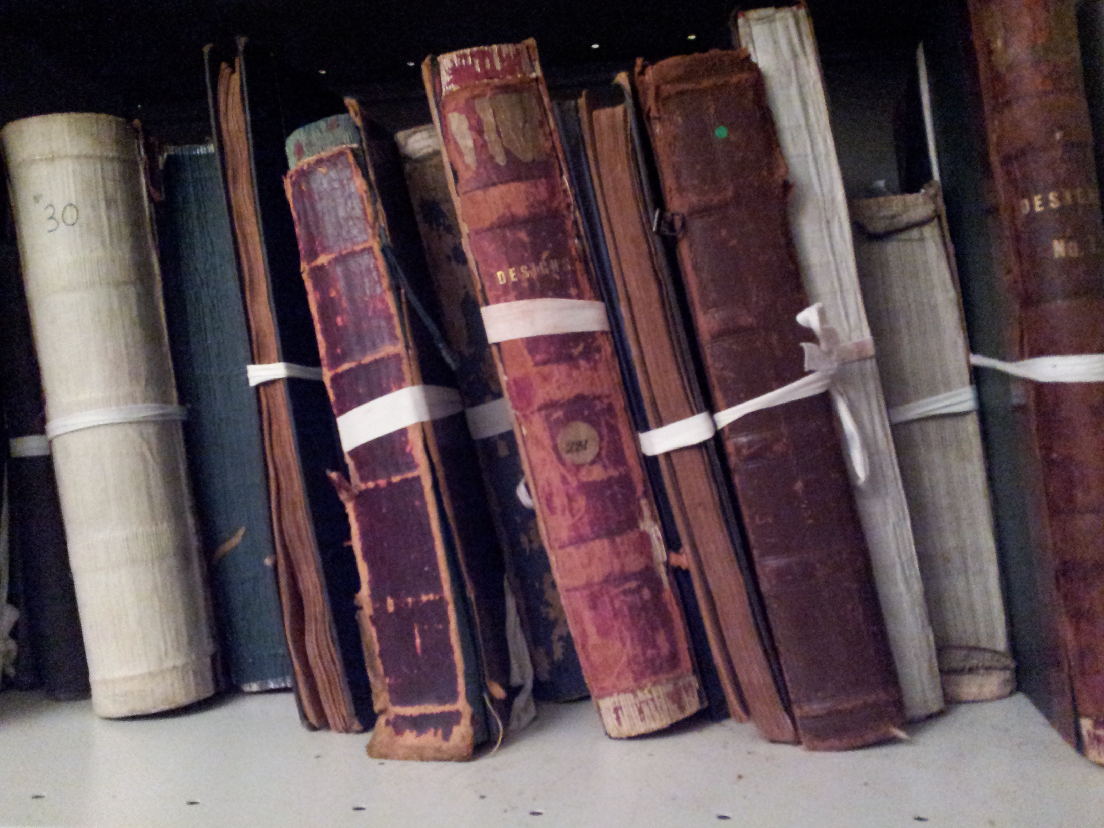
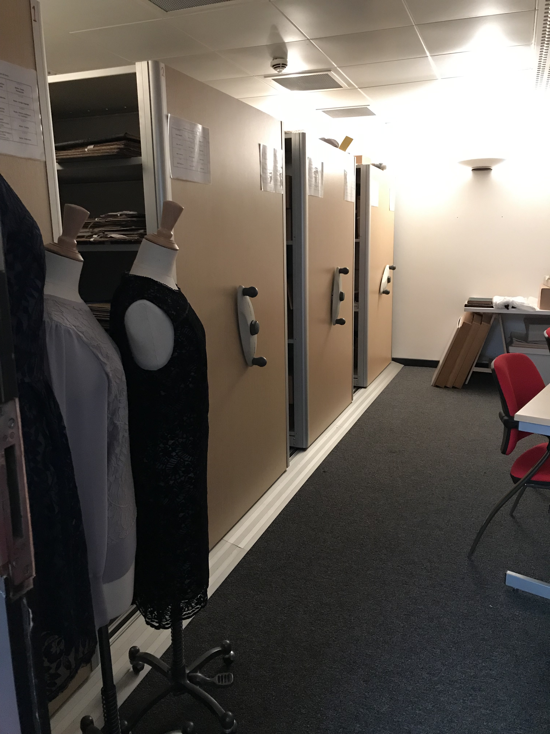
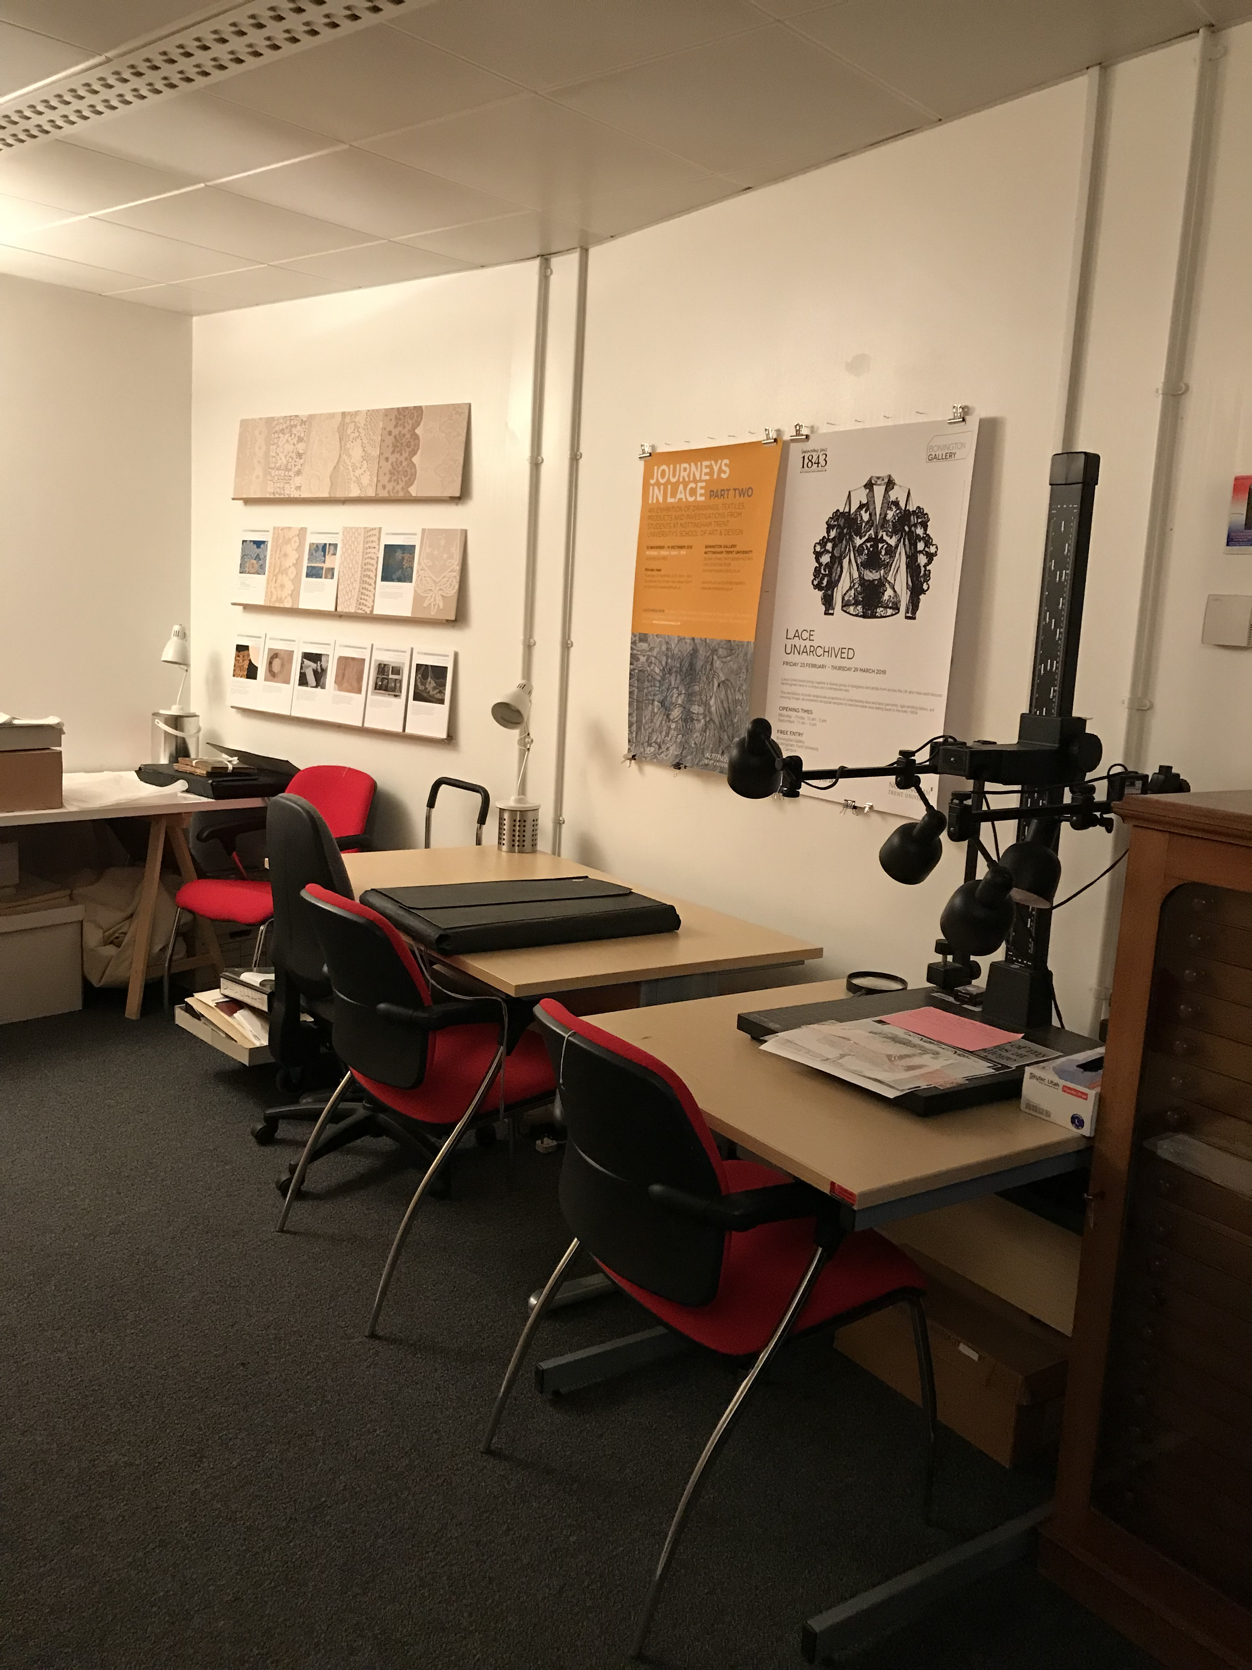
Challenges
To be removed
Funding – staffing and digitization
Access
Space
Lack of provenance of the objects
Expertise (related to funding/staffing)
Expectations

Slide 16
To be removed
Challenges
Fashion still seen as only meaning womenswear
Meeting the demands of various stakeholders.
Services expected from industry, students, and researchers are different
Collection rapidly outgrowing current space
Demands of cataloguing and digitalisation of records and imagery

Slide 17
Challenges from Kevin?

Slide 18
To be removed
Challenges
Off site location
Funding required for cataloguing and digitization
Funding and support required for exhibitions and outreach
Staff time for research and use as teaching resource
Restrictions on learning activities that can take place in the archive
Separation of GSA Archives & Collections, and Library Special Collections

Slide 19
Selected References from our work with archives?
Almond, K. 2014. Made in Yorkshire: Harnessing the Zeitgeist. Catwalk: The Journal of Fashion, Beauty and Style, 3 (1). Pp. 1-24 ISSN 2045 2349, Available from: http://eprints.hud.ac.uk/id/eprint/19720/
Almond, K. 2020. Disrupting the Fashion Archive: The Serendipity of Manufacturing Mistakes. Fashion Practice, 12(1). Pp.78-101.
Almond, K. and Evans, E. 2019. Everyday Fashion in Yorkshire 1939 – 1999. In: Everyday Fashion Conference: Extraordinary Stories of Ordinary Clothes, 27-28 Jun 2019, University of Huddersfield and University of Leeds [online]. White Rose Research Online, no pagination. [Date accessed: 14.03.2023]. Available from: https://eprints.whiterose.ac.uk/148093/
Almond, K. and Evans, E. 2022. A Regional Study of Women’s Emotional Attachments to the Consumption and Making of Ordinary Clothing, Drawing on Archives in Leeds, West Yorkshire, 1939–1979. Costume. 56(1), pp.74–100.
Backhouse, D. and Watson, C. 2011. Untold History: The Story of a Yorkshire Wedding Dress, Fashion in a Global World (A Moda Num Mundo Global), pp. 157 – 170, ISBN 978-972-788-414-8, Uniarte Grafica, S.A.
Evans, E. 2019. The relationship between Yorkshire fashion consumers and their clothing in the 20th Century, in Futurescan 4: Valuing Practice conference proceedings, 23-24 January 2019, University of Bolton, in review.
Hall, S. 2017. Memories of Style: Digitizing the Yorkshire Fashion Archive. Art Libraries Journal, Volume 42, Issue 3 (Fashion Collections) pp. 157-161, Available from: https://www.cambridge.org/core/journals/art-libraries-journal/article/memories-of-style-digitizing-the-yorkshire-fashion-archive/BECAC9DEF7C7F014C5899B3482836DA5
Webster, L. Watson, C. and Backhouse, D. (2012), Vintage Re-Fashioned, Global Fashion 2012, International Fashion Conference proceedings, available from: http://gfc-conference.eu/files_download/GFC2012/WEBSTER,%20WATSON%20and%20BACKHOUSE-%20Vintage%20Re-Fashioned.pdf
Exhibitions from the Yorkshire Fashion Archive:
‘Dress Rehearsal’ (Salts Mill, April – May 2011)
‘Wool Re-Fashioned’ (Salts Mill, Sept 2012 – Jan 2013
‘Jonathan Silver: Romantic Capitalist’ (Salts Mill, Sept 2013)
‘Snapshot’ (Barnsley Civic, Sept – Nov 2015)
‘The Synthetics Revolution’ (ULITA, June – Dec 2016)
FTC Conference: 'Futurescan 5'
(University of Leeds – Sep 2022)

Slide 20
Almond, K. 2014. Made in Yorkshire: Harnessing the Zeitgeist. Catwalk: The Journal of Fashion, Beauty and Style, 3 (1). Pp. 1-24 ISSN 2045 2349, Available from: http://eprints.hud.ac.uk/id/eprint/19720/
Almond, K. 2020. Disrupting the Fashion Archive: The Serendipity of Manufacturing Mistakes. Fashion Practice, 12(1). Pp.78-101.
Almond, K. and Evans, E. 2019. Everyday Fashion in Yorkshire 1939 – 1999. In: Everyday Fashion Conference: Extraordinary Stories of Ordinary Clothes, 27-28 Jun 2019, University of Huddersfield and University of Leeds [online]. White Rose Research Online, no pagination. [Date accessed: 14.03.2023]. Available from: https://eprints.whiterose.ac.uk/148093/
Almond, K. and Evans, E. 2022. A Regional Study of Women’s Emotional Attachments to the Consumption and Making of Ordinary Clothing, Drawing on Archives in Leeds, West Yorkshire, 1939–1979. Costume. 56(1), pp.74–100.
Backhouse, D. and Watson, C. 2011. Untold History: The Story of a Yorkshire Wedding Dress, Fashion in a Global World (A Moda Num Mundo Global), pp. 157 – 170, ISBN 978-972-788-414-8, Uniarte Grafica, S.A.
Evans, E. 2019. The relationship between Yorkshire fashion consumers and their clothing in the 20th Century, in Futurescan 4: Valuing Practice conference proceedings, 23-24 January 2019, University of Bolton, in review.
Hall, S. 2017. Memories of Style: Digitizing the Yorkshire Fashion Archive. Art Libraries Journal, Volume 42, Issue 3 (Fashion Collections) pp. 157-161, Available from: https://www.cambridge.org/core/journals/art-libraries-journal/article/memories-of-style-digitizing-the-yorkshire-fashion-archive/BECAC9DEF7C7F014C5899B3482836DA5
Webster, L. Watson, C. and Backhouse, D. (2012), Vintage Re-Fashioned, Global Fashion 2012, International Fashion Conference proceedings, available from: http://gfc-conference.eu/files_download/GFC2012/WEBSTER,%20WATSON%20and%20BACKHOUSE-%20Vintage%20Re-Fashioned.pdf

