Slide 1
LITA
Regional Impact-Cluster Engagement Mechanisms for Fashion & Textiles
Sue Rainton - Associate Director, LITAC
9th November 2023

Slide 2
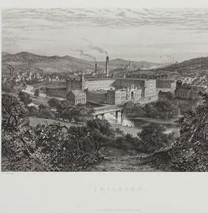
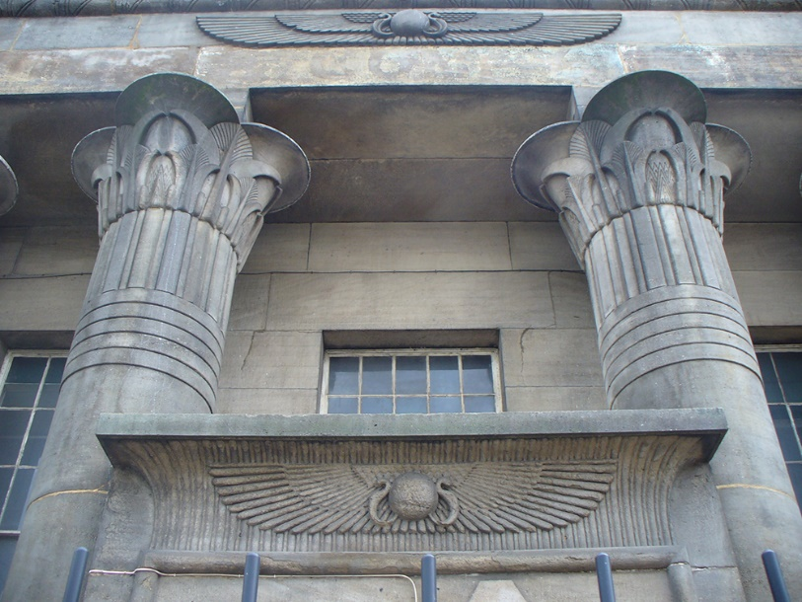
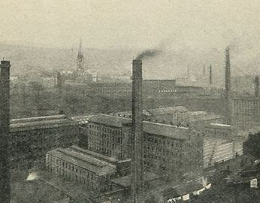
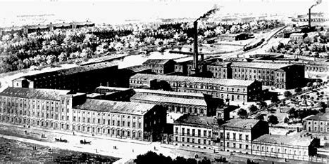
How it all began …….
Sectoral Transformation
Traditional, established, mature globally connected economy
Digitally-enabled sustainable circular economy
Yorkshire-based cluster
HEI-industry connectivity
Regional awareness
Skills / Innovation drive

Slide 3
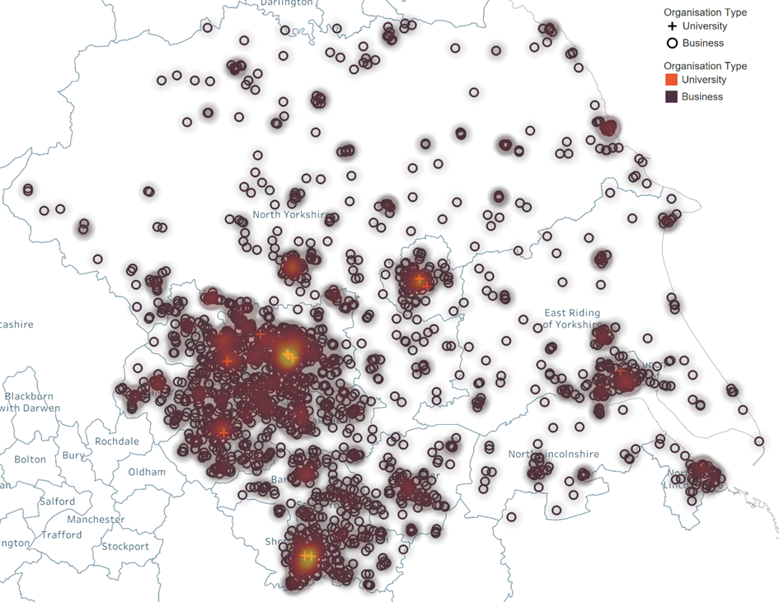
The Essential Ingredients
Local government buy-in
Sectoral recognition
Cross-department connectivity (i.e. planning & cultural services)
Industrial support
Established manufacturing base
Design community
Sector body connectivity (UKFT/BFC)
Regional skills focus (TCoE)
Academic excellence
Leeds, Huddersfield, RCA
Ref: Perspective Economics, Fashion & Textile in Yorkshire
Core industry partners
Existing experience
Key initiatives (MIT REAP)
Lots of goodwill

Slide 4
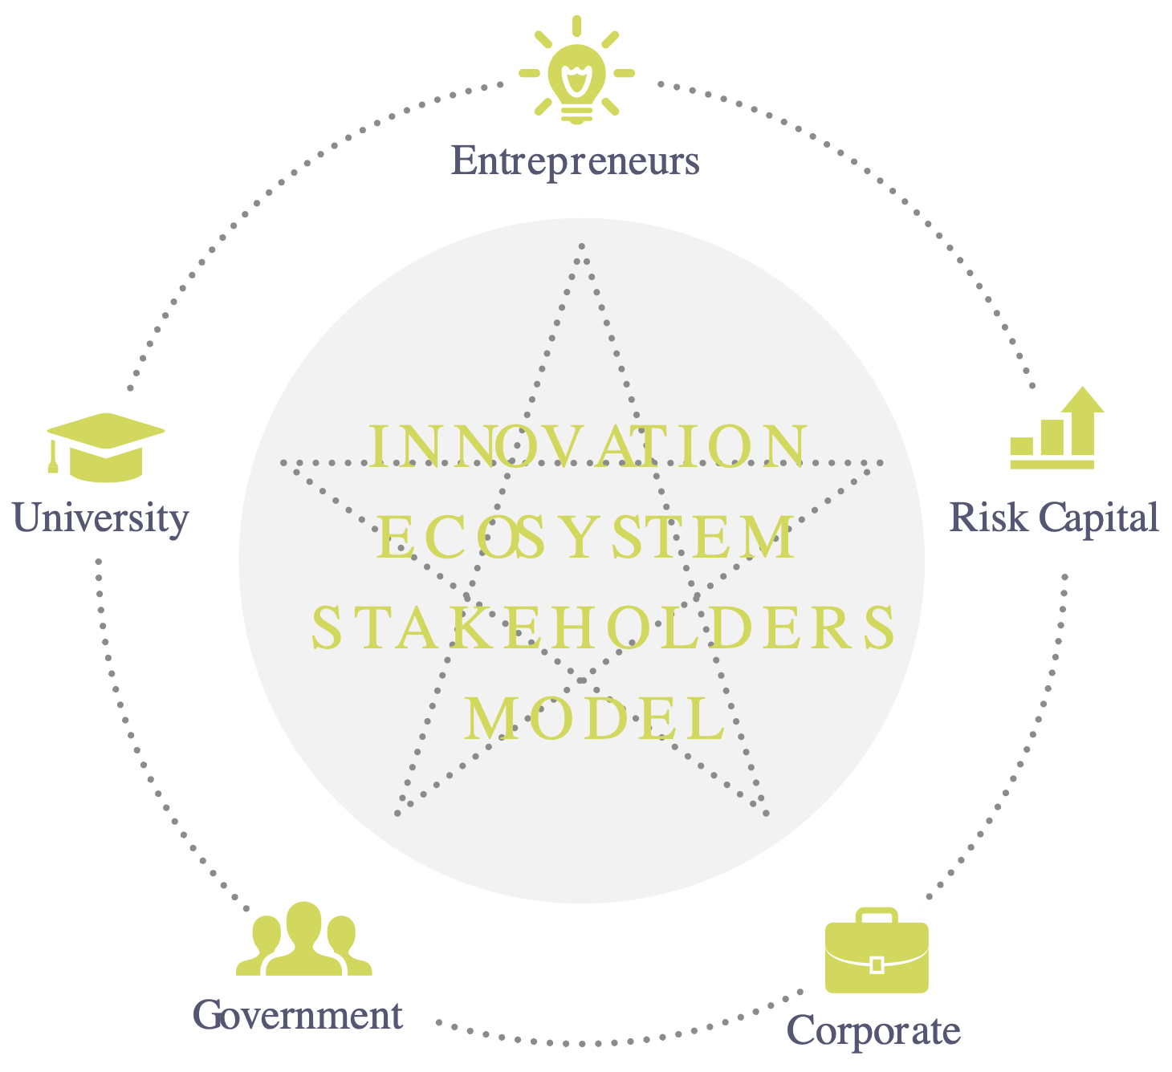
Economic Development: MIT REAP
MIT REAP – cohort 6 (January 2020)
A 2-year process
9 regions – global spread
Engagement meetings – 2019
Leeds hosted visit
Learning & outcomes
“high-level teams selected from regions dedicated to working alongside MIT faculty over a 2-year period to drive innovation-driven entrepreneurship in their city, region or country”
Ref: Our Team (idealeedscityregion.com)
Tools to inspire and support entrepreneurs

Slide 5
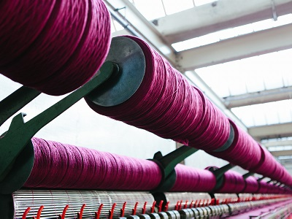
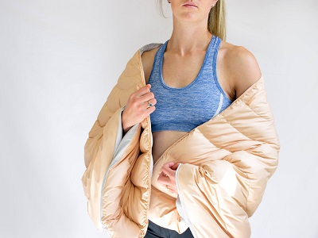
A Fringe Creative Industry?
“Design and designer fashion” – so we’re in …..
but what about the rest of the sector – textiles are creative building blocks for so much more!
Creative Industries “have their origin in individual creativity, skill and talent and which have a potential for wealth and job creation through the generation and exploitation of intellectual property’”
DCMS, 2021
Fashion & Textiles is: established, mature, tangible, physical, conservative And: innovative, disruptive, ubiquitous, global, impactful, flamboyant, connective
Notes:
How do we fit within the Creative Industries Cluster Programme – listening to some of the other clusters we sometimes appear to have an identity crisis
A slight feeling of disorientation – F&T, especially textiles, is lots of different things
Also we feel old when set aside some of the other clusters, the ‘grumpy old man’ of the CICP network

Slide 6
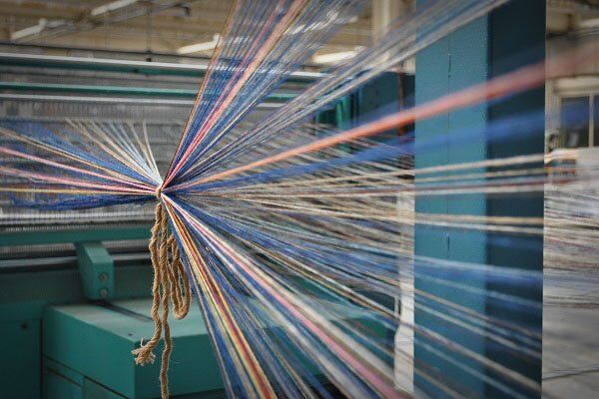
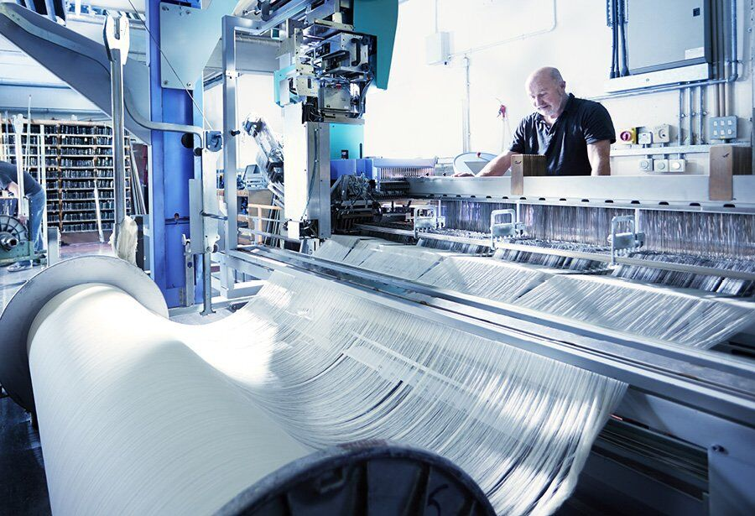
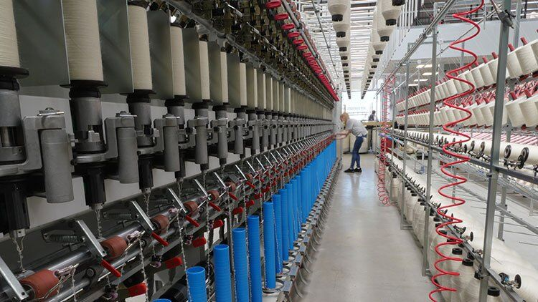
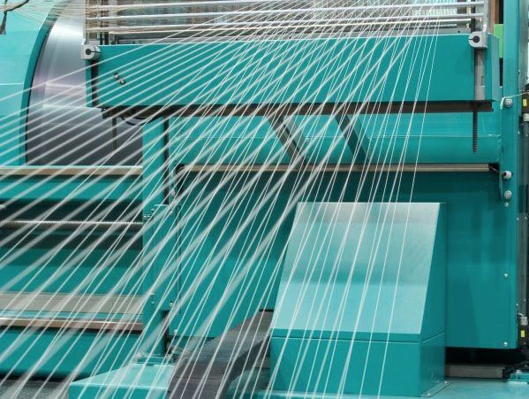
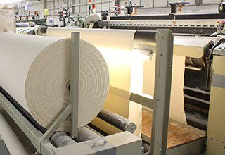
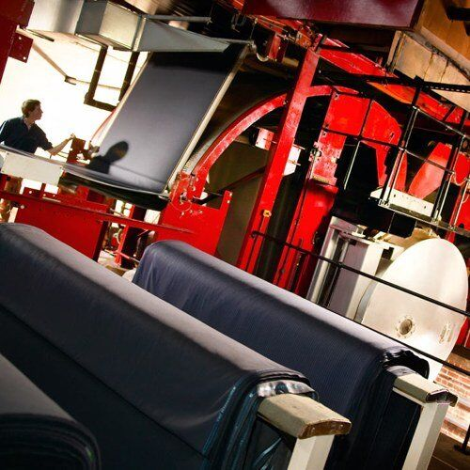
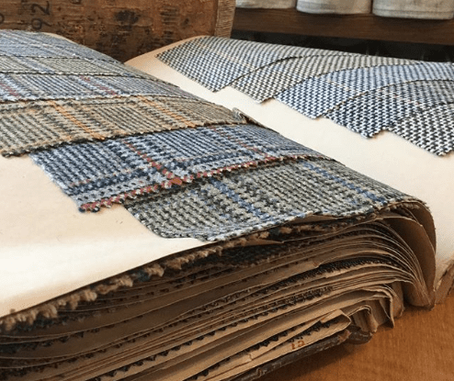
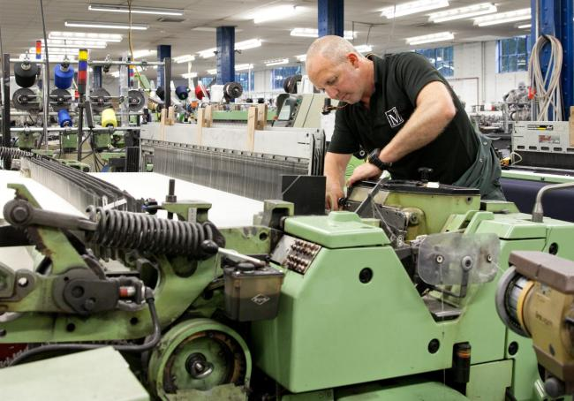
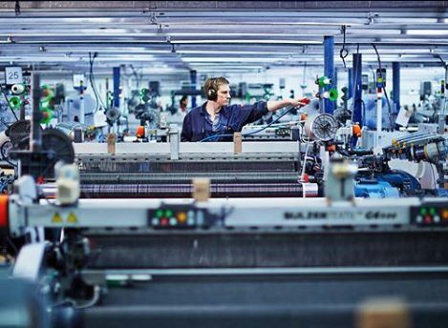
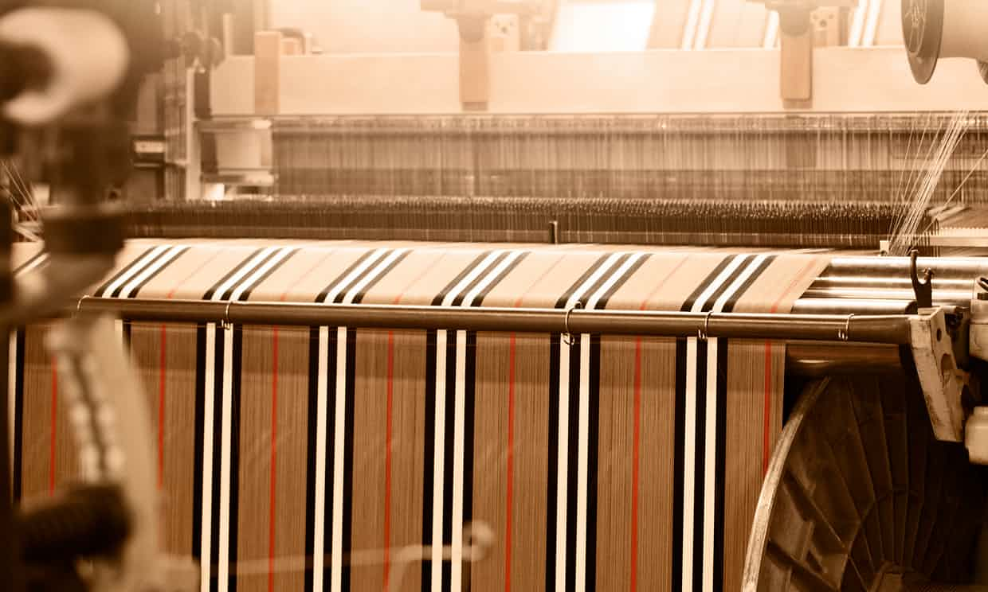
There’s lots going on!!!
Colour | Fabric finishing
Fibre | Garment – activewear / 3D print / accessories / seamless / shoes
Yarn | Knitwear
Fabric: weave and 3D weave | Specialist applications: Interiors, automotive, geotextiles, medical
Fabric: warp knit | Sales: retail, mail order, digital
Fabric: circular knit | Communications
Lace – and other non-woven Fabric | Second-life / End-of-life: re-sale, re-cycling, re-nt, re-model, re-vive, re-duce
3D print fabric | Future ……

Slide 7
Designing the Team
A new type of programme, a new type of approach
Doing our homework
Listening to the sector
Balancing skills & perspectives
Making sure that the industry voice is heard
Director
Textile Engineering / scientific-approach
Regional Connectivity
Business-facing
Impact focused academic approach
Co-Director
Textiles / Marketing / Communications
Regional Connectivity
Fashion - Designer - Textile knowledge
Sectoral knowledge
Programme Manager
Varied background – local government / HEI / SME management
Experienced
Problem-solving
Sector awareness but not experience
Notes:
We needed to embrace our differences of approach and context
Academic Director – technical textile engineering background, industry-facing and Director of a university spin-out (NIRI)
Fashion Marketing Co-Director -

Slide 8
Engagement – what does that mean?
Valuing our network
Sectoral bodies
Core Research Themes
Regular communication
Visible management
Steering Group
Programme Management Group
Aesthetic Digital Communication
Data-Driven Design / AI
Late-stage Customisation
Skills and Education
Sustainable Circular Economies
Quarterly Meetings
Inform
Consult
and Listen!
Notes:
It’s not all about events and press releases

Slide 9
Engagement – and what does it look like
A delivery structure crafted for:
Balanced perspective
Industry engagement
Sectoral Impact
Transparent communication
Extended Fashion & Textile Eco-System (FFF network)
FFF Steering Group
FFF Director
(academic)
FFF Co-Director
(industry)
FFF Programme Management Group
Core Research Theme Leaders
FFF Programme Manager
Investment Committee (R&D calls)
FFF Administrator
FFF Communications and Digital Engagement Officer

Slide 10
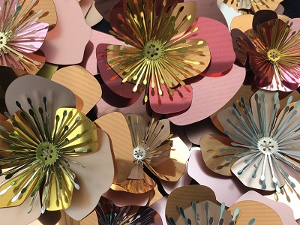
Brokerage – what does that mean for us?
Considering our sector – preferences and prejudices
In-person meetings & Creative Labs
Physical showcase – 2019 Salts Mill
Mutual respect, consideration of ‘language’
Sectoral knowledge
Clarification of mission (innovation vs business growth)
Different approaches for different network members (SMEs vs LCs)
and digital translation – how COVID changed things!
New engagement channels
Flexibility & wider reach
Notes:
This is representative of ‘what we did’
A listening network, to both our formal management (PMG and SG) but also to the wider ecosystem

Slide 11
A ‘Tool Kit’ Approach
It’s not all about the money
Listening and responding
Embedding learning
Giving the network what it wants
Building trust
Notes:
This is representative of ‘what we did’
A listening network, to both our formal management (PMG and SG) but also to the wider ecosystem

Slide 12
Regular Communication
In-person and digital
Annual Showcases
Creative Labs
Speaker Events
Responsive workshops
Commissions
Competitions
Notes:
This is representative of ‘what we did’
A listening network, to both our formal management (PMG and SG) but also to the wider ecosystem

Slide 13
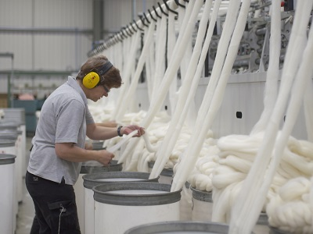
Cluster-based Responsive R&D
Designed the scheme
Took into account industry challenges
Defined ‘innovation’
Cluster connectivity
Made sure there was a Y&H connection
Based on industry-feedback
Switched things up in response to feedback
Independent Investment Committee
UK-wide sectoral representation (UKFT Chair)
Regional industry body
Academic expertise
Commercial / impact overview
Notes:
This is representative of ‘what we did’
A listening network, to both our formal management (PMG and SG) but also to the wider ecosystem

Slide 14
Cluster-based Responsive R&D
Levels of Funding available
Funding Stream | Total Project Value | Maximum Grant Value | Purpose | Funding Breakdown
Proof of Market (PoM) | Up to £10k | £9k | To evaluate a market opportunity; identify existing IP/conduct freedom to operate searches; explore further funding options; carry out small-scale R&D activity. | 10% minimum match-funding requirement 90% Intervention rate
Proof of Concept (PoC) | Up to £50k | £37.5k | To carry out interventions that progress proven methods and knowledge into validated technologies for a defined application. | 25% minimum match-funding requirement Up to 75% Intervention rate Varies depending on company size & project
Innovation Challenge Project (ICP) | Up to £100k | £60k | Funding for innovations in partnership with industry to demonstrate and begin to scale up new technologies in a commercial setting. Such projects should be near to market (TRL 7-8, see table on page 5) | 40% minimum match-funding requirement Up to 60% Intervention rate Varies depending on company size & project
3 Levels of Project Funding
Proof of Market (PoM)
Proof of Concept (PoC)
Innovation Challenge Project (ICP)
Intervention Rates vary depending on project size and focus

Slide 15
Co-Development & Planning for Impact
Aligned Industry-Led,
55 Responsive R&D Projects; 6 calls; 3 mechanisms
Supported brokerage to develop industry-led applications
Match-making service (Industry – academia)
Gateway Criteria
Linkage with industry challenges / Core Research Themes
Something for everyone
Geographic cluster linkage
Call
6
Call
1
Core
Collaborative R&D
Projects (CRTs)
Data-driven design / AI
Late-stage customisation
Sustainability & CEs
Digital comms of aesthetics
Skills & education
Call
5
Call
2
Call
3
All projects are co-investments
Call
4
Notes:
This is representative of ‘what we did’
A listening network, to both our formal management (PMG and SG) but also to the wider ecosystem

Slide 16
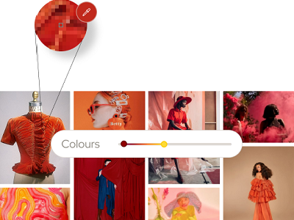
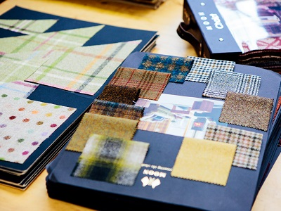
Trial (and error)
Mechanism 3
Challenge Call
Single Pathway (Sustainability / Circular Economies)
Single Stage
Call 6
Trialled different mechanisms
Mechanism 1
Open Call
Three Pathways
Single Stage
Call 1
Mechanism 2
Open Call
Three Pathways
Two Stage
Calls 2-5
Notes:
This is representative of ‘what we did’
A listening network, to both our formal management (PMG and SG) but also to the wider ecosystem

Slide 17
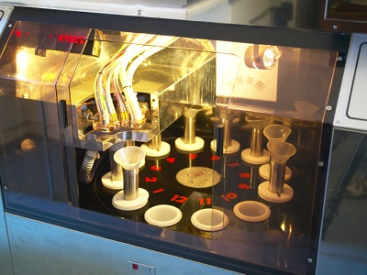
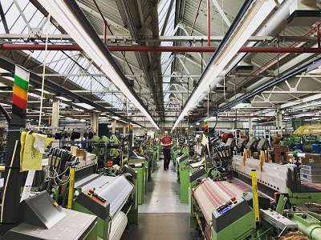
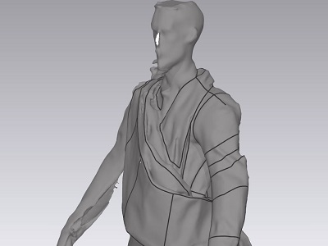
Lessons Learnt
The admin:
Allow (much) longer than original anticipated
More resource heavy trialling ‘something different’
Don’t rely on other people’s / organisation’s systems
Build in safeguards / be connected
ED&I matters!
The usual suspects:
Plan well
Consult, and listen
Communicate clearly
Set milestones
Check on progress
Collaboration is best!
Notes:
This is representative of ‘what we did’
A listening network, to both our formal management (PMG and SG) but also to the wider ecosystem

Slide 18
Embedding the Learning
Increased academic engagement / building capacity
Facilitating academic-industrial co-development and learning
Empowering Early Career Researchers
Informing and transitioning CPD mechanisms
From in-person set programmes …….
To mixed digital/physical programmes and bespoke content
Research-led industry-led content
FFF-based discovery modules
Online only MA including FFF case studies
Co-developed and industry approved BSc
Livery company support – provision of UG & PG scholarships
Notes:
This is representative of ‘what we did’
A listening network, to both our formal management (PMG and SG) but also to the wider ecosystem

Slide 19
Where are we now: the genesis of LITAC
Expended Networks (domestic & international)
Stronger business case – Strategic Impact Assessment
Better Connected – increased industry input
Embedded industry-informed skills mechanism
Academic / Industry / Policy alignment (regional)
Increased Funding Support
UKRI circular fashion and textile programme
Notes:
This is representative of ‘what we did’
A listening network, to both our formal management (PMG and SG) but also to the wider ecosystem

Slide 20
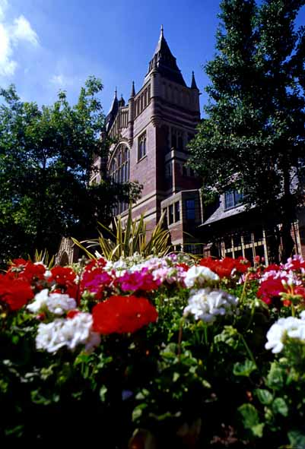
Thank you
s.rainton@leeds.ac.uk

