Slide 1
Fig. 1
Un-Stressed situation
Stressed situation
a
b

Slide 2
Fig. 1
c
d
e

Slide 3
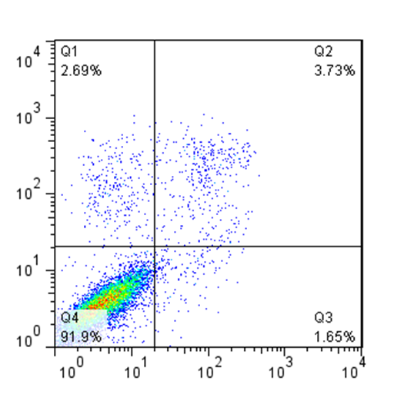
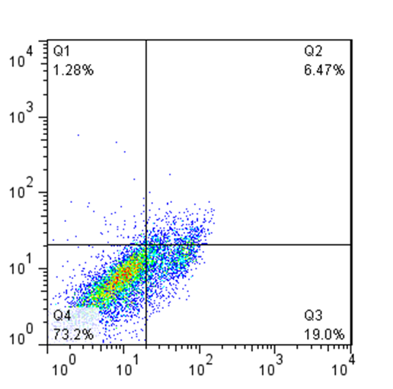
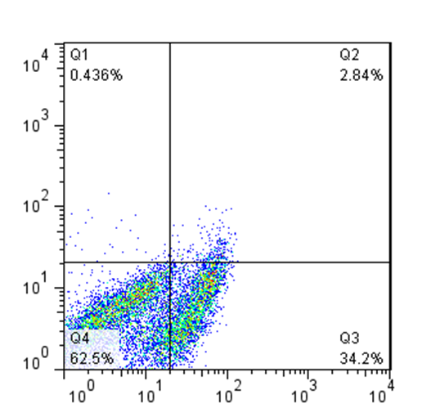
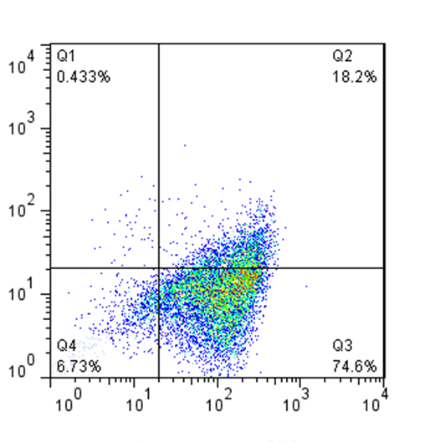
Fig. 2
Control
4µ8C
5-FU
5-FU/ 4µ8C
PI
Annexin V-FITC

Slide 4


Fig. 3
TM
4m8C
5-FU
+ + - + + + - - + -
+ + - - -
XBP1u
XBP1s
Actin

Slide 5
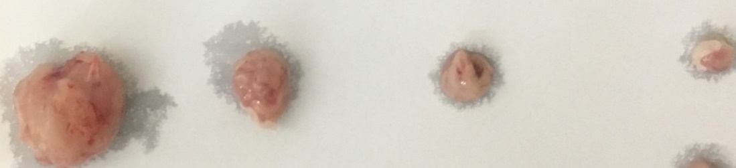
Fig. 4
Control 5- Fu 4µ8C 5-Fu+ 4µ8C

Slide 6
Fig. 5
a
b

Slide 7
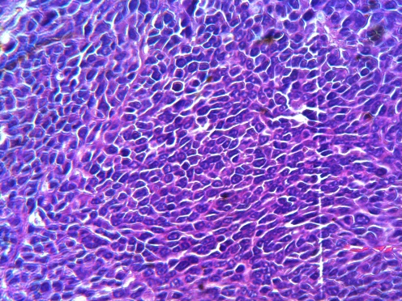
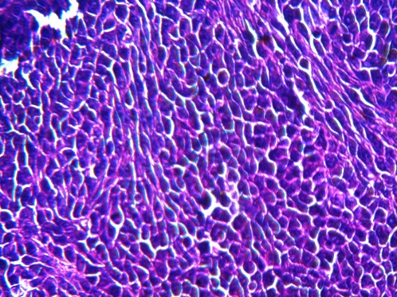
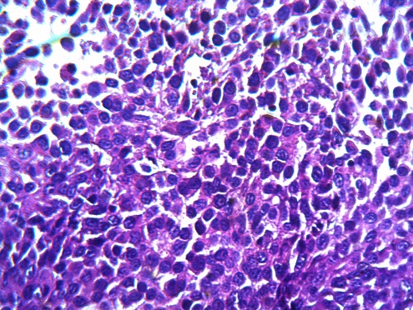
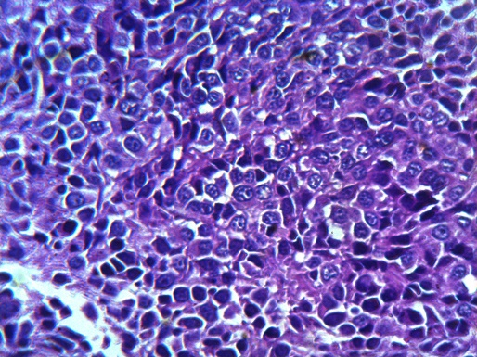
Fig. 6
Control
4µ8C
5-Fu+ 4µ8C
5-Fu
X400

Slide 8
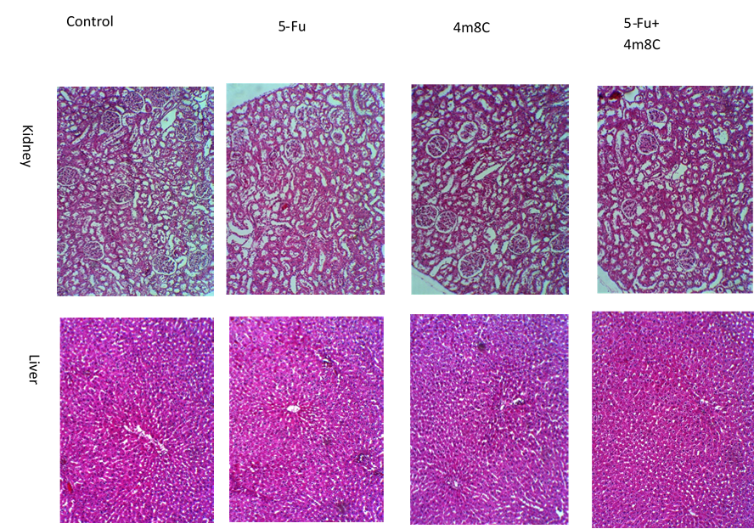
Fig. 7

