Slide 1
‘No care without community’: The importance of connection in older adult care
Dr Kayonda Ngamaba
Dr Cheyann Heap
University of York
Tackling the Crisis in Care Homes: Rebuilding Social Care Capacity After the Pandemic, Meeting Funding and Staffing Shortfalls and Protecting the Most Vulnerable

Slide 2
Overview
Background and context
Case study: Benefits of Running a Multicultural Singing Project Among Older Adults in a Naturalistic Residential Environment (Ngamaba & Heap, 2022)
What have we learned? How we can take forward our example of community engagement

Slide 3
Background and context

Slide 4
The covid-19 pandemic – crisis or resilience?
Care homes worked together; Some relationships became closer; Community networking & resources (Marshall et al., 2021)
Good relationships with caregivers reduced covid-19 stress (Chee, 2020)
Opportunities for engagement, physical touch, person-centred care, and positive communication / small talk (Ferdous, 2021)
Move to ‘social-relational’– fewer covid-19 deaths than in medical / institutional care models (Power & Carson, 2021)
Care staff tend to have a ‘relational-moral’ and wellbeing-focused way of working (Dohmen et al., 2016; Dutch study)
Best practice – maintain social connections, strengthen social connections – esp between residents and ‘outside world’ (Beogo et al., 2022)

Slide 5
Interpersonal relationships are key
‘Therapeutic reciprocity’ (Moniz-Cook, 1997)
Staff: interpersonal skills, commitment, awareness/reflection
Organisation: Staff & physical space; mid-managers (esp permission); person-centred organisation (security & support); person-centred culture (reduced focus on top-down tasks & clinical outcomes) – Ryan, 2022
Relationship-centred like the Nolan’s Senses Framework and positive communication can reduce challenging behaviour (Gillis et al., 2019; Passalacqua & Harwood, 2012).
Burnout related to staff negative expectations / perceptions of age, illness and dementia (Mandiracioglu et al., 2006)
Person-centred care increases staff sense of competence (Mullan, 2016)
But ‘sense of reward’ may come more from positive self-as-carer (Hillman, 2001)

Slide 6
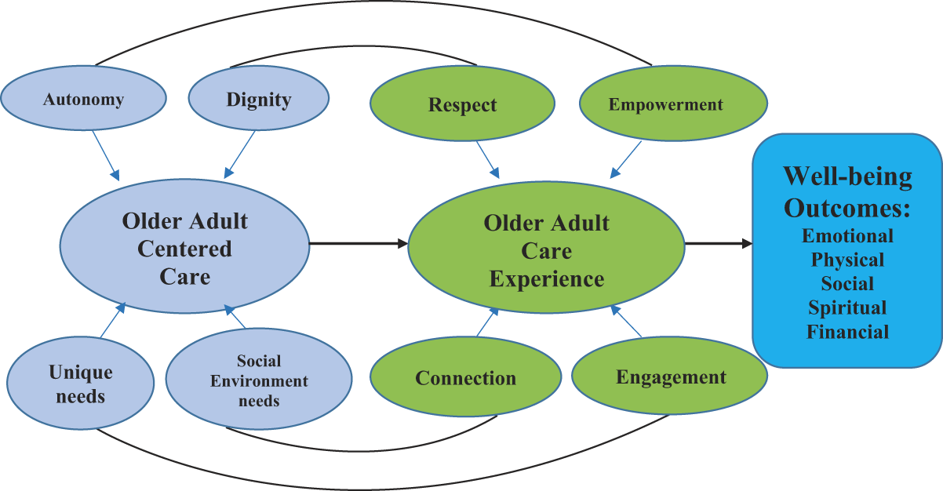
Older Adult-Centred Care
Autonomy, dignity, unique needs and social environment (Kayabadi et al., 2020)
Reciprocity → value (Ryan & Nolan, 2019)
Non-medical, mutually caring human relationships (Heap & Wolverson, 2020)

Slide 7
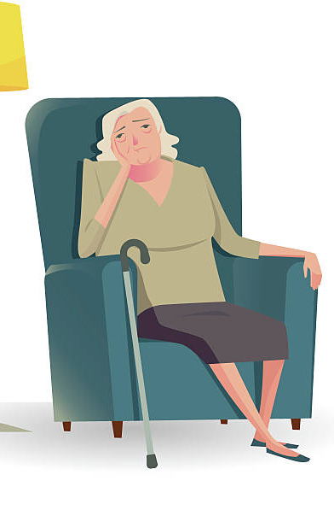
Singing in groups in care homes
Organised activities → genuinely person-centred?
“A man, who couldn’t sing, was singing at the residents. He failed to interact with the people he was entertaining. No eye contact was made and there was a distinct lack of dialogue with the residents” (Eyers, 2012; p. 68)

Slide 8
Singing in groups
Reduces cortisol (Cambell & Bodkin-Allen, 2022)
Release endorphins (Klang et al., 2018)
Connectednessw/ oxytocin (Good & Russo, 2022)
Memories / nostalgia
Quick group bonding (Weinsten et al., 2016)
Motivation, attention, behavioural synchronicity, and a collective achievement

Slide 9
Case study
Kayonda Ngamaba & Chey Heap
Ngamaba, K. H., & Heap, C. J. (2022). Benefits of Running a Multicultural Singing Project Among Older Adults in a Naturalistic Residential Environment: Case Studies of Four Residential Care Homes in England. Journal of Gerontological Nursing, 48(9). https://doi.org/10.3928/00989134-20220808-04

Slide 10
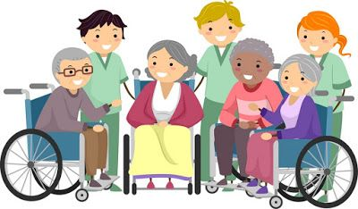
Multicultural singing intervention (Ngamaba & Heap, 2022)
Local church community connection (predominantly African refugees), mixed ages
4 care homes in Bolton
Hospital, care home, nursing home x 2
With and without dementia
Long and short term stays
Predominantly White-British
Making a connection (talk to manager)

Slide 11
The singing intervention
Risk assessment
Training for choir
Setting a schedule
Consent – prior to visit and ongoing
Communal area setup (& instruments!)
Members introduce themselves and distribute written song lyrics
Residents can come and go, watch or join
Choir leader asks to share experience after song

Slide 12
Feedback on the project
Care home 1: “Our resident really enjoys; the choir makes them interact with singing and clapping; very enjoyable”. “Makes the patients enjoy and get involved”.
Care home 2: “Happy smiling faces good mood. Very good keep up the good singing”.
Care home 3: “I really enjoy your visit. Thank you for singing Happy Birthday; it really made my day”.
Care home 4: “All service users enjoyed this. Greatly improved their moods and got them up dancing. This is a good idea for the elderly”. “Amazing, brightens up the lives of people waiting for treatment”.

Slide 13
Community cohesion & mutual benefit
Residents enjoyed a group activity, socialised, reminisced, and became at ease with each other and ‘outsiders’ (an African choir).
The project helped to break down psychological barriers between younger choir members and care home residents, and between African refugees and a largely White British community.
Both care home residents and staff reported personal benefits.
Acts of giving and kindness can improve wellbeing; choir members reported positive emotional impact from the project.

Slide 14
Our Project and Older Adult-Centred Care
Autonomy – choice of song, choice whether to participate
Dignity – respectful introductions, ‘done with’ not ‘done to’
Unique needs – every person participates as they wish, sing or not
Social environment – focus on the social connection
Reciprocity – teaching the choir new songs! Breaking barriers about ‘older people’

Slide 15
What have we learned?
Using this knowledge moving forward

Slide 16
Implications for the ‘care home crisis’
Not just physical resource - culture change is needed
Social-relational, not medical
Community connections & capacity building
Policies that enable fun, safety, connection & creativity
Relationships – within and outside care homes
Care homes and residents can give something back to the community and break social barriers
The future is with the community

Slide 17
Take home message This intervention helps to
Tackle loneliness & social isolation
Target local people to be involved in ASC
Local Immigrants who are usually better workers
Involve children/youth
Link to ASC as potential employees
Give a Break to Staff who are exhausted: Well-Being & Job satisfaction of staff

Slide 18
Thank you! Questions?
Dr Kayonda Ngamaba, Research Fellow
Kayonda.ngamaba@york.ac.uk
Dr Cheyann Heap, Research Associate
cheyann.heap@york.ac.uk

Slide 19
References
Beogo, I., Tchouaket, E. N., Sia, D., Bationo, N. J. C., Collin, S., Tapp, D., ... & Gagnon, M. P. (2022). Promising best practices implemented in long-term care homes during COVID-19 pandemic to address social isolation and loneliness: a scoping review protocol. BMJ open, 12(1), e053894.
Campbell, Q., Bodkin-Allen, S., & Swain, N. (2022). Group singing improves both physical and psychological wellbeing in people with and without chronic health conditions: a narrative review. Journal of Health Psychology, 27(8), 1897-1912.
Campbell, Q., Bodkin-Allen, S., & Swain, N. (2022). Group singing improves both physical and psychological wellbeing in people with and without chronic health conditions: a narrative review. Journal of Health Psychology, 27(8), 1897-1912.
Chee, S. Y. (2020). COVID-19 pandemic: The lived experiences of older adults in aged care homes. Millennial Asia, 11(3), 299-317.
Dohmen, M. D., van den Eijnde, C., Thielman, C. L., Lindenberg, J., Huijg, J. M., & Abma, T. A. (2022). Good Care during COVID-19: A Narrative Approach to Care Home Staff’s Experiences of the Pandemic. International Journal of Environmental Research and Public Health, 19(4), 2106.
Eyers, I., Arber, S., Luff, R., Young, E., & Ellmers, T. (2012). Rhetoric and reality of daily life in English care homes: the role of organised activities. International Journal of Ageing and Later Life, 7(1), 53-78.
Ferdous, F. (2021). Social Distancing vs Social Interaction for Older Adults at Long-Term Care Facilities in the Midst of the COVID-19 Pandemic: A Rapid Review and Synthesis of Action Plans. INQUIRY: The Journal of Health Care Organization, Provision, and Financing, 58, 00469580211044287.
Gillis, K., Lahaye, H., Dom, S., Lips, D., Arnouts, H., & Van Bogaert, P. (2019). A person‐centred team approach targeting agitated and aggressive behaviour amongst nursing home residents with dementia using the senses framework. International journal of older people nursing, 14(4), e12269.
Good, A., & Russo, F. A. (2022). Changes in mood, oxytocin, and cortisol following group and individual singing: A pilot study. Psychology of Music, 50(4), 1340-1347.
Hillman, J., Skoloda, T. E., Angelini, F., & Stricker, G. (2001). The moderating effect of aggressive problem behaviors in the generation of more positive attitudes toward nursing home residents. Aging & mental health, 5(3), 282-288.
Kabadayi, S., Hu, K., Lee, Y., Hanks, L., Walsman, M., & Dobrzykowski, D. (2020). Fostering older adult care experiences to maximize well-being outcomes: A conceptual framework. Journal of Service Management.
Kang, J., Scholp, A., & Jiang, J. J. (2018). A review of the physiological effects and mechanisms of singing. Journal of Voice, 32(4), 390-395.

Slide 20
References
Mandiracioglu, A., & Cam, O. (2006). Violence exposure and burn-out among Turkish nursing home staff. Occupational medicine, 56(7), 501-503.
Marshall, F., Gordon, A., Gladman, J. R., & Bishop, S. (2021). Care homes, their communities, and resilience in the face of the COVID-19 pandemic: interim findings from a qualitative study. BMC geriatrics, 21(1), 1-10.
Moniz‐Cook, E., Clin, D., Millington, D., & Silver, M. (1997). Residential care for older people: job satisfaction and psychological health in care staff. Health & social care in the community, 5(2), 124-133.
Mullan, M. A., & Sullivan, K. A. (2016). Positive attitudes and person-centred care predict of sense of competence in dementia care staff. Aging & mental health, 20(4), 407-414.
Ngamaba, K. H., & Heap, C. (2022). Benefits of Running a Multicultural Singing Project Among Older Adults in a Naturalistic Residential Environment: Case Studies of Four Residential Care Homes in England. Journal of Gerontological Nursing, 48(9), 52-53.
Passalacqua, S. A., & Harwood, J. (2012). VIPS communication skills training for paraprofessional dementia caregivers: an intervention to increase person-centered dementia care. Clinical Gerontologist, 35(5), 425-445.
Power, G. A., & Carson, J. (2022, January). The promise of transformed long-term care homes: Evidence from the pandemic. In Healthcare Management Forum (Vol. 35, No. 1, pp. 25-28). Sage CA: Los Angeles, CA: SAGE Publications.
Ryan, T. (2022). Facilitators of person and relationship‐centred care in nursing. Nursing Open, 9(2), 892-899.
Ryan, T., & Nolan, M. (2019). Relationships, values and dementia care: Promoting reciprocity and interdependence. In Textbook of Dementia Care (pp. 11-19). Routledge.
Weinstein, D., Launay, J., Pearce, E., Dunbar, R. I., & Stewart, L. (2016). Singing and social bonding: changes in connectivity and pain threshold as a function of group size. Evolution and Human Behavior, 37(2), 152-158.
Weinstein, D., Launay, J., Pearce, E., Dunbar, R. I., & Stewart, L. (2016). Singing and social bonding: changes in connectivity and pain threshold as a function of group size. Evolution and Human Behavior, 37(2), 152-158.

