Slide 1
The Urban Renaissance Revisited: Richard Rogers and the Idea of Planning as a Public Good
Simon Parker
Architecture, the urban, and the politics of public space
University of York
26-27 May 2022

Slide 2
Introduction
Richard Rogers’ leadership of the Urban Task Force at the invitation of Deputy Prime Minister John Prescott in 1998 and its subsequent report Towards an Urban Renaissance was heralded at the time as an opportunity to champion ‘a holistic approach to urban regeneration’.
The UTF’s brief was to tackle three specific urban challenges:
The decline of regional inner-city areas and communities.
The need to provide homes for up to 4 million additional households.
Suburban sprawl and associated social and economic decline within inner-city areas.

Slide 3
The context
Richard Rogers interview in the Times “we lost our nerve because of the failures of the Sixties and as a result are way behind the rest of Europe”.
Membership of the Task Force
Richard Rogers (Lord Rogers of Riverside)
Richard Burdett (LSE)
Tony Burton (CPRE)
Alan Cherry (Countryside Properties plc)
Martin Crookston (Llewelyn-Davies)
Anthony Dunnett CBE (SEEDA)
Sir Peter Hall (University College London)
Phil Kirby (BG Properties)
David Lunts (Prince of Wales Foundation for Architecture and the Urban Environment)
Anthony Mayer (Housing Corporation)
Anne Power ( LSE)
Wendy Thomson (London Borough of Newham)
Sir Crispin Tickell (Government Panel on Sustainable Development)
Lorna Walker Director (Arup)

Slide 4
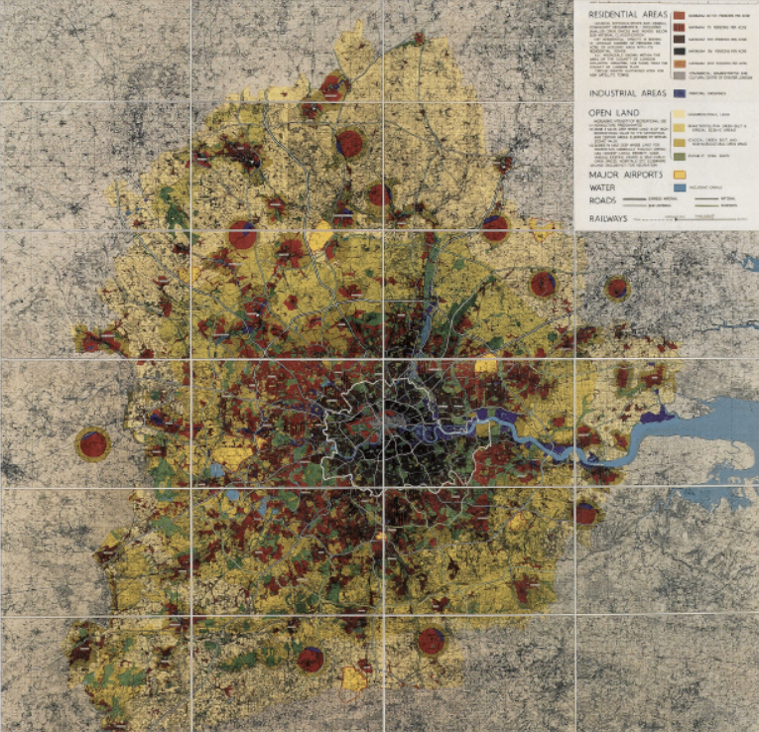
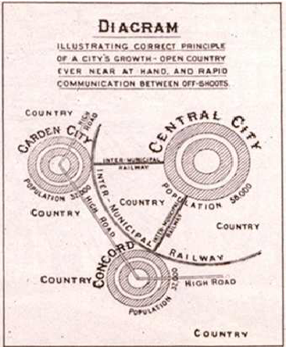
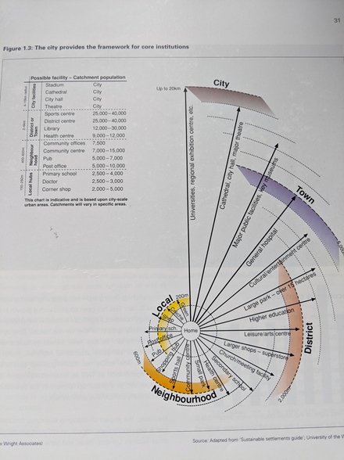
Homage to the Green Belt
The Urban Task Force maintained a very traditional idea of the rural-urban divide that would be familiar with readers of Howard’s Garden Cities of To-morrow or Abercrombie’s 1944 London Plan
The one dissenting figure was Sir Peter Hall who insisted on a dissenting footnote in the much shorter Towards a Strong Urban Renaissance in which he insisted that there was scope for considerate development on ‘green’ sites and that not all the regeneration that was needed could be achieved through brownfield development alone.

Slide 5
Towards an Urban Renaissance Objectives to 2021
All urban neighbourhoods will be managed according to the principles of sustainable development. The main environmental indicators - air pollution, ground contamination, energy use, waste recycling and waste disposal - will show significant improvement.
A more balanced national economy will allow for more even distribution of economic opportunities and income within cities, between cities, and between regions. Key social indicators, such as educational achievement, health, crime and poverty, will have improved.
There will be substantial increase in recycling of previously-developed ‘brownfield’ land in line with local needs and projected demand for housing. A parallel decrease in demand for greenfield sites will have taken place.

Slide 6
TUR Objectives
There will be urban repopulation with year on year growth in the number of people living in towns and cities. Movement will have taken place from the outskirts to inner areas and distinctions between market and social housing will have become blurred.
There will be increased quality of life with at least five major English cities in the European ‘top 50’. None will be in the bottom third.
Attitude surveys will show that people and investors take a positive view of urban areas, enjoy living in towns and cities, and regard them as safe and attractive places to raise children.
England will enjoy a world-wide reputation for innovation in sustainable and high quality urban design.
Public services such as health, education and social services will include a clear urban dimension that specifically addresses the needs and aspirations of urban communities.

Slide 7
TUR Objectives
All urban areas will be managed according to standards agreed by the local community.
England will have become the leading international location to acquire urban development skills, (DETR, 1999, pp. 2-3).

Slide 8
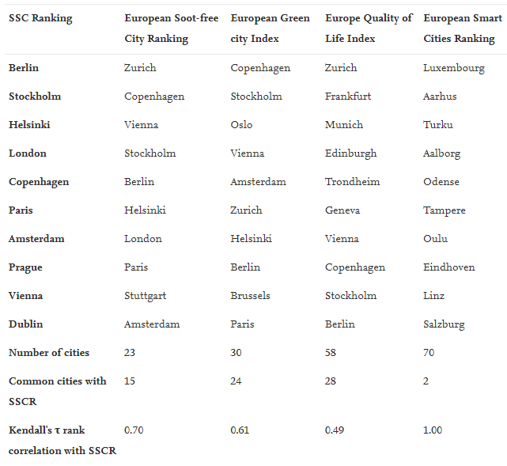
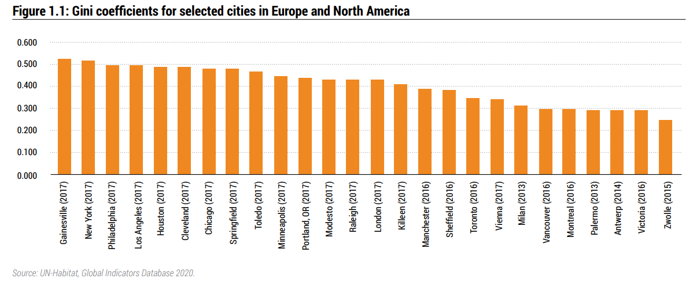
Sustainable development
Only London appears in the top 10 of the Lisbon ranking for smart sustainable cities in Europe

Slide 9
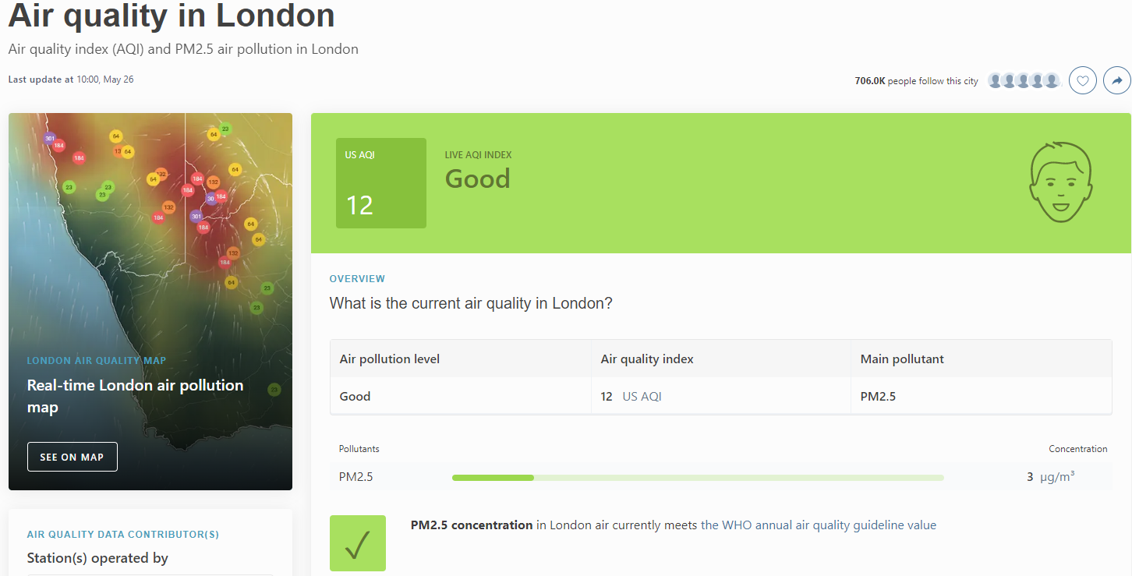
Sustainable development
London is 81st in the world for air quality. No other UK cities below that.
Part of the credit must go to the introduction of congestion charging by the Livingstone administration and ULEZ under Sadiq Khan

Slide 10
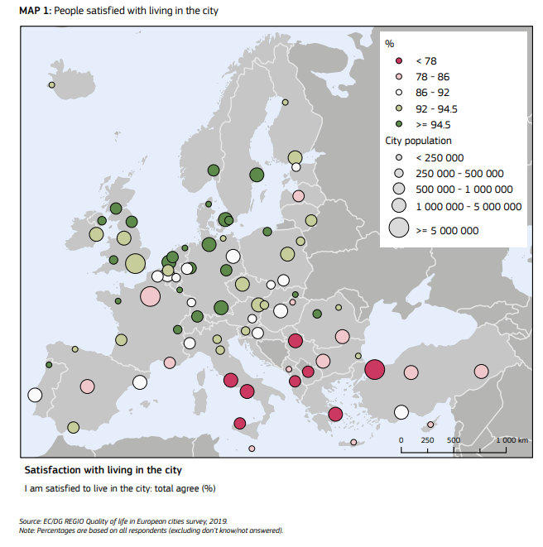
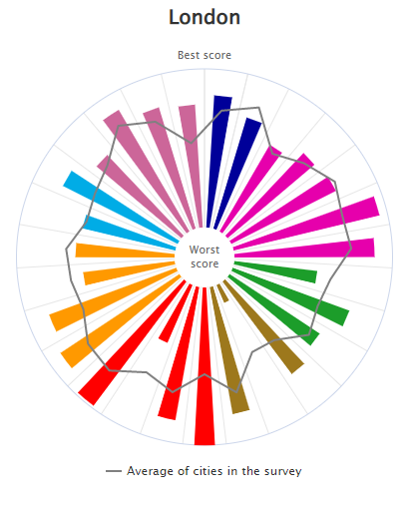
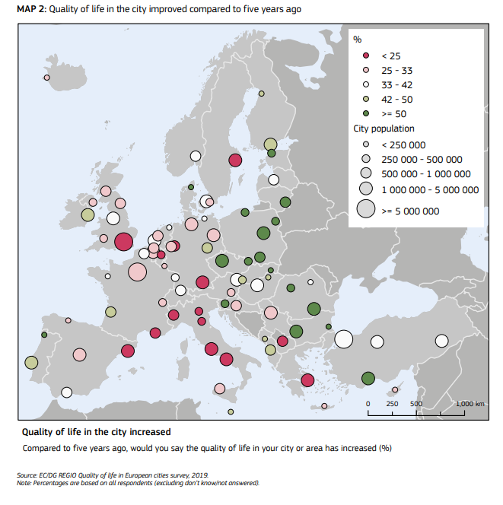
Quality of life
Outliers: air quality satisfaction (green) 57% (Euro average = 62%)
Housing is affordable (teal) 14% (Euro average = 39%) Pub transport affordable 59% (Euro average = 79%)

Slide 11
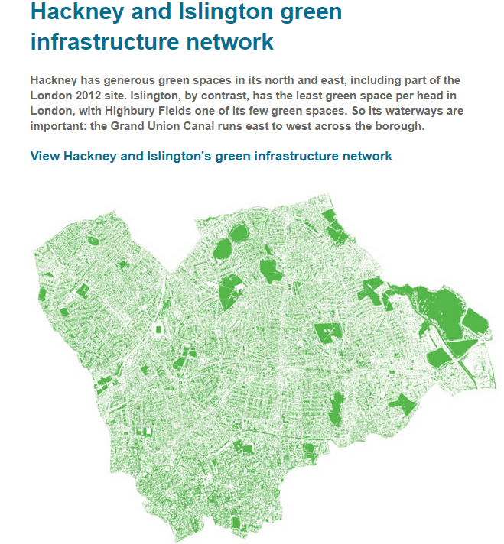
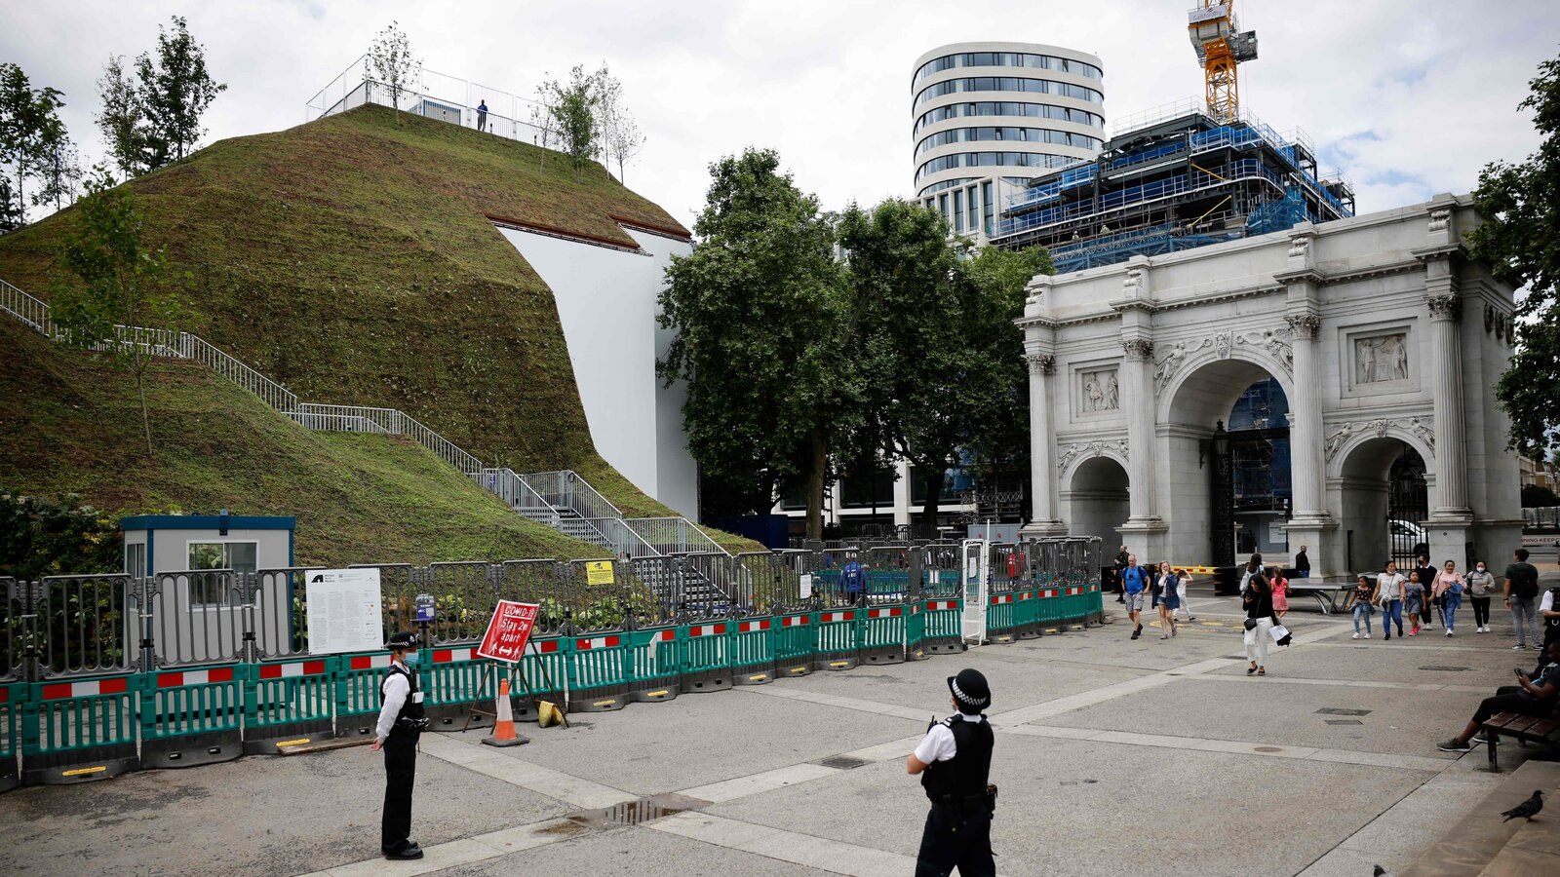
Innovation in sustainable and high quality urban design?
CABE - Commission for Architecture and the Built Environment
Est in 1999 on recommendation of UTF. Funded by both the Department for Culture, Media and Sport and the Department for Communities and Local Government. It was merged into the Design Council on 1 April 2011.
16 commissioners with advisory functions only. Including its chairman Stuart Lipton also CEO of developers Stanhope.
Responsible for Grey to Green Campaign and eco-towns initiatives
Instead of an architect embedded with every regional resource centre – the Design Council has become a residual consulting and advisory resource. Its partnerships are inevitably ad hoc and there is no statutory obligation to make design quality a
requirement of new housing and commercial developments or environmental and infrastructure projects

Slide 12
PPG3 on Housing
Ensure planning schools and courses take board new ways of thinking and working
Producing guidance on best practice
Regional road shows for key staff and members from regional bodies and local planning authorities
Greater role for inspectors, examination in Public Panels and Public Examination Panels. Regional Planning Guidance and planning appeals against key procedures and principles in the new guidance
Sec of State to use call in powers to enforce new policies (consistent with T&CPA 1947)
Stress on role of Regional Development Agencies (RDAs) (since abolished) and European Spatial Development Perspective (since abandoned).
Stress on regional planning guidance and enhanced role for Government Regional Offices.
Oppose release of greenfield sites for development by individual LAs at regional level in order to force the regeneration of derelict brownfield sites for redevelopment in inner cities.

Slide 13
4 million houses by 2021?
Category | Total 200-2019
All | 3,559,410
Private | 2,968,420
Local Authority | 31,630
Housing Assoc. | 559,410

Slide 14
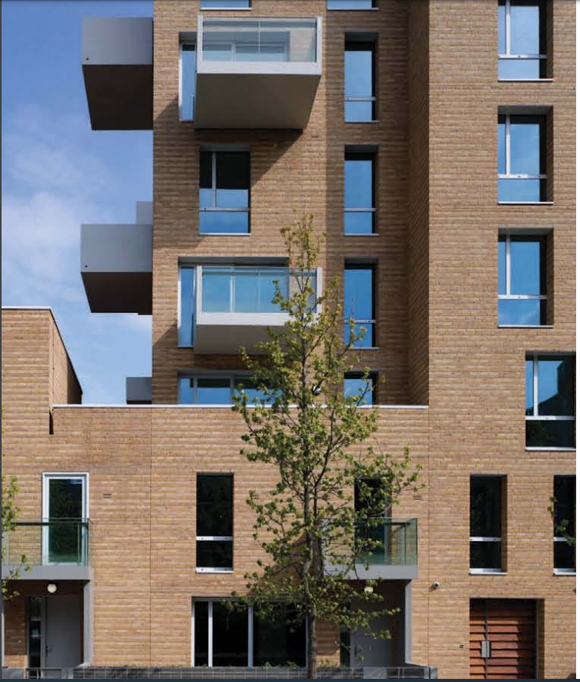
The new London vernacular
Maximum number of homes have own front doors directly opening to the street, often through the use of maisonettes at lower levels (Fig 5)
Ground floors are taller than intermediate floors, or combine with first floor as maisonettes to create a pronounced podium to upper floors
Elevations are wholly or predominantly faced in brickwork
Elevations are topped with a parapet
Brick parapet functions as a balustrade to units set back on top floor and in some cases is raised to around 3m with cut-outs offering views from behind
Top-floor units are oversized as penthouses or wheelchair accessible apartments for larger families, with very private outdoor space behind brick parapets
Internal circulation space is rarely shared by larger family units, which either have direct access from the street or are served by galleries or decks on the top floor.

Slide 15
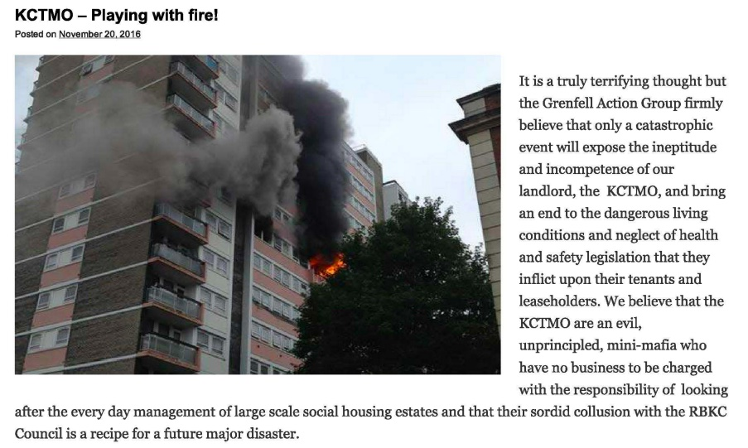

Slide 16
The decline of regional inner-city areas and communities

Slide 17
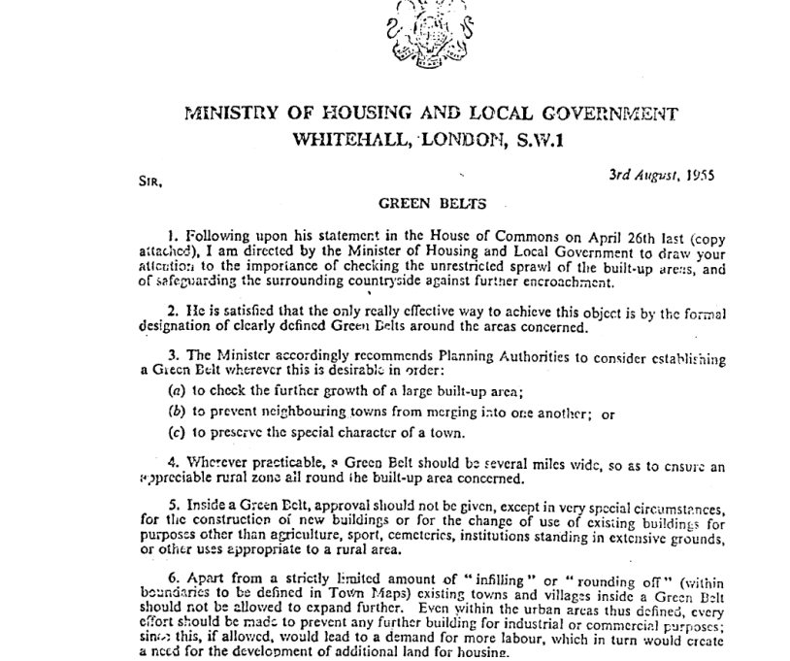
Urban renaissance – forward to the past?
Much of the idea of how modern urban societies in TUR is drawn from the turn of the last century and from the still dominant values of the Town and Country Planning Act of 1947 and the notorious “Green Belts” Circular 42/55 which referred to the ‘importance of checking the unrestricted sprawl of the built-up areas’.
Brief 3 of the UTF was to tackle ‘suburban sprawl and associated social and economic decline within inner-city areas.’

Slide 18
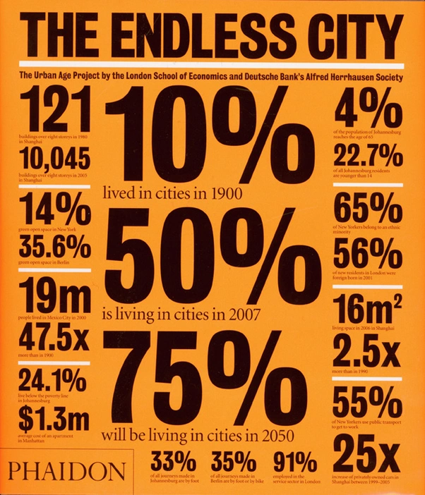
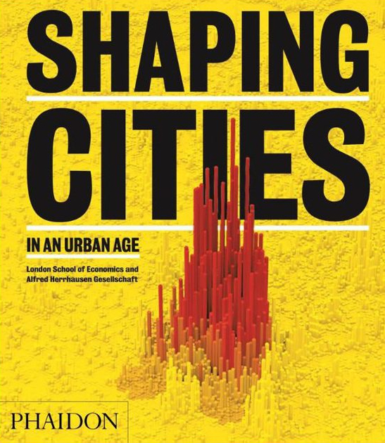
The city is dead! Long live the city!
New patterns and pathways of urbanization are emerging around the world, and these transformations require a radical rethinking of inherited approaches to urban theory and research…requir[ing] scholars to rethink inherited disciplinary divisions of labor (e.g. urban studies vs. agrarian studies) and sociospatial binarisms (e.g. urban/rural; city/countryside; industrial/agrarian; society/nature). Brenner + Balakrishnan
The relation between urban form and population density is a key dynamic of urban sustainability. Higher densities can facilitate more efficient public transport, walking and cycling, more integrated services and promote urban vitality. Lower densities and urban sprawl stretch all forms of urban infrastructure, while contributing to pollution and social exclusion. Burdett et al. Urban Age/LSE Cities.

