Slide 1
Into the pandemic and out of the fire?
A review of the incidence of paediatric burns before and during national lockdown
Miss S. Green, Mr D. Ronan, Mr D. Ralston

Slide 2
Introduction
Nationally enforced lockdown has produced a dramatic lifestyle change across all age groups
Recent studies suggest the incidence of adult burns has significantly fallen
Well defined, accurately recorded data set for analysing changes in incidence

Slide 3
Objectives
Determine incidence of burns pre-pandemic, within lockdown and inter-lockdown time periods, and compare these phases
Review types of burns and whether the aetiology differed during these time periods

Slide 4
Methods
Analysed 788 patient records from April 2019 to January 2021
Time period further broken down into Pre-Covid (PC), and During-Covid (DC). The discreet episodes of national and regional lockdown were compared with the periods in between.
Statistical analysis of epidemiology and aetiology using Chi-square and Mann-Whitney U tests

Slide 5
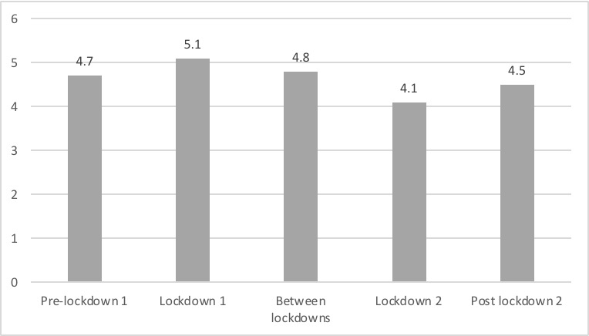
Results
Mean age at presentation
Age (Years)
p <0.3
Notes:
No significant statistical difference between phases of lockdown, or when comparing lockdown to pre lockdown

Slide 6
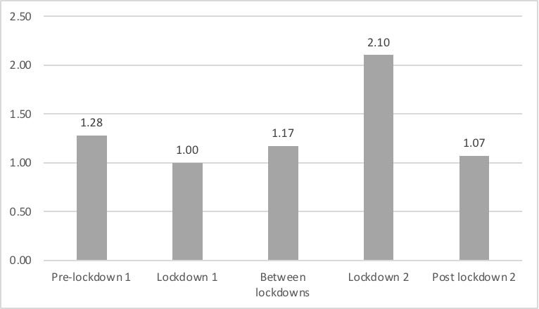
Results
Mean number of burns per day during each pandemic phase
Mean burns/day
p <0.2
Notes:
Average number of burns per day appear to have increased during lockdown 2 - however this period was during fireworks night and the annual variation is reflected on the next graph

Slide 7
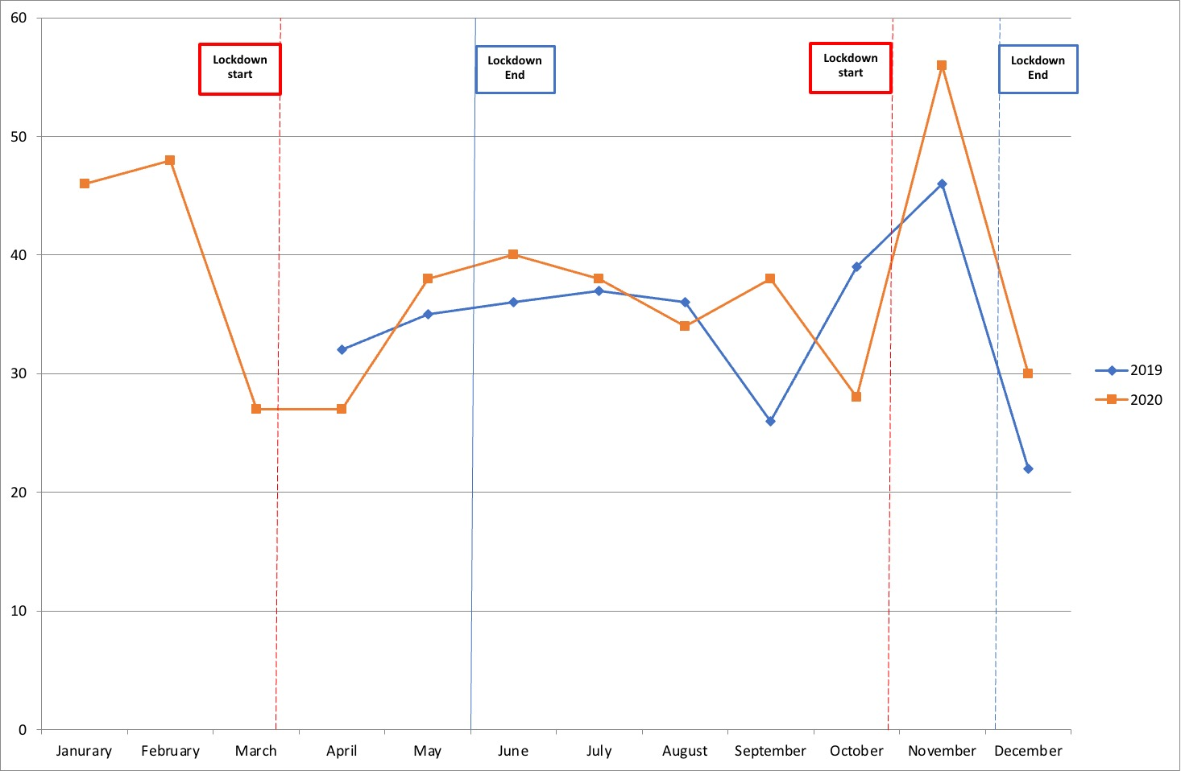
Results
Comparison of numbers of burns pre- and during-COVID
Number of burns per month
Notes:
Again, no statistical difference between the pre-pandemic year and that of covid 19, with the peak in second lockdown reflected in the 2019 data
Unable to explain discrepancy between September data points ?weather ?parties pre lockdown

Slide 8
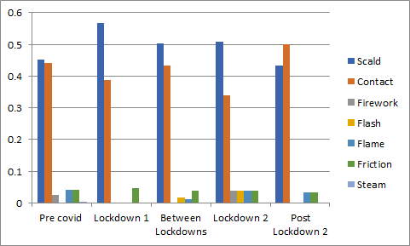
Results
Relative changes of burns aetiology during phases of the pandemic
Relative incidence of burns
by aetiology
p <0.3
Notes:
Here there appears to be an increased risk of scalds as compared to other causes of burn injuries, however this also failed to reach statistical significance

Slide 9
Conclusions
No significant differences in incidence of paediatric burns during any phase of the pandemic
Despite increased parent/carer presence, incidence or aetiology did not change significantly
The usual cause of paediatric burns is unchanged during periods of lockdown - domestic burns
Similar future situations may require redirection of resource as adult burns have been shown to decrease during periods of lockdown
Notes:
Most children pre-school age - not affected really by lockdown changes
Sheffield representative of UK - mix of socioeconomic backgrounds

Slide 10
Thank you

