Slide 3
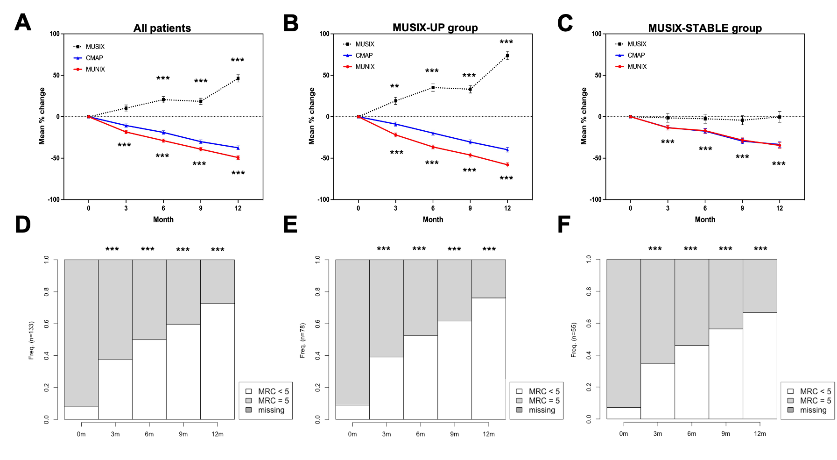
Notes:
Figure 1. Longitudinal changes in MUNIX, MUSIX and distribution of MRC muscle strength score.
A. Longitudinal changes for all participants showing group level decreases in MUNIX/CMAP, with concomitant increases in MUSIX.
B. Longitudinal changes in the MUSIX-UP group.
C. Longitudinal changes in the MUSIX-STABLE group. Here, MUSIX does not increase and, as expected CMAP and MUNIX are largely identical.
D. Longitudinal changes of the proportion of MRC scores for all participants.
E. Longitudinal changes of the proportion of MRC scores for MUSIX-UP group.
F. Longitudinal changes of the proportion of MRC scores for MUSIX-STABLE group.
Brackets denote SEM. Asterisks denote p-values for MUSIX (upper half) and MUNIX (lower half P value represents MUSIX-UP vs. MUSIX-STABLE. *p<0.05, **p<0.01, ***p<0.001). The term logit refers to the log odds of having an MRC score < 5. See supplemental tables for further details of CMAP and MRC score statistics.

Slide 4
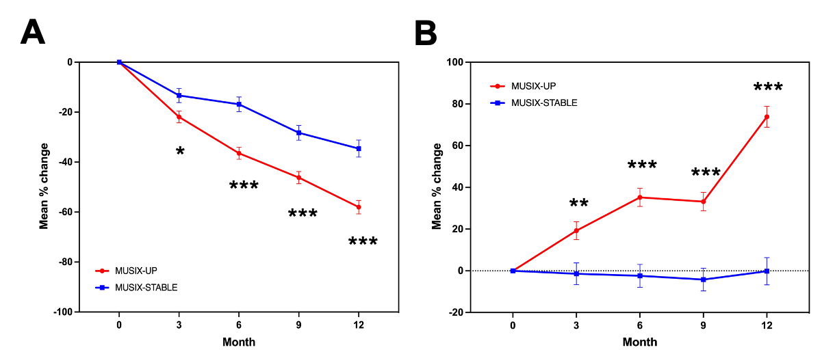
Notes:
Figure 2. Reinnervation is associated with greater motor unit loss.
A. Significant differences in MUNIX are seen between the MUSIX-UP and MUSIX-STABLE groups.
B. Significant differences in MUSIX are seen between the MUSIX-UP and MUSIX-STABLE groups.
Asterisks denote p-values: *p<0.05, **p<0.01, ***p<0.001.

Slide 5
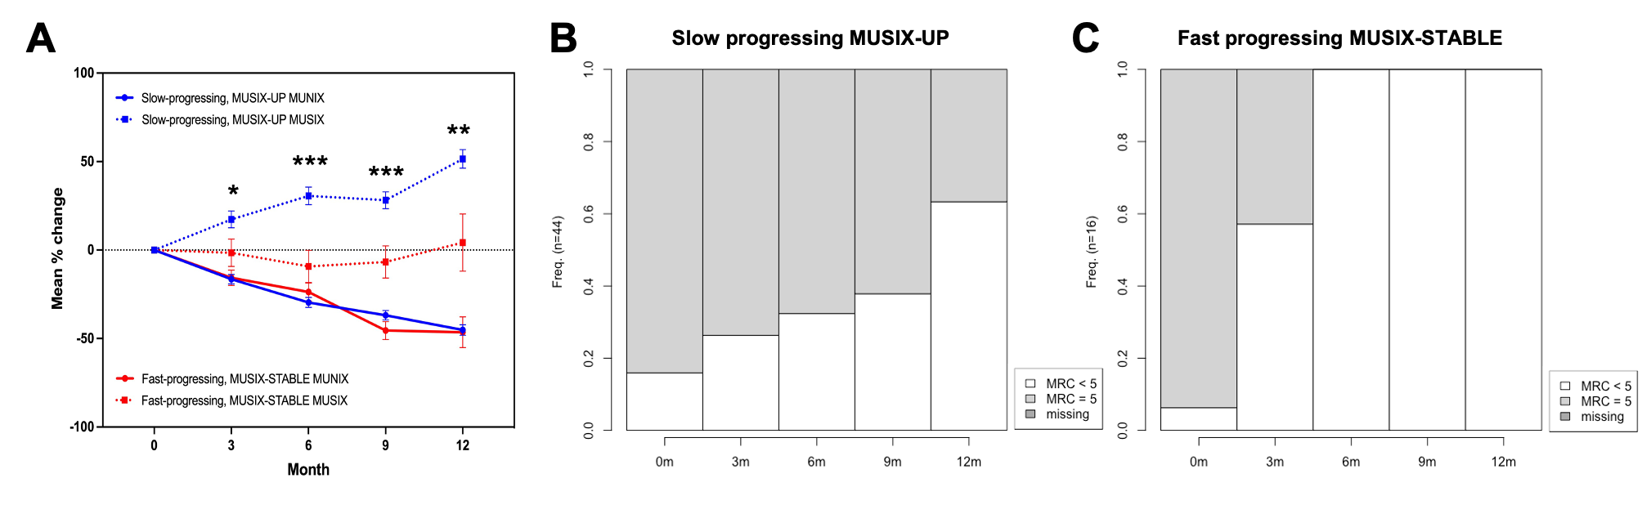
Notes:
Figure 3. Lack of MUSIX is associated with a more rapid loss of muscle strength.
A. Muscles in the fast MRC progression MUSIX-STABLE group lose motor units (MUNIX) at a similar rate to the slow MRC progression MUSIX-UP group. Asterisks denote P-values for MUSIX (upper half). *P<0.05, **P<0.01, ***P<0.001.
B. Longitudinal changes of the proportion of MRC scores for slow MRC progression MUSIX-UP group.
C. Longitudinal changes of the proportion of MRC scores for fast MRC progression MUSIX-STABLE group.

Slide 6
Supplemental

Slide 8
Supplementary table 2. The mean longitudinal changes from the linear mixed-effects models and logits from the logistic mixed-effects model for the complete cohort (i.e. all muscles).
CMAP, compound muscle action potential; MRC, medical research council; MUNIX, motor unit number index; MUSIX, motor unit size index
Linear mixed-effects models |  |  |  |  |  |  | Logistic mixed-effects model (MRC change)
Month | CMAP | p-value | MUNIX | p-value | MUSIX | p-value | Logit | p-value
3 | -10.55 | < 0.001*** | -18.43 | < 0.001*** | 10.5 | 0.129 | 13.46 | < 0.001***
6 | -18.90 | < 0.001*** | -28.80 | < 0.001*** | 20.63 | < 0.001*** | 32.48 | < 0.001***
9 | -30.09 | < 0.001*** | -39.16 | < 0.001*** | 18.56 | < 0.001*** | 45.07 | < 0.001***
12 | -37.45 | < 0.001*** | -49.22 | < 0.001*** | 46.32 | < 0.001*** | 56.07 | < 0.001***

Slide 9
Supplementary table 3. The mean longitudinal changes from the linear mixed-effects models and logits from the logistic mixed-effects model for the MUSIX-UP muscles.
CMAP, compound muscle action potential; MRC, medical research council; MUNIX, motor unit number index; MUSIX, motor unit size index
Linear mixed-effects models |  |  |  |  |  |  | Logistic mixed-effects model (MRC change)
Month | CMAP | p-value | MUNIX | p-value | MUSIX | p-value | Logit | p-value
3 | -8.88 | 0.004** | -21.91 | < 0.001*** | 19.25 | 0.003** | 15.09 | < 0.001***
6 | -19.74 | < 0.001*** | -36.43 | < 0.001*** | 35.24 | < 0.001*** | 29.46 | < 0.001***
9 | -30.47 | < 0.001*** | -46.19 | < 0.001*** | 33.18 | < 0.001*** | 49.89 | < 0.001***
12 | -39.76 | < 0.001*** | -58 | < 0.001*** | 73.86 | < 0.001*** | 63.4 | < 0.001***

Slide 10
Supplementary table 4. The mean longitudinal changes from the linear-mixed effects models and logits from the logistic mixed-effects model for the MUSIX-STABLE muscles.
CMAP, compound muscle action potential; MRC, medical research council; MUNIX, motor unit number index; MUSIX, motor unit size index
Linear mixed-effects models |  |  |  |  |  |  | Logistic mixed-effects model (MRC change)
Month | CMAP | p-value | MUNIX | p-value | MUSIX | p-value | Logit | p-value
3 | -13.05 | < 0.001*** | -13.30 | < 0.001*** | -1.42 | 1 | 9.46 | < 0.001***
6 | -17.42 | < 0.001*** | -16.83 | < 0.001*** | -2.41 | 0.996 | 19.36 | < 0.001***
9 | -29.41 | < 0.001*** | -28.25 | < 0.001*** | -4.18 | 0.971 | 31.95 | < 0.001***
12 | -33.45 | < 0.001*** | -34.56 | < 0.001*** | -0.21 | 1 | 35.52 | < 0.001***

Slide 11
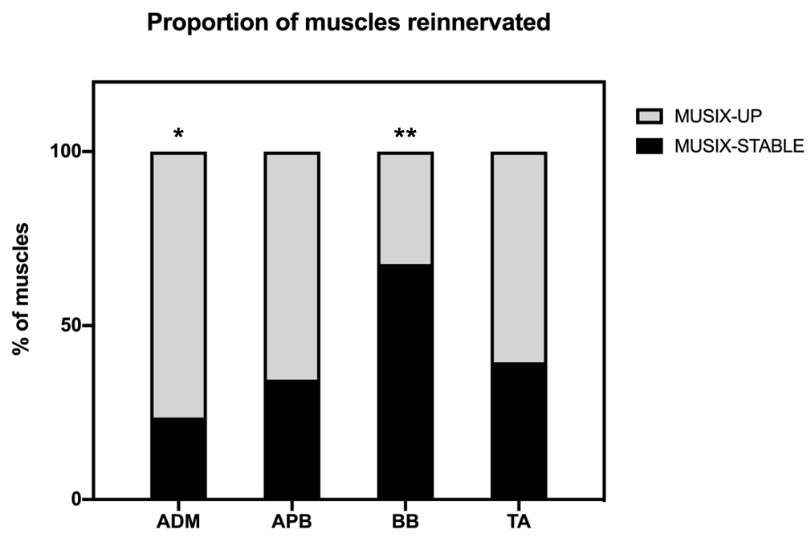
Notes:
Supplementary figure 1.
Distribution of MUSIX change by individual muscles. ADM had significantly more muscles allocated to the MUSIX-UP group, while biceps had significantly more allocated to the MUSIX-STABLE group. No significant difference in the proportion of muscles allocated to the MUSIX-UP and MUSIX-STABLE groups was seen in APB or BB. *p<0.05, **p<0.01.

Slide 12
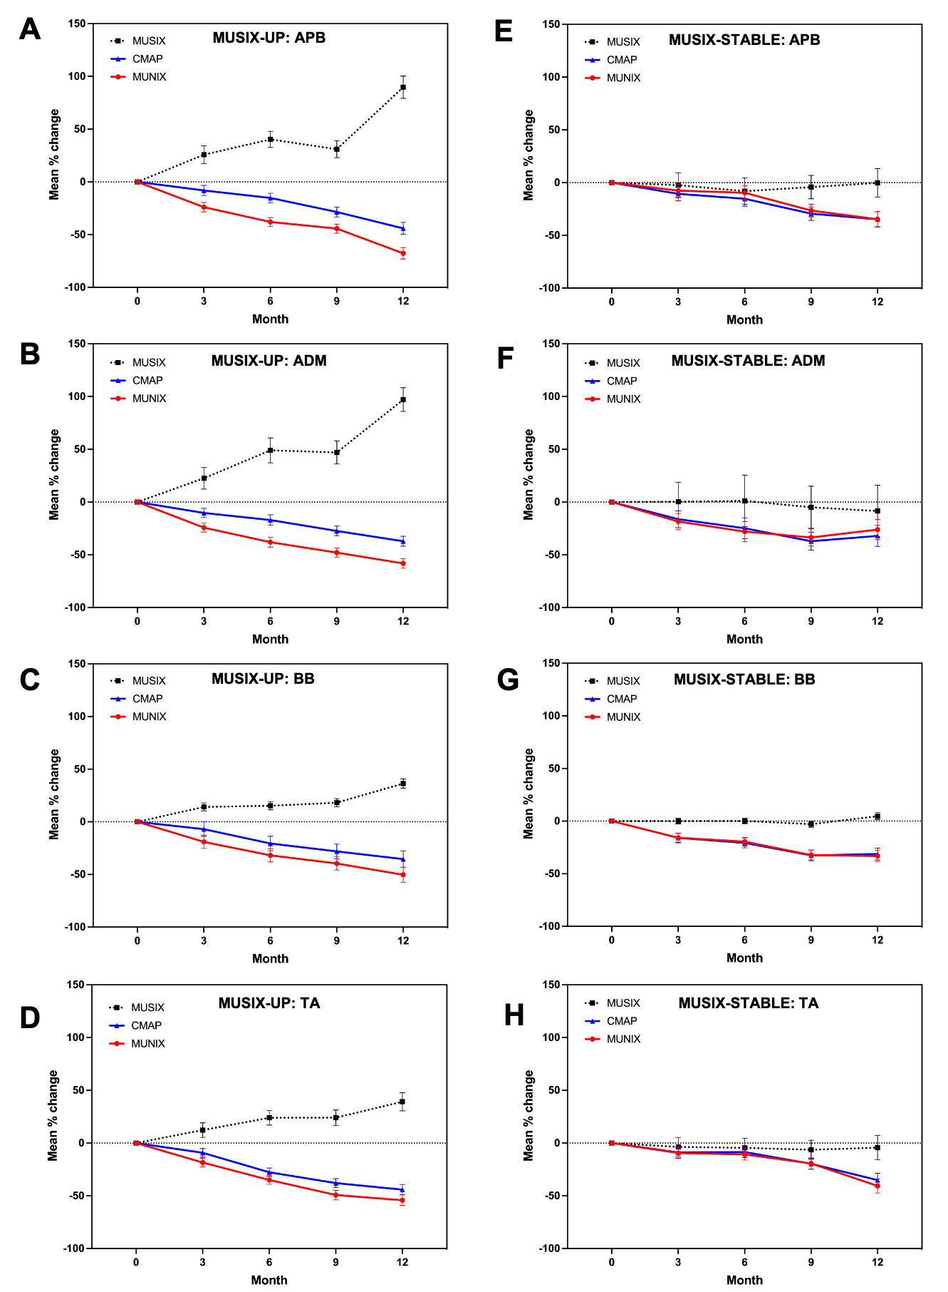
Notes:
Supplemental figure 2. Longitudinal data for individual muscles.
A-D. Longitudinal plots for MUNIX/MUSIX/CMAP for individual muscles in the MUSIX-UP group. Particularly prominent MUSIX increases are seen in the hand muscles (APB/ADM).
E-H. Longitudinal plots for MUNIX/MUSIX/CMAP for individual muscles in the MUSIX-STABLE group. The change in parameters was largely consistent across the different muscles.

Slide 13
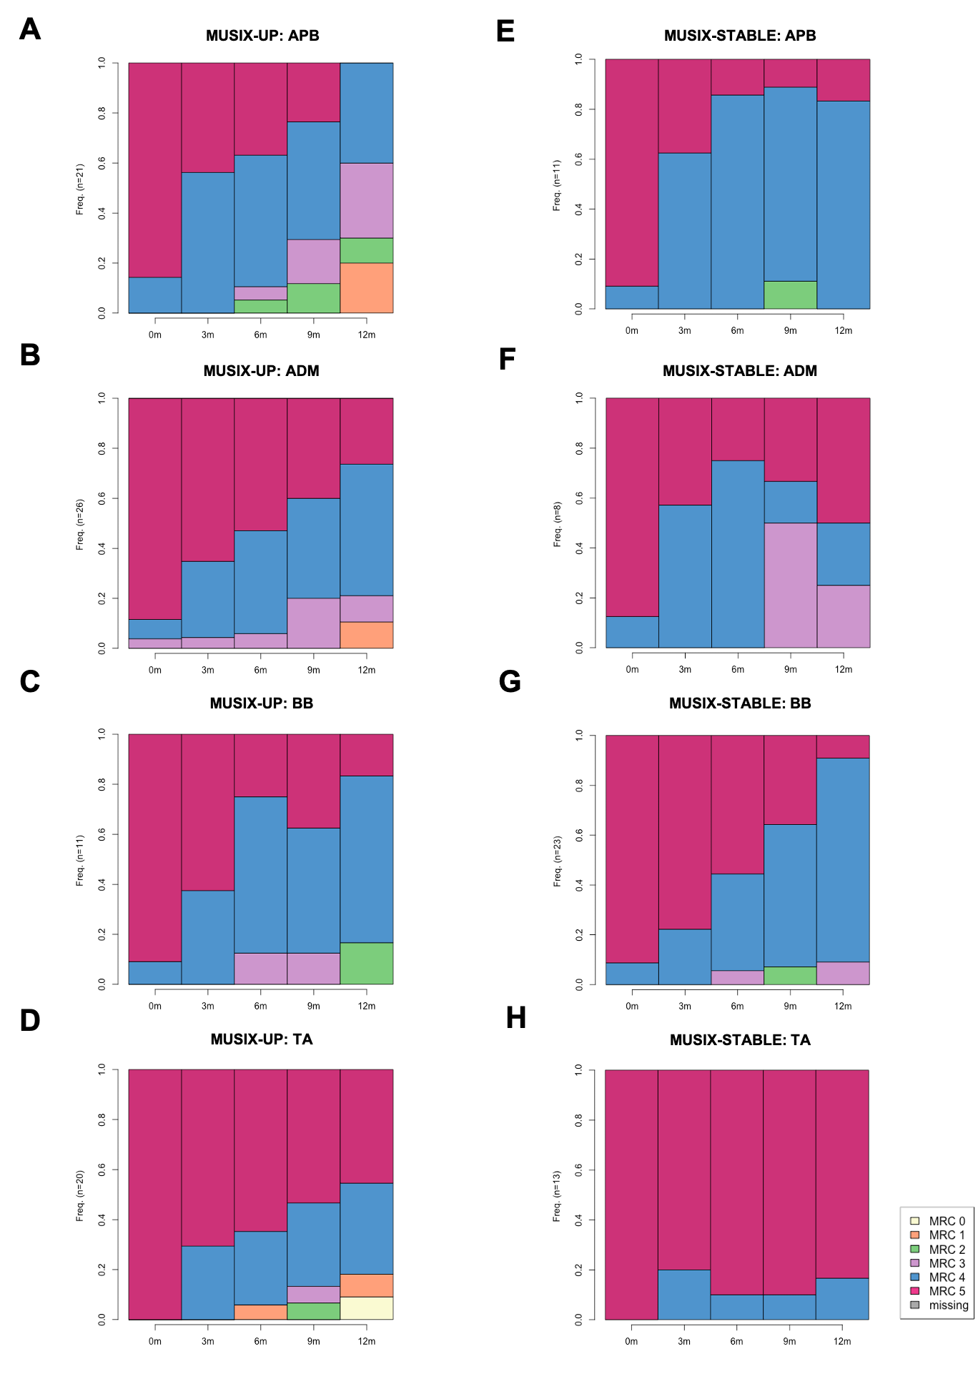
Notes:
Supplemental figure 3. Longitudinal MRC score distributions for individual muscles
A-D. Lasagna plots for longitudinal change in the proportion of MRC scores for individual muscles in the MUSIX-UP group.
E-H. Lasagna plots for longitudinal change in the proportion of MRC scores for individual muscles in the MUSIX-STABLE group.

