Slide 1
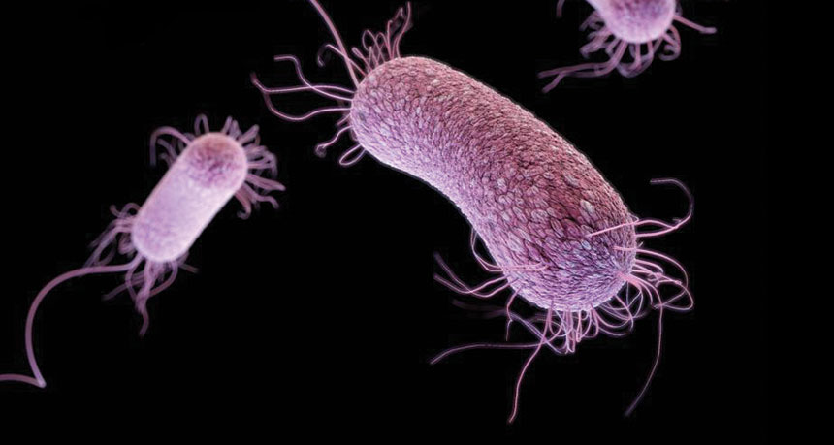
Use of Pseudomonas serum antibodies in a tertiary cystic fibrosis centre
Neil Lawrence, Frank Edenborough
Sheffield Adult Cystic Fibrosis Centre, Sheffield Teaching Hospitals NHS foundation trust, United Kingdom
Background
Results
185 patients studied
The most common sputum pathogen in cystic fibrosis is Pseudomonas aeruginosa (P. aeruginosa). Caught early, this can be eradicated with antibiotics (1), but in 10-40% of cases eradication fails leaving patients with chronic infection associated with reduced life expectancy (2) despite long term treatment (3).
Cough swab and sputum results have a good positive predictive value (PPV) but a poor negative predictive value (NPV) (4). Serum antibodies to P. aeruginosa have a PPV >80% and a NPV >95% (5), and their measurement may provide an earlier opportunity to begin treatment for eradication.
Patients with previous lung transplantation or on Ivacaftor were excluded.
Table 1: Comparison of baseline and characteristics of those tested and not tested
 | PAbs done n = 56 | PAbs not done n = 129 | P-value
Patients classified as chronic Pseudomonas | 13 | 98 | < 0.001
Patients classified as intermittent or no Pseudomonas | 43 | 31 | < 0.001
Age in years, (IQR) | 24 (18 – 33) | 27 (22 – 34) | 0.024
Pancreatic insufficient (%) | 28 (50%) | 114 (88.4%) | < 0.001
CF Related Diabetes, (%) | 5 (8.9%) | 37 (28.7%) | 0.003
BMI, (IQR) | 23.8 (22.2 – 28.3) | 22.3 (19.8 – 24.9) | 0.001
% FEV1, (IQR) | 92 (81 – 98) | 76 (52 – 90) | < 0.001
IV days, median (IQR) | 0 (0 – 13) | 21 (1 – 39) | < 0.001
74 culture negative for
P. aeruginosa
111 culture positive for
P. aeruginosa
13 patients PAbs measured
inappropriately
43 patients had PA
measured
31 had no PA measured
5 patients had +ve PA
with clinical deterioration
38 patients had +ve PA
without deterioration
Computer Graphic depicting Pseudomonas aeruginosa
(6)
Table 2: Comparison of investigations of those tested and not tested
Objectives
 | PAbs done n = 56 | PAbs not done n = 129 | P-value
Sputum producer, (%) | 26 (46.4%) | 113 (87.6%) | < 0.001
Total respiratory samples, median (IQR) | 5 (3 – 6) | 7 (4 – 10) | 0.001
Sputum, median (IQR) | 0 (0 – 3) | 4 (1 – 8) | < 0.001
Cough swabs, median (IQR) | 3 (2 – 5) | 1 (0 – 3) | < 0.001
1 patient was started on
eradication treatment
To review the use of P. aeruginosa serum antibodies (PAbs) in a medium sized adult cystic fibrosis centre, and to standardise their future use through production of a specific guideline.
Discussion
Method
Consensus guidelines state that P. aeruginosa infection should be treated energetically and early (8). This approach has resulted in a delay in the onset of chronic infection in the UK CF population (9).
Those patients without chronic Pseudomonas were younger, healthier had higher BMI, were more often pancreatic sufficient and had less CF related diabetes. They had higher % FEV1, required fewer days IV antibiotics and were less likely to produce sputum, produced fewer respiratory samples overall (less clinic attendances), and we therefore relied more on cough swab samples than sputum, hence the need to measure PAbs to detect early infection.
Although the trend for our measurement is sensible, our testing has been haphazard and not guided by a departmental consensus. 13 patients had their PAbs measured despite being registered in the department as chronically infected with P. aeruginosa. These results cannot be interpreted as there is no literature studying PAbs following treatment of infection. 31 patients culture negative for P. aeruginosa did not have PAbs measured. A PAbs level would be useful to refer to in the future if they were to clinically deteriorate, but we were to fail to grow anything in culture. Our department would benefit from a protocol to standardise PA measurement in the future.
The microbiological and serological results for all Sheffield CF patients in 2015 were reviewed. We assessed how many microbiological samples each patient provided, and what proportion of these were sputum or cough swab. We assessed lung function through %FEV1 vs. predicted, how many days of IV antibiotics each patient received, BMI, age and the presence of diabetes or pancreatic insufficiency.
The PAbs results were tabulated to find out how many patients on the register had rising levels of titres despite no microbiological evidence of current P. aeruginosa infection, in order to assess how serum antibodies changed management.
Guideline
Guideline for the measurement of P. aeruginosa serum antibody levels in adult cystic fibrosis patients
Never order Pseudomonas serum antibodies if a patient is known to have chronic Pseudomonas
Don’t order if had levels within 3 months
Please order Pseudomonas serum antibodies per the following criteria:
1) Annual Review:
All patients who are listed as No history of Pseudomonas, Intermittent Pseudomonas infections or Pseudomonas screen –ve (but have had in the past) , should have Pseudomonas serum antibodies every year at their annual review.
2) Clinical Suspicion:
Patients listed as Pseudomonas negative or those suffering from intermittent Pseudomonas infections can also have their Pseudomonas serum antibodies measured because of clinical suspicion: If there is suspicion that the patient is deteriorating due to an unidentified infection, Pseudomonas antibodies can be measured provided it is longer than 3 months since the last time they were measured.
Technical Assay Details
PA have been measured at Leeds General Infirmary using the CF-pseudomonas-IgG ELISA kit from SSI diagnostica (product code 64742), since 7th October 2011. Kit insert states that ‘Non-specific antibodies due to cross-reactivity between P. aeruginosa and other bacterial species are low and correlates with taxonomic relatedness... The normal ELISA unit value of non-P. aeruginosa infected CF patient of P. aeruginosa IgG is 0.57 +/- 2.39 (mean +/- 2 times standard deviation). The 95% upper normal limit is therefore 2.96 and a significant increased titre compared to non-P. aeruginosa infected CF patients is = or > 2.96 Units.’ (7) .
Conclusion
PAbs offer an opportunity to detect and treat infection earlier. Attempting to grow P. aeruginosa on cough swab samples is insensitive (4). Rising PAbs with negative sputum culture warrant further investigation. These results show we appropriately targeted PA for those who were culture negative and provided cough swabs instead of sputum samples. However, PAbs were tested haphazardly. We have developed a protocol (left) whereby we recommend PAbs would be measured in all non-chronic P. aeruginosa patients at annual review, or if there is clinical deterioration with negative sputum samples.
References:
1. Kappler M, Kraxner A, Reinhardt D, Ganster B, Griese M, Lang T. Diagnostic and prognostic value of serum antibodies against Pseudomonas aeruginosa in cystic fibrosis. Thorax. 2006;61(8):684-8.
2.Kosorok MR, Zeng L, West SEH, Rock MJ, Splaingard ML, Laxova A, et al. Acceleration of lung disease in children with cystic fibrosis after Pseudomonas aeruginosa acquisition. Pediatric Pulmonology. 2001;32(4):277-87.
3.Vidya P, Smith L, Beaudoin T, Yau YCW, Clark S, Coburn B, et al. Chronic infection phenotypes of Pseudomonas aeruginosa are associated with failure of eradication in children with cystic fibrosis. European Journal of Clinical Microbiology and Infectious Diseases. 2016;35(1):67-74.
4. Equi AC, Pike SE, Davies J, Bush A. Use of cough swabs in a cystic fibrosis clinic. Archives of Disease in Childhood. 2001;85(5):438-9.
5.Pressler T, Karpati F, Granstrom M, Knudsen PK, Lindblad A, Hjelte L, et al. Diagnostic significance of measurements of specific IgG antibodies to Pseudomonas aeruginosa by three different serological methods. Journal of Cystic Fibrosis. 2009;8(1):37-42.
6.Samoray C. Random changes in behavior speed bacteria evolution. Science News [Internet]. 2016; Feb.
7.SSI Diagnostica. Pseudomonas-CF-IgG ELISA Kit insert. 2nd ed, 2010.
8. Cystic Fibrosis Trust. Antibiotic Treatment for Cystic Fibrosis. 3rd ed, 2009
9. UK Cystic Fibrosis Registry. Annual Data report. 2015
Acknowledgements
None of the authors have any conflict of interest.
We would like to thank those at SSI Diagnostica for contributing to the costs of presenting this work.

