Slide 1
A
Cholesterol
SOAT1
Cholesteryl oleate
x
Oleoyl CoA
SH-CoA
B
Cholesterol
SOAT2
Cholesteryl palmitate
x
Palmitoyl CoA
SH-CoA
C
Cholesteryl palmitate
Cholesterol
LCAT
9.9%
+ Lysolecithin
Lecithin
(Phosphatidylcholine
[16:0/18:1])
84.4%
Cholesteryl oleate
Figure 1

Slide 2

A
PRISMA 2009 Flow Diagram
Figure 2
Records identified in SCOPUS (n = 970)
Records identified in WoS
(n = 1189)
Records identified in PubMed
(n = 847)
Records identified in Cochrane
(n = 20)
Other sources
(n = 4)
Identification
Records after duplicates removed (n = 1543)
Records excluded (n = 1333) with reasons:
Not an original research (n = 270)
Not cancer (n = 577)
In vitro/in silico (n = 242)
Ester or enzyme not studied (n = 244)
Abstracts screened
(n = 1543)
Screening
Studies assessing cholesterol esterification in cancer (n = 210)
Records excluded: Human studies (n=126)
Studies on cholesterol ester enzyme inhibition in tumours (n = 43)
Studies on cholesterol ester concentrations in tumours (n = 41)
Eligibility
Articles excluded: not SOAT or LCAT (n = 19)
Articles excluded (n = 28):
Full text not available (n = 7)
Full text not in English (n = 1)
Not matched measurements (n = 20)
Studies included in qualitative synthesis (n = 24)
Studies included in qualitative synthesis (n = 13)
Included
Studies included in quantitative synthesis (n = 24)
Studies included in quantitative synthesis (n = 10)
B
1
C
1
2
2
12
3
6
4
26
6
8
7
7

Slide 3
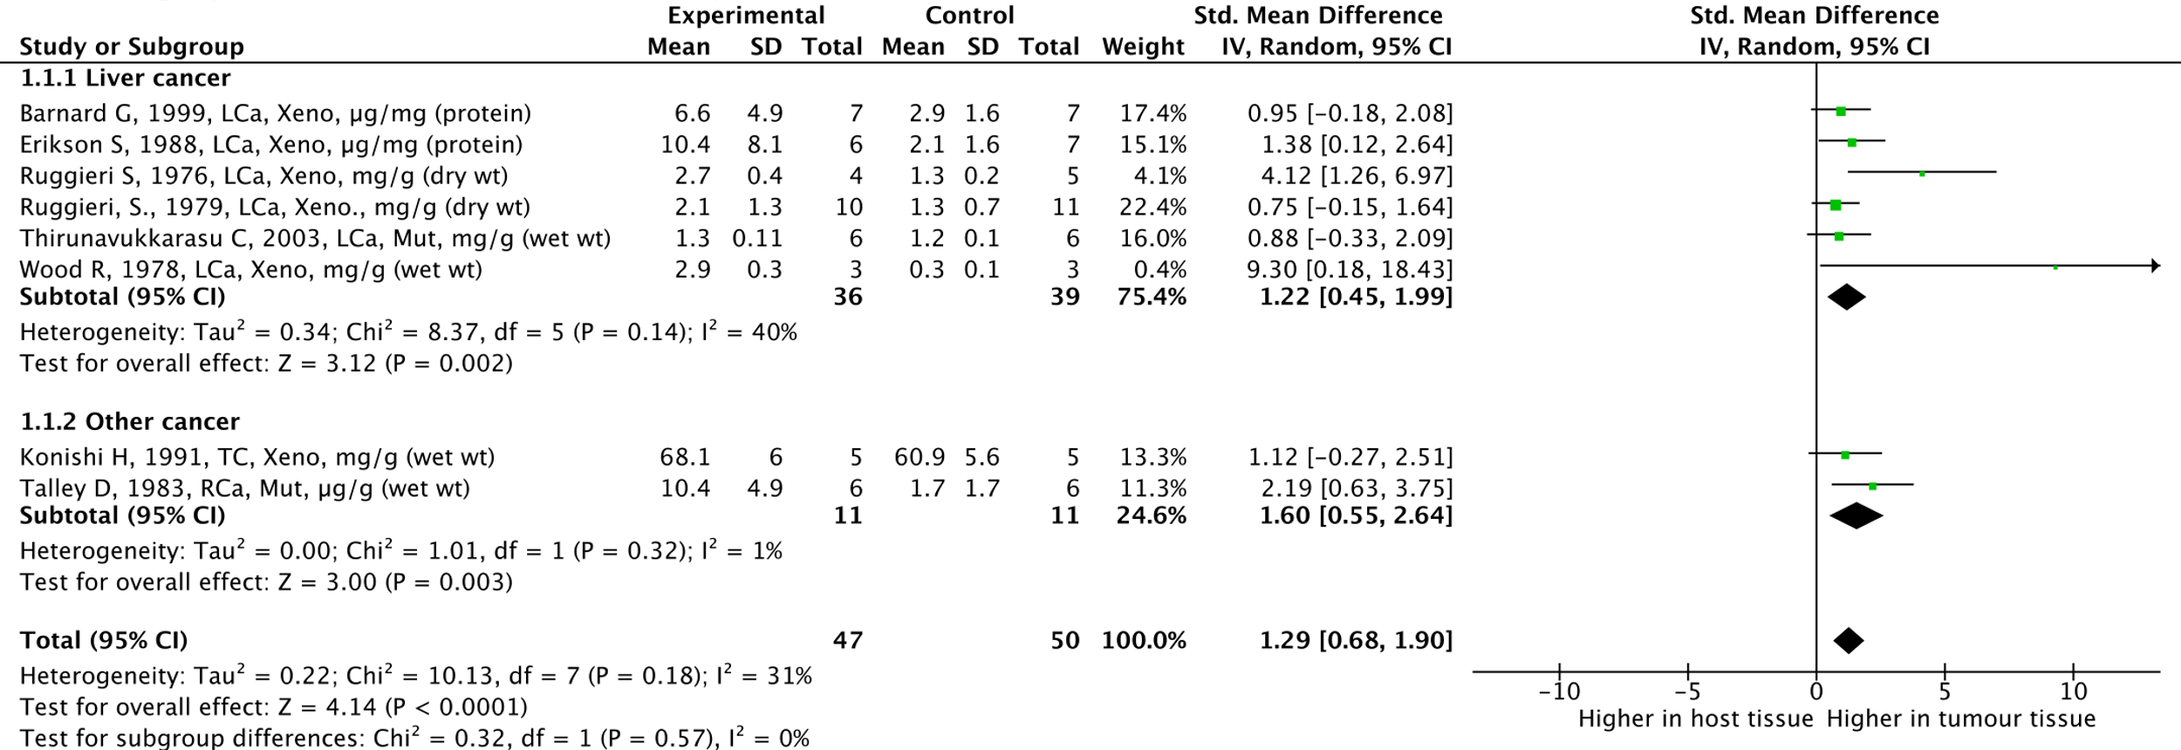
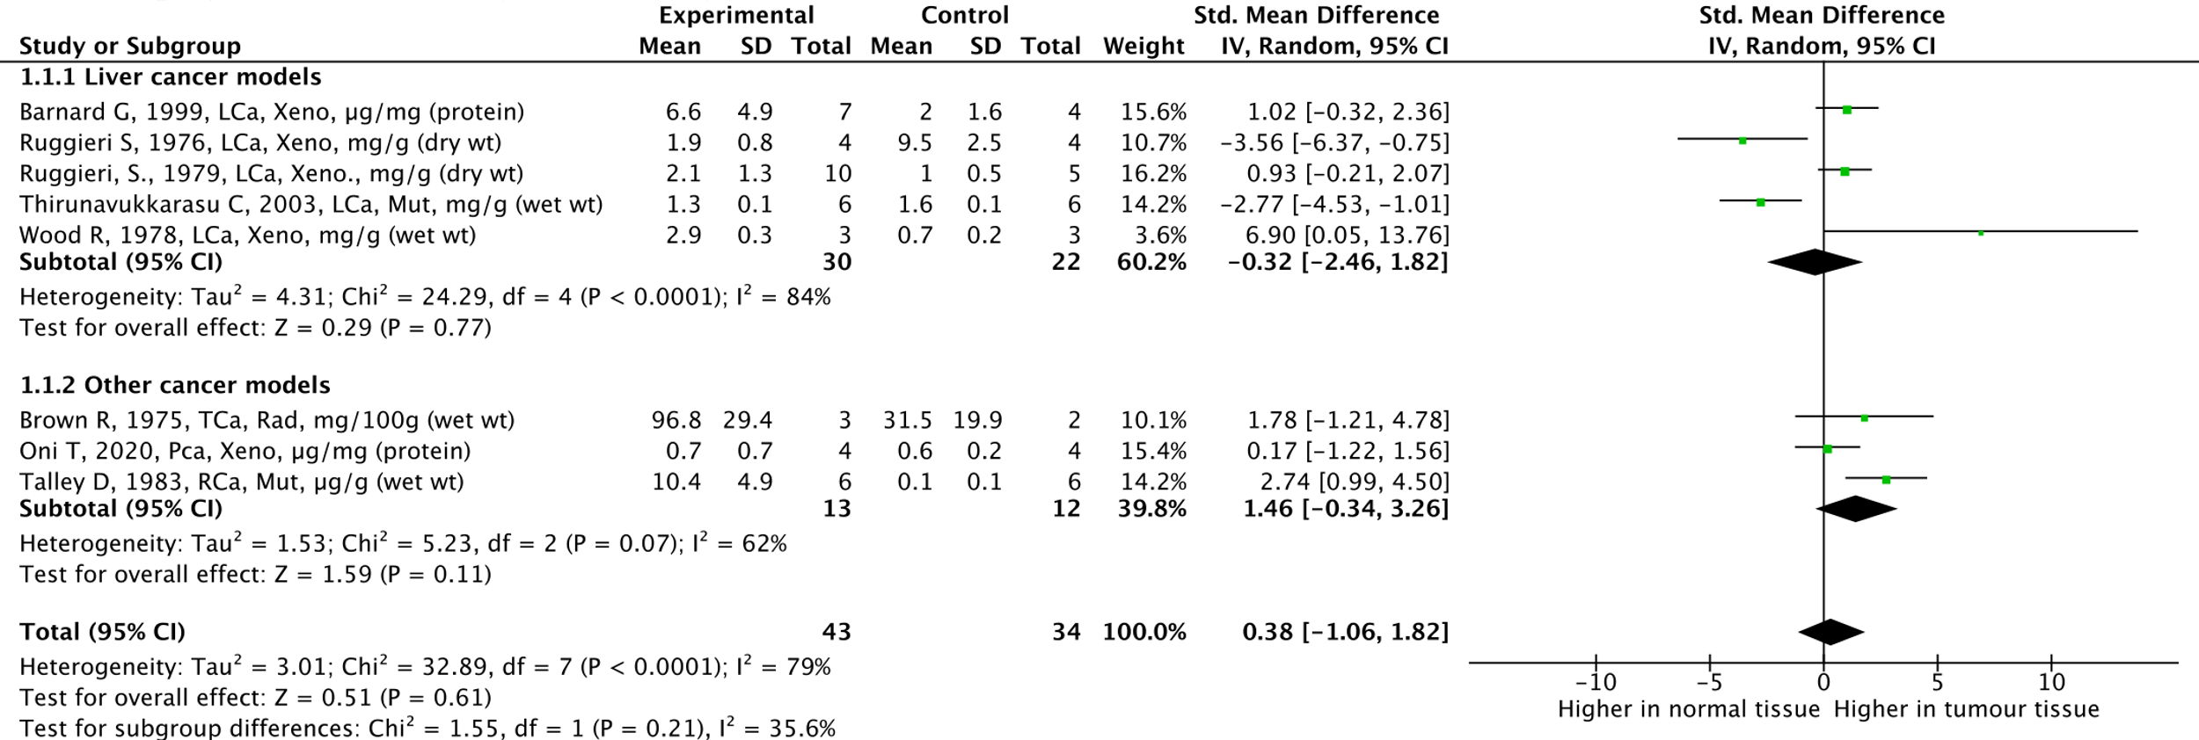
A
Liver cancer
Other cancer
Higher in intra-animal normal tissue
Higher in intra-animal tumour tissue
B
Liver cancer
Other cancer
Higher in inter-animal normal tissue
Higher in inter-animal tumour tissue
Figure 3

Slide 4
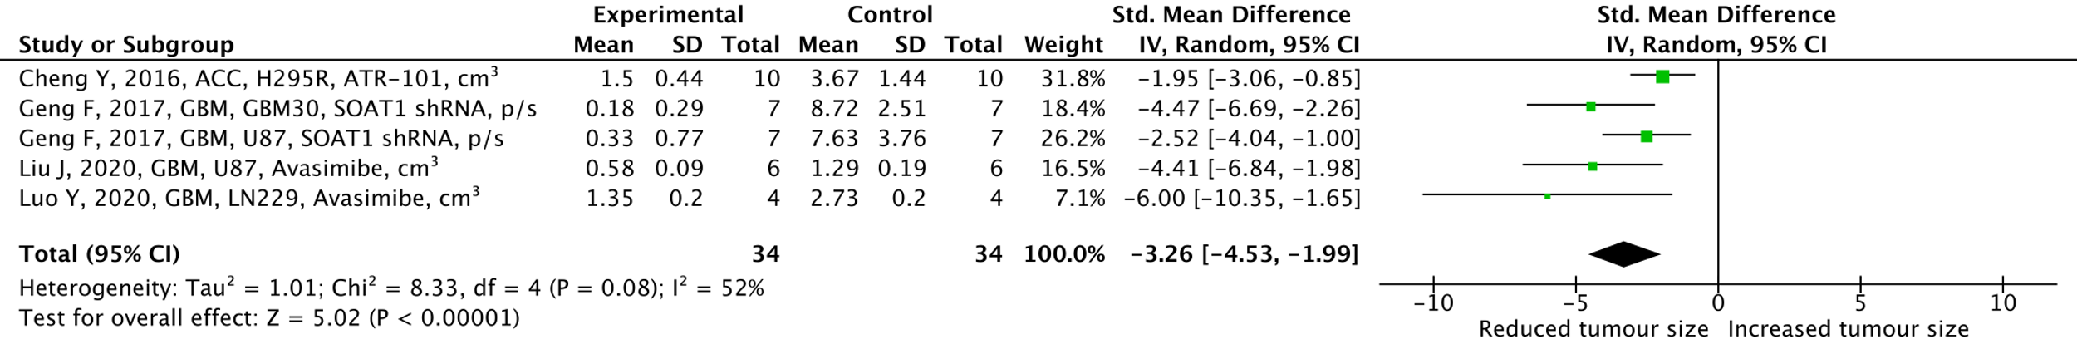
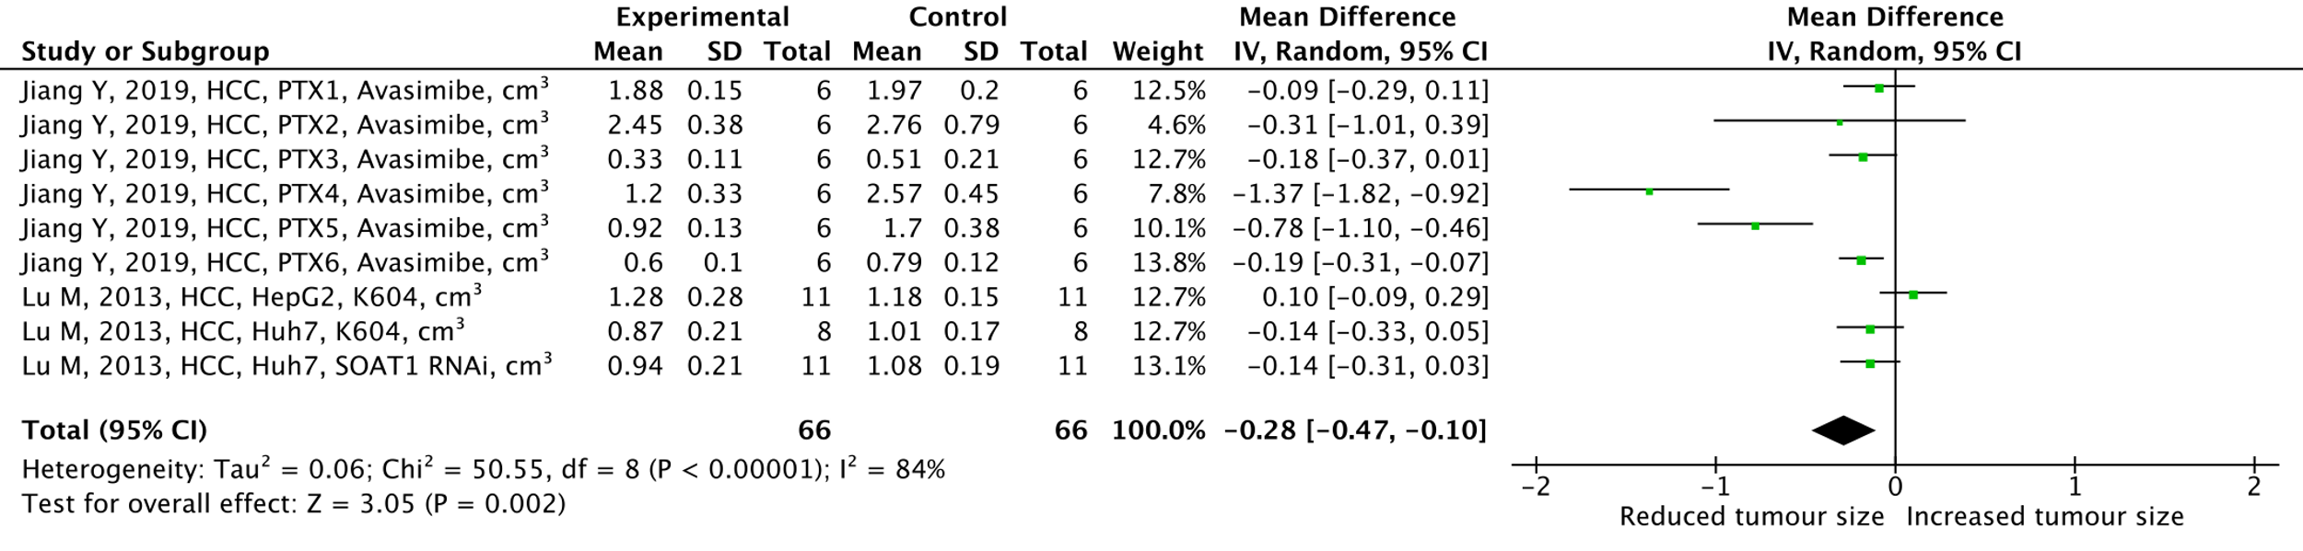
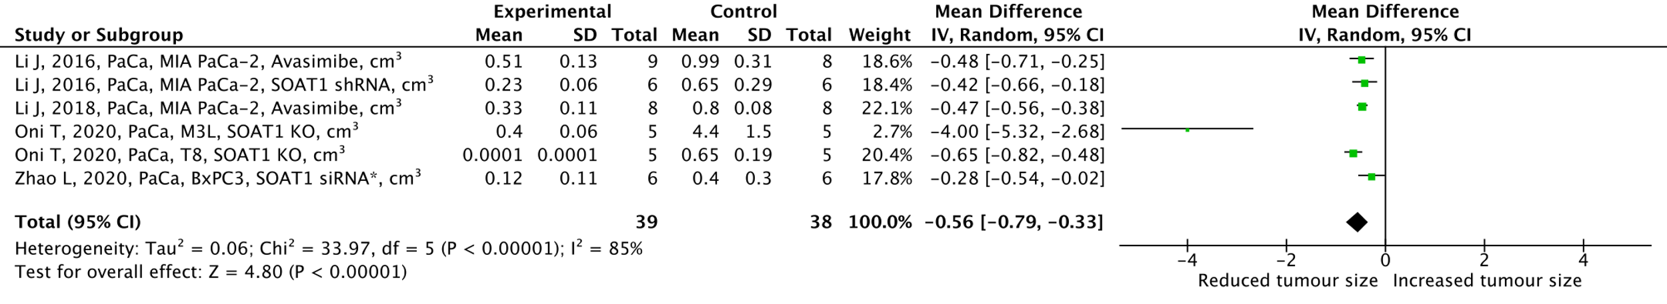
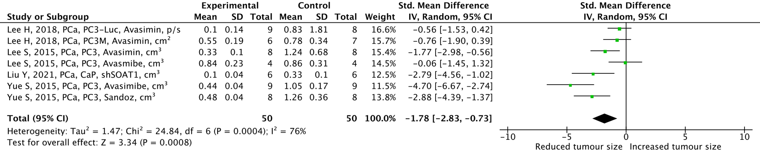
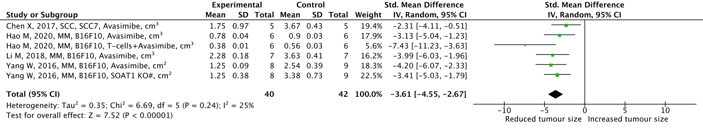
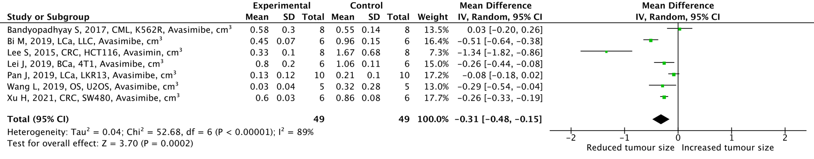
A
Figure 3
B
SOAT1 low
SOAT1 high
C
Reduced tumour volume (cm³)
Increased tumour volume (cm³)
D
Reduced tumour volume (cm³)
Increased tumour volume (cm³)
E
F
Reduced tumour volume (cm³)
Increased tumour volume (cm³)
Notes:
Do we still refer to overall effect size?

Slide 5
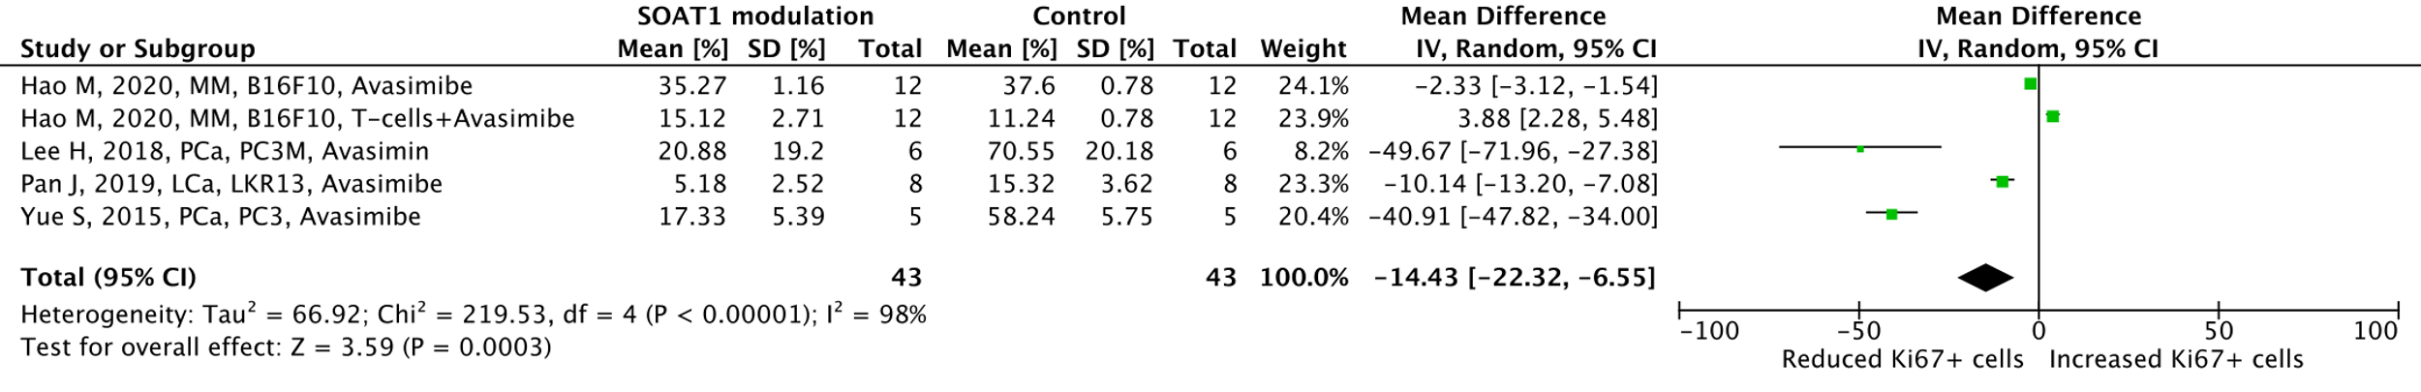
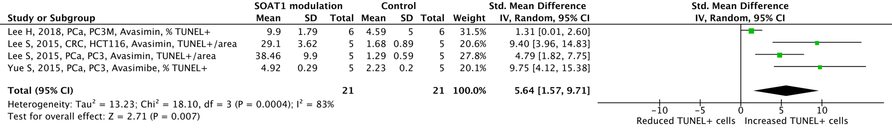
A
Reduced % Ki67+ cancer cells
Increased % Ki67+ cancer cells
B
Reduced apoptosis
Increased apoptosis
Figure 5

Slide 6
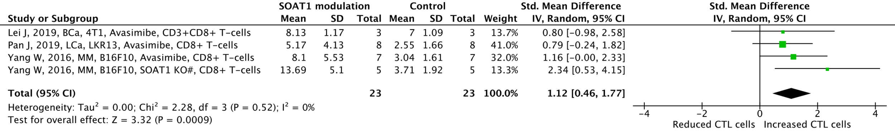
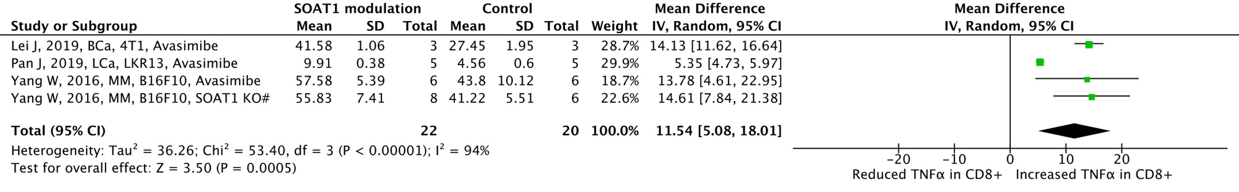

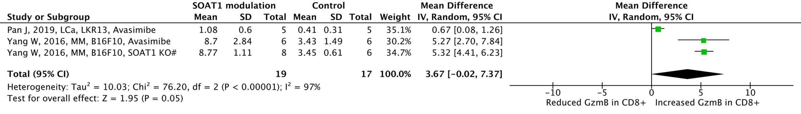
A
B
C
D
Figure 6

Slide 7
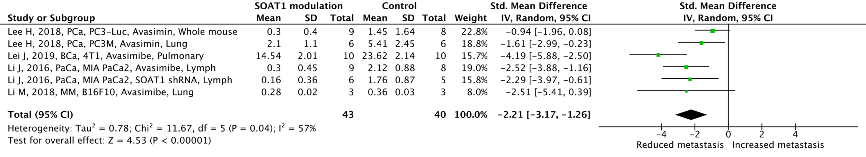
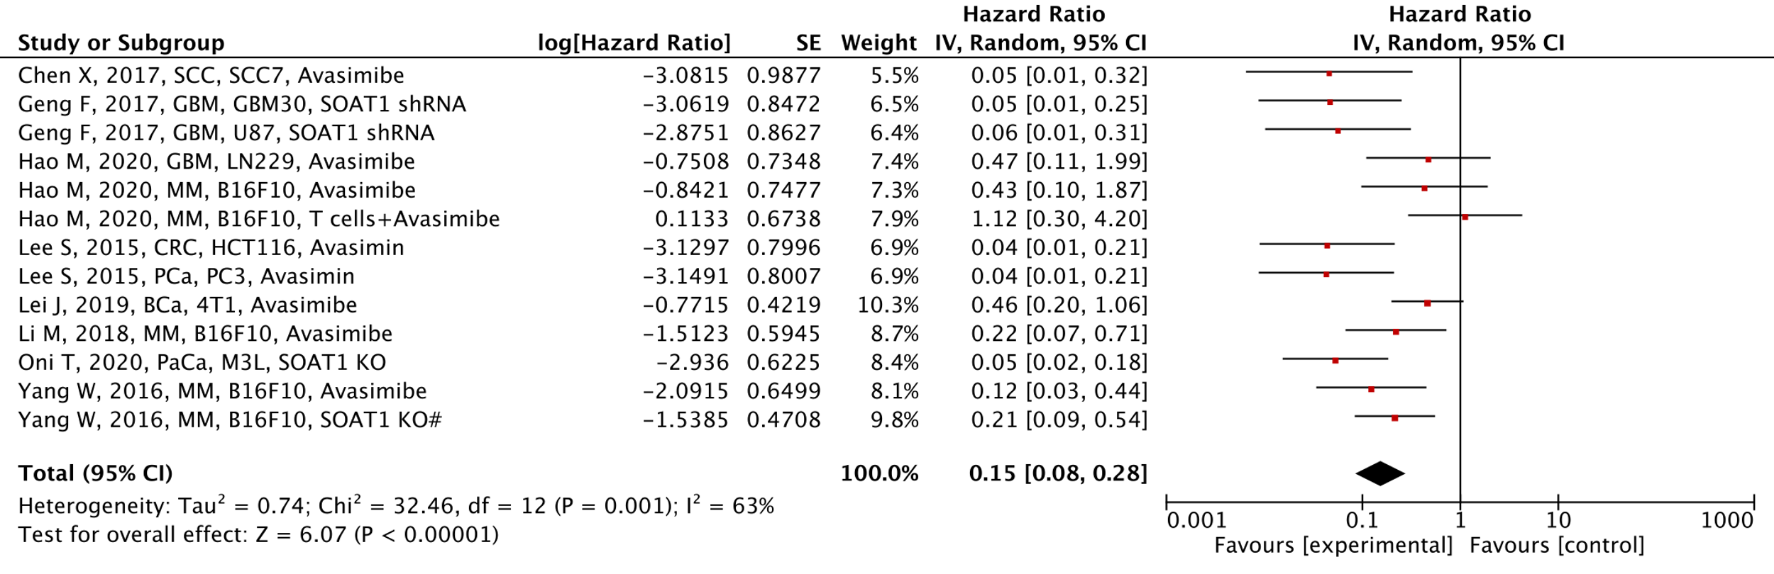
A
Reduced metastasis
Increased metastasis
B
Reduced risk of euthanasia
Increased risk of euthanasia
Figure 7

Slide 8
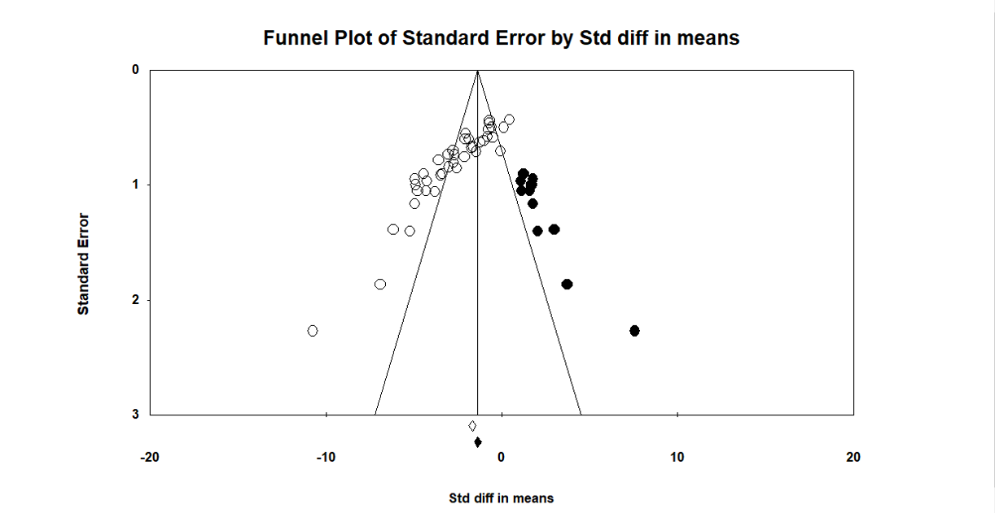
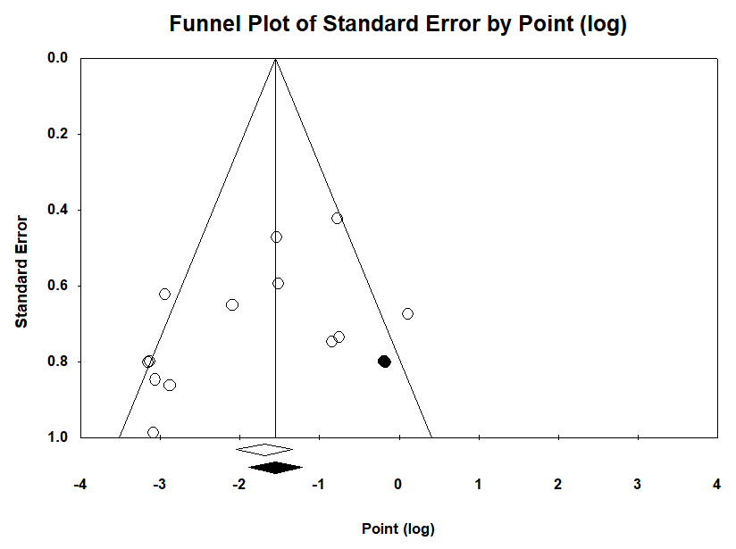
A
B
D
C
Standardised error
E
Standardised mean difference
Standardised error
Log[Hazard Ratio]
Figure 8

