Slide 1
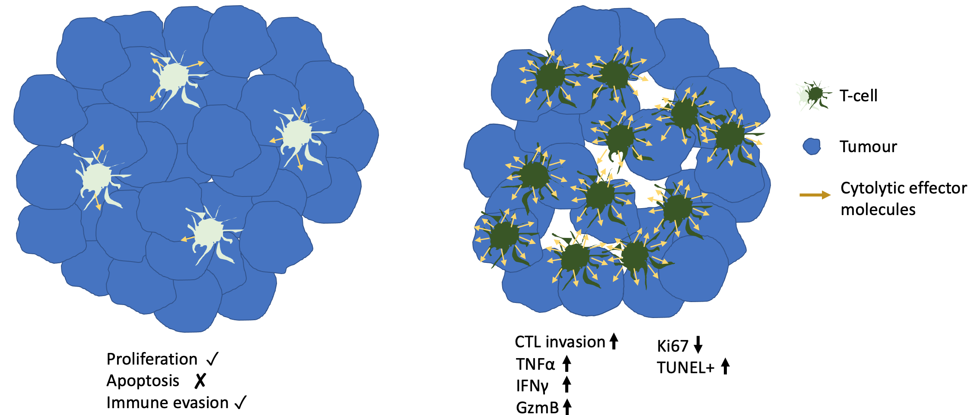
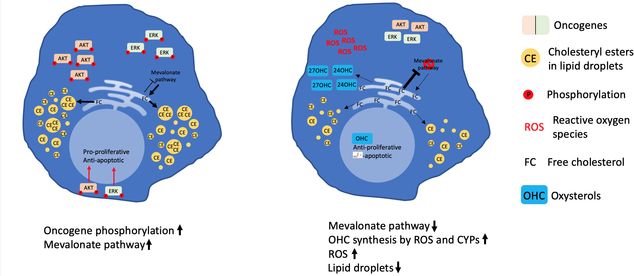
SOAT activity unaltered
Systemic inhibition of SOAT
SOAT activity unaltered
Systemic inhibition of SOAT
Tumour microenvironment
Tumour cell

