Slide 1
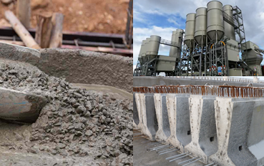
The Power of Statistical Learning Applied to the
Proportioning of Fiber-Reinfoced Concrete
Emilio Garcia-Taengua
E.Garcia-Taengua@leeds.ac.uk
Special Session ‘The Concrete Industry in the Era of Artificial Intelligence’
ACI Convention March 2021

Slide 2
Introduction
Overview of the presentation
Introduction
Modelling the mix proportioning variables
Modelling the residual flexural strength
Closing remarks

Slide 3
Statistical learning?
Plenty of terms, plenty of overlap:
data science, data analytics, big data, data mining, multivariate analysis, machine learning, artificial intelligence…
Plato’s allegory of the cave (ca. 2,400 years old):
Data
That’s artificial intelligence!
Statistics
Apps
Data science
Users (society)

Slide 4
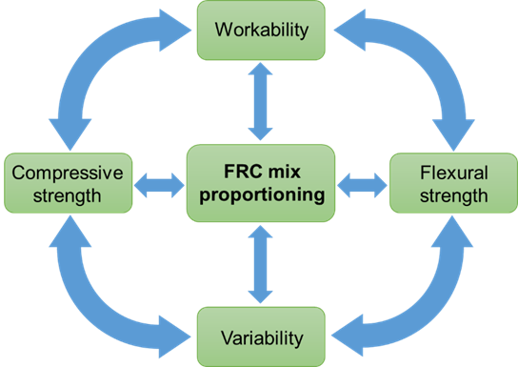
Optimization of FRC mixes
Project “Optimization of Fiber-Reinforced Concrete using Data Mining” funded by CRC / ACI Foundation.
Articulating principle: proportioning FRC mixes as a multiobjective optimization problem.
Implications:
Workability and variability are not ‘associates’: they are ‘partners’.
Shift to a multivariate perspective, taking advantage of correlations.
Variability is not a problem but a source of information → data mining.
Objectives:
Exhaustive database with mix proportionings and characterization results from papers.
Predictive models for residual flexural strength parameters and their variability.
Statistical analysis of all four dimensions above by means of multivariate techniques.
Software ‘OptiFRC’ for visualization and interpretation of database and utilization of the predictive models for mix optimization.

Slide 5
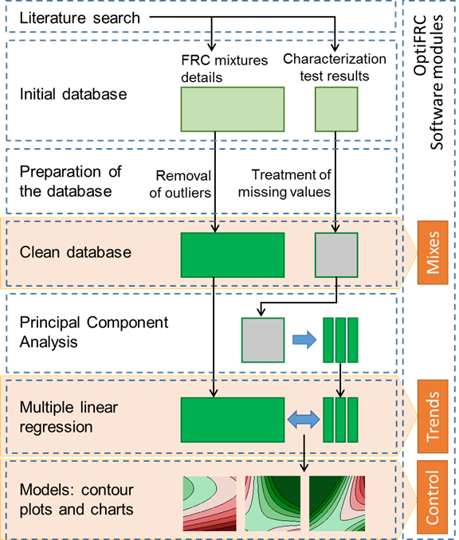
Optimization of FRC mixes
Outline of the Project
Literature search and descriptive analysis.
Development of database of FRC mixes and characterization test results.
Meta-analysis of FRC proportionings.
Meta-analysis of FRC residual flexural capacity.
Development of multivariate quality control charts.
Development of software OptiFRC.

Slide 6
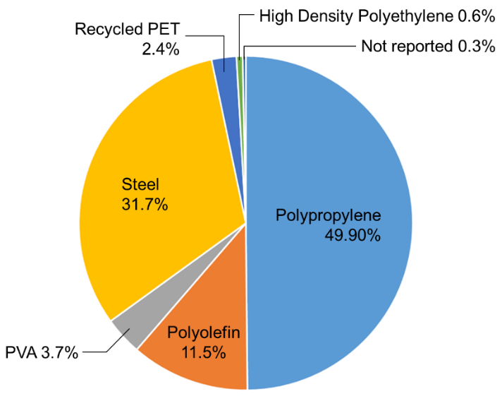
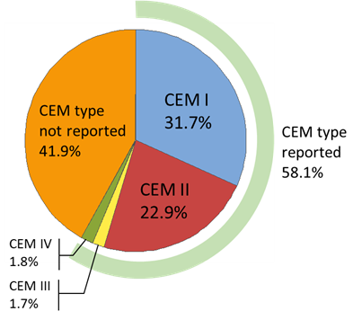
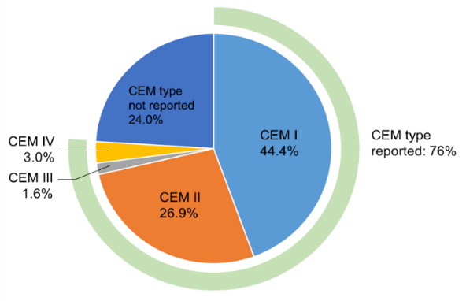
The database
Data structure (variables in the database):
Cement_kgm3
Water_kgm3
Binder_Kgm3
SCMs_kgm3
LSP_kgm3
GGBS_kgm3
SF_kgm3
PFA_kgm3
Sand_kgm3
Gravel_kgm3
MaxAggSize_mm
Retarder_kgm3
AirEntrainer_kgm3
HRWR_kgm3
VMA_kgm3
Vf_%
FibreLength_mm
FibreDiameter_mm
FibreAspectRatio
FibreStrength_Mpa
FibreContent_kgm3
Slump_mm
SlumpSpread_mm
SlumpFlowTable_mm
Age_days
CompStrength_Mpa
TestType
LOP_MPa
fR1_Mpa
fR2_MPa
fR3_MPa
fR4_MPa
Mix proportioning variables
Properties
Steel FRC dataset
766 cases
Synthetic FRC dataset
1053 cases

Slide 7
Modelling the relationships between mix proportioning variables
Overview of the presentation
Introduction
Modelling the mix proportioning variables
Modelling the residual flexural strength
Closing remarks

Slide 8
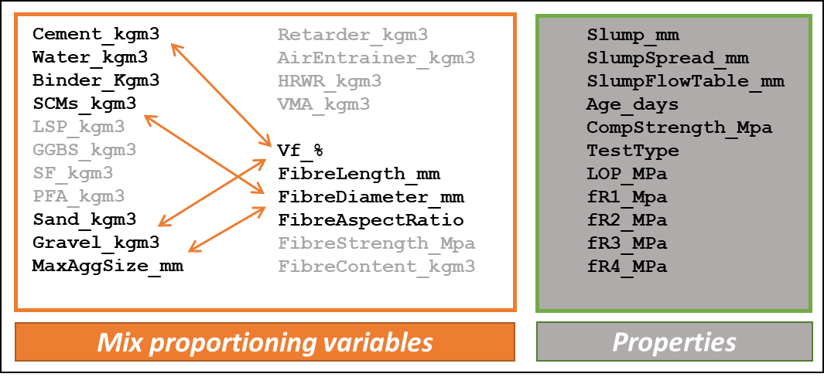
Overview
Relationships between Proportioning Variables
Focus: relationships that exist between FRC mixtures in terms of the relative amounts of their constituents and their main descriptors.
Contents of cement, sand, etc (kg/m³)
Fiber volume fraction (%)
Maximum aggregate size (mm)
Fiber material (steel, PP, etc)
Fiber length (mm)
Fiber aspect ratio
Objectives:
Analysis: to visualize and understrand trends in one variable when others change.
Modelling: quantification of mix proportioning variables as a function of others.
Method: multiple linear regression.

Slide 9
Overview
Relationships between Proportioning Variables
Focus: relationships that exist between FRC mixtures in terms of the relative amounts of their constituents and their main descriptors.
Contents of cement, sand, etc (kg/m³)
Fiber volume fraction (%)
Maximum aggregate size (mm)
Fiber material (steel, PP, etc)
Fiber length (mm)
Fiber aspect ratio
Objectives:
Analysis: to visualize and understrand trends in one variable when others change.
Modelling: quantification of mix proportioning variables as a function of others.
Method: multiple linear regression.
Regression Models: Specification
Alternative definitions trialled for different variables, including for example:
Total binder = cement + SCMs, total aggregates = fine + coarse aggregate
Ratios: water/cement, water/binder, fine/coarse aggr. ratio.
Fiber contents in kg/m³ instead of volume fraction and fiber material
Model specification selected based on: goodness of fit (i.e. accuracy of resulting equations), interpretability, and robustness of the models.

Slide 10
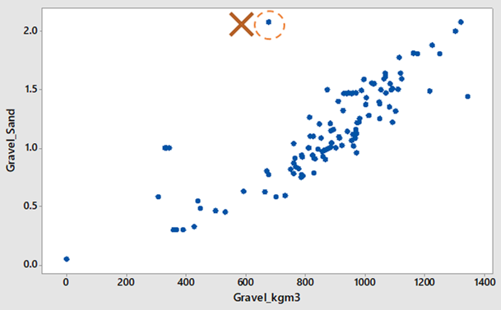
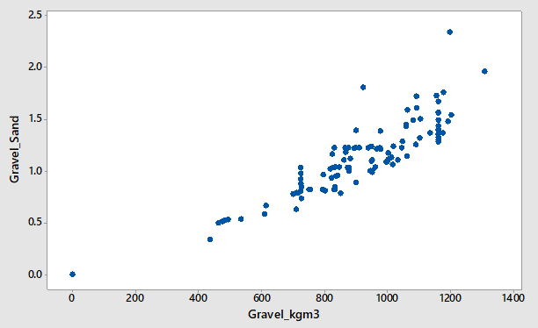
Coarse/fine aggr. ratio
Justification
Practical first approximation as descriptor of aggregates grading.
~ Cohesiveness of the mix → informative in relation to fresh state performance.
Statistical Modelling
Good correlation with coarse aggregate content in both datasets:
Steel FRC dataset
Synthetic FRC dataset

Slide 11
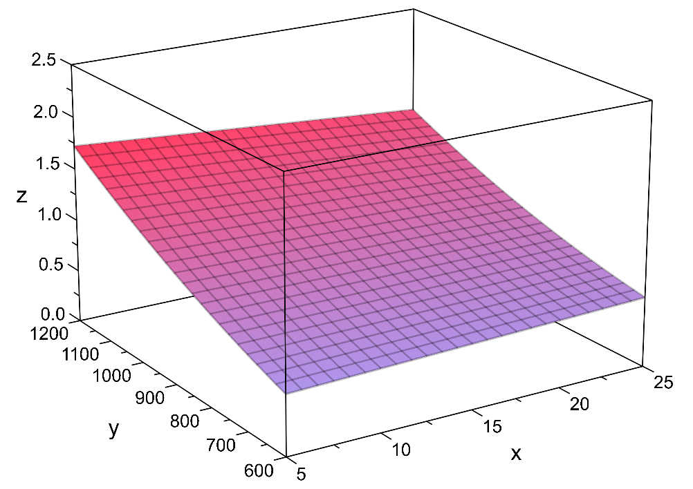
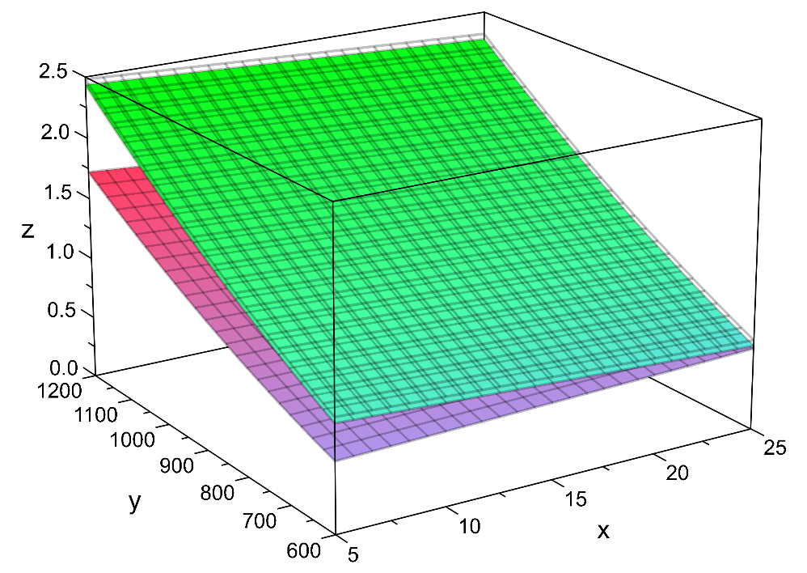
Coarse/fine aggr. ratio
Statistical Modelling
In addition to the coarse aggregate content, the max. aggregate size and fiber material also have a statistically significant impact on coarse/fine aggr. ratio.
Simple equations with very high goodness of fit (R² = 0.92 and 0.87).
Steel FRC:
Synthetic FRC:
Coarse / Fine
Coarse / Fine
Coarse aggr. (kg/m³)
Coarse aggr. (kg/m³)
Max. Agg. Size (mm)
Max. Agg. Size (mm)

Slide 12
Coarse aggregate content
Justification
Together with the coarse/fine aggr. ratio, it is representative of the volume of aggregates.
Why not fine aggregate, or total aggregates?
Models for coarse aggregate proved more robust: goodness of fit, simple specification.
Interactions with max.agg.size and fiber length were most clear (interpretability) when the model was based on coarse aggregate content.
Statistical Modelling
Equations obtained (R² = 0.76 and 0.61):
Coarse aggr. content as a function of maximum aggregate size, fiber volume fraction, fiber length and aspect ratio.
Fitted coefficients are different for steel FRC and synthetic FRC.
Statistically significant interactions between fiber volume fraction, length and aspect ratio, and maximum aggregate size.

Slide 13
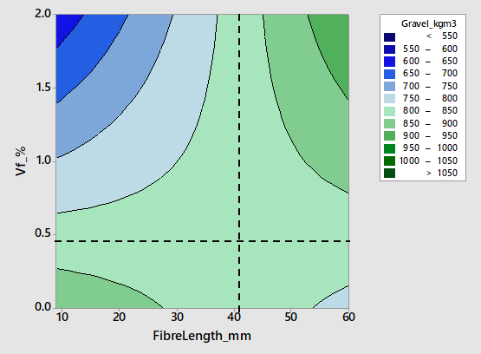
Coarse aggr. content in SFRC
Coarse Aggregate Content, Steel Fiber Length and Dosage
For low to medium fiber dosages (up to 0.4-0.7%), the coarse aggregate content is not remarkably sensitive to changes in fiber length and generally within 800-850 kg/m³.
For high to very high fiber dosages (>1%), coarse aggregate contents are generally within 800-850 kg/m³ as long as the fiber length is between 35 and 45 mm.
That is also the case for fiber dosages up to 1%, for fiber lengths between 30 and 50 mm.
$$\frac{∂G}{∂V_{f}}=0 →l_{f}=35−45$$
$$\frac{∂G}{∂l_{f}}=0 →V_{f}=0.4\%−0.7\%$$

Slide 14
Coarse aggr. content in SFRC
Coarse Aggregate Content, Steel Fiber Length and Dosage
For low to medium fiber dosages (up to 0.4-0.7%), the coarse aggregate content is not remarkably sensitive to changes in fiber length and generally within 800-850 kg/m³.
For high to very high fiber dosages (>1%), coarse aggregate contents are generally within 800-850 kg/m³ as long as the fiber length is between 35 and 45 mm.
That is also the case for fiber dosages up to 1%, for fiber lengths between 30 and 50 mm.
Short fibers (~30 mm and shorter) in moderate to high dosages are generally associated with lower coarse aggregate contents → mixtures with more sand and paste to be more cohesive.

Slide 15
Binder content
Justification
It is representative of the finer constituents of the mixture.
Why not cement and SCMs separately? Some reasons:
The water-to-binder ratio is a defining parameter of the mixture.
The model for total binder turned out to be the most robust: goodness of fit, simple specification.
Statistical Modelling
The equations obtained showed very good fit to data (R² = 0.90 and 0.84):
Binder content as a function of fine and coarse aggregate contents, and maximum aggregate size.
Quadratic effects and statistically significant interactions between these terms.
Why are the fibers dimensions and their dosage not in the equations? Don’t they have an ‘effect’ on the binder content in a FRC mixture?

Slide 16
Three equations, one model
A Data-Driven Proportioning Method
Why are the fibers dimensions and their dosage not in the equations? Don’t they have an ‘effect’ on the binder content in a FRC mixture?
By organising the equations in sequence, a sort of FRC mix proportioning method begins to emerge:
m.a.s.
V_{f}(%), L_{f}/d_{f}, L_{f}
Coarse agg (kg/m³)
Coarse/Fine ratio
Sand (kg/m³)
Binder (kg/m3)

Slide 17
Three equations, one model
A Data-Driven Proportioning Method
Why are the fibers dimensions and their dosage not in the equations? Don’t they have an ‘effect’ on the binder content in a FRC mixture?
Yes, because they influence the aggregate contents!
By organising the equations in sequence, a sort of FRC mix proportioning method begins to emerge:
m.a.s.
V_{f}(%), L_{f}/d_{f}, L_{f}
Coarse agg (kg/m³)
Coarse/Fine ratio
Sand (kg/m³)
Binder (kg/m3)

Slide 18
Residual flexural strength parameters as a function of mix proportions
Overview of the presentation
Introduction
Modelling the mix proportioning variables
Modelling the residual flexural strength
Closing remarks

Slide 19
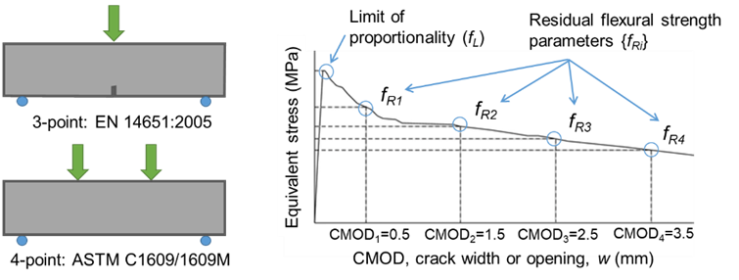
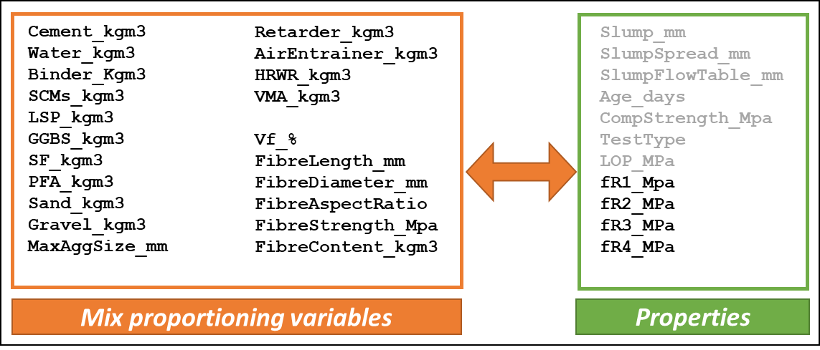
Overview
Modelling Residual Flexural Strength
Focus: relationships that exist between f_{R1}, f_{R2}, f_{R3} and f_{R4} and the FRC mix proportioning variables.
Method: multiple linear regression for each residual flexural strength parameter.
Objectives:
Analysis: visualising and understranding trends, with a particular focus on statistically significant interactions.
Modelling: f_{Ri} estimates as a function of mix proportioning.

Slide 20
Overview
Modelling Residual Flexural Strength
Focus: relationships that exist between f_{R1}, f_{R2}, f_{R3} and f_{R4} and the FRC mix proportioning variables.
Method: multiple linear regression for each residual flexural strength parameter.
Objectives:
Analysis: visualising and understranding trends, with a particular focus on statistically significant interactions.
Modelling: f_{Ri} estimates as a function of mix proportioning.
Specification of the Models
Several alternative specifications were trialled.
What I was trying to achieve when developing the models:
Compromise between goodness of fit (R²) and degrees of freedom (number of terms).
Same model structure (i.e. format of the equation) for the four residual parameters.
Same model structure for steel and synthetic datasets (different coefficients).
Good performance of models obtained: R² values between 0.75 and 0.85.

Slide 21
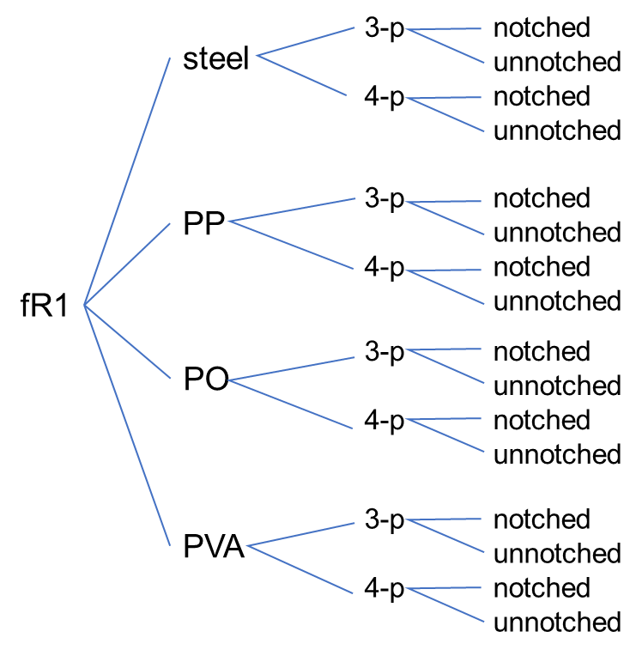
Modelling
Modelling Residual Flexural Strength
General equation of the model obtained:
$$k_{0}+k_{1}\frac{G}{S}+\left(a_{0}+a_{1}MAS\right) L_{f}+\left(b_{0}+b_{1}CEM+b_{2}HRWR+b_{3}λ_{f}+b_{4}L_{f}\right) V_{f}+k_{2} SCMs+k_{3} HRWR+k_{6}CEM+\left(c_{1} CEM+c_{2} SCMs+c_{3} G/S\right) AGGR$$
$$f_{R,i}=$$
Coefficients take different values for each residual flexural strength parameter.
Coefficient k₀ depends on test configuration (3- or 4-point) and specimen (notched or not).
All other coefficients (colored in red) depend on the fiber material.
The equation above is in fact a compact representation of dozens of equations:
It makes interpretation and understanding easier, and is the result of trying to find a common model specification that fits well the values of all four parameters.

Slide 22
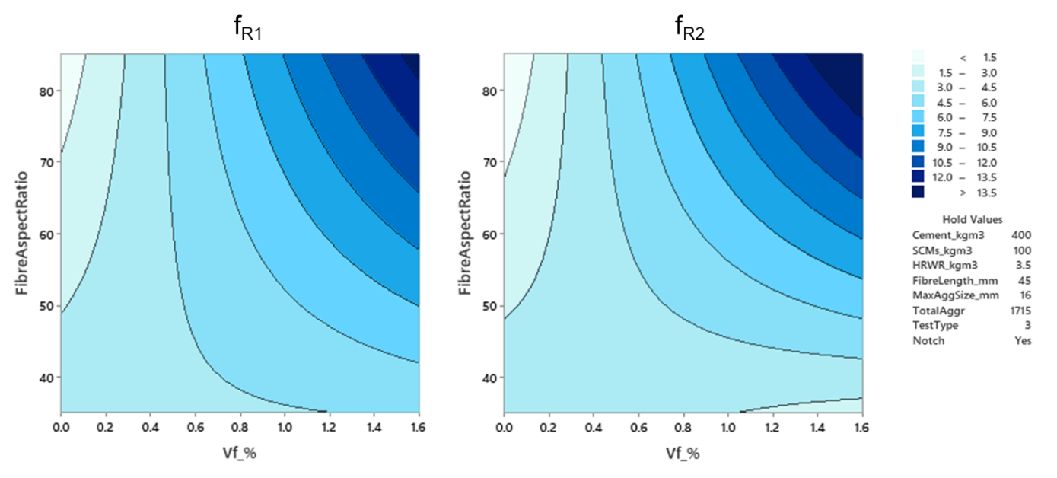
Fiber aspect ratio (SFRC)
Increasing the aspect ratio has a clear positive impact on residual flexural strength for moderate to high fiber contents.

Slide 23
Fiber aspect ratio (SFRC)
Increasing the aspect ratio has a clear positive impact on residual flexural strength for moderate to high fiber contents.
Changing the aspect ratio does not affect f_{R1} or f_{R2} when the fiber content is 0.3%-0.4%.
$$0.1616 V_{f}−0.0679=0→V_{f}=0.42\%$$
$$0.2179 V_{f}−0.077=0→V_{f}=0.35\%$$

Slide 24
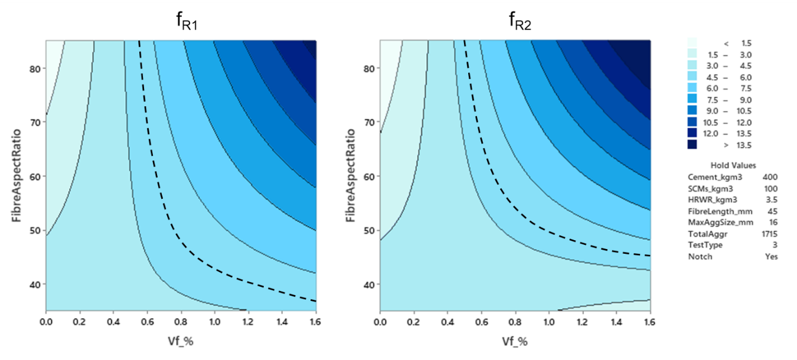
Fiber aspect ratio (SFRC)
Increasing the aspect ratio has a clear positive impact on residual flexural strength for moderate to high fiber contents.
Changing the aspect ratio does not affect f_{R1} or f_{R2} when the fiber content is 0.3%-0.4%.
Do we need high fiber dosages to get better-than-average performance? No.
With aspect ratios between 60 and 80, fiber contents in the region of 0.6%-0.8% are generally enough to get better-than-average residual flexural strength.
Minimum fiber contents to get better than average performance as a function of the fiber aspect ratio can be obtained:
$$λ_{f}=80→V_{f}≥0.56\%$$
$$λ_{f}=60→V_{f}≥0.69\%$$

Slide 25
Closing remarks
Overview of the presentation
Introduction
Modelling the mix proportioning variables
Modelling the residual flexural strength
Closing remarks

Slide 26
Closing remarks
Statistical Learning
Equations / software ‘learn’ from the data, but the treatment and modelling of data is a fantastic resource to help us learn and better understand the material.
Database and Mix Proportionings
A database of almost 2,000 cases has already been compiled, ‘cleaned’ and analysed.
The regression models obtained to describe the correlations between mix proportioning parameters are robust and show good fit with data. They are:
Useful to obtain reliable estimates of the contents of different constituents.
A powerful tool to better understand the interplay of the different parameters.
The three semi-empirical equations represent a data-based mix proportioning rationale for guiding design of FRC mixes.
Residual Flexural Strength Model
A unified predictive model has been obtained for all four residual flexural strength parameters in steel and synthetic FRC mixes.
This model shows good fit with data and captures the effect of the most significant interactions between fiber content, size of fibers and aggregates, and the contents of all constituents.

Slide 27
The Power of Statistical Learning Applied to the Proportioning of Fibre-Reinforced Concrete Mixes
Thank you
Emilio Garcia-Taengua
E.Garcia-Taengua@leeds.ac.uk
ACI Convention March 2021

