Slide 1
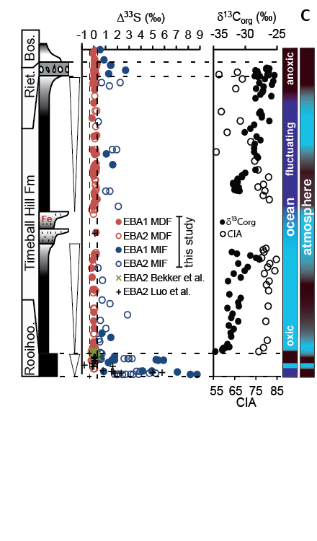
A
Post-GOE slope = -0.006

