Slide 1
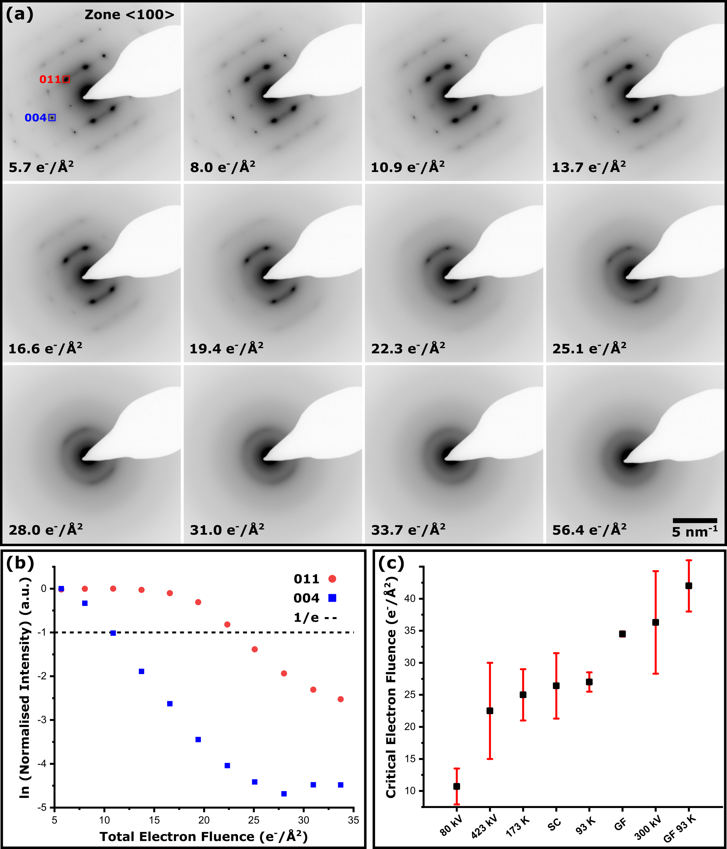
Figure 1
Figure 1. (a) Diffraction series of theophylline form II along the <100> zone axis using an electron flux of 0.098 e⁻/(Å²s) and at 200 kV. (b) Plot of the logarithmic normalised spot intensity versus total electron fluence for the {004} and {011} diffraction spots. The C_{F} is measured at 1/e of the initial spot intensity which in this case is approximately 11 e⁻/Å² and 23 e⁻/Å² for the {004} and {011} spots respectively. (c) Comparison of experimentally determined critical fluence values relative to standard conditions (SC: 200 kV, room temperature and continuous carbon support film) for theophylline form II arranged in order from lowest to highest (least stable to most stable). Values with units of kV refer to electron beam accelerating voltages, while values with units of K refer to sample temperatures. GF stands for graphene film substrate respectively.

Slide 2
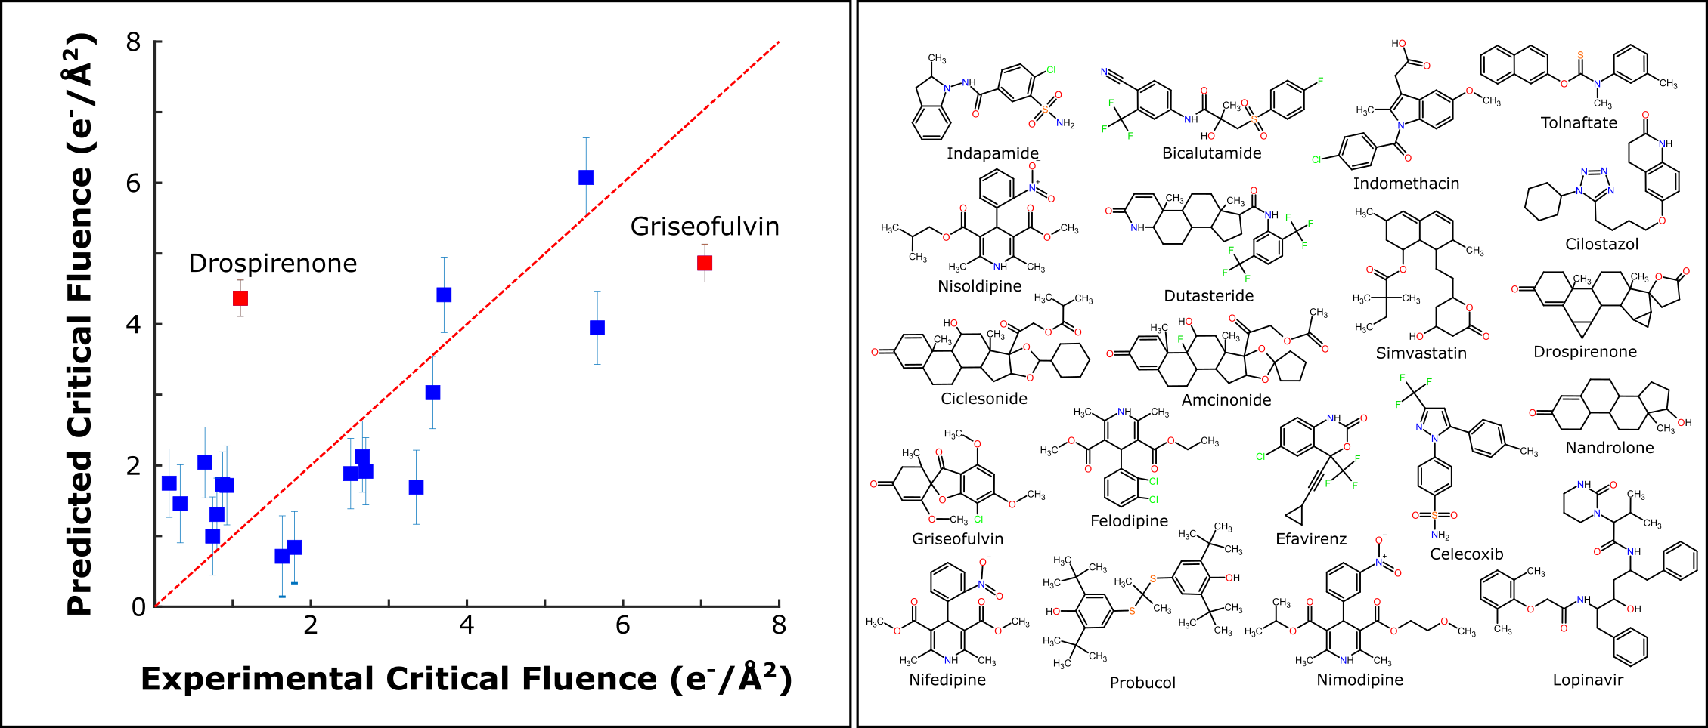
Figure 2
Figure 2. Predicted critical fluence (C_{F}) of 20 different pharmaceutical compounds, to calculate the predicted C_{F} a multiple-linear regression equation was created using different chemical parameters that related to the chemical structures such as number of hydrogen bond donors/acceptors and number of conjugated carbons/non-conjugated carbons. The points shown in red are two of the compounds that were poorly predicted and the data point for tolnaftate is not shown due to the experimental C_{F} being twice as large as the next highest compound.

Slide 3
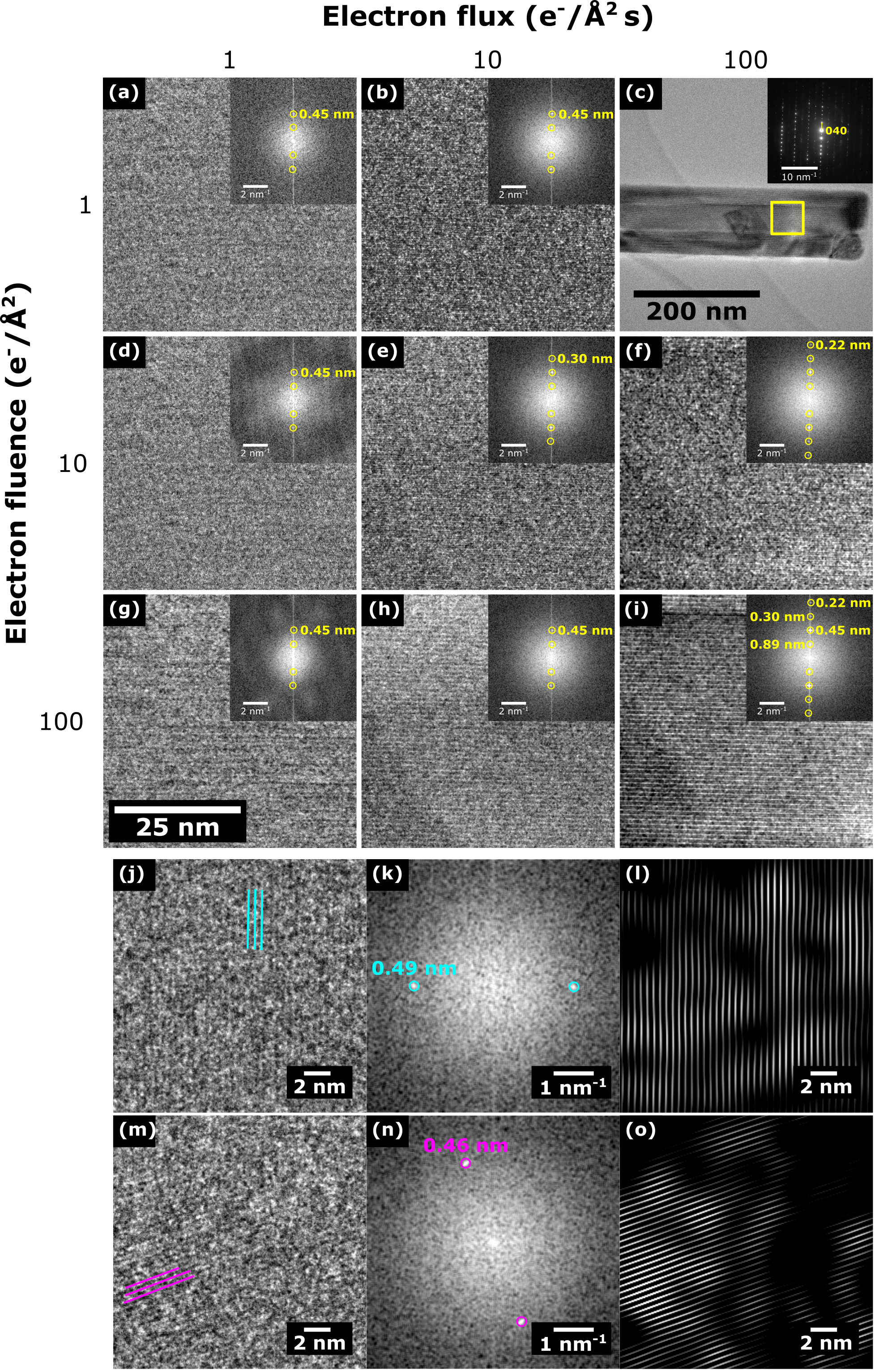
Figure 3
Figure 3: HRTEM of a crocidolite needle (low magnification image in (c) shows the magnified area and SAED pattern), used as a model system to determine which electron flux and electron fluence regime would be best suited for clearly resolving lattice information at low dose. Images (a), (d) and (g) were captured using an electron flux of 1 e⁻/(Å²s) and show the same area of the crocidolite crystal but are exposed for a total electron fluence of 1, 10 and 100 e⁻/Å² respectively. Images (b), (e) and (h) were captured using an electron flux of 10 e⁻/(Å²s) at a total electron fluence of 1, 10 and 100 e⁻/Å² respectively. Finally, (f) and (i) were captured using an electron flux of 100 e⁻/(Å²s) at a total fluence of 10 and 100 e⁻/Å² respectively. Inset in images (a) - (i) is the corresponding FFT with visible lattice points highlighted. The bottom panel shows HRTEM of two different areas (j) and (m) from the same furosemide crystal acquired using an electron flux of 10 e⁻/(Å²s) and total fluence of 10 e⁻/Å². The corresponding FFTs are shown in (k) and (n) and filtered FFTs showing the lattice fringes more clearly are shown in (i) and (o). Adapted from (54).

Slide 4
Figure 4
Damage rate
(A)
(B)
Linear relationship
Probe size 0.14 nm
100 nm
STEM
0.5 nm beam broadening
TEM
Dose rate
few nm delocalised damage
Figure 4: (A) A schematic illustrating the differences in the relationship between damage and dose rates for different samples. It is postulated that diffusion limited processes correspond to a power law relationship with exponent <1 (blue line). For such samples high flux STEM would be preferential in reducing the damage rate. In comparison samples that exhibit a direct dose v damage relationship (green line) tend to exhibit more damage at higher dose rates and CTEM is predicted to be more advantageous. The schematic in (B) illustrates the concept of beam broadening and delocalised damage in STEM. The predicted minimum delocalised damage is typically a few nm, suggesting a pixel size > a few nm would be preferential to avoid over-sampling.

Slide 5
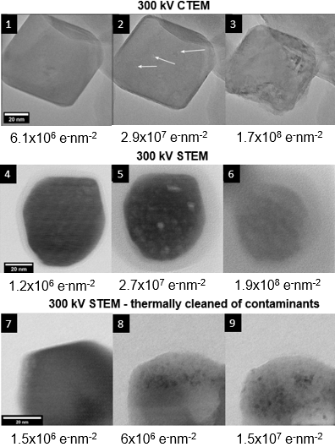
Figure 5
Figure 5. Left Panel: a comparison between high resolution 300 kV CTEM (1-3) and STEM (4-9) imaging of calcite nanoparticles. STEM BF imaging was able to detect a lattice at higher fluences than was possible in CTEM. However, this was found to be due to the contamination deposited during STEM imaging, as when the contamination was removed (7-9), STEM imaging caused more severe specimen degradation than CTEM, converting the specimen to calcium oxide at a lower fluence.
Right Panel: Comparison of O:Ca atomic ratios extracted from time-resolved CTEM EDX spectra from both a contaminated and (cleaned) uncontaminated calcite nanoparticle specimen.

Slide 6
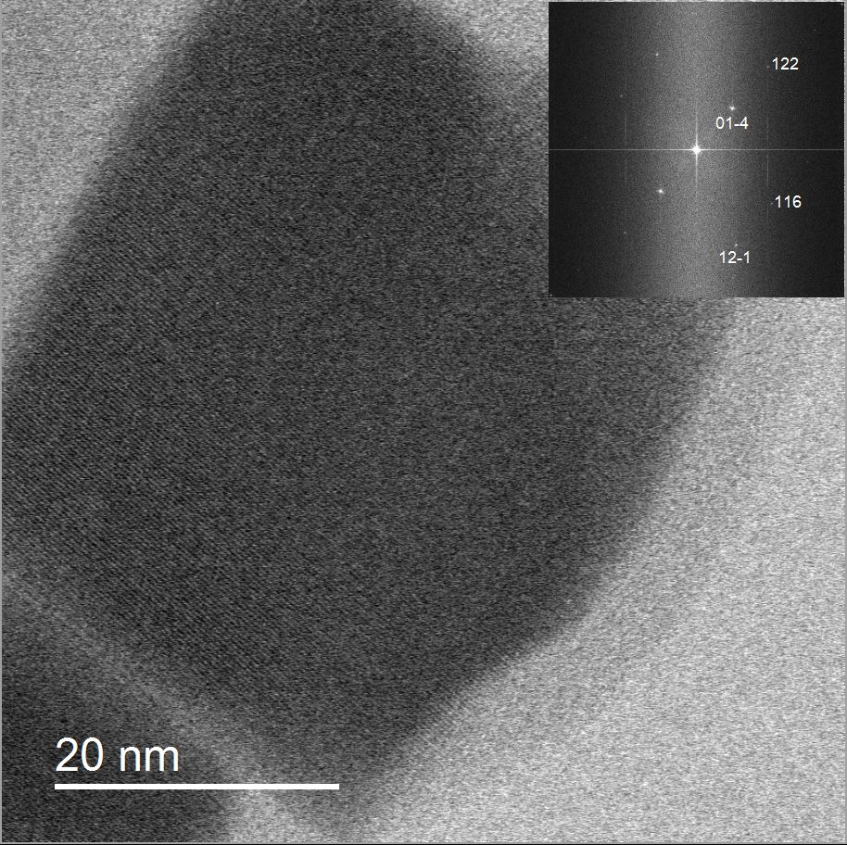
Figure 6
Figure 6. 300 keV bright field STEM image of a calcite nanoparticle showing contamination and also 1.6 Å calcite (122) crystal lattice measured with a 1 pA probe current and a fluence per pixel of 165 e⁻/Å² which is 0.05% of the measured 300 kV damage threshold. Note 25% electron collection efficiency due to non-reciprocal conditions used.

Slide 7
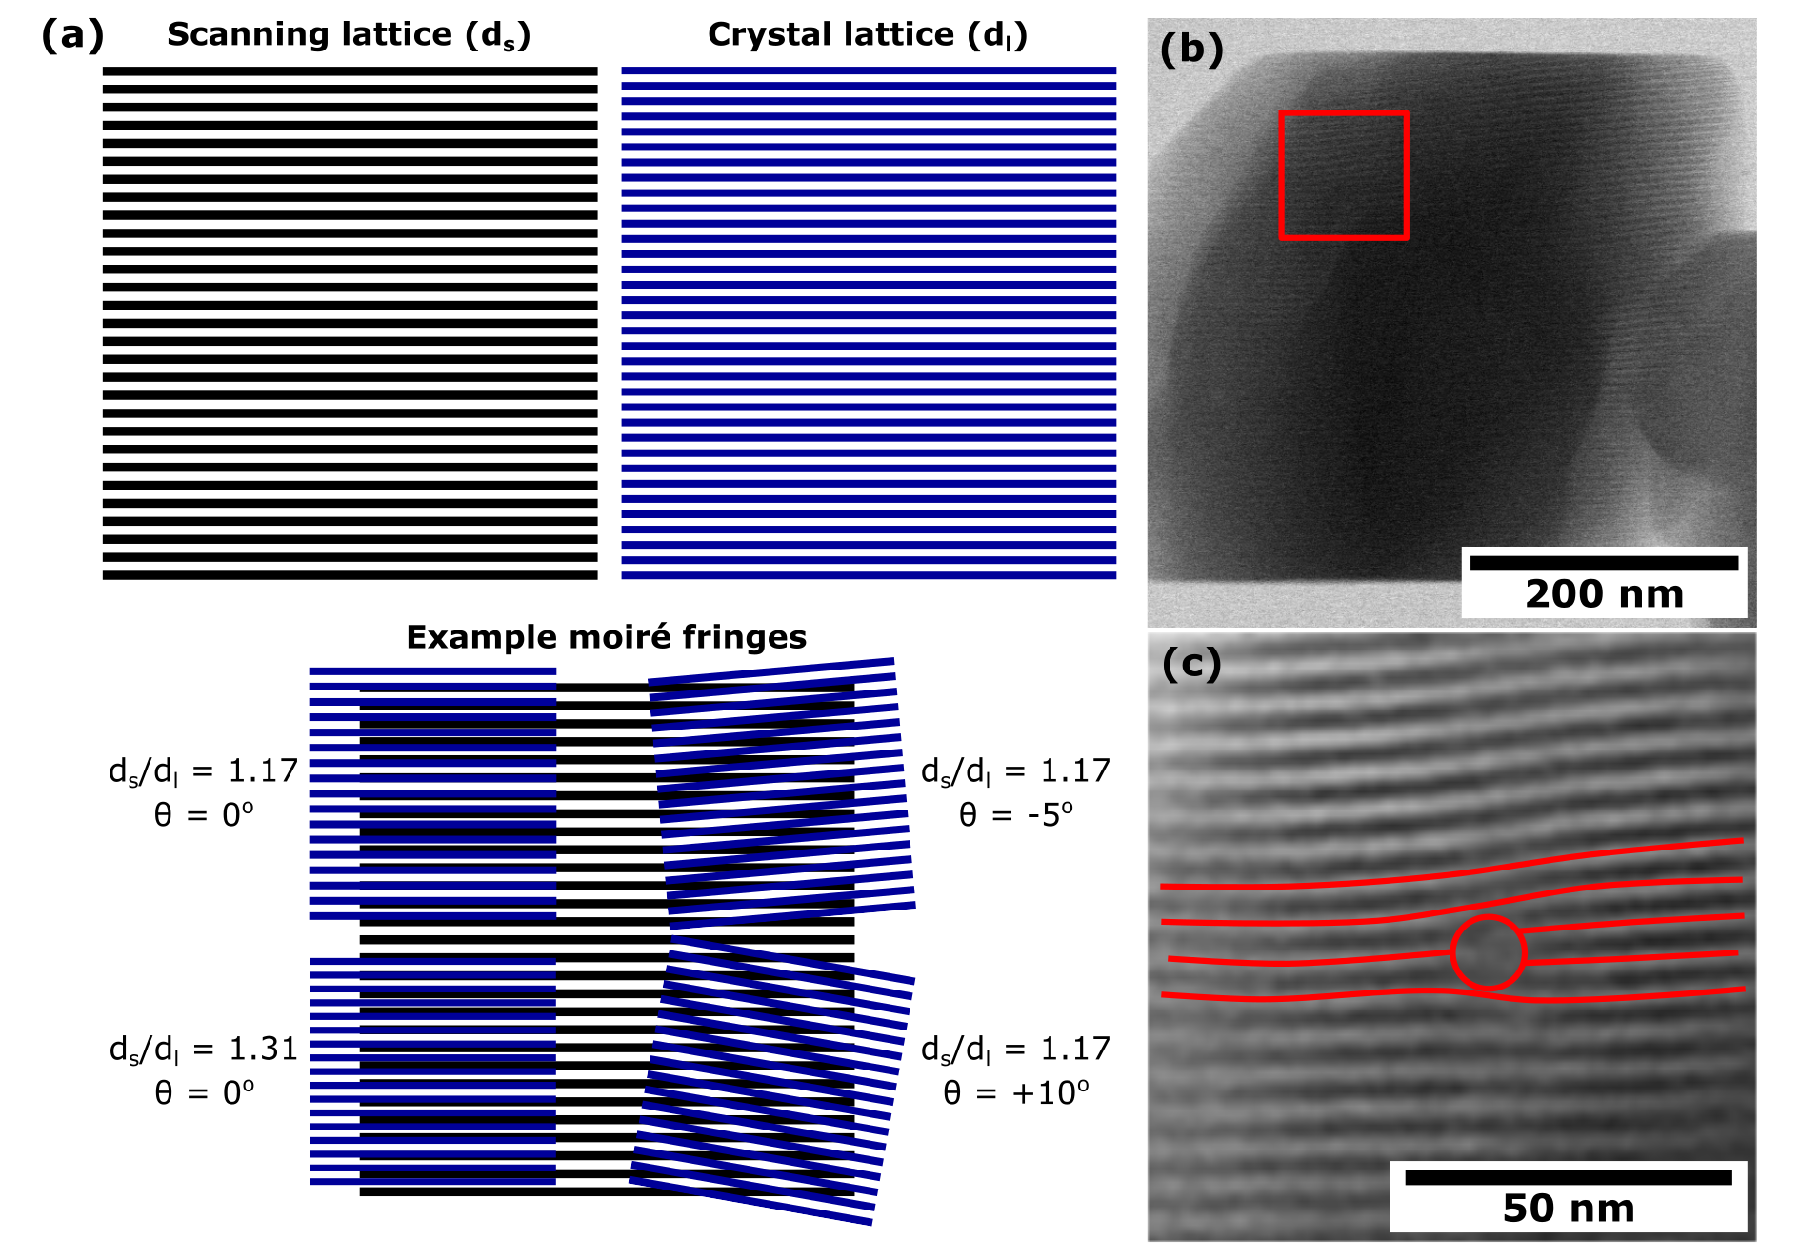
Figure 7
Figure 7. (A) Schematic showing example moiré fringes generated from a scanning lattice (d_{s}) and crystal lattice (d_{l}) of a similar size being overlaid at different d_{s} / d_{l} ratios and rotations. (B) Example of a scanning moiré fringe image of furosemide using d_{s} of 1.32 nm and d_{l} of 1.50 nm (C) Magnified area from the area highlighted in (B) showing a defect within the furosemide crystal.

Slide 8
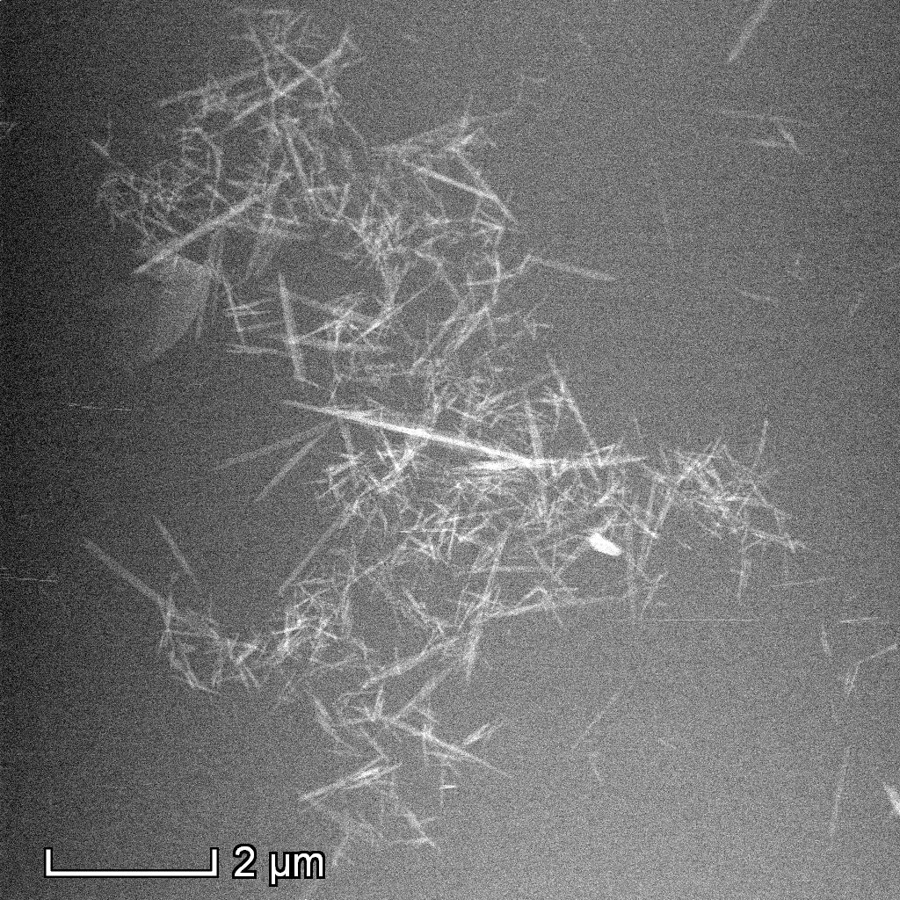
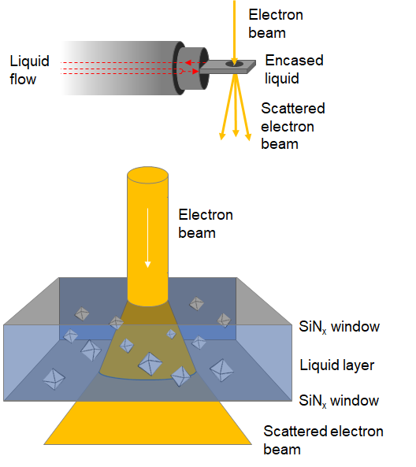
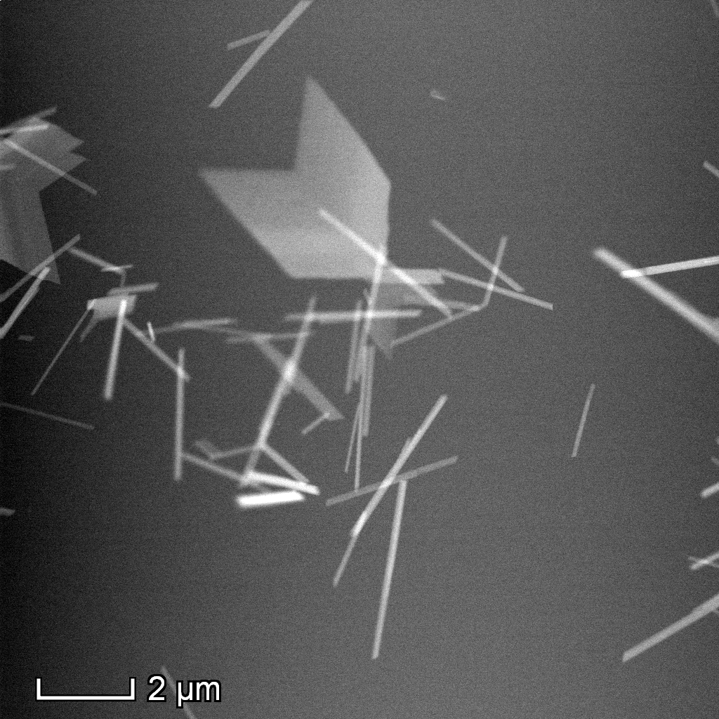
Figure 8
(c)
(a)
Considerations and challenges
Size and concentration of particles
Liquid thickness
Reaction / induction / nucleation time
Flow rate
Data capture rate
Electron induced radiolysis
pH change
Nucleation and growth
Crystallisation
Bubble formation
(b)
(d)
Figure 8. Schematic of typical liquid phase TEM holder (a) and cell (b). Silicon nitride windows are typically 200 µm x 50 µm x 50 nm. An example of using liquid phase TEM to follow the hydration of calcium sulfate in aqueous solution is shown in (c) and (d); bassanite rods in (c) transform to larger gypsum crystals (d).

Slide 9
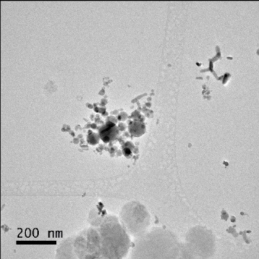
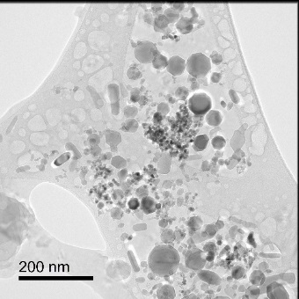
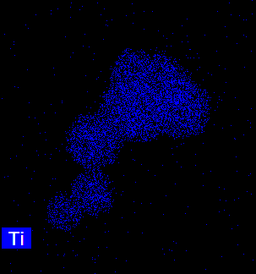
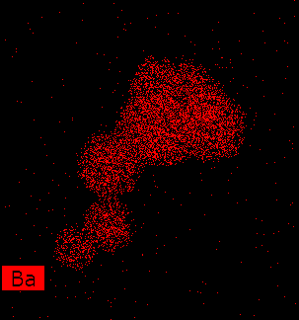
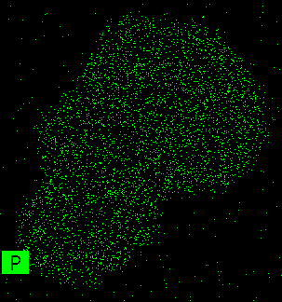
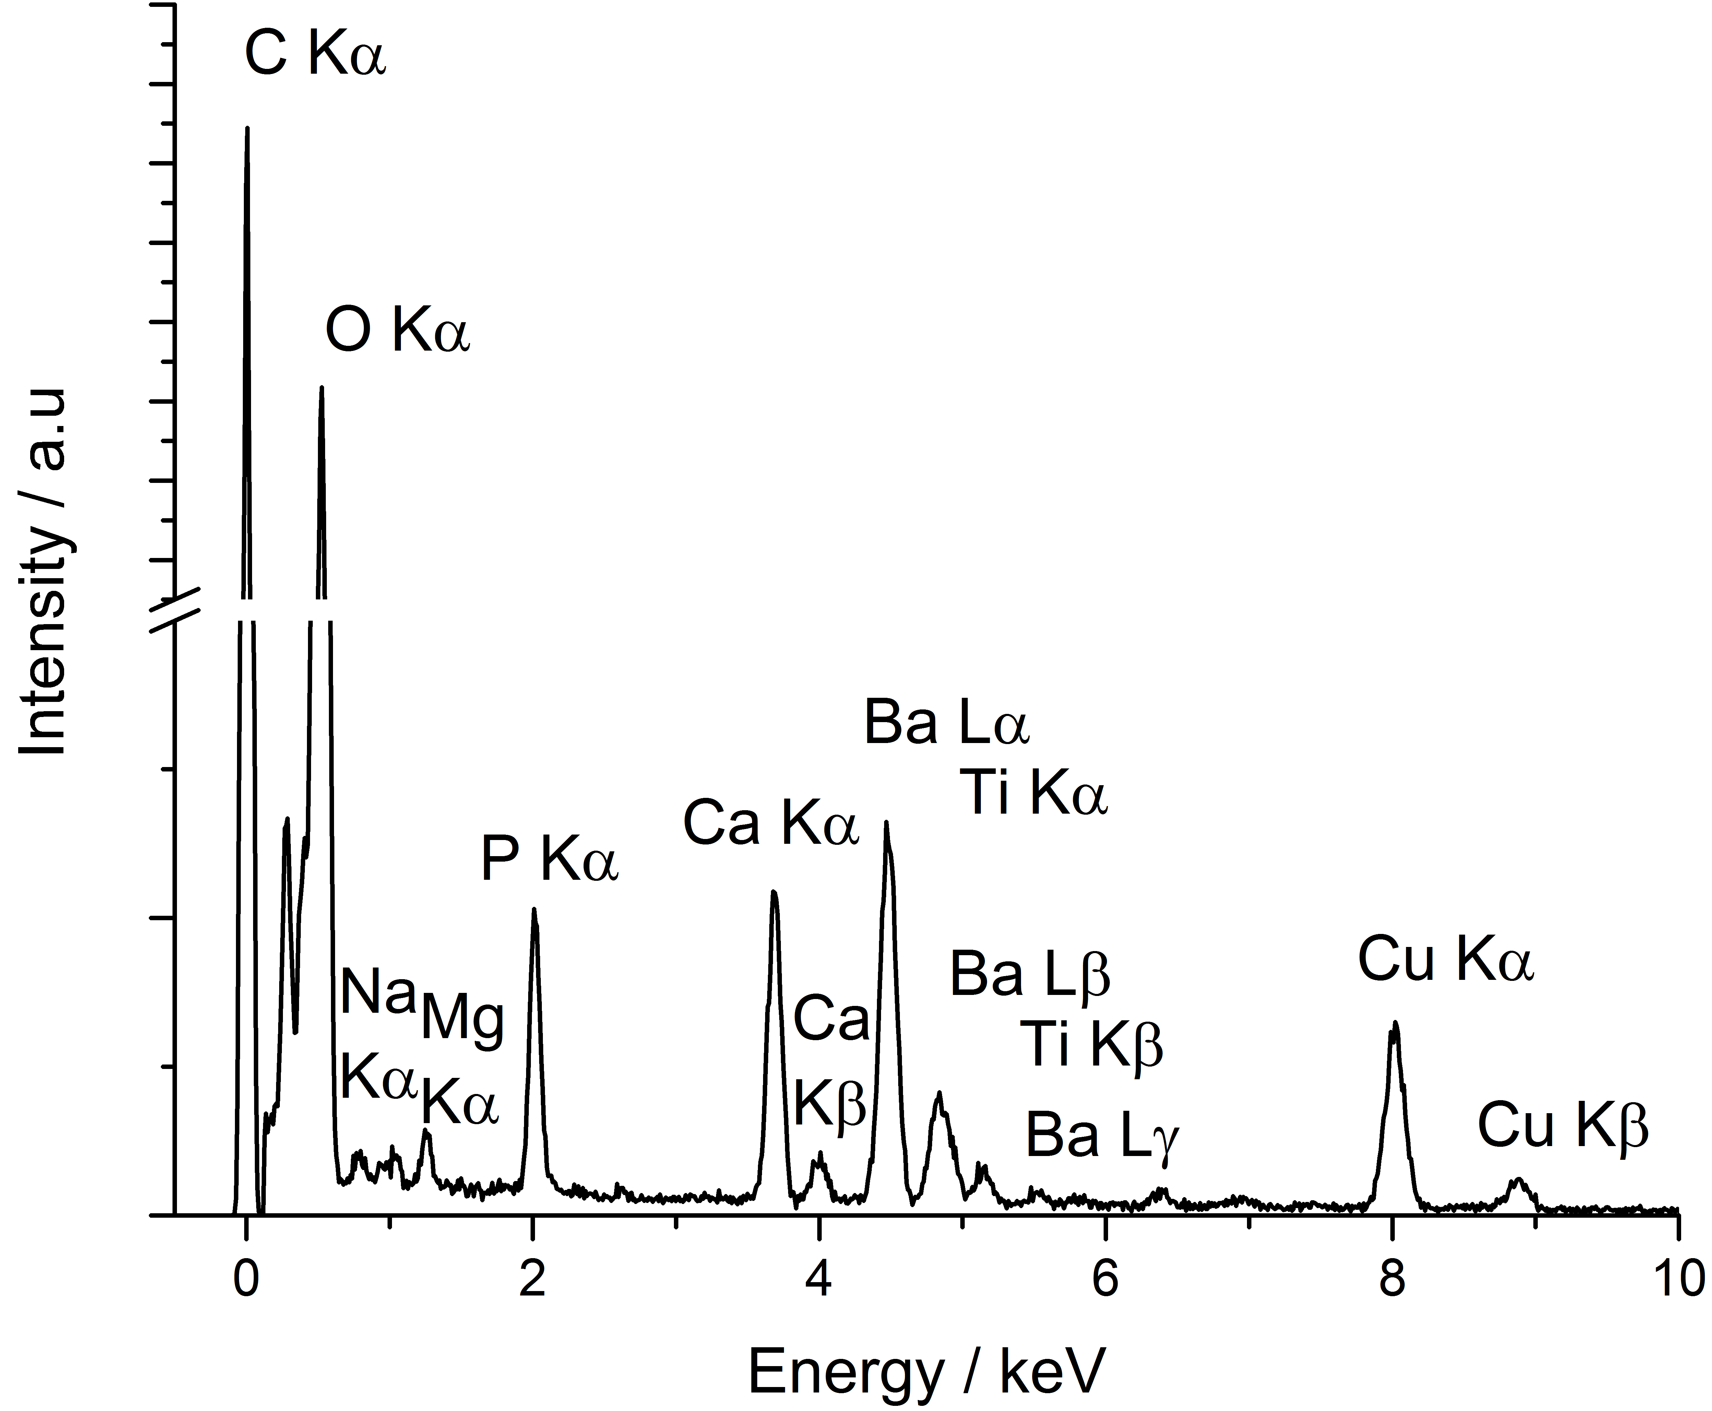
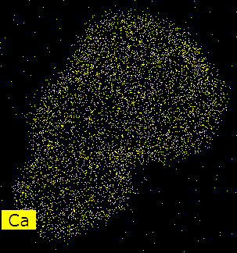
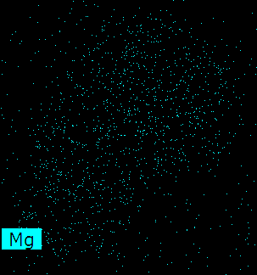
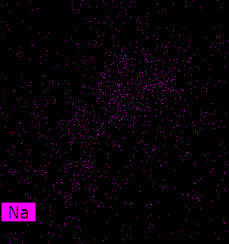
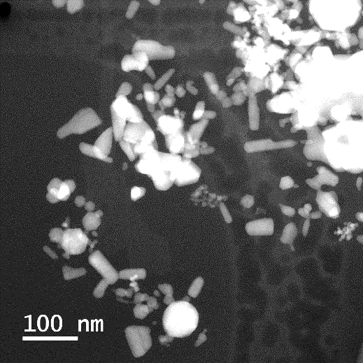
Figure 9
(A)
(B)
(E)
(G)
(C)
(D)
(F)
Figure 9: A comparison between cryo-CTEM and cryo-STEM indicated far less bubbling was observed in STEM. CTEM images were captured using a definitive electron fluence and showed that at 100 e⁻/Å² (A) little bubbling in the vitreous ice was observed, but after exposure to 400 e⁻/Å² (B) significant bubbling in the ice occurred. In comparison HAADF STEM images taken using 300 e⁻/Å² (C) and after exposing to a further 1000 e⁻/Å² (D) indicated much less bubbling of the ice. The inset in (D) indicates more clearly the bubbling of the vitreous ice shown by the white arrow. Cryo-analytical STEM has been used to characterise a calcium phosphorus rich corona around BaTiO₃ nanoparticles suspended in cell culture media (E-F). STEM/EDX maps are shown in (G) for Ti Kα (blue), Ba Lα (red), P Kα (green), Ca Kα (yellow), Mg Kα (turquoise) and Na Kα (pink) and indicate Ca and P spatially resolve to the position of the coating. The EDX data was acquired using a total electron fluence of 1900 e⁻/Å².

