Slide 1
Food Ladders
A multi-scaled approach to everyday food security and community resilience
Dr. Megan Blake
Department of Geography, University of Sheffield
m.blake@Sheffield.ac.uk
Finding innovative interventions for building food secure communities
Food Ladders is a novel, evidence-based approach for creating household and community resilience by capitalizing on the capacity for food to bring people together. Food Ladders is not like existing household food insecurity approaches that focus on the lack of good food within households and then feeds that gap. Instead Food Ladders activates food and its related practices progressively to reduce local vulnerability to food insecurity and its knock-on effects.
Specifically Food Ladders advocates for:
Mobilising the more than nutrient, calorie and commercial aspects of food, such as its capacity to bring people together to foster shared understanding and collaboration;
Creating safe and inclusive spaces for experimentation and interaction with food;
Using a positive language of empowerment around food;
Building place-specific levels of support that enable the recognition and enhancement of locally based assets to create transformations in communities.

Slide 2
Everyday food insecurity
More than just lack of access to food based on ability to afford
Food insecurity makes it difficult for particular groups to eat and enjoy a diet that sustains their health and wellbeing in everyday life.
Food insecure communities are more vulnerable to shocks.
Two levels:
  Severe Food insecurity
  Moderate Food insecurity
Nutrition
Emotional aspects
Social aspects
Physical access
Cultural constraints and limited know-how
Lack of autonomy/
confidence
Food
Insecurity
Notes:
Nutrition—Not just lack of calories, but lack of nutrition--Food Foundation 18bn/yr NHS spend on diet related illness.
Emotional aspects: stress, lack of motivation, poor relationship with food, risk aversion
Social aspects: “If you don’t have money for food, you don’t have money to socialise”
Physical access: availability in places where people live, ability to get to places that provide food (could be transport or personal mobility)
Cultural constraints and limited know-how
Lack of autonomy and confidence to make food choices that meet their nutritional, cultural and social needs

Slide 3
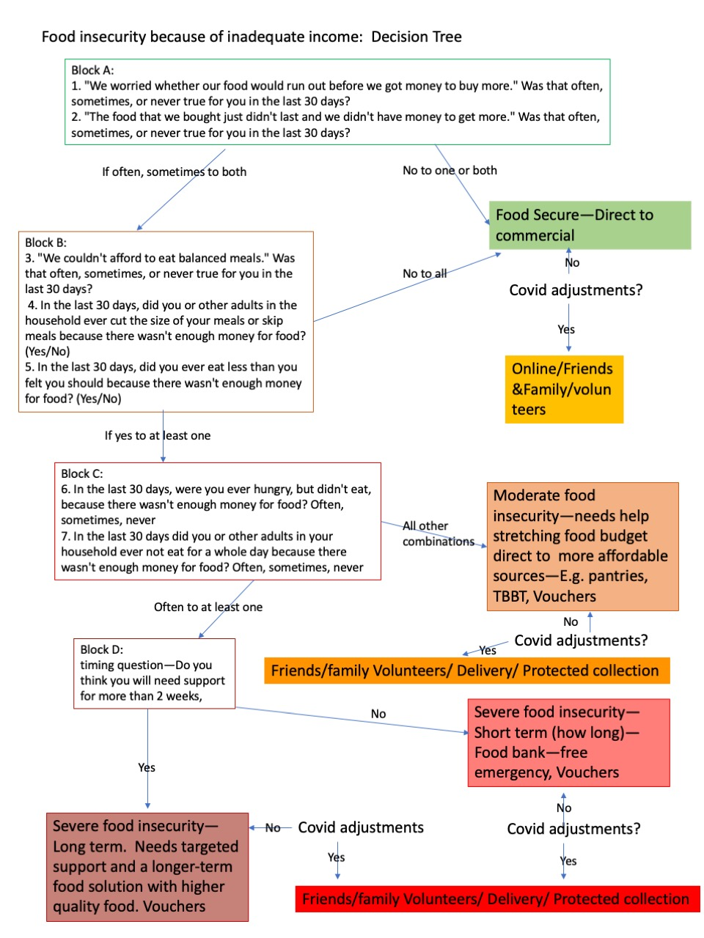
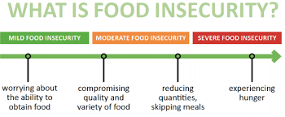
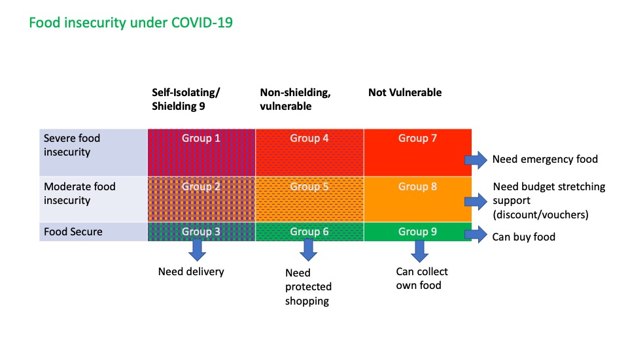

Slide 4
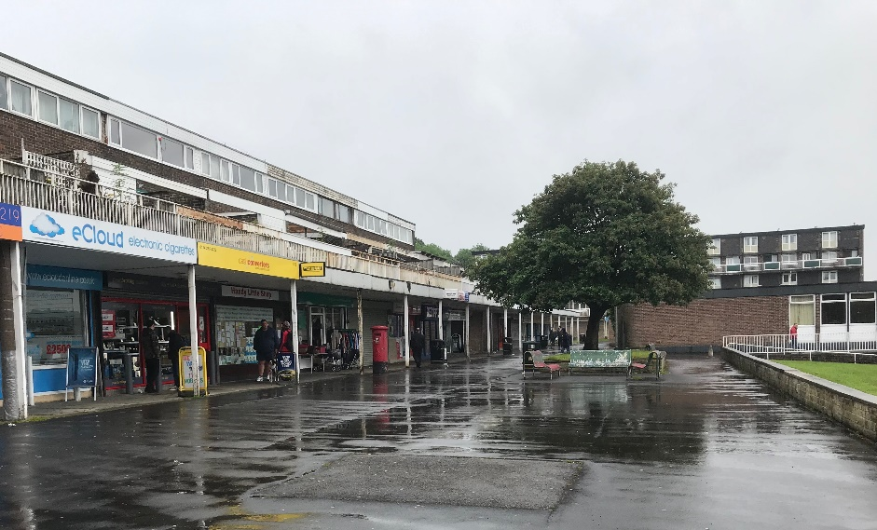
Foodscapes: The produced geographical contexts within which we source the food that we eat.
Commercial food system
Food only available if it is profitable
Low Income
If you can’t afford it can’t buy it
+ Risk aversion
+know what/know how
+Domestic preferences
+ Poor food relationships
Foodscape outcomes
Narrow diets
Diet related illness
Low availability w/ch limits potential for change
See:
Blake 2019: Increasing diet diversity in low income communities: https://ukprp.org/how-to-apply/call-2-scope/
Blake, M.K. More than Just Food: Food Insecurity and Resilient Place Making through Community Self-Organising. Sustainability 2019, 11, 2942. https://doi.org/10.3390/su11102942
Blake, M., 2018. Landscape and the politics of food justice. In Routledge Handbook of Landscape and Food (pp. 487-499). Routledge.
Notes:
Communities, supermarkets, to domestic store cupboards
Poverty as it intersects with food insecurity, national policy, and the commodification and financialisation of food systems is written into foodscapes—
Effects of commercial food system—food is only present in the landscape if it is profitable and can be purchased
+
Effects of low-income—If you can’t afford it, you cant buy it
+
But other causes-effects: Risk aversion to wasting food b/c wasting money, Household and daily struggle creates negative relationships with food, etc
=
narrow diets, diet-related illness, poor foodscapes

Slide 5
Food insecurity linked to loneliness and isolation
“If you have not got money for food, you have not got money to socialize”
People with strong social networks live longer and better
People during COVID who had strong social networks were less reliant on external support to access food.
Percent indicating improved social outcomes from participation in a food membership scheme
Standard error =/-6%
Survey Population: 2313
Responses: 300

Slide 6
Resilience
The ability to bounce back or recover from a shock
The removal of vulnerability to shocks
Shocks in a social and food context e.g.,
  Financial: loss of a job, benefits sanctions, increases in prices, need to divert cash unexpectedly to meet other needs, but also persistent state of shock—insufficient resources to meet basic needs.
  Social: Loss of a partner, Illness
  Foodscape: Loss/ withdrawl of service, food outlet closure
Vulnerability is enhanced by conditions within a context (e.g., isolation, withdrawal of services, poor foodscapes, loss of community cohesion)
Multi-scaled Solutions Needed
  National policy change
  Local responses to address isolation, fear, loss of capacity, distrust, poor foodscapes and disconnected communities.

Slide 7
Food Ladders: Levels of intervention
Rung 1: Catching—Crisis support, enables ability to cope
Rung 2: Capacity building—Vulnerable to crisis, enables adapting through education, sharing. Low stigma (doing with not to), accessible choices.
Rung 3: Self-organising for community change—Transformation from a recipient or content user to a content provider. Can be a commercial product or a social good.
Ladder not levels. Ladder not an escalator. More than how food is accessed.
People will be on different rungs on different ladders.
Capacity building is about enhancing capacity where it is needed for each person.
Starts from a position that everyone has assets.

Slide 8
Aim of Food Ladders
Build long term resilience and reduce vulnerability to shock
Intersects with three domains:
Food
Social
Economic

Slide 9
Where activity sits on the Food Ladders
 | Catching | Capacity building | Transformation
Food | Emergency support: Food parcel, soup kitchen | Activities that expand food literacy, nutrition. E.g., cooking lessons, pantry schemes that expose people to new food items, children’s food literacy. | Activities that diversify the foodscape to meet all local food needs. Positive relationships with food.
Social | Mental health support, befriending groups, resilience networks | Regular activities that brings people together to develop meaningful social networks. Breakfast clubs, afterschool clubs, craft sessions, social eating. | Self-organized activity, Social ties that look out for each other.
Economic | Free food to meet basic needs, crisis support | Interventions that stretch budgets, financial, employability and business skills development. May help subsidize demand to help markets get established. Business incubators and start-up grants. | Local procurement and community growing, develop markets, creates demand, creates local profit and employment opportunity, activity that brings economic sustainability to an area
Note that an individual organization may cross boxes. Individuals, depending on their role in relation to the organization/activity may be located in different boxes for example a volunteer in a resilience network may be located in social transformation, but the person for whom food is being collected/delivered this might be social catching.
Key here is to map framework onto local activity and then assemble across organizations to identify collective in-place provision.

Slide 10
Identifying Food Ladders: Food Activity
Catching: Emergency food support. Soup Kitchens, Food Parcels
Capacity Building: Activities that enhance food literacy and skills such as increasing exposure to new foods, nutrition and health information, cooking lessons. Pantries, cooking lessons and recipes, menu planning, tasting sessions, food safety, gardening skills.
Transformation: Community Gardens, Locally owned food businesses, Markets, Market gardening, Cooperatives and community owned businesses, Buying clubs, Community meals.

Slide 11
Identifying Food Ladders: Social
Catching: a place to go to get support and meet other people (e.g., mental health support). Usually one to one. Clear divisions between volunteer and service user. Done to or done for.
Capacity building: activities that enable people to engage with others and build strong social networks—volunteerism, regular eating together (social eating, parent and children breakfast/after school clubs) craft sessions. Individual outcomes also include increased confidence, reduced stress. Done with. More likely to involve some group engagement. Can be difficult to tell the difference between paid employees, volunteers and service users.
Transformation: Strong local social networks, self-organized social activities. Friends/family/neighbors who look out for each other and provide support when needed. Community centers run by and for local residents. Circular social economies (e.g., people give and receive). Volunteering. Community cook and eats, allotments. Tend to be self-governing. Embedded fully within the community.

Slide 12
Identifying Food Ladders: Economic
Catching: enabling people to meet basic needs (e.g., free food),
Capacity building: training and education, internship/apprenticeship opportunities, skills building e.g. budgeting, business skills development, vouchers and other schemes that stretch budgets (household and third-sector). Alternatively might be interventions that help support a market to be able to thrive.
Transformation: support for start-up businesses, local procurement processes that keep money locally. Provides economic opportunity. Activities that build local demand.

Slide 13
Moving people up the ladders
Some organisations offer internal ladders—e.g., they offer services that intersect at each stage
Others serve needs at one or two points on the ladder
Some see their services only intersecting with a single domain—e.g., offering food in the foodscape, meeting a social need, meeting an economic need.
We need to encourage organizations to support people to move up the ladders across all domains for change to happen.

Slide 14
Evaluating the Foodscape
Low quality: foodscape meets basic calorie needs, nutritional needs may not be available. –e.g. foodscape is dominated by low nutrition food. Few options. Food deserts/swamps. Diets are narrow.
Enhanced: Foodscape includes opportunities that enable people to engage positively with the foodscape—But supported by outside organization.
Transformational: A diverse foodscape that meets everyone’s needs regardless of age, race, religion, income or gender. Includes a mix of high-cost, low-cost, and free food that is healthy and meets social needs. Builds toward a sustainable future.

Slide 15
Strategies that make people play in the space.
How does food become a tool for intentional community?
Cooperation—coops. Challenge the way that services that are provided to demand and design
Tool for social. And a new sense of confidence.

Slide 16
What needs to happen to help move people up and across
Ensure that organisations understand that they are part of a bigger picture that includes commercial, public sector and third sector organisations.
Awareness of other services in an area that map onto different points on each of the ladders. Could be council led but distributed to Community/VCS organisations. National organisations collaborate to understand where their members fit onto the ladders.
Encourage organisations to refer people to these services or partner with them to enable mobility. Encourage councils/VCS to provide advice or support for this movement.
Use existing social prescribing to ensure people are accessing the right rung for their needs. Food insecurity question tool can help with this.
Greater recognition that while an organization’s main purpose may be in one domain, it is possible that they are or could be meeting need in another—may need help understanding how to see how they might identify this in their service.
Support to be able to understand what is involved in creating internal opportunities to move up and across—help reduce frustration and avoid pitfalls with some “how to” examples.
Provide opportunities for community residents to contribute their own assets and to be a part in identifying needs and solutions.

Slide 17
How do we coordinate and build ladders in place? ABCD approach*
Identify who and what is in the landscape. Local stakeholders
Identify what assets* they have
Help them to see where they fit in the ladder and where they might contribute their assets.
Identify potential opportunities and barriers
External threats? Structural race/class/gender etc. , National policy,
Consider how national level stakeholders can contribute
  Identify assets—data, communication networks, influence on policy, local placement…
*Asset based community development—does with not to. Starts from a position of strengths not needs.
*Target areas that are most highly deprived—where health inequalities are the greatest?
*Assets are internally held resouces—what is in place or within the network, resources are external to the network. Increase local assets through internal development and through targeted expansion of the network, which may be short term or long term.

Slide 18
Stakeholders--Local
Community residents
Community organizations
Pantry and membership schemes
Foodbanks
Food redistribution
Ancillary service providers (non-food services)
Local Authorities…(departments? Communities, skills, health and wellbeing boards)
Resilience networks
Commercial sector
Social prescribing-- Health services

Slide 19
Assets—
Fixed material—buildings, land
Transferable material—vehicles, equipment, goods, food
Human—employees, volunteers
Networks—Networks can be mobilized to bring resources to the group
Knowledge/skills—knowledge of community culture, assets and needs; business skills; food literacy skills; growing; facilitation skills, etc.
Financial (£)
Data
Procedural? Sourcing—this may be an opportunity
Two scales—individual level and organizational?—Might be useful to develop/find a proforma tool that could be used. Could be done as a workshop with different stakeholders.

Slide 20
Place based assets not held by any one person or organisation
Physical—e.g., lakes, views etc.
Cultural—strong family ethos, long history of organizing, friendly, diverse…
Transportation links
Shared stories...

Slide 21
One of the biggest threats is lack of buy-in across the range of stakeholders
Don’t see themselves as part of the solution/problem so don’t show up.
Want to help, but struggle to see how they fit in or what they can bring.
Want to help, but have an us/them mentality—not part of the same community.
Very internally focused on their way of doing as the only/best way. See others as competition.
Effort fatigue— “I keep going to events and all it ever is is a talking shop.”
Distrust of other types of organizations-past experiences of feeling used.
Scale disconnect—hyper local versus borough or council priorities, time is limited.

Slide 22
How do we overcome this barrier?
Develop the social networks –start with targeted engagements, webinars, individual tailored communications with each type of stakeholder.
Purpose is to show them where they fit in the ladder, why this might be useful for them and help identify what they can bring to bear—Assets exercise?
Once there is buy in and purpose then bring together to structure across and consider what they want to address together. Should be focused and specific with clear actions.
Start with scale of the problem to be collectively solved. What is the scale for one organization may not be that of another.
Invite larger scale organisations who are more well resourced to the smaller scale rather than the other way around. Challenge larger scale orgs to see how they can scale across their activity rather than scale up.

Slide 23
Opportunities
Opportunities are the issues that are identified as needing to be addressed—co-produced. Could start as a threat/problem but reframe as an opportunity.
For each opportunity, identify what assets are available that can be mobilized.
Consider what additional resources might be needed and mobilize community network to find solutions.
RSA Bridges to the future activities to stimulate thinking.

Slide 24
Stakeholders--National
National Charities and Networks—Food
National Charities and Networks—Services and identity groups
BiTC, LGA
Sustainable Food Places
Defra, PHE
….

Slide 25
The research behind Food Ladders
Food Ladders was developed through a series of research projects funded by the ESRC, MRC, and The N8 AgriFood Programme. This interdisciplinary work is a collaboration with a wide range of partners including local authorities, food industry actors, national charities and community organisations across the UK, which enabled a better understanding of what is working in communities and where different levels of resources and challenges are situated. A special mention goes to Gary Stott (Community Shop and Incredible Edible) and Samantha Siddall (ECO), Rupert Suckling (Doncaster Metropolitan Council), and the teams at Greater Manchester Poverty Action and FareShareUK.
Related Papers and Reports:
Blake, M., 2019. More than just Food: Everyday food insecurity and resilient place making through community self- organising. Sustainability. 11(10), 2942; https://doi.org/10.3390/su11102942 (PDF)
Blake, M., 2018. Building and Unjust Foodscape: Shifting Governance Regimes, Urban Place Making and the Making of Chinese Food as Ordinary in Hong Kong. Local Environment. Available from the publisher online (authors accepted version)
Blake, M., 2020. Releasing social value from surplus food, Evaluation Report for FareShare and the British Red Cross. Available from https://www.researchgate.net/profile/Megan_Blake2
Blake, M., 2017. Feeding Affordances and Decent Helpings, 10.13140/RG.2.2.20070.93762/1

