Slide 1
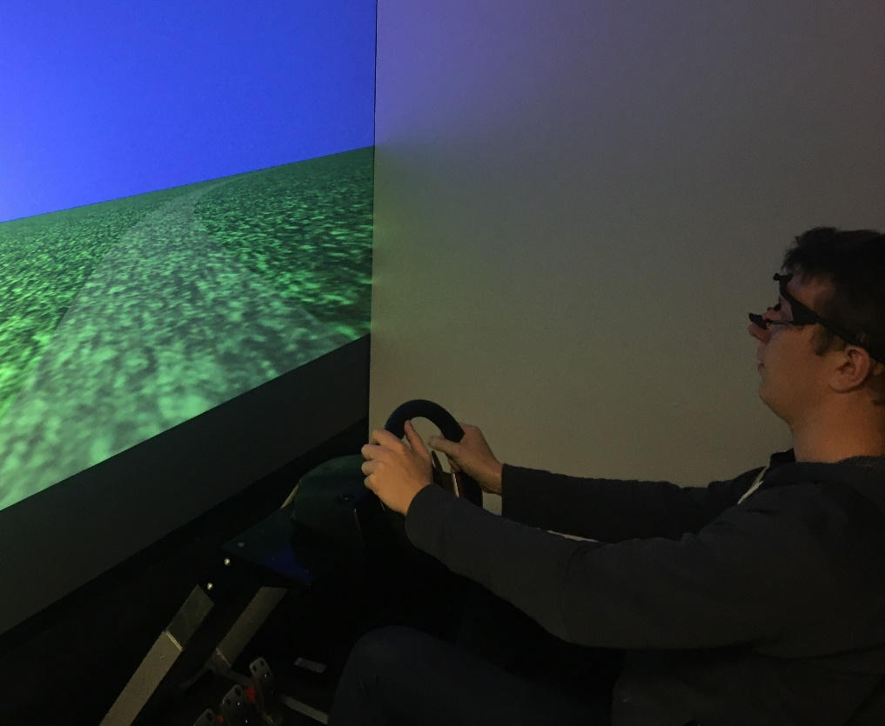
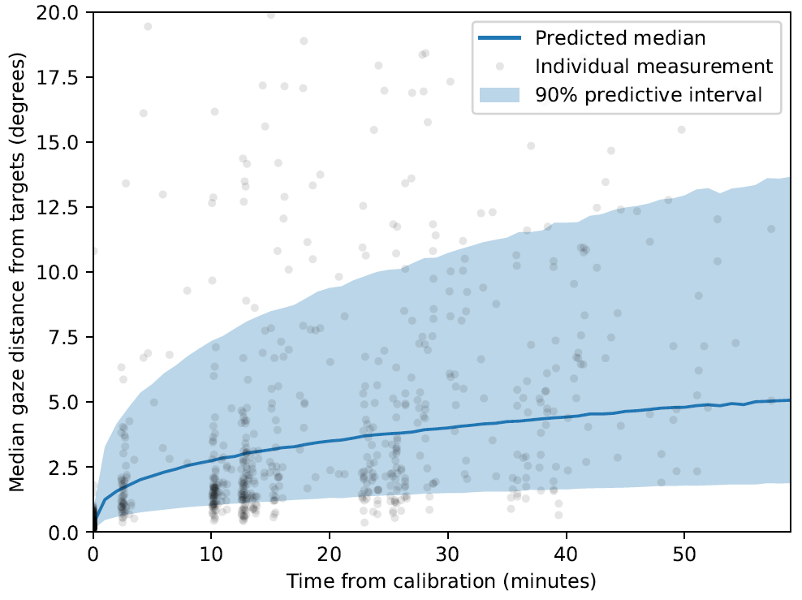
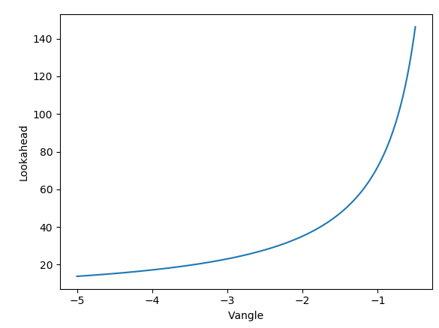
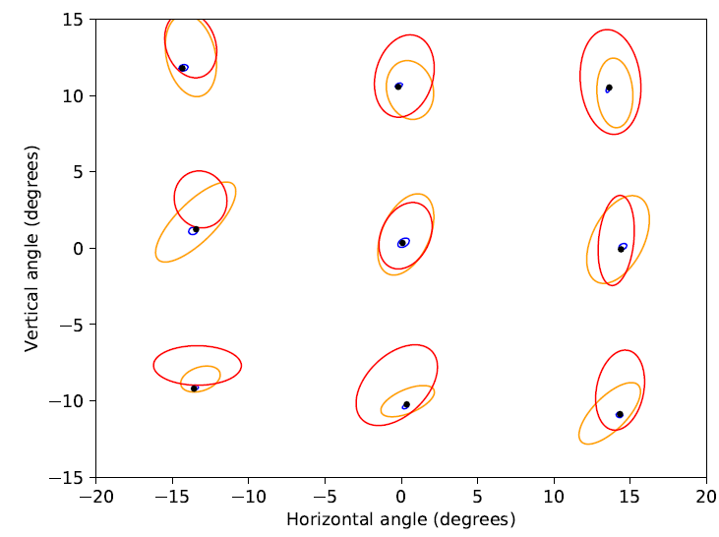
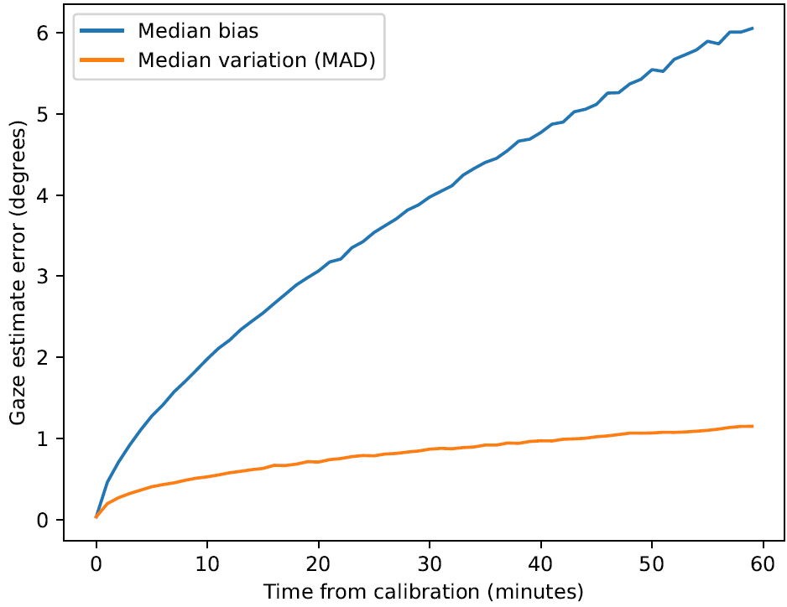
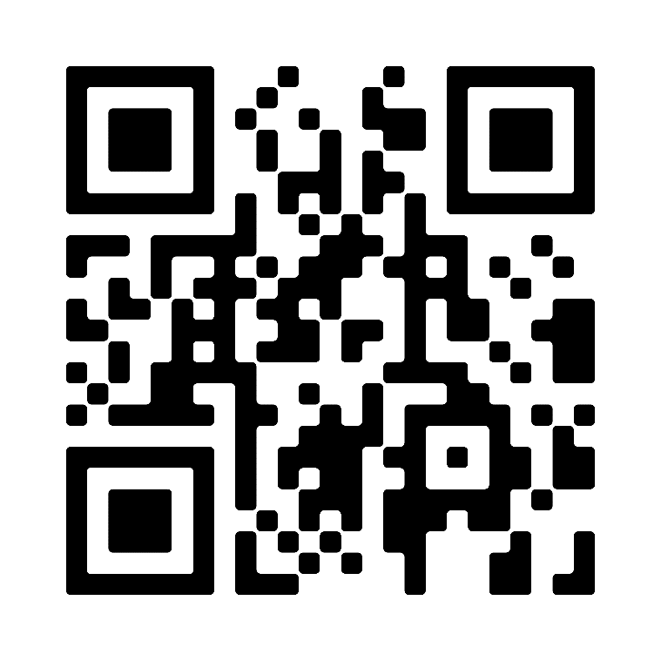
Mobile eye-trackers may need to be calibrated every 1-2 minutes to the achieve levels of accuracy stated by manufacturers.
How long does it take for mobile eye-tracker calibration to drift?
Non-Cognitive Predictors of Student Success: A Predictive Validity Comparison Between Domestic and International Students
William E. A. Sheppard, Jami Pekkanen, Callum D. Mole and Richard M. Wilkie
Perception Action Cognition Laboratory, School of Psychology.
Non-Cognitive Predictors of Student Success: A Predictive Validity Comparison Between Domestic and International Students
INTRO:
Errors can be caused by calibration drift and can compromise the ability to make useful inferences from data.
Errors are particularly problematic when projecting gaze from the screen into the world.
Driving simulator set-up
METHODS:
Participants (N=11) completed 4x10 min simulated driving while being eye-tracked using Pupil Labs mobile eye-tracker.
Calibration took place before and after each block of driving using a 5x7 target array.
RESULTS:
After 2 mins median error was ~ 2.5°.
After 60 mins more than half of participants showed error of >5°, and some >10°.
Pupil Labs mobile eye-tracker mounted on a dummy
CONCLUSIONS:
Gaze estimation error due to drift far exceeds that due to noise.
This error could be removed using ‘debiasing’.
Take a picture to download more details.
Error for the central 3x3 calibration grid at three time points
Notes:
Notes:
In Powerpoint, click View > Guides
Keep text within gutter guides.
Author list: Don’t split names onto two lines (e.g., “Jimmy [break] Smith”). If that happens, use a new line, unless you need the space. Bold the first names of anybody who’s presenting in person.
Intro/methods/result: Do not drop below font size 28, but if you have extra space, jack up the font size until the space is full.
Do not use color in the sidebars except in graphs/figures. It’ll pull attention from the center and slow interpretation for passersby.

