Slide 1
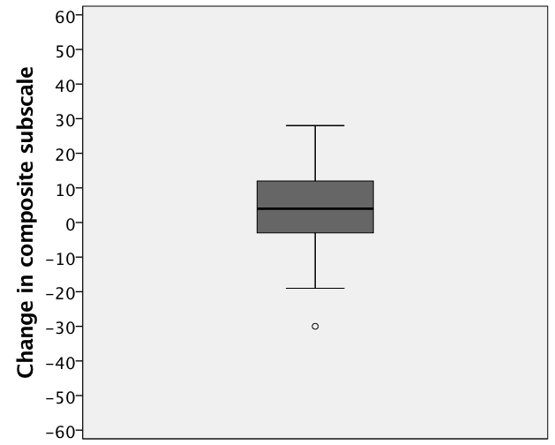
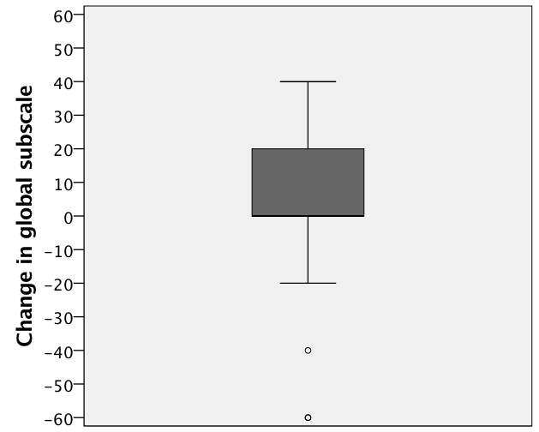
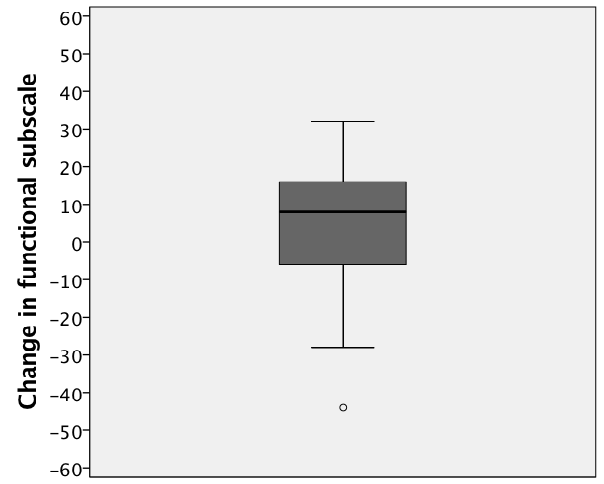
A
p=0.021
B
p=0.035
C
p=0.058
D
p=0.061
E
p=0.072

