Slide 1
Recovering the costs of the child support system: The approach of Australia, NZ, UK and US.
2nd International Child Support Symposium, Swinburne University, Melbourne, Australia 4-5 December 2017
Daniel R. Meyer, University of WI–Madison, US
*Christine Skinner, University of York, UK.
Kay Cook, Swinburne , Australia.
Michael Fletcher AUT University, NZ.
Notes:
a black box– is the interaction between CS systems and Social Assistance Benefits.
We now very little about that interaction – in part due to the complexity involved in exploring two systems, but perhaps also due to a lack awareness about its significance.
Today – we want to consider that interaction as part of a number of different cost recovery mechanism used by the state to reduce fiscal expenditures in dealing with separated families.

Slide 2
Introduction
Part 1: Background to the study:
  Research project comparison Child Support (CS) schemes 4 countries.
  Conceptual basis
  Cost recovery mechanisms and state interests
  Some Big Questions
Part 2: Effects of Cost recovery on Government Revenues:
  Why compare Australia, NZ,UK and US?
  Methods – Vignettes
  Results % CS recovered by the state
  Different cost recovery approaches
Notes:
Research project
Define CS: Amount of money owed by separated parents (usually dads) for the upkeep of children post-sep.
State has a role in most developed countries in upholding this private parental obligation.
But at same time the state may have an interest in keeping their costs low – either in terms of minimising costs of running a dedicated CS system and / or in providing social assistance benefits to separated parents – mainly lone mothers.

Slide 3
Part 1: Background
Three parts to research project:
Analysis focus - lone parent poverty and child support interactions with social security/social assistance schemes.
Analysis focus - effects of cost recovery mechanisms on government revenues
Analysis focus - whether/how governments ‘rationalize their CS regimes – in progress.
Notes:
Research project
Define CS: Amount of money owed by separated parents (usually dads) for the upkeep of children post-sep.
State has a role in most developed countries in upholding this private parental obligation.
But at same time the state may have an interest in keeping their costs low – either in terms of minimising costs of running a dedicated CS system and / or in providing social assistance benefits to separated parents – mainly lone mothers.
We wanted to explore this idea of the state mechanisms in recovering their costs.
Part 1: looked at lone parent poverty. We explored how much CS poor lone parent families received once you took into account interactions between CS systems and SA schemes.

Slide 4

Part 1: Conceptual Basis
Lots research on CS systems & on poverty reduction.
BUT little on how CS systems interact with social security schemes.
Interactions & how they impact on CS outcomes are a Black Box.
  “Child maintenance and social security interactions: the poverty reduction effects in model lone parent families across four countries.” Journal of Social Policy 2017 Vol 46 (3).
  Explored interaction effect using lone parent ‘model’ families.
  To find out ‘how much’ of the paid CS lone parents got in their hands.
Notes:
Research project
Define CS: Amount of money owed by separated parents (usually dads) for the upkeep of children post-sep.
State has a role in most developed countries in upholding this private parental obligation.
But at same time the state may have an interest in keeping their costs low – either in terms of minimising costs of running a dedicated CS system and / or in providing social assistance benefits to separated parents – mainly lone mothers.
We wanted to explore this idea of the state mechanisms in recovering their costs.
Part 1: looked at lone parent poverty. We explored how much CS poor lone parent families received once you took into account cost recovery mechanisms.
Combination of these mechanisms produced different outcomes or LP’s across countries.
We found:
CS could be treated as a substitute for social assistance benefits – ie. Multiple or strong cost recovery mechanisms – meaning LP not getting full benefit of CS payments added to their incomes.
CS could be treated as complement to LP incomes - i.e. very few or weak mechanisms for recovering costs - meaning LP’s could be better off with CS.
Implications:
In 1 = attractive to governments seeking to reduce public expenditure and promote private responsibility.
In 2 = attractive to governments seeking to tackle child poverty
= attractive to both parents as see their child get the CM money
PART 2: We …..
IN part 2: discussed today - we want to explore the perspective of the state – the idea of the state making some gains by recovering their own costs.
In our earlier analysis, we found different types of cost recovery mechanisms:
EXPLICIT mechanisms = The state held back some or all of the CS paid. Passing through less CS to the LP than was paid by the other parent.
IMPLICIT mechanisms = more complex. The state does not disregard CS monies. Rather any CS money that is paid by the parent and passed through by the state is counted as income and reduces amounts of other social assistance benefits.
In this analysis we will look at these 2 mechanisms – and another mechanism not explored previously:
3. FEES – which are a charge to use the formal CS system.

Slide 5
Part 1: Conceptual Basis
  We identified mechanisms in the interactions that reduced value of CS to poor lone parent recipients
INTERACTION
CS INPUT
$ Paid by Parent
CS systems
Social Assistance Schemes
CS OUTCOMES
0% -100%
INTERACTION MECHANISMS
‘The Pass Through’
‘CS Disregards’ in Social Assistance Schemes
100%
Notes:
Context – poor lone parent families reliant on social assistance benefits
To understand how much they LP’s can actually get ‘in their hands’
– we must consider the interactions between CS systems and SA schemes.
We found that operational mechanisms can intervene to reduce the value of the CS that had been paid:
The pass through –
This is a mechanism in which the state decides how much of the CS to pass through from the paying parent to the receiving parent. The state could decide to pass it all through, or only some of it through or none of it through! This is usually an explicit mechanism that is well known and understood. In the US it varies by state, so some pass it all through, some pass none through and various amounts in between. In our study we focused On Wisconsin - which passed 75% of the paid Cs through the receiving parent. .
Alongside this another more implicit mechanism could operate – the CS Disregard-
This is where CS payments can be disregarded or not disregarded as income when calculating SA amounts.
Where CS is NOT disregarded the amounts of SA are reduced dollar for dollar by the amount of CS that has been paid.
Depending on which mechanism predominates and how they might work in combination, the outcomes are commonly to reduce the value of the CS that is paid.
S.

Slide 6
Part 1: Cost Recovery Mechanisms
  The state could recover its costs through these mechanisms:
    By treating CS as SUBSTITUTE for Social Assistance benefits by NOT passing it all through - or by NOT disregarding it when calculating SA amounts.
  Alternatively parents stood to gain IF…
    All CS was passed through or fully disregarded when calculating SA. In this case CS was treated as a COMPLEMENT to SA. Only in UK.
  Our second analysis we focused on state perspective
  Looked at 3 cost recovery mechanisms:
    EXPLICIT mechanisms – Pass Through
    IMPLICIT mechanisms – CS Disregards
    FEES charged to use CS system
Notes:
When considering these mechanisms we argued in our first paper that they effectively treated CS payments:
As a SUBSTITUTE for SA payments – for example where not all of the CS was passed through to the receiving parent OR where it was counted as income in calculating SA benefits. In these ways the parents did not gain financially from CS payments – but the state did gain financially.
The state could recover some of its fiscal costs by treating CS as a substitute for SA benefits. We found in these cases Multiple or strong cost recovery mechanisms – meaning LP not getting full benefit of CS payments added to their incomes.
Alternatively, the state could treat CS payments as a COMPLEMENT to SA benefits. It could pass through ALL the CS and fully disregard CS when calculating SA benefits.
When CS treated as complement to LP incomes – there were few or weak mechanisms for recovering costs - meaning LP’s could be better off with CS.
In our analysis – only the UK treated CS as a complement.
Clearly the state has a financial interest in CS payments – at least that is where the receiving parent is dependent on SA benefits.
We wanted to explore this idea of the state’s financial interest by exploring these mechanisms and how they were used as tools for cost recovery.
In 1 = SUBSTITUTE attractive to governments seeking to reduce public expenditure and promote private responsibility.
In 2 = COMPLEMENT attractive to governments seeking to tackle child poverty
= attractive to both parents as see their child get the CM money

Slide 7
Big Questions
How do child support payments interact with other governmental social assistance programmes in different countries?
What cost recovery mechanisms are used?
How much does the state gain in cost recovery?
What differences in approaches across countries with ostensibly similar CS systems?

Slide 8
Part 2: Why Australia, NZ, UK and US?
All Agency systems – use formulae/ rules to set CS
  Explicit policy transfer: UK modelled on US- Wisconsin; NZ modelled on Australia.
Similar policy drivers and histories:
  Increase in lone parent families
  Rise in fiscal costs support lone parents
  Initial principle of cost recovery (CS paid on behalf of children receiving benefits should be used to offset government costs)
All started their child support schemes focused on cost recovery, but policy has now diverged.
Notes:
Child Maintenance Regimes similar policy drivers:
Concerns about costs resulting from demographic change – increase in lone parent families.
But also about costs of supporting LP’s and the fact that NRP’s expected to pay something – but not doing so.
CM Regimes types:
All standardised agency systems use formulae/ rules rather than judicial decision making
UK – was CSA – now known as statutory Child Maintenance Service (CMS)
Australia – was CSA – now known as Dept. of Human Services – Child Support (DHS-CS)
NZ – Inland Revenue administers it.
US (Wisconsin) Hybrid - CSA and Courts can set orders.

Slide 9
Method Vignette
Good technique (model families) - detail few cases.
Standardises context - easier comparison
We explore how much:
CS the state ‘passes through’ to low income cases (lone parent one child).
CS the state ‘disregards’ in interactions with social assistance benefits.
Fees are charged, and to whom and thus the value of fees to the state.
How the cost recovery mechanisms work in combination in the 4 countries and their total value as a % of CS
Notes:
Vignette good technique look in detail at a few cases rather than a broad range of cases. Helps standardise context for cross country comparison.
3 purposes use this vignette:
Explore how much state passes through to low income cases – lone parent one child.
Explore what happens in interactions with Social assistance benefits – how much is clawed back by the state (if it is paid by other parent).
Explore – fees – who is charged (Mary or Paul), how much is charged, and how much does it impact on CS payments and therefore what is its value to the state.

Slide 10

Vignette Family
Mary & Paul: 1 child (Peter)
Neither has other children
Live in rented accommodation
(~ bottom quartile rental)
Explore 10 scenarios – vary by Mary and Paul’s earnings; with and without CS
Notes:
This Vignette is Ms Mary a single parent with one child under 5 years.
Paul is her ex partner, they never lived together or were married, though Paul is involved in his child’s life.
We assume both live in private rent ().

Slide 11
10 Scenarios within Vignette
 | Mary | Paul | CS
A | Unemployed | Unemployed | No
B | ‘’ | Unemployed | Yes
C | ‘’ | 2/3 median earnings | Yes
D | ‘’ | Median earnings | Yes
E | Median PT earnings | 2/3 median earnings | No
F | ‘’ | 2/3 median earnings | Yes
G | ‘’ | Median earnings | Yes
H | 2/3 Median FT earnings | 2/3 median earnings | No
I | ‘’ | 2/3 median earnings | Yes
J | ‘’ | Median earnings | Yes
Notes:
What is rationale between A and B?
One to test even if unemployed what CM would be expected to be paid? – Some countries set a minimum amount.
Also as a baseline to see what happens to Ms Mary’s income if gets CM.
Table 2: Standardized Earnings and Housing Expenditures
Australia New Zealand United Kingdom United States
Median Full-Time Male Earnings 79,664 (52,605) 52,832 (36,081) 29,251 (39,875) 47,316 (47,316)
Median Part-Time Female Earnings 29,245 (19,312) 17,680 (12,075) 8694 (11,852) 14,148 (14,148)
Annual Housing 13936 (9203) 14560 (9944) 8316 (11336) 9744 (9744)
Notes: The first figure in each cell is in each country’s own currency; figures in parentheses are in PPP-adjusted US dollars.

Slide 12
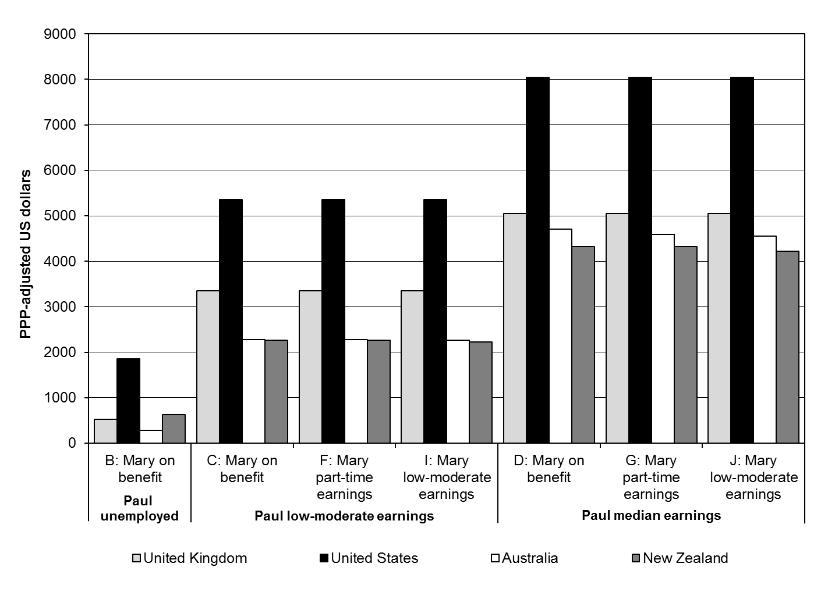
Expected child support amounts - PPP $US

Slide 13
3 Types cost recovery mechanisms
Notes:
*Mary does not receive social assistance in these scenarios in any country = no explicit cost recovery.
ª One-time application fee
^{b} Implicit cost recovery mechanism
^{c} Explicit cost recovery mechanism
^{d} Mix of explicit and implicit cost recovery, plus fees for Paul
^{e} Implicit cost recovery, plus fees for Paul and Mary

Slide 14
Cost recovery approaches
Implicit Only: Australia
Implicit & Explicit:
New Zealand
Fees Only:
UK
Implicit, Explicit & Fees:
US – Wisconsin
Notes:
Australia – only recovered in hidden ways - complex interactions with Family Tax Benefits and rent supplements – counted as income.
UK – recovered only those who those opt-in to formal CMS (FEES).
NZ – recovers mostly from low income explicitly – state keeps 100% CS if lone parent in receipt social assistance & Implicitly counted as income in receipt of some cash benefits and rent supp.
US –WISC – Recovers many ways as possible – holds back 25%, counts as income in calculating other benefits and charges fees.

Slide 15


Conclusion
Advantages and disadvantages different approaches?
Don’t know for sure data limited. We suggest:
If NO cost recovery –i.e. parent keeps it all:
  Other parent more likely to pay.
  Reduces debt and debt recovery costs
  Less conflict between parents
  Better family relationships for children
If YES cost recovery
  State make some savings
  State increases costs in more debt recovery
  Parents ‘nudged’ into informal agreements (Fees)
  Parental conflict increased
  Lone parent poverty increased
  Greater inequality rich and poor – legitimacy issues for CS
Notes:
If non resident parent charged fees – effectively being charged for a service to have money taken off them? It would be like paying a fee to have your tax removed from you income.

Slide 16
Limitations
Only one family type – limited scenarios (7)
Assumes CS fully paid, SA benefits fully received
Ignores behavioural effects (work incentives)
No information on how these approaches are working in real cases
Need to explore:
  Whether and how approaches are rationalised in policy making?

Slide 17




Thank You

