Slide 1
Recovering the costs of the child support system: The approach of Australia, NZ, UK and US.
Daniel R. Meyer, University of WI–Madison, US
Christine Skinner, University of York, UK.
Kay Cook, Swinburne , Australia.
Michael Fletcher AUT University, NZ.
Notes:
Relationship breakdown very common –intimate relationships fragile –in many western countries.
Living arrangements of parents and children increasingly fluid and complex.
Not a good situation for welfare states
institutionally and operationally challenging to keep pace with changes in partnership formation and dissolution
important to do so in supporting poor families esp lone parents
A system which is often not closely scrutinised is CS .
Even more of a black box – to use the stream’s title – is the interaction between CS systems and Social Assistance Benefits.
We now very little about that interaction – in part due to the complexity involved in exploring two systems, but perhaps also due to a lack awareness about its significance.
Today – we want to consider that interaction as part of a number of different cost recovery mechanism used by the state to reduce fiscal expenditures in dealing with separated families.

Slide 2
Introduction
Research project comparison Child Support (CS) schemes 4 countries.
Child Support definition
Cost recovery and the interest of the state
Three parts to research project:
“Child maintenance and social security interactions: the poverty reduction effects in model lone parent families across four countries.” Journal of Social Policy 2017 ,Vol 46 (3) (focuses on effects on lone-parent poverty).
We found that through different cost recovery mechanisms CS was treated as:
A substitute for social security benefits
Or as a complement to for social security benefits
Notes:
Research project
Define CS: Amount of money owed by separated parents (usually dads) for the upkeep of children post-sep.
State has a role in most developed countries in upholding this private parental obligation.
But at same time the state may have an interest in keeping their costs low – either in terms of minimising costs of running a dedicated CS system and / or in providing social assistance benefits to separated parents – mainly lone mothers.
We wanted to explore this idea of the state mechanisms in recovering their costs.
Part 1: looked at lone parent poverty. We explored how much CS poor lone parent families received once you took into account cost recovery mechanisms.
Combination of these mechanisms produced different outcomes or LP’s across countries.
We found:
CS could be treated as a substitute for social assistance benefits – ie. Multiple or strong cost recovery mechanisms – meaning LP not getting full benefit of CS payments added to their incomes.
CS could be treated as complement to LP incomes - i.e. very few or weak mechanisms for recovering costs - meaning LP’s could be better off with CS.
Implications:
In 1 = attractive to governments seeking to reduce public expenditure and promote private responsibility.
In 2 = attractive to governments seeking to tackle child poverty
= attractive to both parents as see their child get the CM money
PART 2: We …..

Slide 3
Introduction
Part 2: of project - Analysis focuses on effects of cost recovery mechanisms on government revenues.
Part 3: in progress …will focus on whether/how governments ‘rationalize their CS regimes.
Part 2: explore the state’s perspective.
Look at range cost recovery mechanisms used by the state.
3 Types:
EXPLICIT mechanisms
IMPLICIT mechanisms, complex
FEES charging to use CS system
Notes:
IN part 2: discussed today - we want to explore the perspective of the state – the idea of the state making some gains by recovering their own costs.
In our earlier analysis, we found different types of cost recovery mechanisms:
EXPLICIT mechanisms = The state held back some or all of the CS paid. Passing through less CS to the LP than was paid by the other parent.
IMPLICIT mechanisms = more complex. The state does not disregard CS monies. Rather any CS money that is paid by the parent and passed through by the state is counted as income and reduces amounts of other social assistance benefits.
In this analysis we will look at these 2 mechanisms – and another mechanism not explored previously:
3. FEES – which are a charge to use the formal CS system.

Slide 4
Big Questions
How do child support payments interact with other governmental social assistance programmes in different countries?
What cost recovery mechanisms are used?
What does the state gain in cost recovery?
What differences in approaches across countries with ostensibly similar CS systems?

Slide 5
Why Australia, NZ, UK and US?
All Agency systems – use formulae/ rules to set CS
Explicit policy transfer: UK modelled on US- Wisconsin; NZ modelled on Australia.
Similar policy drivers and histories:
Increase in lone parent families
Rise in fiscal costs support lone parents
Initial principle of cost recovery (CS paid on behalf of children receiving benefits should be used to offset government costs)
All started their child support schemes focused on cost recovery, but policy has now diverged.
Notes:
Child Maintenance Regimes similar policy drivers:
Concerns about costs resulting from demographic change – increase in lone parent families.
But also about costs of supporting LP’s and the fact that NRP’s expected to pay something – but not doing so.
CM Regimes types:
All standardised agency systems use formulae/ rules rather than judicial decision making
UK – was CSA – now known as statutory Child Maintenance Service (CMS)
Australia – was CSA – now known as Dept. of Human Services – Child Support (DHS-CS)
NZ – Inland Revenue administers it.
US (Wisconsin) Hybrid - CSA and Courts can set orders.

Slide 6
Method Vignette
Good technique (model families) - detail few cases.
Standardises context - easier comparison
We explore how much:
CS the state ‘passes through’ to low income cases (lone parent one child).
CS the state ‘claws back’ in interactions with social assistance benefits.
Fees are charged, and to whom. Thus the ‘value of fees’ to the state.
How the cost recovery mechanisms work in combination in the 4 countries and their total value as a % of CS
Notes:
Vignette good technique look in detail at a few cases rather than a broad range of cases. Helps standardise context for cross country comparison.
3 purposes use this vignette:
Explore how much state passes through to low income cases – lone parent one child.
Explore what happens in interactions with Social assistance benefits – how much is clawed back by the state (if it is paid by other parent).
Explore – fees – who is charged (Mary or Paul), how much is charged, and how much does it impact on CS payments and therefore what is its value to the state.

Slide 7
Vignette Family
Mary & Paul: 1 child (Peter)
Neither has other children
Live in rented accommodation (~ bottom quartile rental)
Explore 10 scenarios – they vary by Mary and Paul’s earnings; with and without CS
Notes:
This Vignette is Ms Mary a single parent with one child under 5 years.
Paul is her ex partner, they never lived together or were married, though Paul is involved in his child’s life.
We assume both live in private rent ().

Slide 8
10 Scenarios within Vignette
 | Mary | Paul | CS
A | Unemployed | Unemployed | No
B | ‘’ | Unemployed | Yes
C | ‘’ | 2/3 median earnings | Yes
D | ‘’ | Median earnings | Yes
E | Median PT earnings | 2/3 median earnings | No
F | ‘’ | 2/3 median earnings | Yes
G | ‘’ | Median earnings | Yes
H | 2/3 Median FT earnings | 2/3 median earnings | No
I | ‘’ | 2/3 median earnings | Yes
J | ‘’ | Median earnings | Yes
Notes:
What is rationale between A and B?
One to test even if unemployed what CM would be expected to be paid? – Some countries set a minimum amount.
Also as a baseline to see what happens to Ms Mary’s income if gets CM.
Table 2: Standardized Earnings and Housing Expenditures
Australia New Zealand United Kingdom United States
Median Full-Time Male Earnings 79,664 (52,605) 52,832 (36,081) 29,251 (39,875) 47,316 (47,316)
Median Part-Time Female Earnings 29,245 (19,312) 17,680 (12,075) 8694 (11,852) 14,148 (14,148)
Annual Housing 13936 (9203) 14560 (9944) 8316 (11336) 9744 (9744)
Notes: The first figure in each cell is in each country’s own currency; figures in parentheses are in PPP-adjusted US dollars.

Slide 9
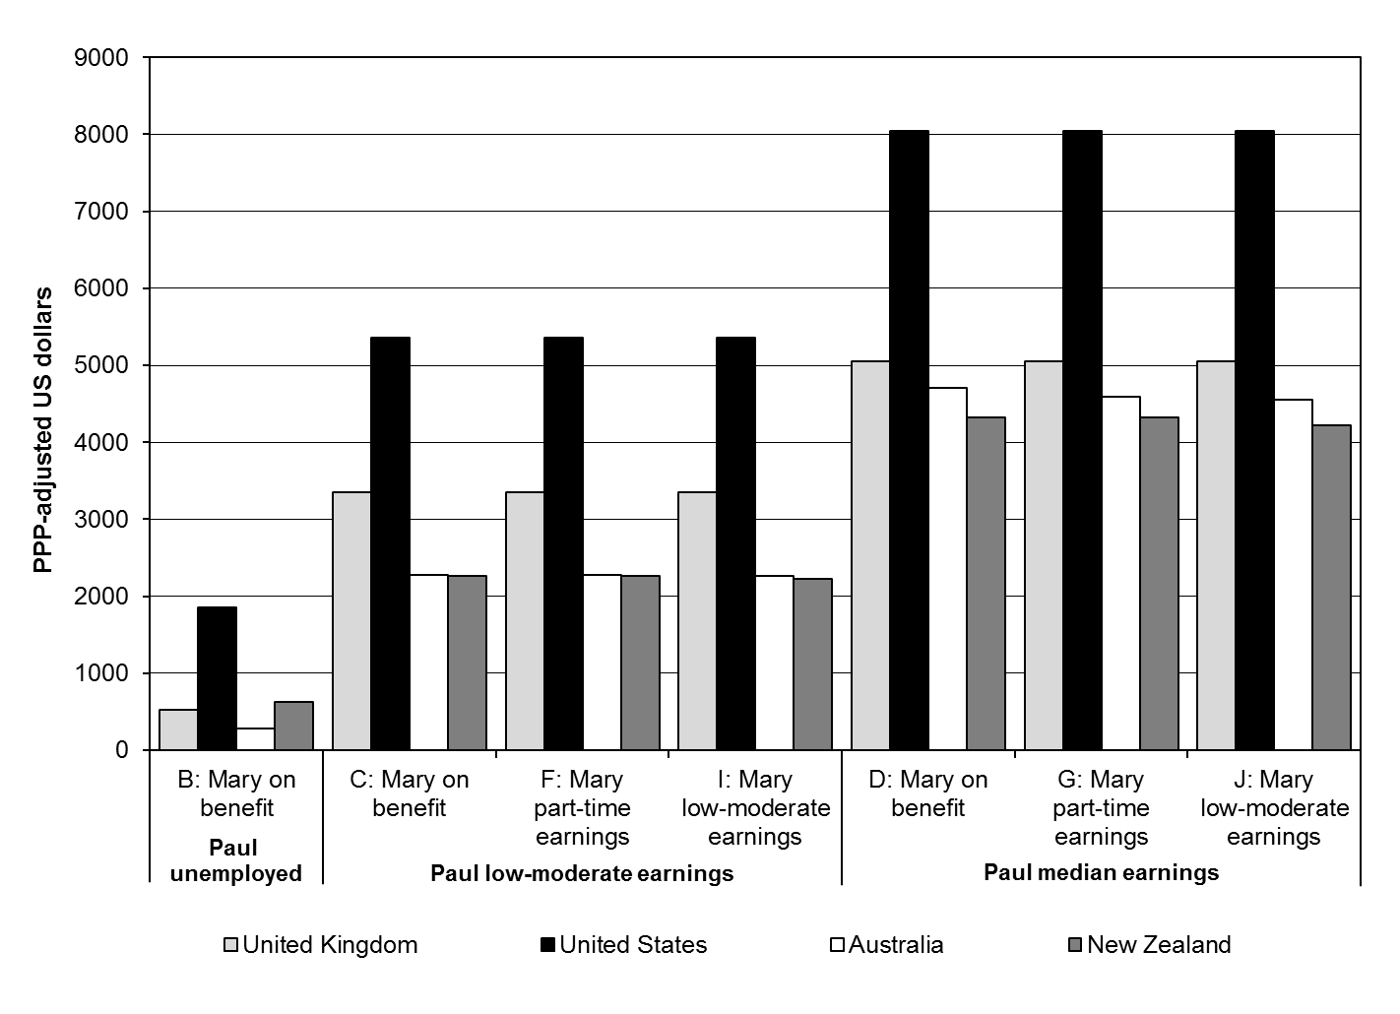
Expected child support amounts - PPP $US

Slide 10
3 Types cost recovery mechanisms
Notes:
*Mary does not receive social assistance in these scenarios in any country = no explicit cost recovery.
ª One-time application fee
^{b} Implicit cost recovery mechanism
^{c} Explicit cost recovery mechanism
^{d} Mix of explicit and implicit cost recovery, plus fees for Paul
^{e} Implicit cost recovery, plus fees for Paul and Mary

Slide 11
Cost recovery approaches
Implicit Only: Australia
Implicit & Explicit:
New Zealand
Fees Only:
UK
Implicit, Explicit & Fees:
US – Wisconsin
Notes:
Australia – only recovered in hidden ways - complex interactions with Family Tax Benefits and rent supplements – counted as income.
UK – recovered only those who those opt-in to formal CMS (FEES).
NZ – recovers mostly from low income explicitly – state keeps 100% CS if lone parent in receipt social assistance & Implicitly counted as income in receipt of some cash benefits and rent supp.
US –WISC – Recovers many ways as possible – holds back 25%, counts as income in calculating other benefits and charges fees.

Slide 12
Conclusion
Advantages and disadvantages different approaches?
We don’t know for sure data limited. We suggest:
If NO cost recovery –i.e. parent keeps it all:
Other parent more likely to pay.
Reduces debt and debt recovery costs
Less conflict between parents
Better family relationships for children
If YES cost recovery
State make some savings
State increased costs in more debt recovery
Parents ‘nudged’ into informal agreements (Fees)
Parental conflict increased
Lone parent poverty increased
Greater injustice between rich and poor – legitimacy issues for CS
Notes:
If non resident parent charged fees – effectively being charged for a service to have money taken off them? It would be like paying a fee to have your tax removed from you income.

Slide 13
Limitations
Only one family type – limited scenarios (7)
Assumes CS fully paid, SA benefits fully received
Ignores behavioural effects (work incentives)
No information on how these approaches are working in real cases
Need to explore:
Whether and how approaches are rationalised in policy making?

