Slide 1
Models for the Enforcement of Accessibility Rights
Synergies, Tensions and Opportunities
by
Maria Orchard and Anna Lawson

Slide 3
Outline
Three models for the enforcement of accessibility rights and the ‘accessibility jigsaw’
Interplay between individual and public enforcement models
Interplay between different individual enforcement models
Next steps

Slide 4
Three models for the enforcement of accessibility rights
Individuals who come within particular legislative categories due to an identity characteristic (e.g. Equality Act 2010)
Individuals who do not need to establish any prior identity (e.g. tort law)
Public bodies (e.g. through criminal or planning law – Highway Code)

Slide 5
The ‘Accessibility Jigsaw’
Highways Act
1980
The Highway
Code
BSI
Standards
Equality Act
2010
UN
CRPD
Tort of
Negligence
National
Planning
Policy
Framework
Human Rights
Act 1998
Web
Accessibility
Directive

Slide 6
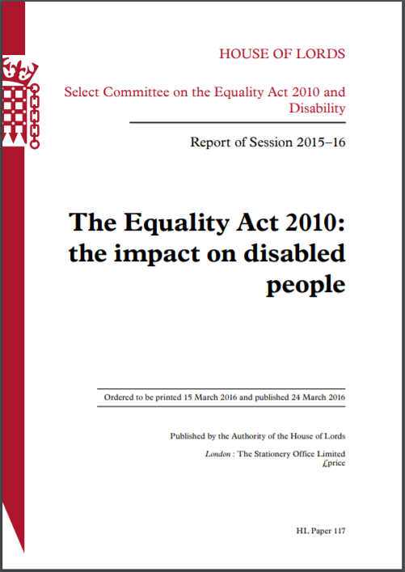
Interplay between individual and public enforcement
Equality Act 2010
Anticipatory reasonable adjustment duty - service providers and public authorities

Slide 7
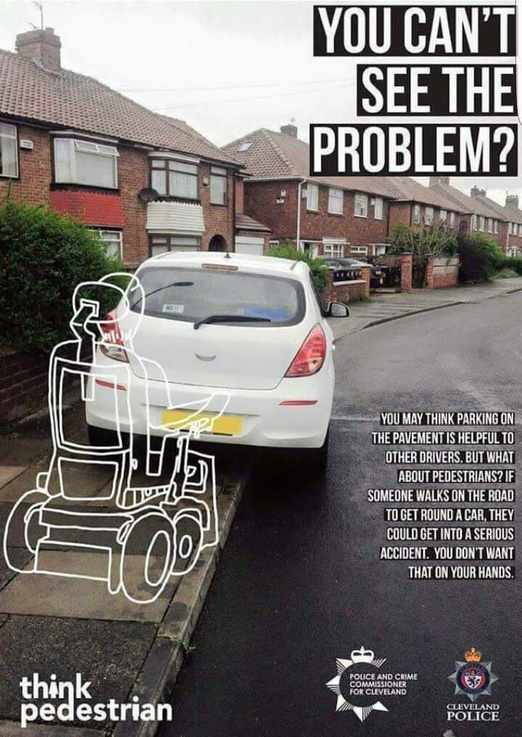
52

Slide 8
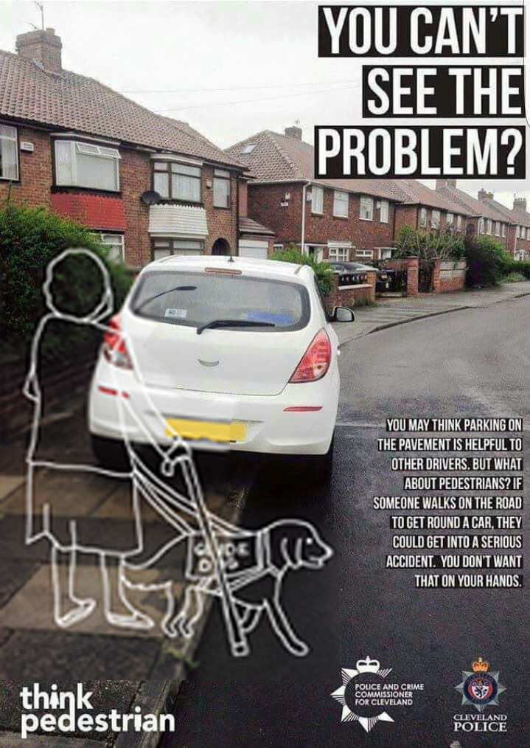
52

Slide 9
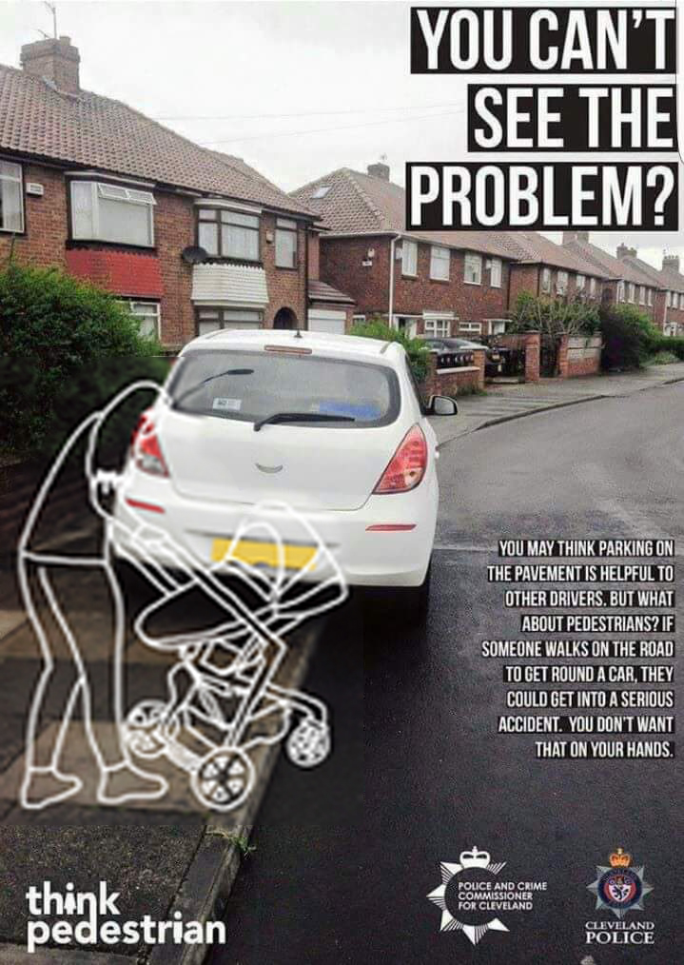
52

Slide 10
Interplay between individual and public enforcement
Individual
Public

Slide 11
Interplay between different individual enforcement models
51

Slide 12
Interplay between different individual enforcement models
Policy Coherence – Different Types of Claimant
EU Directive on Accessible
Public Sector Websites and Mobile Apps
UK implementing regulation
55

Slide 13
Interplay between different individual enforcement models
Policy Coherence – Different forms of Action
Equality Act 2010
Tort law / Negligence
51

Slide 14
53
54

Slide 15
53

Slide 16
Next Steps
UK
Comparative analysis
Theoretical reflection
Practical impact?
56

