Slide 1
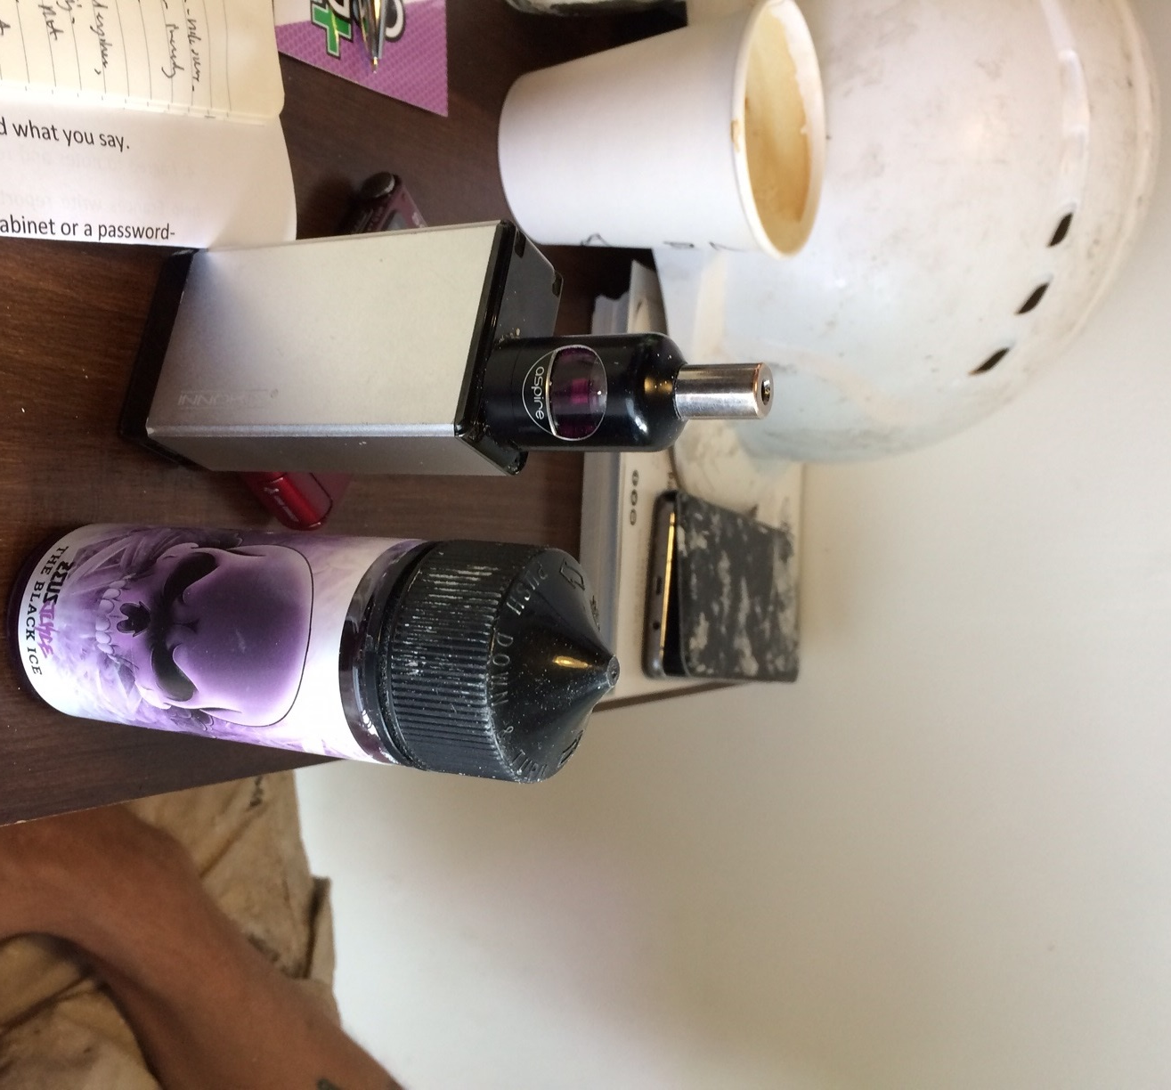
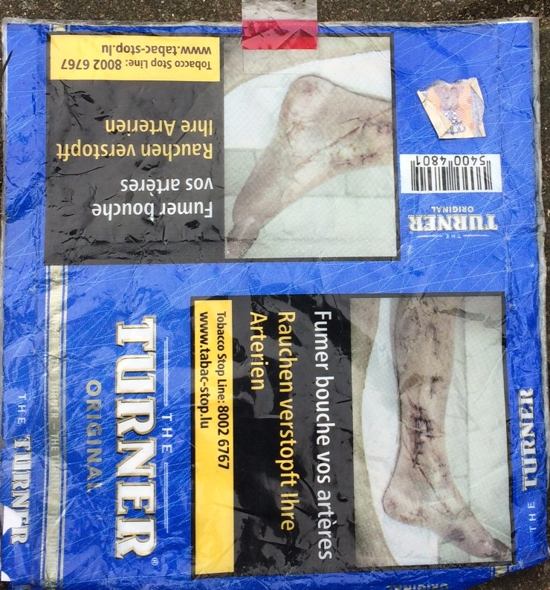
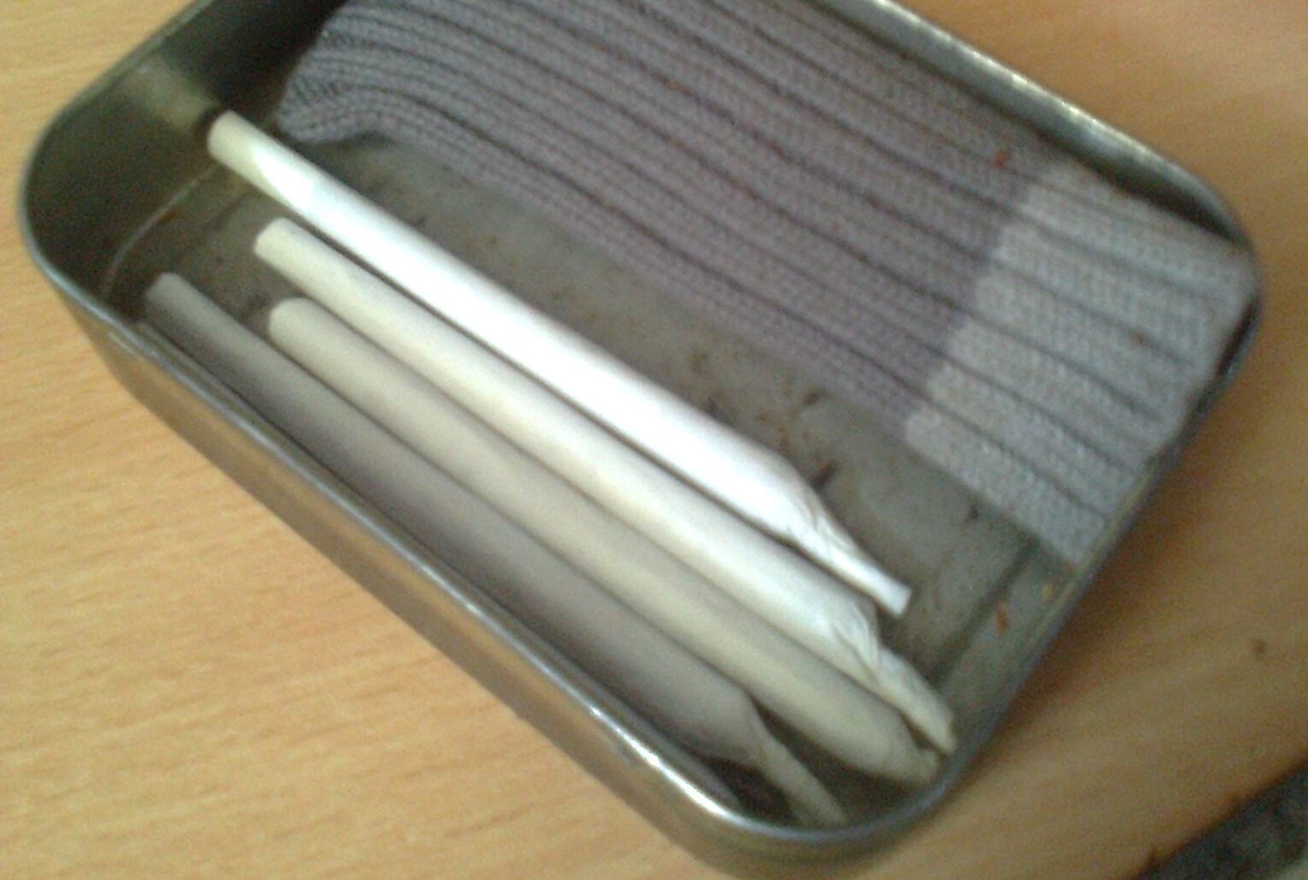
Patterns of regular tobacco and cannabis co-use amongst low-SES users and the arrival of CBD on the retail market Dr Frances Thirlway, University of York, Sociology Department
BACKGROUND
There is an inverse social gradient in tobacco and increasingly in cannabis use in high-income countries ¹
cannabis is increasingly used by older people ^{2,3}
This is probably a cohort effect related to the ageing of the generation first exposed to cannabis in the mid-1960s ⁴
Most European users consume cannabis with tobacco ⁵
= cannabis use may be a barrier to tobacco smoking cessation, particularly in low-SES areas with higher cannabis
prevalence ^{6,7,8}
There is a higher incidence of chronic illness in lower-SES populations,
= the author hypothesises that low-SES cannabis users over the age of 40 use it for medicinal purposes, and that the relief
they obtain from it constitutes a barrier to tobacco smoking cessation.
However, some recent developments have the potential to reduce the use of combusted cannabis for self-medication and potentially therefore also the use of tobacco ⁹:
the quasi-legalisation of cannabidiol or CBD (the non-psychoactive component of cannabis), which can be used for self-medication instead of combusted cannabis
the rise of electronic cigarettes, which can provide an alternative route of administration not just for nicotine but also for cannabis (CBD, THC or both)
the legalisation of cannabis in other jurisdictions leading to increasing availability of cannabis vaporisers online.
AIMS
As part of a wider qualitative study of smoking and electronic cigarettes, the author interviewed former and current smokers and vapers as well as vape shop staff. Some smokers/vapers also used cannabis or CBD, and some vape shops sold CBD. Relevant issues in the context of the author’s research on smoking cessation and health inequalities were:
combusted cannabis use: recreational or medicinal
cannabis use as a barrier to tobacco smoking cessation
tobacco and cannabis co-users switching to CBD
e-cigarettes and vaporisers as a harm-reducing alternative to combusted cannabis
METHODS
The research took place over 18 months in two deprived areas in the North of England with high tobacco and cannabis prevalence. Tobacco smokers or former smokers were recruited from community venues and described the history and context of their tobacco, cannabis and CBD use. Vape shop staff provided contextual data about the evolution of the local market.
The data used in this presentation relate to 15 participants who used cannabis or CBD and 15 vape shop staff. The approach taken was naturalistic enquiry, whereby participants’ experiences and actions are explored in a wider societal and cultural context. This involved multiple visits to field sites and interactions with participants in addition to audio-recorded interviews. Data relating to cannabis and CBD arose in the course of conversations and interviews about smoking and vaping.
Mark (46) used cannabis when he was 22 to recover from a work accident and give up opioids. Stopped smoking with an e-cig 5 years ago, continues to use cannabis pollen which he heats and dissolves into his food at night.
EMERGING FINDINGS
Cannabis was readily available and used alongside tobacco, although prevalence and acceptability in older generations varied considerably between areas and trades (e.g. common in the building industry ¹⁰)
Younger users were more likely to use cannabis recreationally and older users medicinally, but some younger users also self-medicated
CBD users were generally older and included some who switched from cannabis self-medication, as well as cannabis never-users
Some younger users switched from combusted cannabis to a vaporiser to reduce their risk and some older cannabis self-medicators switched to CBD, which was cheaper than cannabis
However combusted cannabis use for self-medication remained an obstacle to smoking cessation; the relatively high initial cost of CBD and variations in quality and strength were off-putting to potential switchers on low incomes.
CONCLUSIONS
This is the first study of the impact of CBD, e-cigarettes and cannabis vaporisers on patterns of tobacco and cannabis co-use in low-SES areas; research outputs have the potential to inform public policy on CBD and cannabis in the context of health inequalities in smoking cessation as well as pain management and the growing cost of prescription medicines in an ageing population.
REFERENCES
1. LEGLEYE, S., PIONTEK, D., PAMPEL, F., GOFFETTE, C., KHLAT, M. & KRAUS, L. 2014. Is there a cannabis epidemic model? Evidence from France, Germany and USA. International Journal of Drug Policy, 25, 1103-1112.
2. DINITTO, D. M. & CHOI, N. G. 2010. Marijuana use among older adults in the U.S.A.: user characteristics, patterns of use, and implications for intervention. International Psychogeriatrics, 23, 732-741.
3. HAMILTON, I., MONAGHAN, M. & LLOYD, C. 2018. Rising numbers of older and female cannabis users seeking treatment in England and Wales. Drugs: Education, Prevention and Policy, 1-3.
4. MILLS, J. H. 2012. Cannabis nation: control and consumption in Britain, 1928-2008, Oxford, Oxford University Press.
5. HINDOCHA, C., FREEMAN, T. P., FERRIS, J. A., LYNSKEY, M. T. & WINSTOCK, A. R. 2016. No Smoke without Tobacco: A Global Overview of Cannabis and Tobacco Routes of Administration and Their Association with Intention to Quit. Frontiers in Psychiatry, 7.
6. AMOS, A., WILTSHIRE, S., BOSTOCK, Y., HAW, S. & MCNEILL, A. 2004. 'You can't go without a fag ... you need it for your hash' - A qualitative exploration of smoking, cannabis and young people. Addiction, 99, 77-81.
7. AKRE, C., MICHAUD, P.-A., BERCHTOLD, A. & SURIS, J.-C. 2010. Cannabis and tobacco use: where are the boundaries? A qualitative study on cannabis consumption modes among adolescents. Health Education Research, 25, 74-82.
8. HAINES-SAAH, R. J., MOFFAT, B., JENKINS, E. K. & JOHNSON, J. L. 2014. The Influences of Health Beliefs and Identity on Adolescent Marijuana and Tobacco Co-Use. Qualitative Health Research, 24, 946-956.
9. HINDOCHA, C., FREEMAN, T. P., WINSTOCK, A. R. & LYNSKEY, M. T. 2015. Vaping cannabis (marijuana) has the potential to reduce tobacco smoking in cannabis users. Addiction, n/a-n/a.
10. THIEL, D. 2013. Builders: Class, gender and ethnicity in the construction industry, Chapter 4, London & New York, Routledge.
Sarah (34) used cannabis in her 20s to cope with a disabled child, switched to anti-depressants when she was broke, then tried vaping CBD which helped, now uses prescribed medication, continues to smoke tobacco.
Paul (48) rolls himself six tobacco cigarettes a day and smokes cannabis at night to help him sleep as he was seriously injured in a traffic accident and suffers from chronic pain.
With thanks to research participants and to Cancer Research UK for funding. Frances Thirlway has no conflicts of interest. All photos are by the author.

