Slide 1
Family: IPR011379; Domain: IPR004518 Cyanophage S-PM2 MazG (S-PM2p139)
50-118
Family: IPR011379; Domain: IPR004518 Synechococcus sp. WH7803 ‘small’ MazG (Syn_WH7803_01219; WP_011933126)
28-98
Family: IPR011511; Domain: IPR004518 Synechococcus sp. WH7803 ‘large’ MazG (Syn_WH7803_02449; WP_011934334)
37-110
187-237
Family: IPR011511; Domain: IPR004518 E. coli K12 MazG (AAC75823.1)
27-100
169-227
Fig. 2

Slide 2
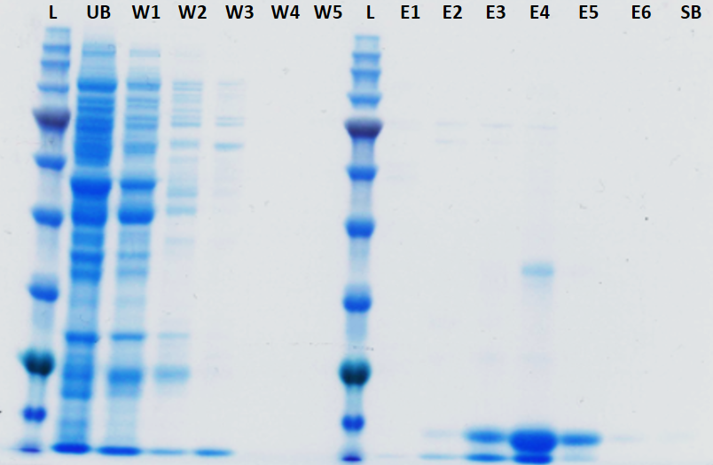
Fig. 3
A
B
L
1
2
3
4
46 kDa
32 kDa
25 kDa
22 kDa
17 kDa

Slide 3
Fig. 4
100
80
60
% V_{max} activity of S-PM2 MazG with dGTP
40
20
0
dATP
dCTP
dTTP
dGTP
ATP
CTP
GTP
UTP
dUTP
2-hydroxy
dATP
8-oxo-dGTP
Substrate
Synechococcus sp. WH7803
Cyanophage S-PM2

Slide 4
Fig. 5A
MBP
RsgA
Syn.
MazG
Viral
MazG
³²P-GTP
³²P-pppGpp
³²P-ppGpp
0.5
0.4
0.3
Fraction bound
0.2
0.1
0
MBP
RsgA
MazG (S)
MazG (V)
GTP
ppGpp
pppGpp

Slide 5
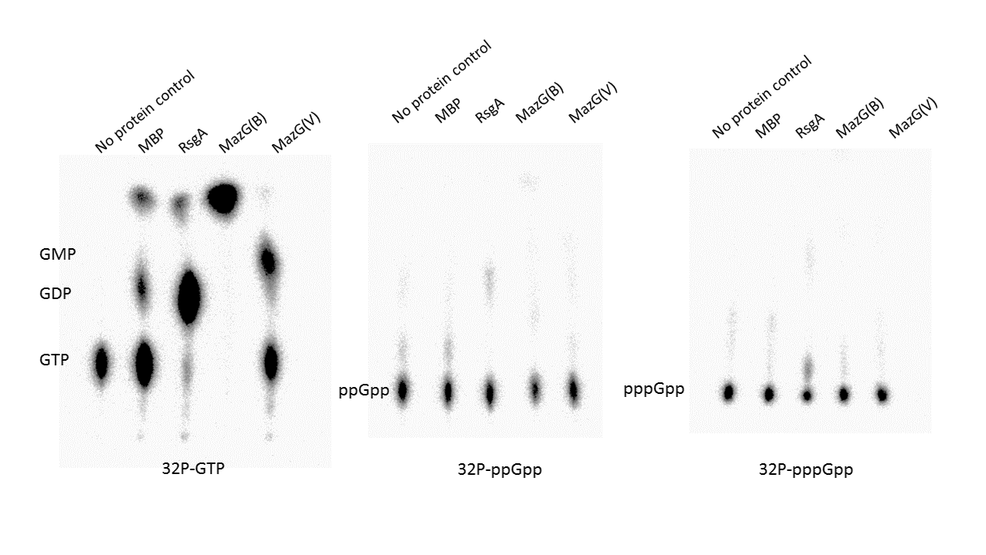
Fig. 5B
No protein control
No protein control
No protein control
MazG (V)
MazG (V)
MazG (V)
MazG (Syn)
MazG (Syn)
MazG (Syn)
MBP
RsgA
MBP
RsgA
MBP
RsgA
³²P-GTP
³²P-ppGpp
³²P-pppGpp

