Slide 1


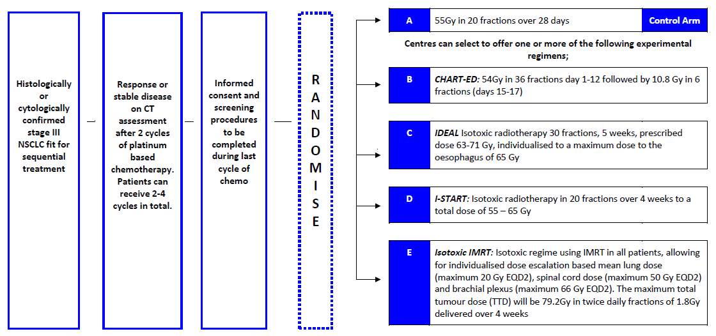



A Randomised Phase II study of Accelerated, Dose escalated, Sequential
Chemo-radiotherapy in Non-Small Cell Lung Cancer
Rationale:
Lung cancer is the most common cause of cancer mortality in the UK, and (NSCLC) accounts for approximately 85% of all lung cancers. The majority of patients are not suitable for the gold standard treatment (concurrent chemo-radiotherapy) due to performance status and comorbidities. Novel strategies integrating radiotherapy advances and radiobiological knowledge need to be evaluated in patients treated with sequential chemo-radiotherapy.
The UK strategy has been to develop separate dose escalation protocols for accelerated radiotherapy schedules (CHART-ED, IDEAL-CRT, I-START and Isotoxic IMRT).
This study will compare these schedules with a UK standard sequential chemo-radiotherapy schedule of 55Gy in 20 fractions over 4 weeks.
As it would be impossible to test all schedules in phase III study the aim is to use a combined randomized phase II screening / ‘pick the winner’ approach to identify the best schedule to take into a randomised Phase III study against conventionally fractionated radiotherapy.
Trial Design: Randomised phase II screening/”pick-the-winner” design to select a single regimen to go forward for phase III testing.
Trial Status: In set Up
Estimated Start Date: Q1 2017
Total Recruitment: 360 patients
Recruitment Period: 3 years 8 months
Planned number of sites: 40
Open to: all cancer centres. Sites can select upfront to participate in one or more of the experimental arms (selecting more than one arm is encouraged). Sites will randomise versus control arm.
Inclusion Criteria:
Histologically or cytologically confirmed stage III NSCLC
Performance status: ECOG 0-2
Inoperable disease, unsuitable for concurrent chemo-radiotherapy
Complete response, partial response or stable disease on CT assessment after 2 cycles of platinum based chemotherapy
Exclusion Criteria:
Clinically significant interstitial lung disease
Medically unstable
Connective tissue disorders
* Other inclusion and exclusion criteria apply *
RTTQA: The quality assurance programme for the study is being co-ordinated by the NCRI Radiotherapy Trials QA (RTTQA) Group.
Prior to site activation, sites will be asked to complete:
Facility Questionnaire
Outlining Benchmark Cases
Planning Benchmark Case
Process document
ADSCaN Study Contact Information
Chief Investigator: Dr Matthew Hatton, Weston Park Hospital, Sheffield
Project Manager: Claire Lawless Tel: 0141 301 7947 Email: claire.lawless@glasgow.ac.uk
CRUK Clinical Trials Unit, Glasgow: Beatson West of Scotland Cancer Centre, 1053 Gt Western Road, Glasgow

