Slide 1
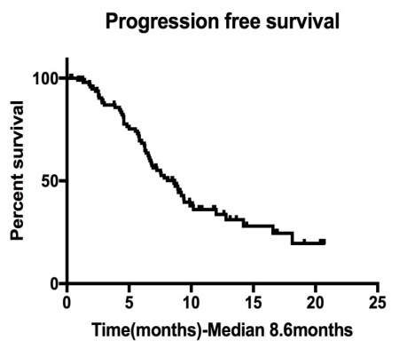
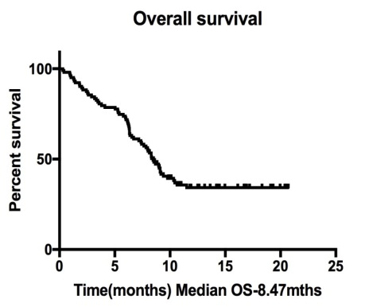
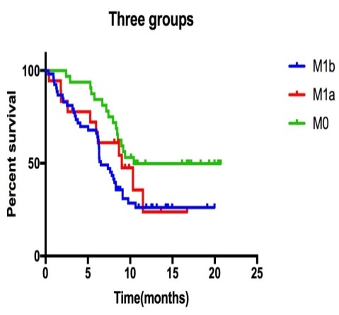
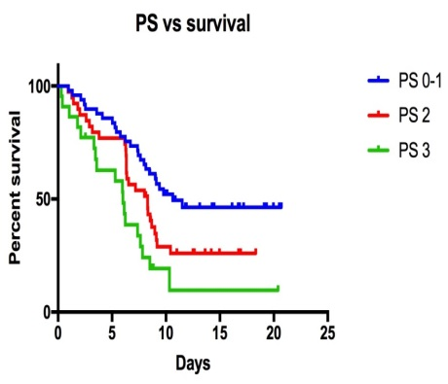
Management and Outcomes of patients with Small cell lung cancer in North Trent
S Garikipati, M Alhilali, A Prakash, A Burnett, C Lee, R Young, S Danson, E Bates, P M Fisher, M Q Hatton, T Das
Weston Park Hospital, Sheffield
Background
Methods
Small cell lung cancers (SCLC) comprise 10-15% of all lung cancers. SCLCs are initially chemo and radio-sensitive, but the majority of patients relapse and die from disease, and the overall survival remains poor. We present an audit of management and outcomes of patients diagnosed between Jan 2016 and Jan 2017 at Weston Park Hospital, Sheffield.
Retrospective data from patient records, pathology and radiology reports was analysed. Kaplan Meir curves and log rank tests were used for survival analysis.
Results
Patient and tumour characteristics
Males | 45 | Performance status
Females | 58 | PS 0-1 | 54(52%)
Median age: 71 yrs |  | PS 2 | 39(38%)
Range 35-90 yrs |  | PS 3 | 10(10%)
Stage of disease
Stage III |  | 32(31%)
Stage IV((M1a) |  | 18(17%)
Stage IV (M1b) |  | 53(52%)
Comorbidities (Charlson co-morbidity index)
Score of 2 in 31% |  | Score at least 3 in 41%
Initial Management
Chemotherapy
All patients had platinum based chemotherapy and 97% had Etoposide alongside platinum. 67% received 4-6 cycles and 31% received 1-3 cycles..
Radiotherapy
54/103 had radiotherapy following initial chemotherapy.
14/54 were treated with radical intent (concurrently in 4 and sequentially in 10). 40 patients had radiotherapy with palliative intent, 90% of those had 30-36Gy in 10-12 fractions. 28/103 patients had prophylactic cranial irradiation(PCI).
Local control rates after Radiotherapy
Survival rates
Local control after radical radiotherapy was 100% and after palliative radiotherapy 63%. There were no recurrences in the brain post PCI.
Stage vs survival
57/103 progressed with a median progression
free survival of 8.6 months.
38/103 were alive at the time of analysis with a
median overall survival of 8.47 months.
Time(months)
On univariate analysis, PS and stage of cancer were significant factors affecting survival. Median OS in stage III, stage IV M1a, and M1b disease was 10.4, 9 and 6.5 months respectively (p=0.008).
Patients with poor PS did worse with median OS of 6, 8.3 and 10.6 months in PS 3, PS 2, and PS 0-1
respectively (p=0.0002).
Conclusions
Overall management and patient outcomes are comparable to national data. Advanced disease and worse PS at the time of diagnosis are confirmed poor prognostic factors. Low uptake of PCI is probably related to our patient cohort with median age over 70 and co-morbidities.

