Slide 1
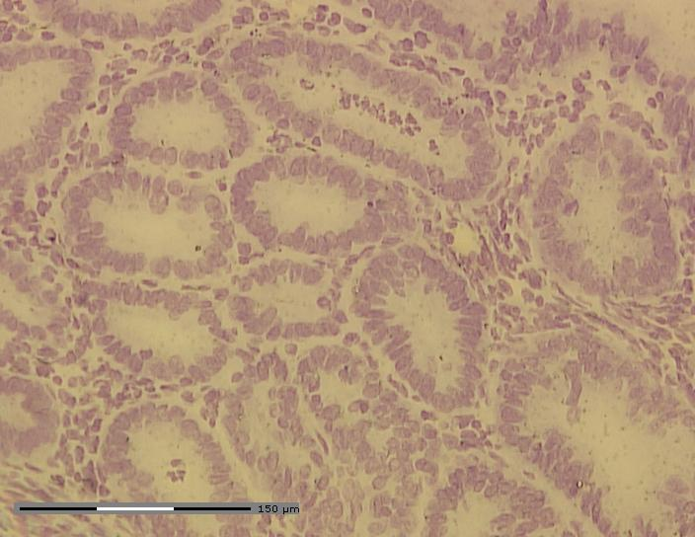
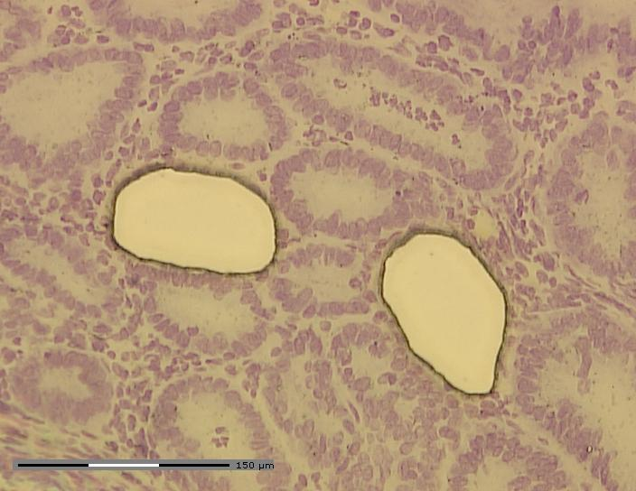
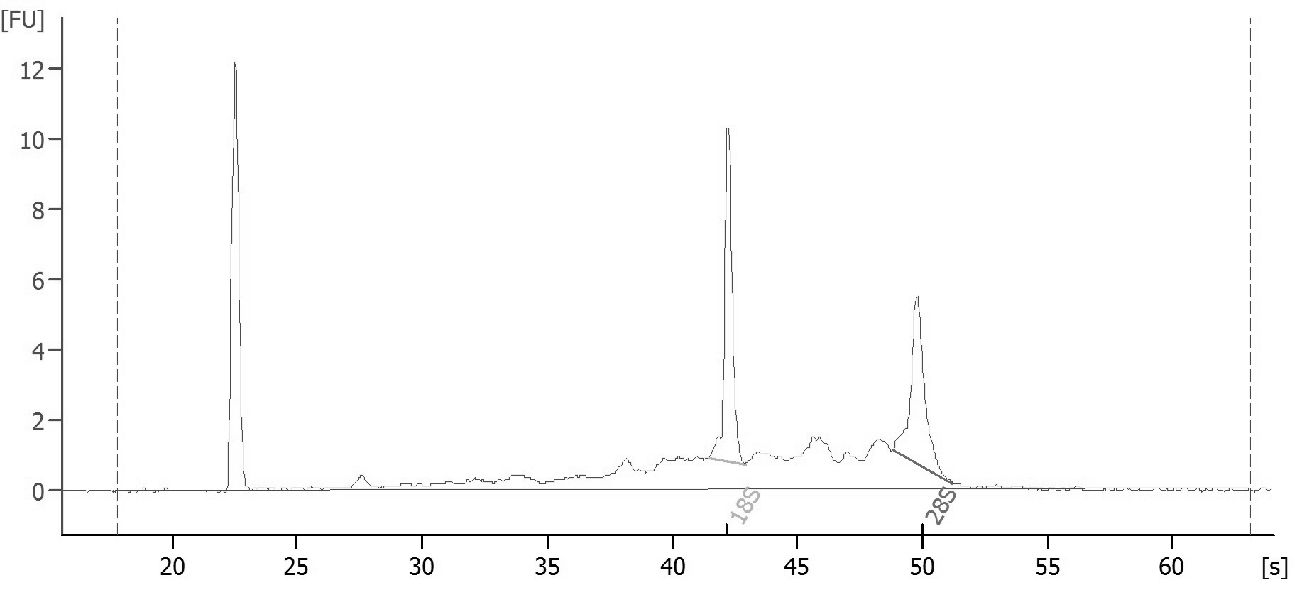
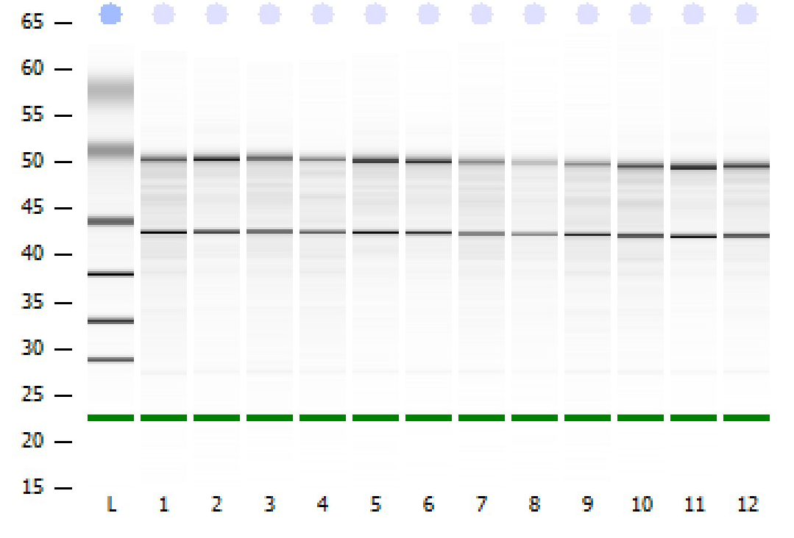
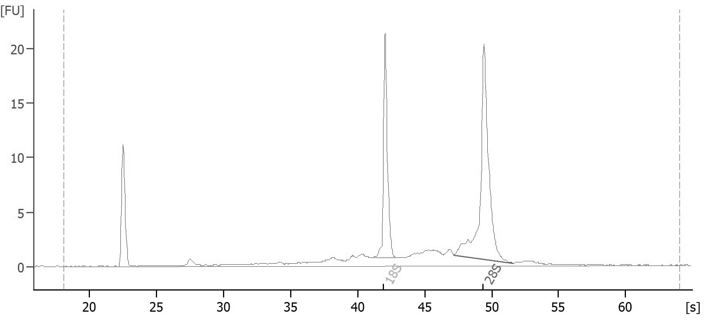
a
b
c
d
Sample 9 (31 ng/µl; RIN = 7.5)
N
Tissue type:
N
N
N
N
N
C
H
C
M
18S
28S
Sample 11 (51 ng/µl; RIN = 9.2)
18S
28S
M

