Slide 1
Figure 2, supplementary online file
*The images shown in the atlas are not from the excercise but have been made for the paper at a later time point.

Slide 2
Wrist
OMERACT-EULAR Combined PDUS score (a)
Gray-scale Synovial Hypertrophy (b)
Grade 0
Grade 1
Grade 2
Grade 3

Slide 3
PIP
OMERACT-EULAR Combined PDUS score (a)
Gray-scale Synovial Hypertrophy (b)
Grade 0
Grade 1
Grade 2
Grade 3

Slide 4
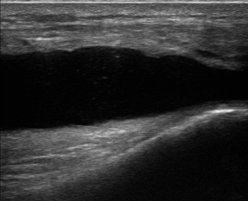
Knee
OMERACT-EULAR Combined PDUS score (a)
Gray-scale Synovial Hypertrophy (b)
Grade 0
Grade 1
Grade 2
Grade 3

Slide 5
MTP
OMERACT-EULAR Combined PDUS score (a)
Gray-scale Synovial Hypertrophy (b)
Grade 0
Grade 1
Grade 2
Grade 3

