Slide 1
Welcome
Hard to reach or easy to ignore? Involving people with dementia in research as advisers and participants

Slide 2
About us
Kate Gridley
Researcher at SPRU
Experience of working with people with high support needs
Life Story Work project
Nada Savitch
Director of Innovations in Dementia
Helped to start DEEP
Talked to a lot of people with dementia

Slide 3
About you
Where do you work?
Do you work with people with dementia?
Do you engage involve people with dementia?
What do you want from today?

Slide 4
Involving People with Dementia: Where, Why, How? Making Research Count, 4th April 2017
Kate Gridley, SPRU, University of York, kate.gridley@york.ac.uk
Nada Savitch, Innovations in Dementia nada@innovationsindementia.org.uk

Slide 5
Overview:
Where:
Where are people with dementia in research?
Why:
Why is this a problem – can’t their families and carers tell us what we need to know?
Why is this relevant to social care?
How:
How can we address this?

Slide 6
Where? Why?

Slide 7
Where are they???
Historically people with dementia have been hard to find in research…
Even when the research was about them!
For a long time:
Researchers assumed that information collected from people with dementia was unreliable and unusable
Also, they didn’t know how to involve people with dementia
Refs:
Cotrell and Schulz 1993
Murphy et al. 2015

Slide 8
But people with dementia are everywhere
Receiving services
Living in the community
Living their lives

Slide 9
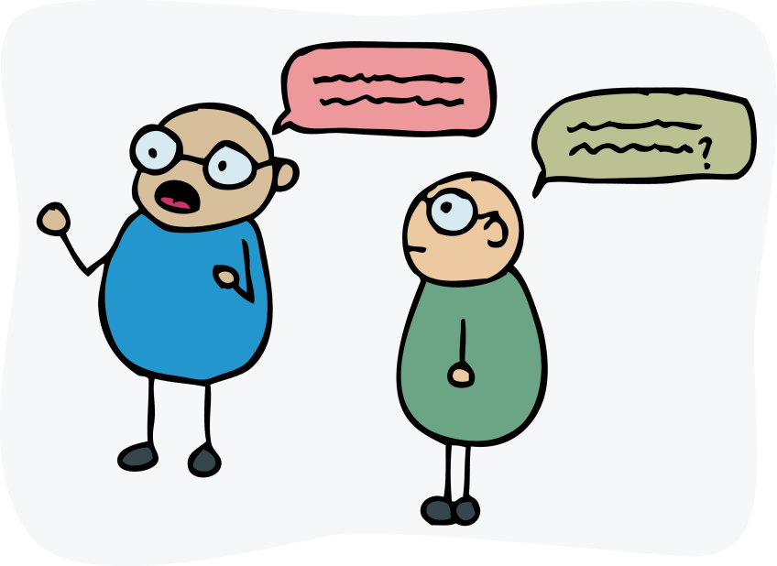
Phone a friend?
Most researchers used proxy accounts (they asked the carer, a family member, or even a member of staff)
This could provide useful insights about:
The experiences of carers/family/staff
Their views on the quality of life of the person with dementia…

Slide 10
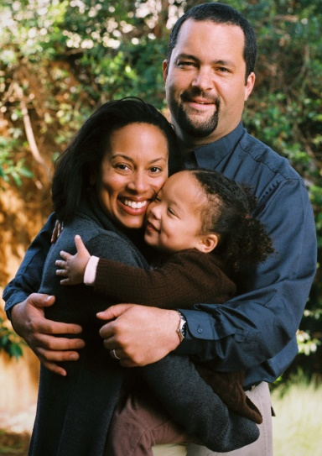
BUT
Carers can’t tell you how the person with dementia actually feels
Why do we assume that family members all have the same interests/views?
Is it always
like this?

Slide 11
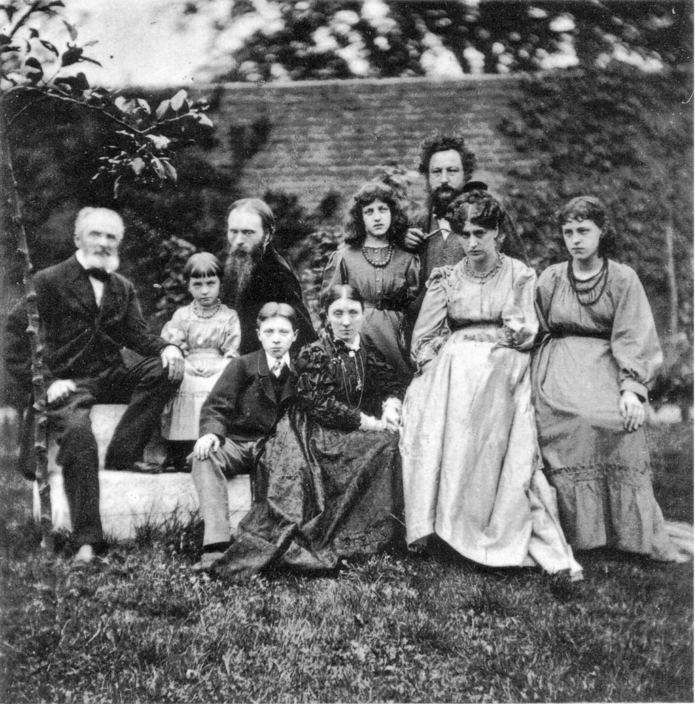
Or is it sometimes more like this?

Slide 12
What do proxy measures tell us? The example of QoL
Proxy measures of quality of life consistently differ from first person accounts
Carers usually rate the person’s quality of life lower than the person rates it themselves!

Slide 13
For dementia in particular:
More severe the dementia, greater the discrepancy (Novella 2001)
People with less insight about their own memory function were likely to report higher quality of life (Trigg et al. 2011)
Does this mean that people with dementia are unreliable (blissfully ignorant)??

Slide 14
For disability in general
But the discrepancy between proxy and first person ratings is true for disabled people in general (i.e. not just those with cognitive impairment):
In a study of 131 sets of disabled people and proxies across multiple settings:
Proxies consistently rated the disabled person’s health related QoL lower than the disabled people rated their health related QoL
Proxies also over-estimated the person’s impairment
But under-estimated their pain
(Andresen, 2001)

Slide 15
So, who’s right?
No-one, it’s just different.
Trigg et al. suggest that proxies and people with dementia simply assess quality of life in different ways:
Proxy looks at what the person can do
Person with dementia is reporting how they feel
Notes:
‘…it is important that the strong association between awareness of memory problems and patient QoL ratings revealed by the current study is not simply taken as evidence that patient QoL ratings are unreliable or uninformed…It seems more likely that the discrepancy between patient and proxy ratings occurs simply because two very distinct modes of QoL assessment, which emphasise very different outcomes, are being employed. Whilst observational or proxy ratings commonly provide QoL judgements based upon an appraisal of the patient’s functional performance, the dementia patient may be appraising the situation on the basis of the mood states and feelings these activities produce.’ Trigg 2011

Slide 16
Focus on Feelings
‘Far from being ignorant (blissfully or otherwise), dementia patients may continue to base their QoL assessments on a rigorous appraisal of their current life circumstances which exploits all the information available to them. None of us could do more. These assessments are probably feeling-centred but given an appropriate measure of QoL they are still reliable. Judging the QoL of dementia patients solely on the basis of functional failure or in relation to proxy ratings is certainly convenient, but it may ultimately fail to capture or help us understand the experience of people with dementia. Understanding such experience will be vital if their life quality is to be maximised.’ Trigg et al. 2011, p90.

Slide 17
Relevance to social care
Recent focus on outcomes in policy – commissioners want to know what impact a service has on the people using it
But, it’s much easier to measure processes than outcomes - how many people used a service, rather than how much those people’s lives have improved (if at all) as a result
How do you judge the quality of your services?
How do you demonstrate this to others?

Slide 18
Why?
Understanding how people with dementia feel can gives us insight into whether interventions are working
This can then feed into service development
No-one else can tell us how the person with dementia actually feels!

Slide 19
People with dementia have views
The act of asking opinions from people with dementia can change how we perceive them as human beings.
People with dementia have a right to be listened to.

Slide 20
To bring about change!
Hearing the voices of people with dementia could potentially challenge and change attitudes
Narrative citizenship – to change the narrative about dementia (which tends to be negative – about deficits) people with dementia need to be supported to tell their stories

Slide 21
How?

Slide 22
Use different measures
What do you want to know
Who do you want to ask?
Why do you want to know it?
What will you do with the answers?
Use the different measures and techniques in different circumstances and with different people

Slide 23
Who are you working with?
Possible upset caused by asking certain questions and/or raising expectations.
Different measures for research vs service evaluation.
Working with people with dementia who don’t use your services (eg DEEP groups)
Notes:
Eg how shit do you feel today?
Tie in with advisory groups – more later on.

Slide 24
Being flexible – using different techniques
Ways of making interview data more quantitative:
Talking Mats
HIN dementia outcome measures based on I-statements.
Different types of interviews
One to one
Walking the patch
Focus / discussion groups

Slide 25
Drawing on your own experience
Have you involved people with dementia – or other lay people or service users – in research or service evaluation?
Any lessons for the rest of us?
Any questions for us?

Slide 26
Break

Slide 27
An example – Involving people with dementia in the York University Life Story Work study
Removing the gag: involving people with dementia in research as advisers and participants
Jenni Brooks, Nada Savitch and Kate Gridley
Social Research Practice, Issue 3, Winter 2016/17
More details about the Life Story Work study on SPRU website: https://www.york.ac.uk/spru/projects/life-story-feasibility/

Slide 28
Involvement at different stages
Stage | Involvement of people with dementia
 | As advisors | As participants
Systematic review of the existing literature to produce a narrative synthesis of good practice and theories of change | Gave views and talked about experiences of life story work which informed the search and data extraction | n/a
Qualitative focus groups and individual interviews with people with dementia and others | - advised on ethical issues involved in doing focus groups - advised on development of information sheets and consent forms - validated focus group findings | - 25 people with dementia (and others) took part in focus groups to explore good practice
Feasibility study to test data-gathering processes and instruments | Advised on the development of information sheets and consent forms | 39 people with dementia took part by completing quality of life measures at several time points 10 people gave qualitative feedback about their life story books

Slide 29
People with dementia as advisers
Gave advice on:
Outcomes of life story work
Ethical issues involved in doing focus groups
Information sheets and consent forms
Validating focus group findings
Advice about dissemination.
Support by:
Accessible documents
Meeting people in their own homes
Matching people with different interests
Involving people with different abilities

Slide 30
Qualitative research
25 people with dementia
4 different groups
Meeting at familiar setting – with trusted facilitators on hand
Took examples to show – books, memory box, tablet

Slide 31
Quantitative research
Six care homes.
Two in-patient mental health assessment units in two hospitals.
3-4 time points.
Three different questionnaires.

Slide 32
Capacity and consent
Mental Capacity Act – support to make decisions.
Personal or nominated consultees for people who lack capacity.
Consent and assent.
Confirming that people are happy to continue.
Looking out for body language.

Slide 33
Challenges
Consent and consultee processes long and complex.
Consent forms for focus groups – too long and scary.
Questionnaires – ‘tick box’ too restrictive.

Slide 34
Recommendations
Include as many people with dementia as possible.
Take a broader, more flexible attitude towards consent, including exploring the concept of assent and the use of consultees.
Use a wide range of ways of engaging people with dementia throughout the process.

Slide 35
Effective communication and measuring outcomes
Hints and tips

Slide 36
Measuring outcomes
Designed for adult social care:
ASCOT – the only
measure of social care
related quality of life
http://www.pssru.ac.uk/ascot/
Designed for people with dementia
DEMQOL https://www.bsms.ac.uk/research/cds/research/demqol.aspx
QOLAD https://eprovide.mapi-trust.org/instruments/quality-of-life-in-alzheimer-s-disease

Slide 37
What about just asking people?
Qualitative research with people with dementia IS possible!
In a number of recent studies, researchers have collected useful, meaningful data by simply interviewing people with dementia
However, most of these have focused on people in the early stages of dementia

Slide 38
Working with large numbers
It IS possible to collect info from pwd on a large scale – Sara Powers etc asked 114 people attending different services
Analysis of themes from across a wide range of people

Slide 39
CORTE guidelines
Gaining Consent
Maximising Responses
Telling the story
Ending on a high
Articulating the strategies for maximising the inclusion of people with dementia in qualitative research studies Murphy et al, Dementia, 2015, 14(6) 800-824

Slide 40
Good conversations
Getting ready to communicate or have a conversation
Noise, relax, how is the person feeling?
Getting communication started
Greeting, physical environment, emotions
Keep it simple
Keeping it going
Visual aids, confirmation of what’s been said
Finish well
SCIE Dementia Gateway - http://www.scie.org.uk/dementia/after-diagnosis/communication/conversation.asp

Slide 41
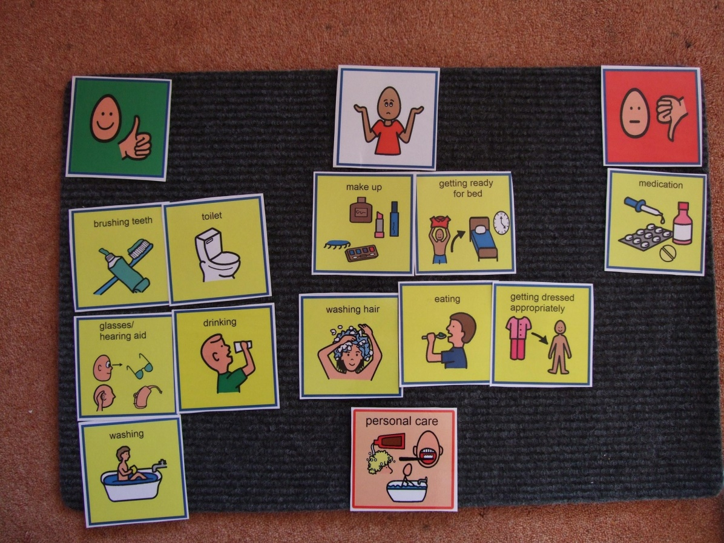
Talking Mats
http://www.talkingmats.com/

Slide 42
Measuring Outcomes in Dementia Services
Based on Dementia I-statements
Adapted for
Community groups
Hospital wards
Care homes
Dementia adviser/navigators services
http://www.hin-southlondon.org/system/resources/resources/000/000/395/original/HIN_Measuring_Outcomes_in_Dementia_Services_V2.pdf

Slide 43
Guides on:
Involving people with dementia in advisory groups
Tips for consulting people with dementia about written documents
Collecting the view of people with dementia
Choosing a dementia-friendly meeting space
http://dementiavoices.org.uk/resources/deep-guides

Slide 44
References
Andresen, E.M., Vahle, V.J. and Lollar, D., 2001. Proxy reliability: health-related quality of life (HRQoL) measures for people with disability. Quality of Life Research, 10(7), pp.609-619.
Baldwin, C. and Group, B.D., 2008. Narrative (,) citizenship and dementia: The personal and the political. Journal of Aging Studies, 22(3), pp.222-228
Cotrell, V. and Schulz, R., 1993. The perspective of the patient with Alzheimer's disease: a neglected dimension of dementia research. The Gerontologist, 33(2), pp.205-211.
Gridley K, Brooks J, Birks Y, Baxter K, Parker G. (2016) Improving care for people with dementia: development and initial feasibility study for evaluation of life story work in dementia care. Health Services Delivery Research 4(23)
Kaiser P and Eley R. (2016) Life Story Work with People with Dementia: Ordinary Lives, Extraordinary People. London: Jessica Kingsley
Murphy, K., Jordan, F., Hunter, A., Cooney, A. and Casey, D., 2015. Articulating the strategies for maximising the inclusion of people with dementia in qualitative research studies. Dementia, 14(6), pp.800-824.
Novella, J.L., Jochum, C., Jolly, D., Morrone, I., Ankri, J., Bureau, F. and Blanchard, F., 2001. Agreement between patients' and proxies' reports of quality of life in Alzheimer's disease. Quality of life research, 10(5), pp.443-452.
Trigg, R., Watts, S., Jones, R. and Tod, A., 2011. Predictors of quality of life ratings from persons with dementia: the role of insight. International journal of geriatric psychiatry, 26(1), pp.83-91.

Slide 45
Acknowledgements and disclaimer
This event presents findings from research funded by the National Institute for Health Research Health Services and Delivery Research Programme.
The views and opinions expressed are those of the research team and do not necessarily reflect those of the HS&DR Programme, NIHR, NHS or the Department of Health.

