Slide 1
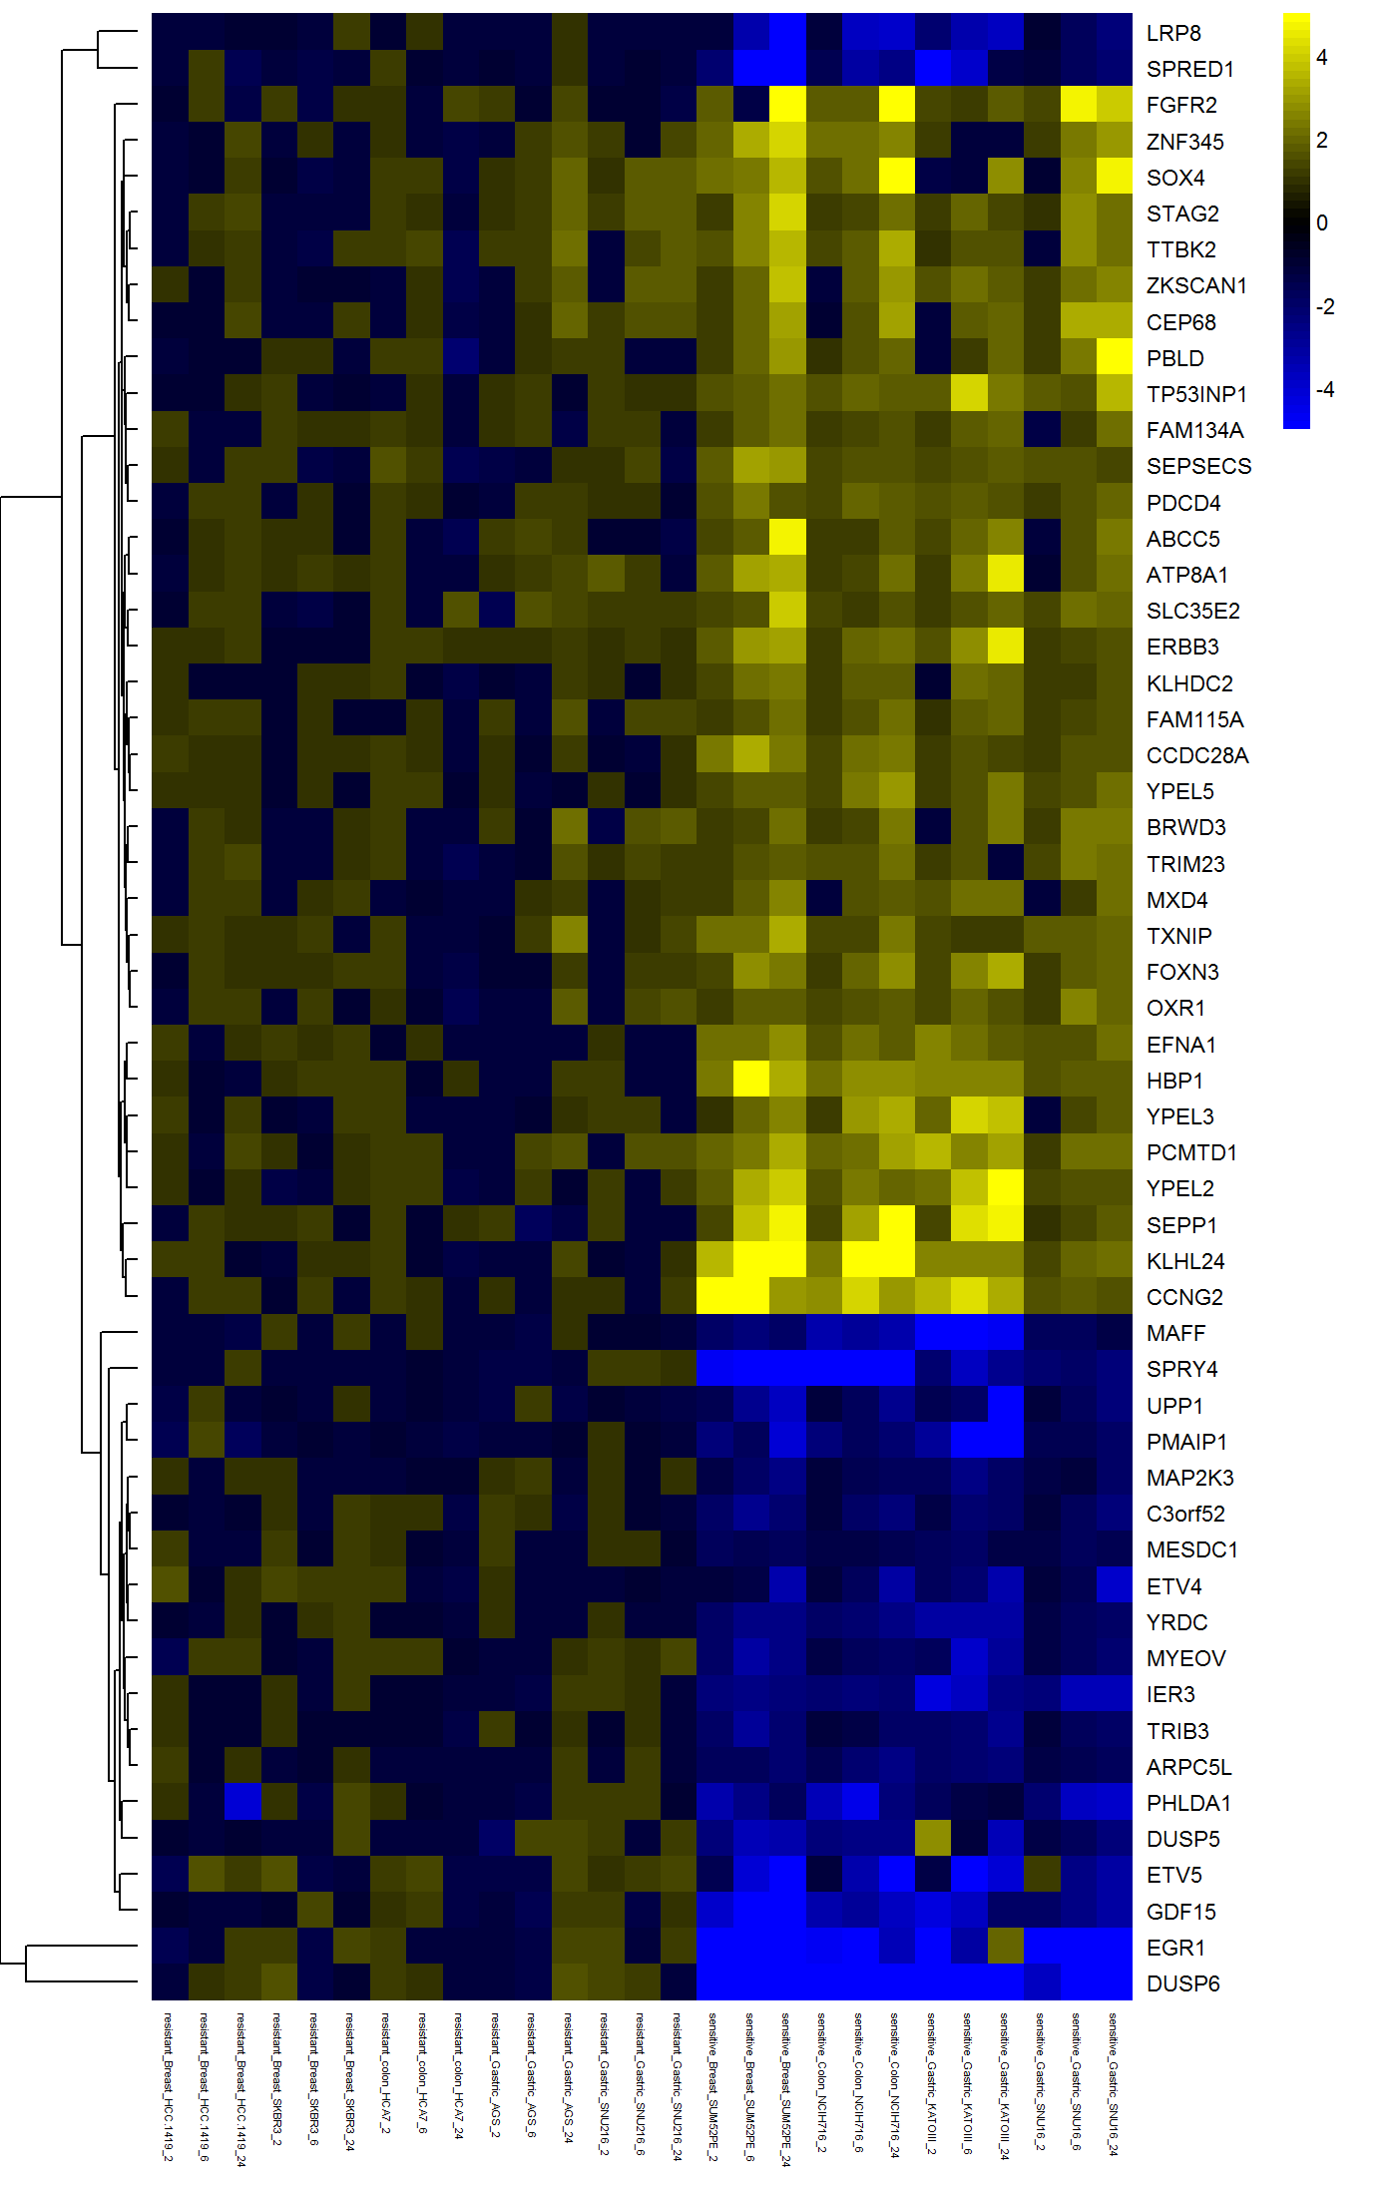
2 A)
Figure 2
Log 2
fold change
2 B)
2 hours
6 hours
24 hours

