Slide 1
S1
2 hours
6 hours
24 hours

Slide 2
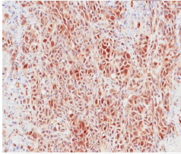
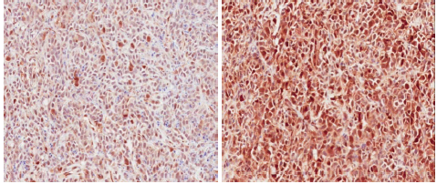
S2
Vehicle
24hrs
48hrs
P-S6
Ser 240/244
SNU16
P-ERK
Thr202/Tyr204
Vehicle
6hrs
48hrs
P-S6
Ser 240/244
KMS11
P-ERK
Thr202/Tyr204
Vehicle
6hrs
16hrs
P-S6
Ser 240/244
KG1a
P-ERK
Thr202/Tyr204

Slide 3
S3
V 2 4 6 16 24 48 V 2 4 6 16 24 48
Hrs (V= vehicle 48 hrs)
pFGFR
FRS2
SNU16
pERK
ERK
V 2 6 16 24 48 V 2 6 16 24 48
Hrs (V= vehicle 48 hrs)
pPLGγ
KG1a
PLGγ
pERK
ERK
V 2 4 6 16 24 48 V 2 4 6 16 24 48
Hrs (V= vehicle 48 hrs)
pFRS2
KMS11
FRS2
pERK
ERK

Slide 4
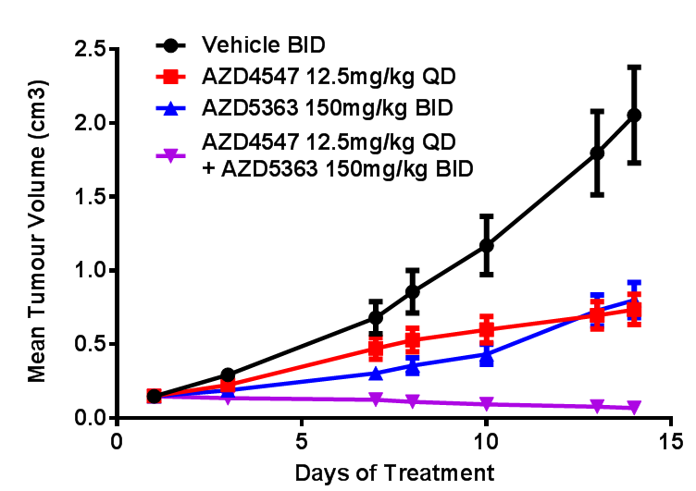
S4
***<0.001
***<0.001
***<0.001

Slide 5
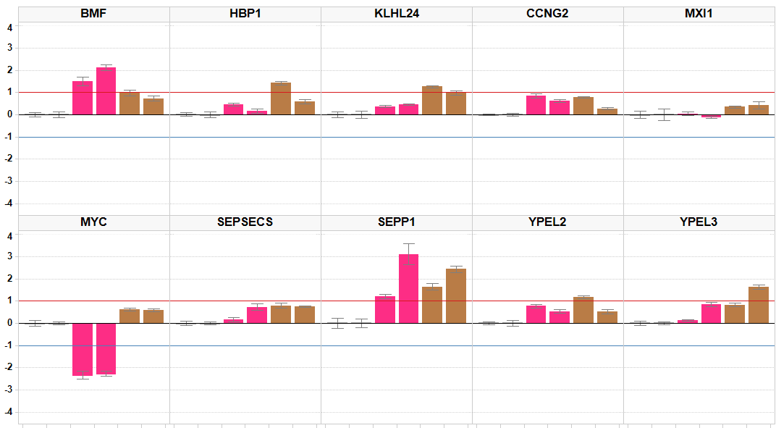
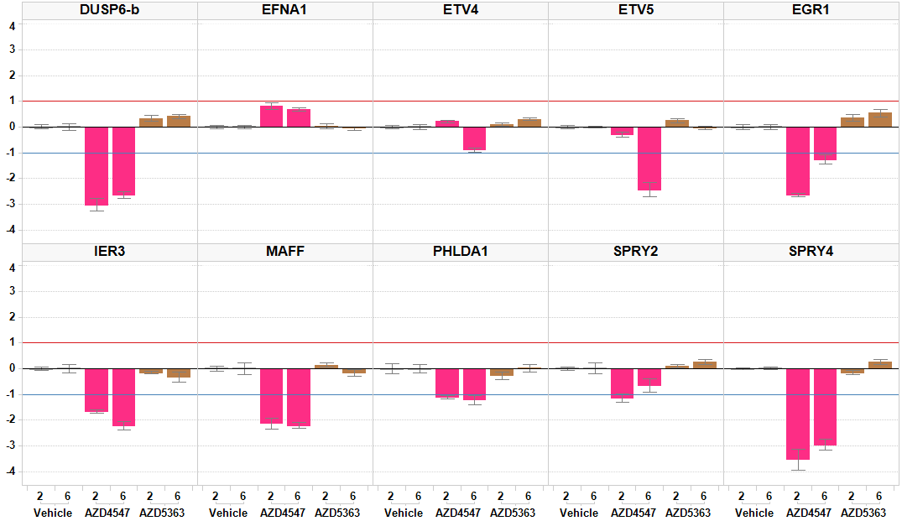
S5
mRNA Log2 Fold change

