Slide 1
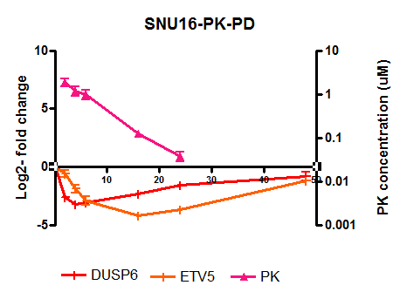
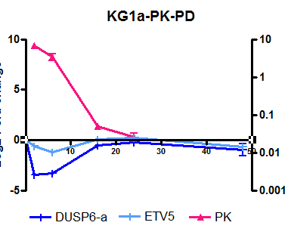
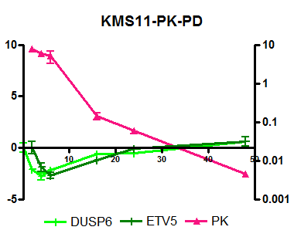
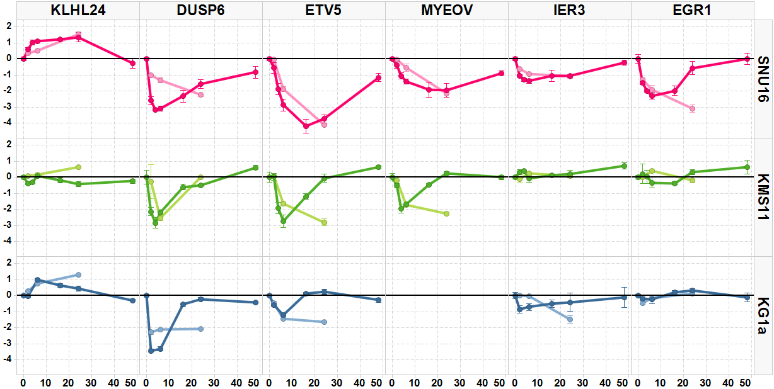
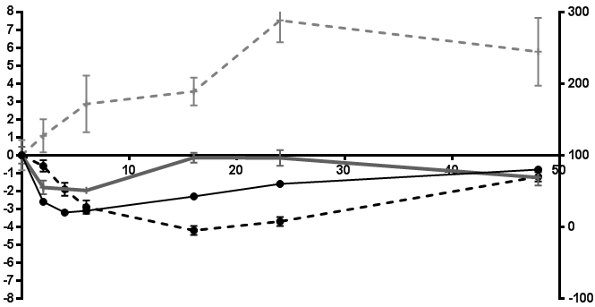
4A)
Figure 4
SNU16
KMS11
KG1a
Time (hours)
4B)
Log2 mRNA Fold change
Time
(hours)
4C
SNU16
Log2 fold change
% P-IHC to control
KMS11
KG1a
Time (hours)

