Slide 1
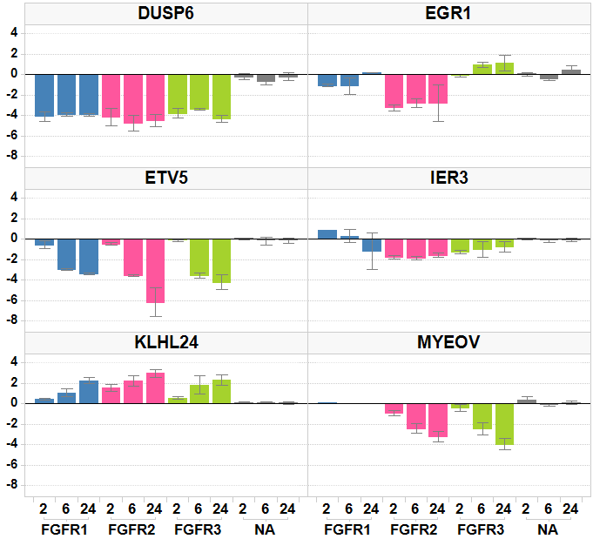
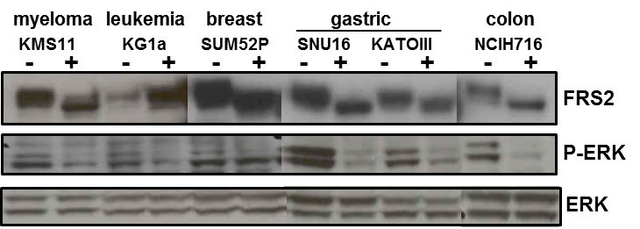
Figure 3
A
*
*
*
*
*
*
*
*
*
Log2 mRNA Fold change
*
*
*
*
*
*
*
*
*
*
*
*
*
*
*
*
*
*
Time
(hours)
B
C
D

Slide 2
FGFR3
FGFR1
FGFR2
myeloma
leukemia
breast
gastric
colon
KMS11
KG1a
SUM52P
SNU16
KATOIII
NCIH716
-
+
-
+
-
+
-
+
-
+
-
+
FRS2
P-ERK
ERK
myeloma
breast
SCLC
gastric
bladder
colon
ARH77
SKBR3
HCC1419
NCIH69
AGS
SNU216
T24
HCA7
-
+
-
+
-
+
-
+
-
+
-
+
-
+
-
+
FRS2
P-ERK
ERK

