Slide 1
Figure 1

Slide 2
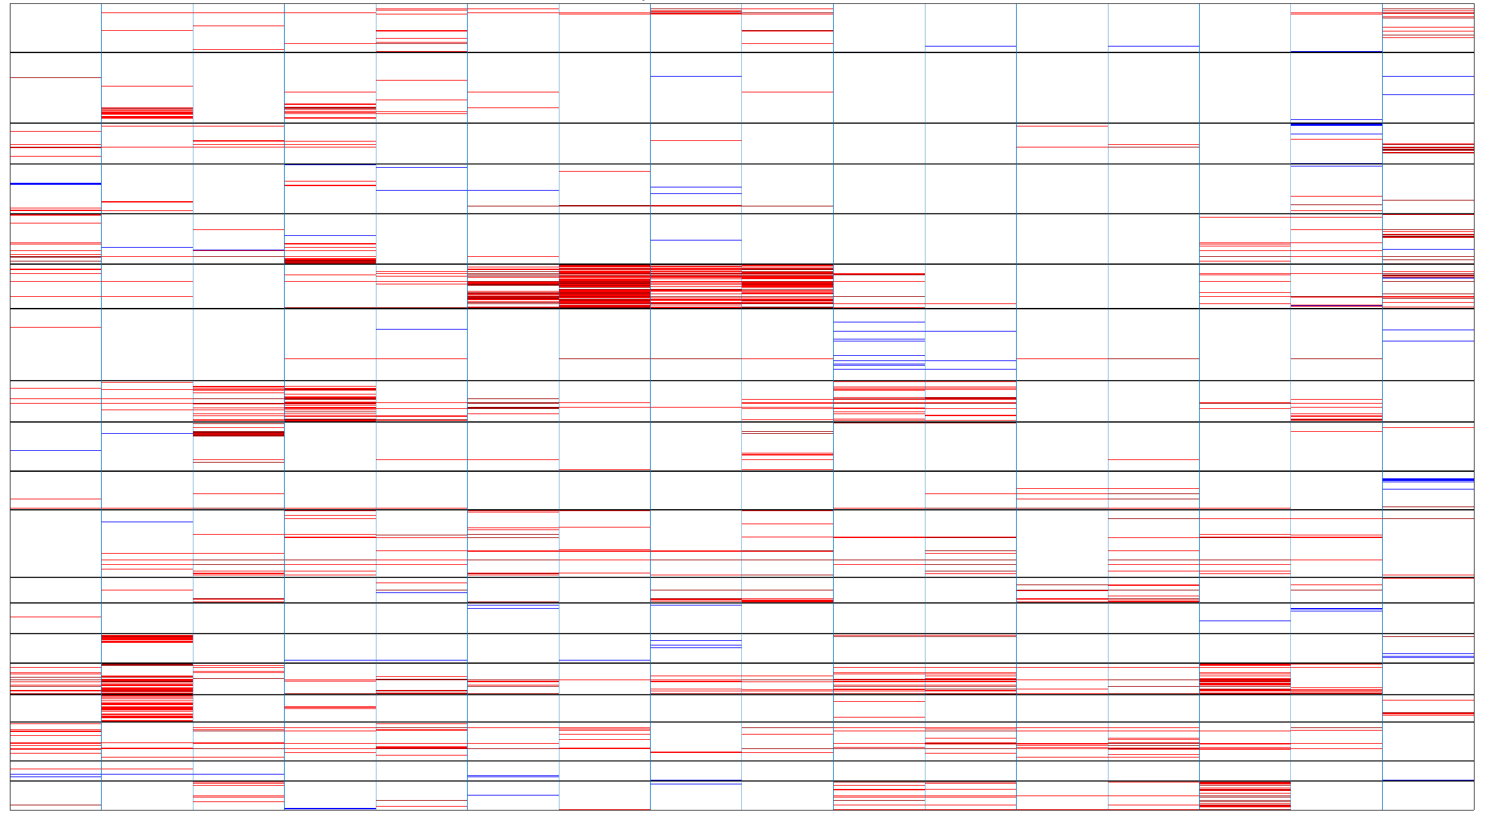
Figure 2
Amplification (>5 copies)
Amplification (1-5 copies)
Diploid
Heterozygous deletion
Homozygous deletion

Slide 3
Figure 3

Slide 4
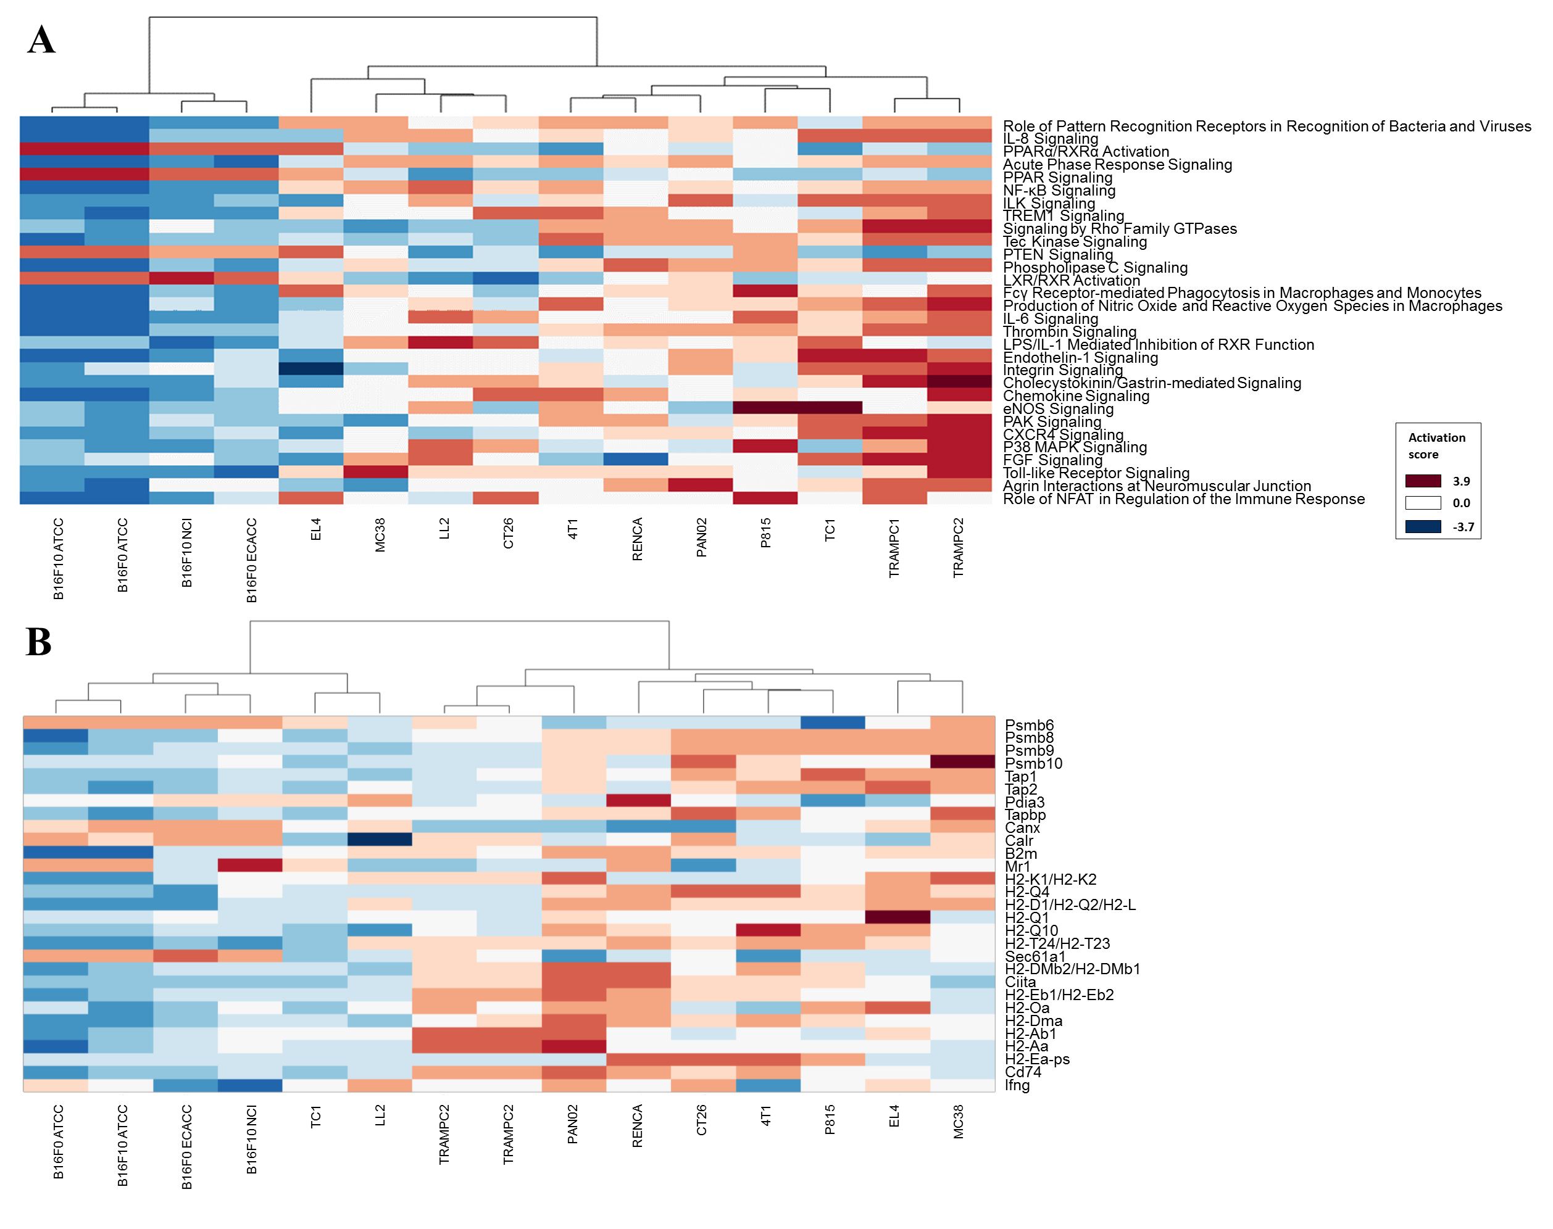
Figure 4

Slide 5
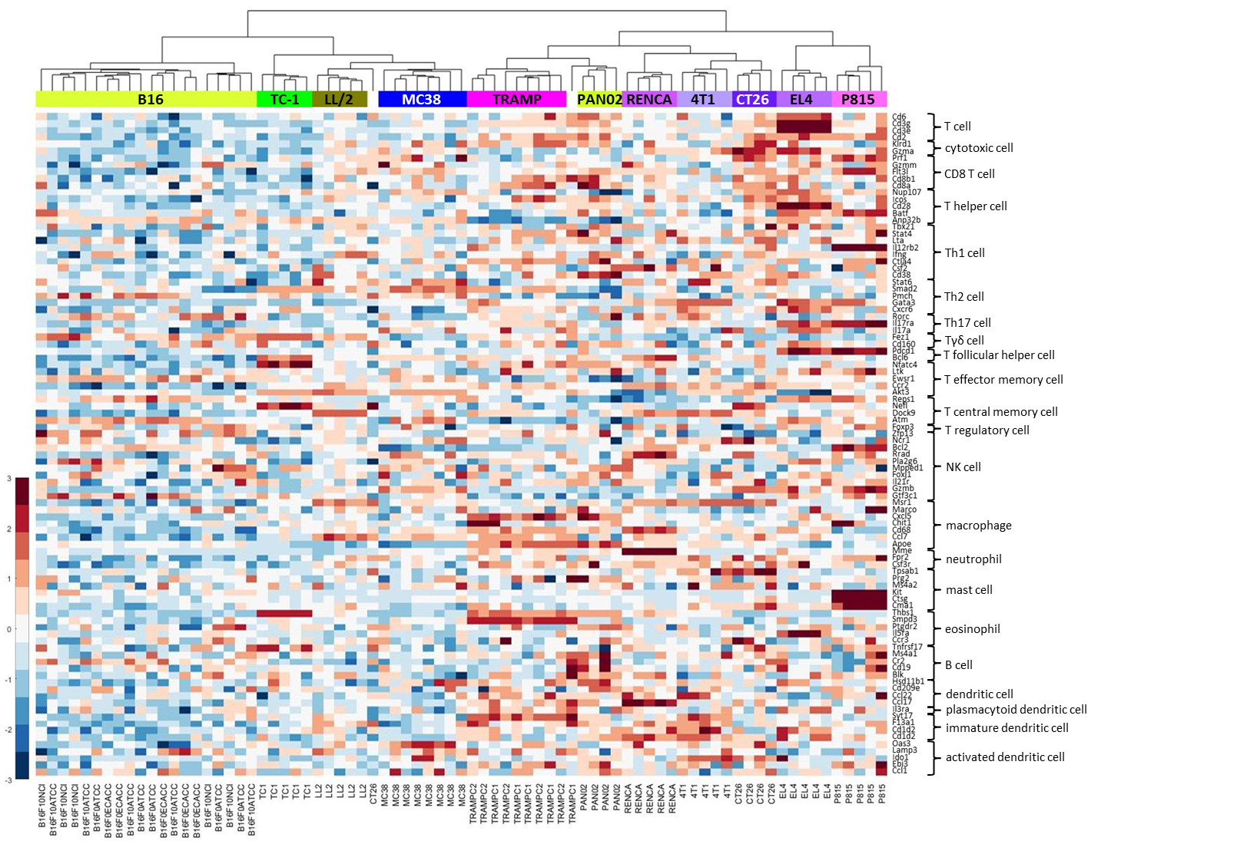
Figure 5

Slide 6
Figure 6

Slide 7
Figure 7

