Slide 1

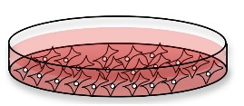

Supplementary Figure S1
Flow cytometry + cytokine analysis
SNParray CNV
Targeted sequencing
implanted in mice
implanted in mice
WES + CNV
Transcriptomic analysis
Treatment
implanted in mice
Anti-tumor activity
Supplementary Figure S1: Summary of experiments

Slide 2
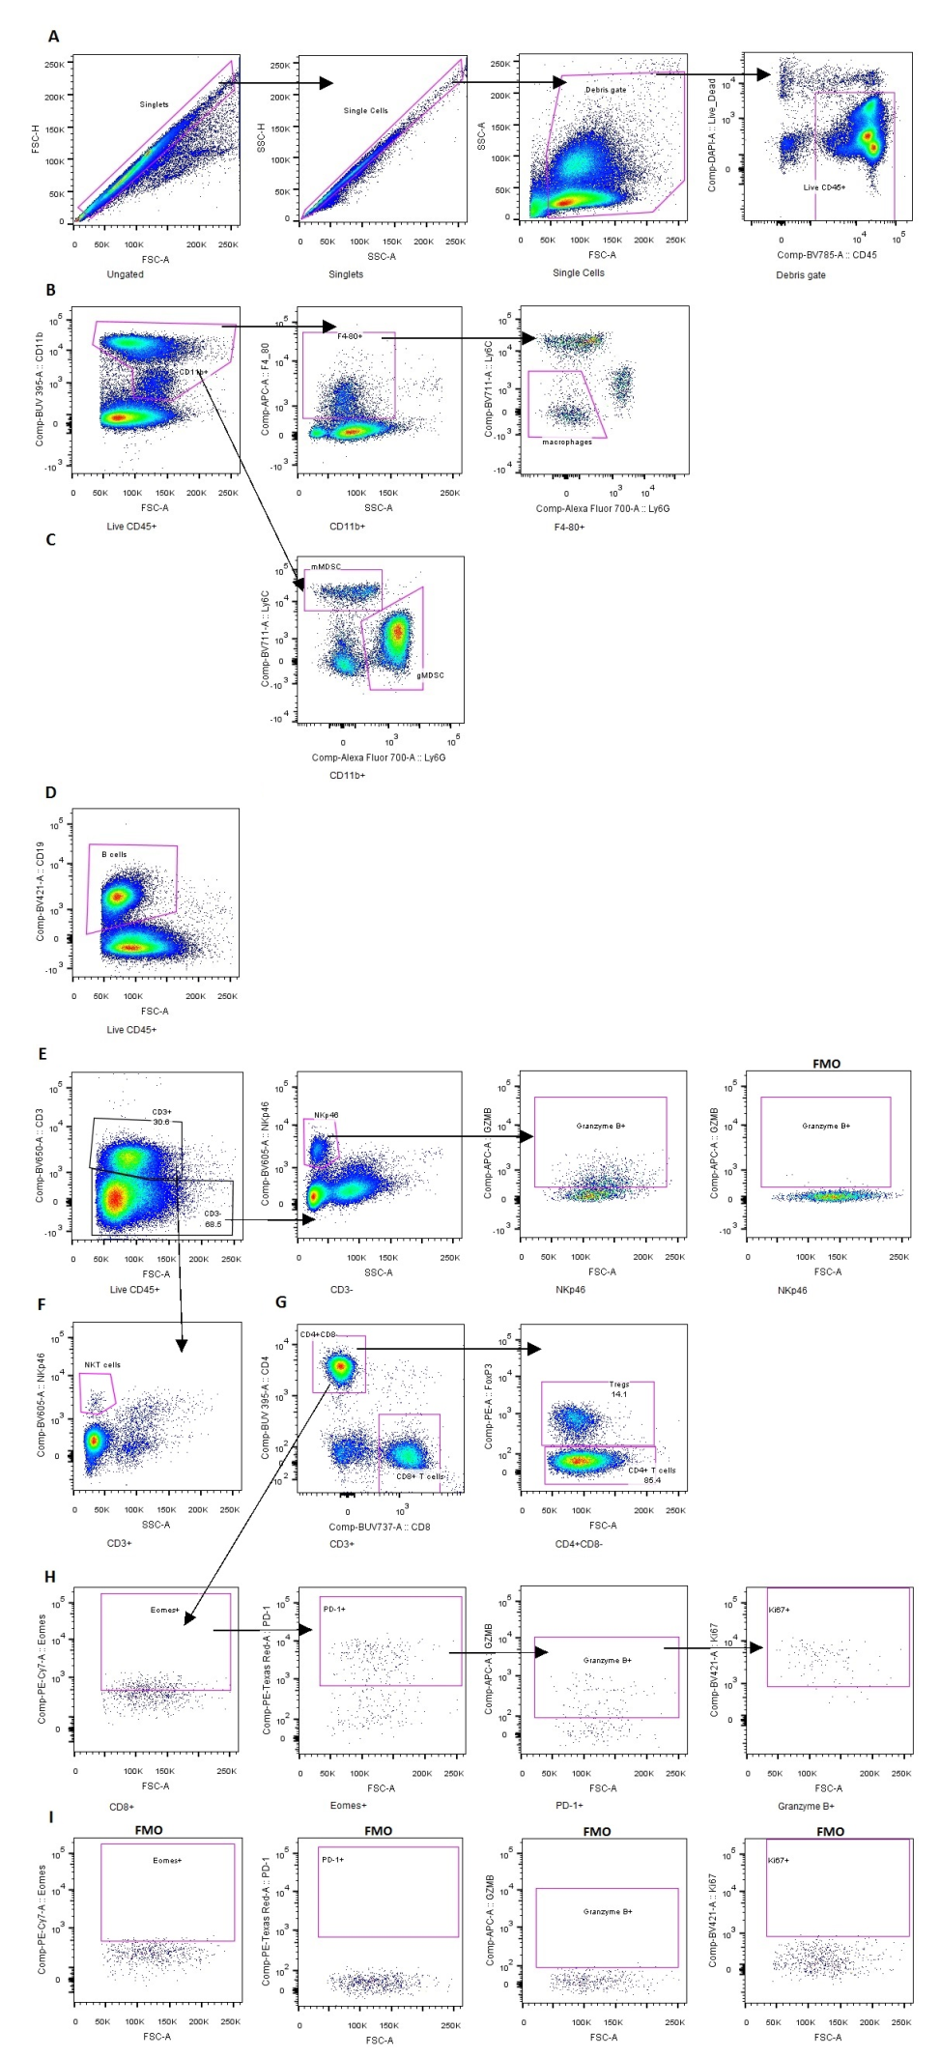
Supplementary Figure S2
Supplementary Figure S2: Gating strategy for identification of 9 major cell types, granzyme B+ NK cells and ‘reinvigorated’ CD8+ T cells
A: Identification of live CD45+ cells by exclusion of doublets, debris, dead cells and CD45- cells. This was carried out before any further gating for all samples. B: Identification of macrophages as CD11b+, F4/80+, Ly6C-, Ly6G- cells. C: Identification of gMDSCs as CD11b+, Ly6G+, Ly6Clow cells and of mMDSCs as CD11b+, Ly6G-, Ly6Chigh cells. D: Identification of B cells as CD19+ cells. E: Identification of NK cells as CD3-, NKp46+ cells. Identification of granzyme B+ NK cells and fluorescence minus one (FMO) control for granzyme B staining. F: Identification of NKT cells as CD3+, NKp46+ cells. G: Identification of CD8+ T cells as CD3+, CD8+, CD4- cells, of CD4+ T cells as CD3+, CD8-, CD4+, FoxP3- cells and of Tregs as CD3+, CD8-, CD4+, FoxP3+ cells. H: Identification of ‘reinvigorated’ CD8+ T cells as CD3+, CD8+, CD4-, Eomes+, PD-1+, granzyme B+, Ki67+ cells. I: Fluorescence minus one controls for Eomes, PD-1, granzyme B and Ki67 staining.

Slide 3
Supplementary Figure S3
Supplementary Figure S3:
Profiling by array CGH, whole-exome and targeted sequencing across 11 cell lines showing the percentage of altered genes from 41 cancer associated genes. Somatic mutations and copy number changes are marked for each gene with the percentage of samples altered along the side of the heatmap. Sideway bargraphs show the total number of genomic alterations across samples, which orders genes in the heatmap from most to least altered. Human homolog genes are stated in brackets beside the mouse gene names where these differ.

Slide 4
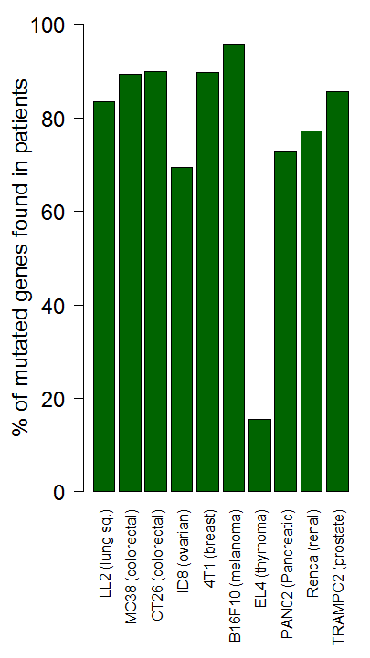
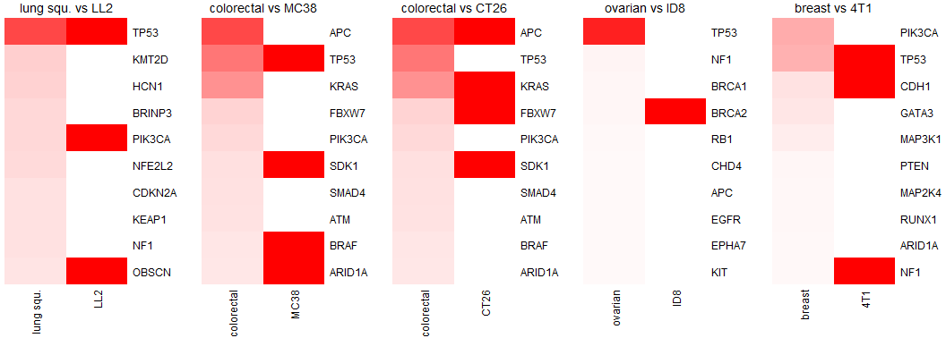

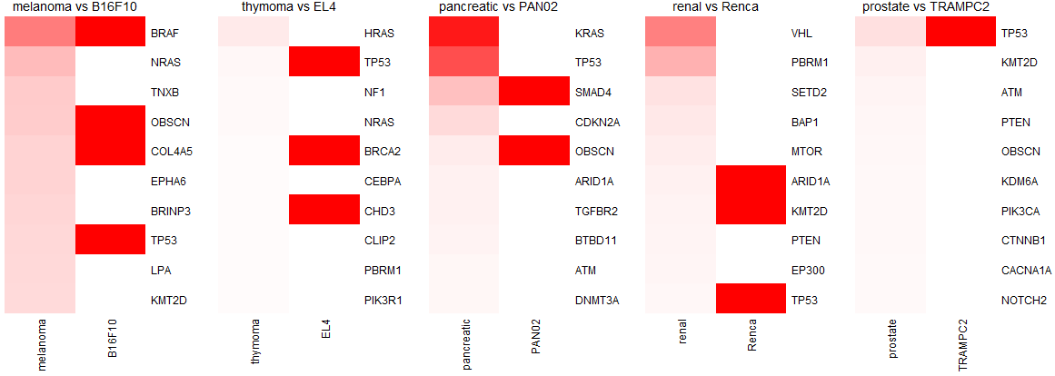
Supplementary Figure S4
A
B
% frequency
Supplementary Figure S4: Comparison of mutational profiles of murine syngeneic tumor cell lines and TCGA patient tumors
A: Percent of all mutations in each murine syngeneic cell line also found in the TCGA (The Cancer Genome Atlas) patient cohort of the corresponding cancer type (lung sq: squamous cell lung cancer). B: Population frequencies of the top 10 recurrent mutations in each TCGA cancer type is plotted beside the mutation profile of their corresponding murine syngeneic cell line.

Slide 5
Supplementary Figure S5
A
LYMPH NODE
Canonical Pathway | 4T1 | CT26 | Renca | MC38 | B16F10_NCI | B16F10_ATCC | B16F0_ATCC | B16F0_ECACC | TRAMPC1 | TRAMPC2 | PAN02 | TC1 | LL2 | EL4 | P815
EIF2 Signaling | 0.00 |  |  | 2.45 |  |  | 3.46 | 2.65 | 0.00 | 0.00 |  | 2.65 |  | 3.61 | 0.00
LXR/RXR Activation | 0.00 | -1.63 | -1.73 |  | -2.00 | -2.00 | -1.00 |  |  | 0.00 |  |  |  | -0.82
iCOS-iCOSL Signaling in T Helper Cells | 0.00 | -2.83 | -3.64 |  |  |  | 2.24 |  | 0.00 | 0.00
Role of BRCA1 in DNA Damage Response |  | 2.24 | 3.00 | 0.00 | 0.00 | 0.00 | 0.00 | 0.00 | 0.00 | 0.00 |  | 0.00 |  | 2.00
Cell Cycle: G2/M DNA Damage Checkpoint Regulation |  | -1.51 | -0.53 |  | 0.00 | 0.00 | 0.00 | 0.00 | 0.00 | 0.00 |  | 0.00 | -2.00 | -1.89 | -1.00
PPARα/RXRα Activation | 0.00 | -1.63 | -2.31 | 0.00 | 0.00 | 0.00 |  |  |  | 0.00 |  |  | 0.38 | 0.38 | -1.63
ILK Signaling | 0.00 | 0.82 | 2.98 |  |  |  | 0.00 | 0.00 | 0.00 | 0.00 |  | 0.00 |  |  | -2.45
Role of NFAT in Regulation of the Immune Response | 0.00 | -3.00 | -2.98 |  |  |  |  |  | 0.00 | 0.00
CD28 Signaling in T Helper Cells | 0.00 | -2.24 | -3.46 |  |  |  |  |  | 0.00 | 0.00
Fc Epsilon RI Signaling |  | -2.00 | -3.16 | 0.00 |  | 0.00 | 0.00 | 0.00 | 0.00 | 0.00 |  | 0.00 | 0.00 | 0.00 | 0.00
B
SPLEEN
Canonical Pathway | 4T1 | CT26 | Renca | MC38 | B16F10_NCI | B16F10_ATCC | B16F0_ATCC | B16F0_ECACC | TRAMPC1 | TRAMPC2 | PAN02 | TC1 | LL2 | EL4 | P815
Cyclins and Cell Cycle Regulation | 0.00 |  |  | 2.24 | 0.00 |  | 0.00 | 0.00 | 0.00 | 0.00 | 2.24 | 2.45 | 2.45 | 2.83 | 0.00
Cell Cycle: G2/M DNA Damage Checkpoint Regulation | 0.00 |  |  | -2.65 | 0.00 | -2.24 | 0.00 | 0.00 | 0.00 | 0.00 | -2.12 | -1.51 | -1.51 | -1.39 | 0.00
Mitotic Roles of Polo-Like Kinase |  | 0.00 |  | 1.63 | 0.00 |  | 0.00 | 0.00 | 0.00 | 0.00 | 2.12 | 2.53 | 2.12 | 2.71 | 0.00
Estrogen-mediated S-phase Entry | 0.00 | 0.00 | 0.00 |  | 0.00 |  | 0.00 | 0.00 | 0.00 | 0.00 |  | 2.00 | 2.00 | 2.24 | 0.00
Role of BRCA1 in DNA Damage Response | 0.00 | 0.00 |  |  | 0.00 |  | 0.00 | 0.00 | 0.00 | 0.00 |  | 1.63 | 1.63 | 1.90 | 0.00
Protein Kinase A Signaling | 0.00 |  | 0.00 |  | 0.00 |  | 0.00 | 0.00 | 0.00 | 0.00 | -0.82 | -1.63 | -1.63 | -0.71 | 0.00
cAMP-mediated signaling | 1.00 | 0.00 | 0.00 | 0.00 | 0.00 |  | 0.00 | 0.00 | 0.00 | 0.00 | 2.00 |  |  | 1.63 | 0.00
p38 MAPK Signaling |  |  | 0.00 | 0.00 | 0.00 | 0.00 | 0.00 | 0.00 | 0.00 | 0.00 |  |  | 2.00 | 2.24 | 0.00
LXR/RXR Activation |  | 0.00 | 0.00 |  | 0.00 | 0.00 | 0.00 | 0.00 | 0.00 | 0.00 |  |  | -2.00 | -2.00 | 0.00
Actin Cytoskeleton Signaling |  | 0.00 | 0.00 |  | 0.00 | 0.00 | 0.00 | 0.00 | 0.00 | 0.00 | 2.00 |  |  | 2.00 | 0.00
Supplementary Figure S5:
Differentially-expressed gene-sets per syngeneic model (FC +/- 2.0, FDR ≤0.05) after IPA core analysis where the top five highest and lowest pathway Z scores per line were selected, sorted for non-disease canonical pathways and ranked by absolute activation score (summed absolute Z score) (IPA comparison tool) for (A) lymph node and (B) spleen.

Slide 6
Supplementary Table S1
Supplementary Table S1: Cell line details
The cell line, supplier, genetic strain and sex of the mouse from which the cell line was derived, tissue of origin of the tumor from which the cell line was originally derived, culture media for the cell line, number of cells injected subcutaneously in 100µl PBS (unless otherwise stated) to form tumors and the day post implantation that samples were collected for transcriptomic analysis or immune cell profiling by flow cytometry (values in brackets) and whether cells were in vivo passaged during original derivation. NMU: N-nitroso-N-methylurethane, DMBA: 9,10-dimethyl-1,2-benzanthracene, MCA: 3-methylcholanthrene

Slide 7
Supplementary Table S2
Cell line | Homozygous deletion = 0 copies | Heterozygous deletion = 1 copy | Diploid | Gain= 3 copies | Amplification = 4 copies
B16F10 NCI | -3.32 | -0.86 | 0 | 0.6556 | 0.93
CT26 | -3.32 | -0.86 | 0 | 0.6337 | 0.93
Hepa1-6 | -3.32 | -0.86 | 0 | 0.585 | 0.93
ID8 | -3.32 | -0.86 | 0 | 0.6296 | 0.93
Renca | -3.32 | -0.86 | 0 | 0.585 | 0.93
4T1 | -3.32 | -0.86 | 0 | 0.6034 | 0.93
B16F0 ATCC | -3.32 | -0.86 | 0 | 0.7483 | 0.93
PAN02 | -3.32 | -0.86 | 0 | 0.6748 | 0.93
EL4 | -3.32 | -0.86 | 0 | 0.585 | 0.93
P815 | -3.32 | -0.86 | 0 | 0.7262 | 0.93
B16F0 ECACC | -3.32 | -0.86 | 0 | 0.5901 | 0.93
TRAMPC1 | -3.32 | -0.86 | 0 | 0.6278 | 0.93
LL2 | -3.32 | -0.86 | 0 | 0.5987 | 0.93
TRAMPC2 | -3.32 | -0.86 | 0 | 0.6738 | 0.93
MC38 | -3.32 | -0.86 | 0 | 0.6439 | 0.93
B16F10 ATCC | -3.32 | -0.86 | 0 | 0.6559 | 0.93
Supplementary Table S2: Copy Number Variation
Probe log2 ratios were converted to copy number variation (CNV) values by determining the median log2 ratio for duplicate probes, mapping gene identities to the probes (mapping from Agilent_244A_014695_D_GeneList_20070207 using R), calculating a median log2 ratio per gene and converting to a gene copy number value using cut offs determined by adjusting absolute values for 10% heterogeneity and technical variance (-4.322 for homozygous deletion, -1 for heterozygous deletion, 0 for diploid and 1 for homozygous amplification). For gains, the minimum cut off value was set to 0.585 (3 copies absolute value) and adjusted per cell line where 90% quantile log2 ratio values were higher. Copy number calls greater than 3 were calculated from the log2 ratio. Genes with non diploid CNV calls and <5 probes were compared to their concomitant segmentation calls (minimal log2ratio difference = 0.15, minimum marker count =4, Heuristic search p value cut off = 0.05 and significant segment p value cut off = 1e-5 (Omicsoft ArrayStudio)) and confirmed if amplification log2ratios were matched to a gained segment, as were deletions with a loss segment. Where these did not match but there were 3 or 4 probes the result was flagged for checking against chromosomal probe plots (Omicsoft ArrayStudio) while genes with <3 probes were reset to diploid.

Slide 8
Supplementary Table S3
Supplementary Table S3: List of 64 genes investigated by targeted sequencing selected among commonly mutated genes in cancer patients (based on proprietary datasets and the COSMIC database)

Slide 9
Supplementary Table S4
Antibody | Supplier
F4/80 Alexa Fluor 647 | AbD Serotec
CD45 BV786 | BD Biosciences
CD11b BUV395 | BD Biosciences
CD8 BUV737 | BD Biosciences
CD4 BUV395 | BD Biosciences
CD3 BV650 | Biolegend
Ly6C BV711 | Biolegend
Ly6G Alexa Fluor 700 | Biolegend
Granzyme B Alexa Fluor 647 | Biolegend
NKp46 BV605 | Biolegend
CD19 BV421 | Biolegend
PD-1 PE-Alexa Fluor 610 | eBioscience
Ki67 eFluor 450 | eBioscience
Eomes PE-Cy7 | eBioscience
FoxP3 PE | eBioscience
Supplementary Table S4: Fluorescent antibodies used
Target, fluorophore and supplier of the fluorescent antibodies used for immunoprofiling.

