Slide 1
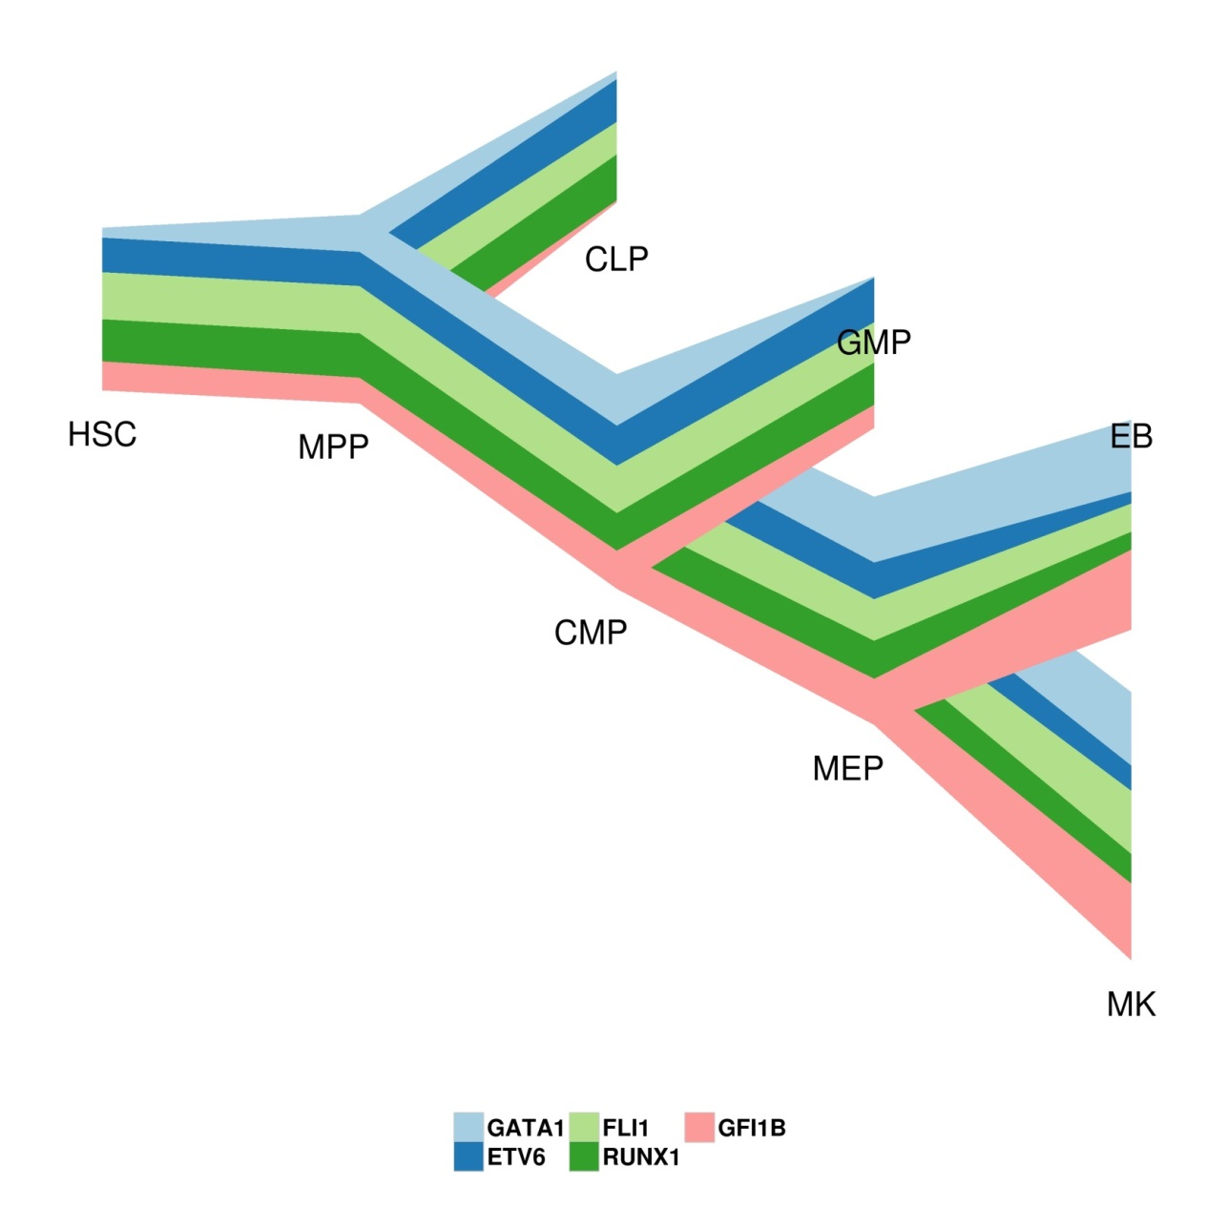
Notes:
Figure 1.

