Slide 1
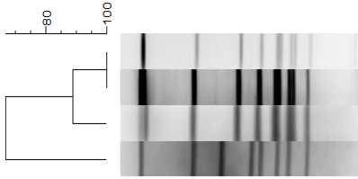
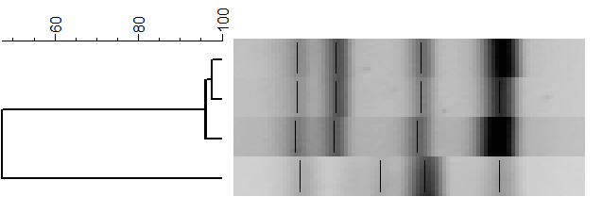
A
% Similarity
SmaI
Pattern
NAP
Type
Strain
023 NAP4 ICC-01
023 NAP4 ICC-05
023 NAP4 ICC-14
NEW TYPE ICC-45
B
% Similarity
Ribotype
Strain
014/020 ICC-01
014/020 ICC-05
014/020 ICC-14
NEW TYPE ICC-45
Figure 1

Slide 2
C.
R20291_ST01
CR5756_ST01
CR_ST154
CR_ST67
CD630
ICC45_ST41
CR_ST252
NAP7/078
NAP9_M68
Figure 1

Slide 3
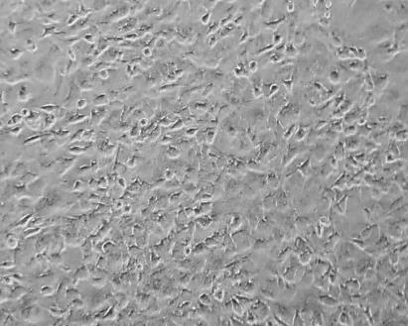
A.
B.
FIGURE 2

Slide 4
TcdB sequence
Strain
200
400
600
800
1.000
1.200
1.400
1.600
1.800
2.000
2.367
R20291NAP1/027
NAP1/027_FQR1
NAP1/027_FQR2
NAP1/027_ST01
CR5809_ST252
CR2811_ST41
TcdB_1470
TcdB_8864
ICC-45_ST41
CR5757_ST67
Figure 3

Slide 5
A
*
CPE_{50%} (1/Log dilution)
*
NAP1/027
ICC-45
NAP4
FIGURE 4

Slide 6
B
NAP1/027
NAP4
ICC-45
TcdA
TcdB
FIGURE 4

Slide 7
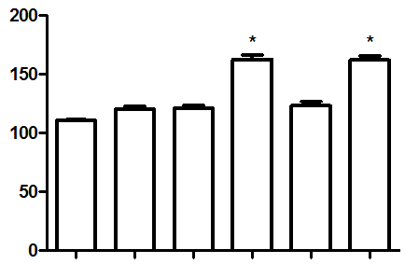
Weight/ileal loop length
(mg/cm)
Saline
BHI broth
Non-Tox
NAP1/027
NAP4
ICC-45
FIGURE 5

Slide 8
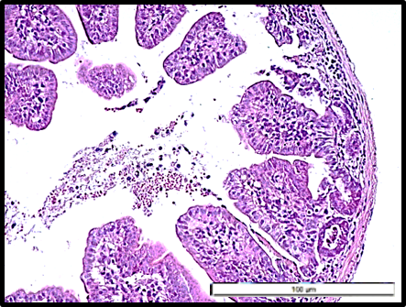
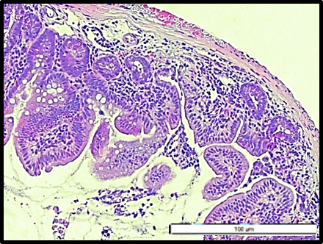
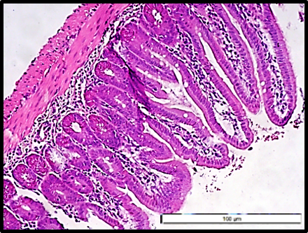
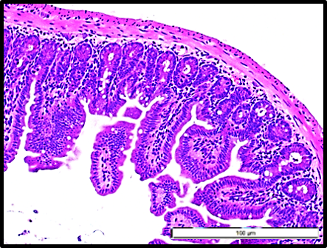
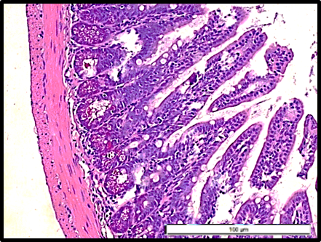
A
ICC-45
B
NAP1/027
C
NAP4/014-20
D
Non-toxigenic
E.
Control
FIGURE 6

Slide 9
A
Epithelial
damage
B
Edema
*
*
*
*
*
*
*
*
Histopathological score
HS
PBS
Non-Tox
ICC-45
NAP4
PBS
Non-Tox
ICC-45
NAP4
BHI Broth
NAP1/027
BHI broth
NAP1/027
C
Neutrophil
infiltration
D
Hemorrhage
*
*
*
*
*
*
HS
HS
PBS
Non-Tox
ICC-45
PBS
Non-Tox
ICC-45
BHI broth
NAP1/027
NAP4
BHI broth
NAP1/027
NAP4
FIGURE 7

Slide 10
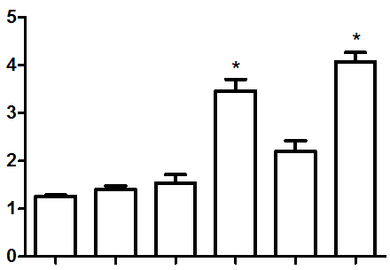
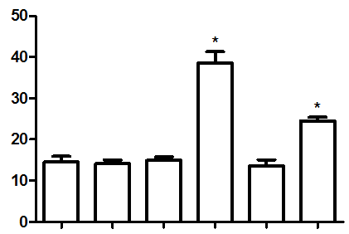
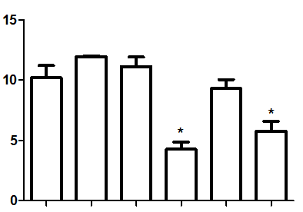
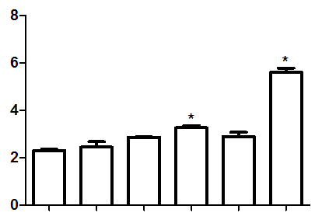
A
B
MPO activity
(U/mg of tissue)
MDA
(nmol/g of tissue)
PBS
Non-Tpx
NAP4
ICC-45
PBS
NAP4
ICC-45
BHI broth
NAP1/027
Non-Tox
BHI broth
NAP1/027
C
D
GSH
(µg/mg of tissue)
Tissue nitrite (µM)
PBS
PBS
Non-Tox
NAP4
ICC-45
Non-Tox
NAP4
ICC-45
BHI broth
NAP1/027
BHI broth
NAP1/027
FIGURE 8

