Slide 1
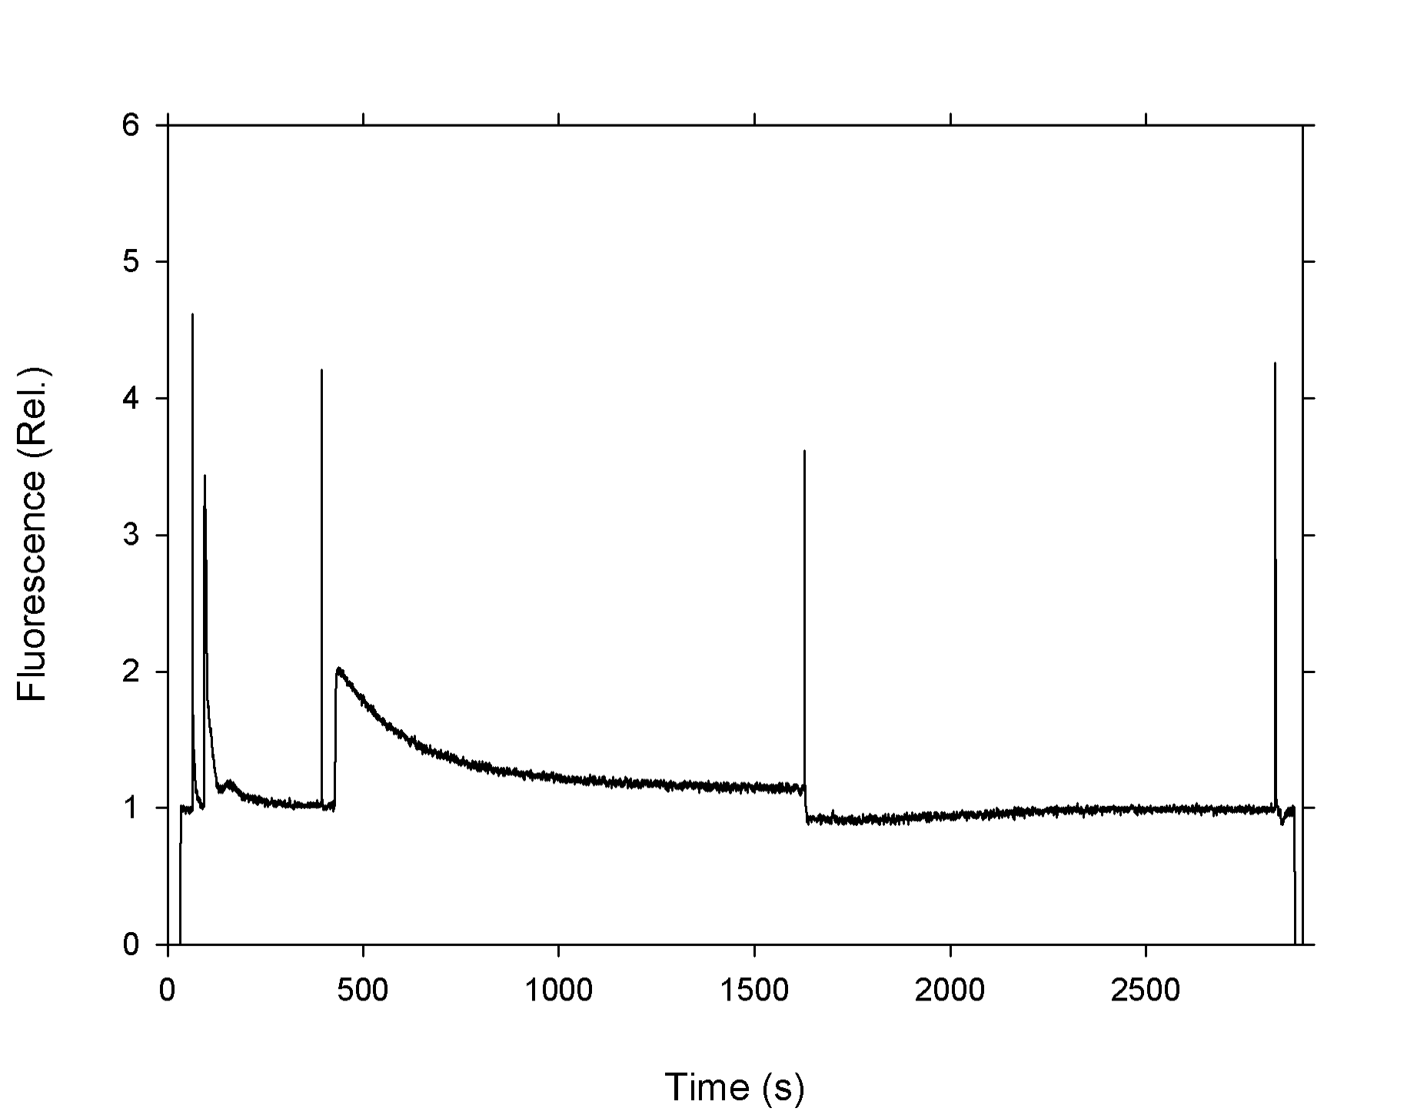
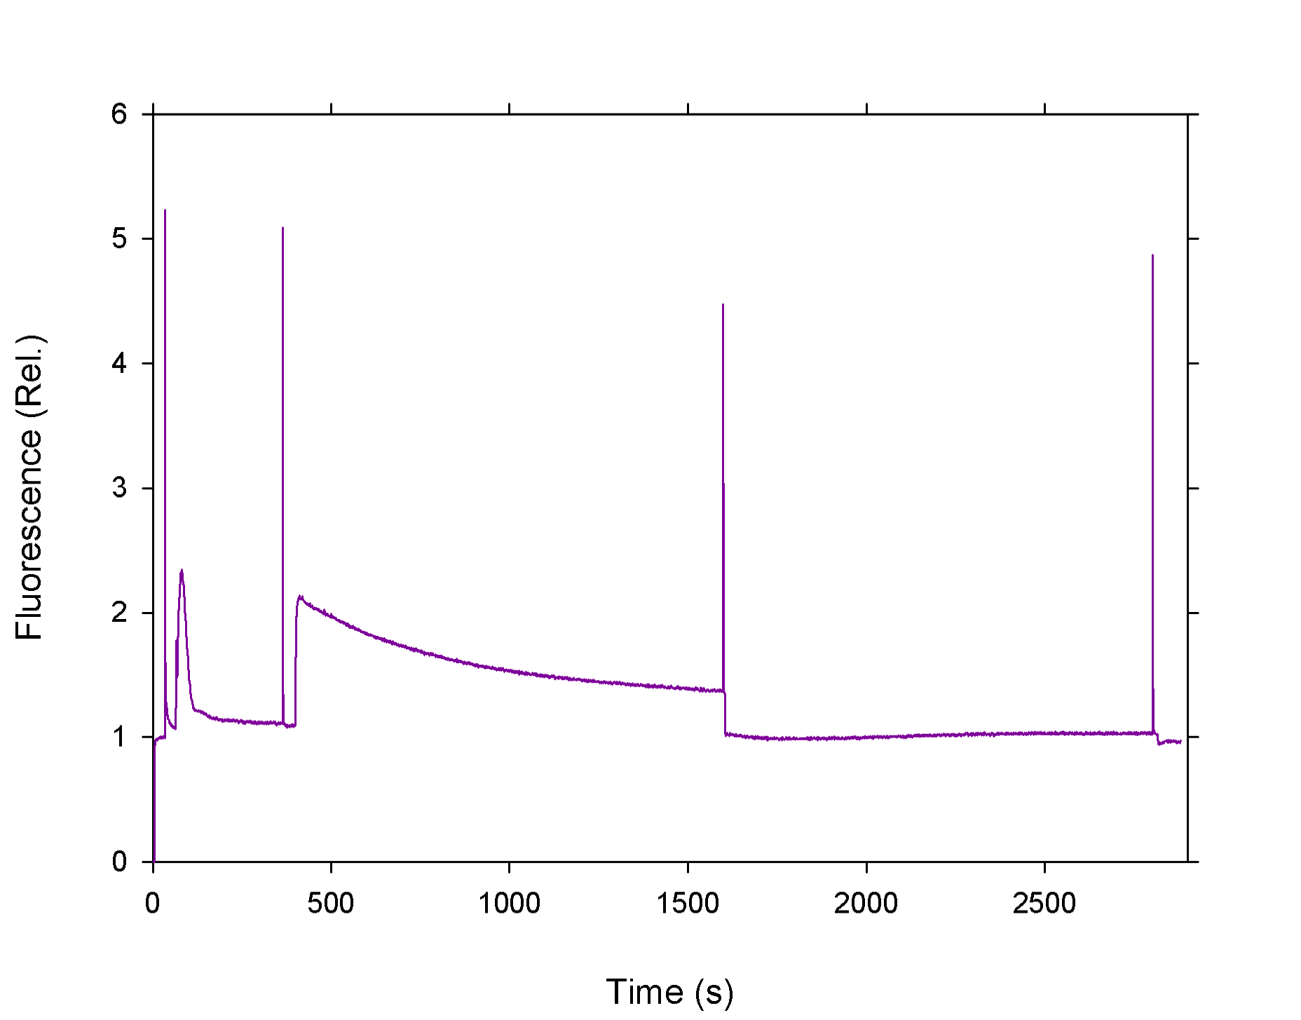
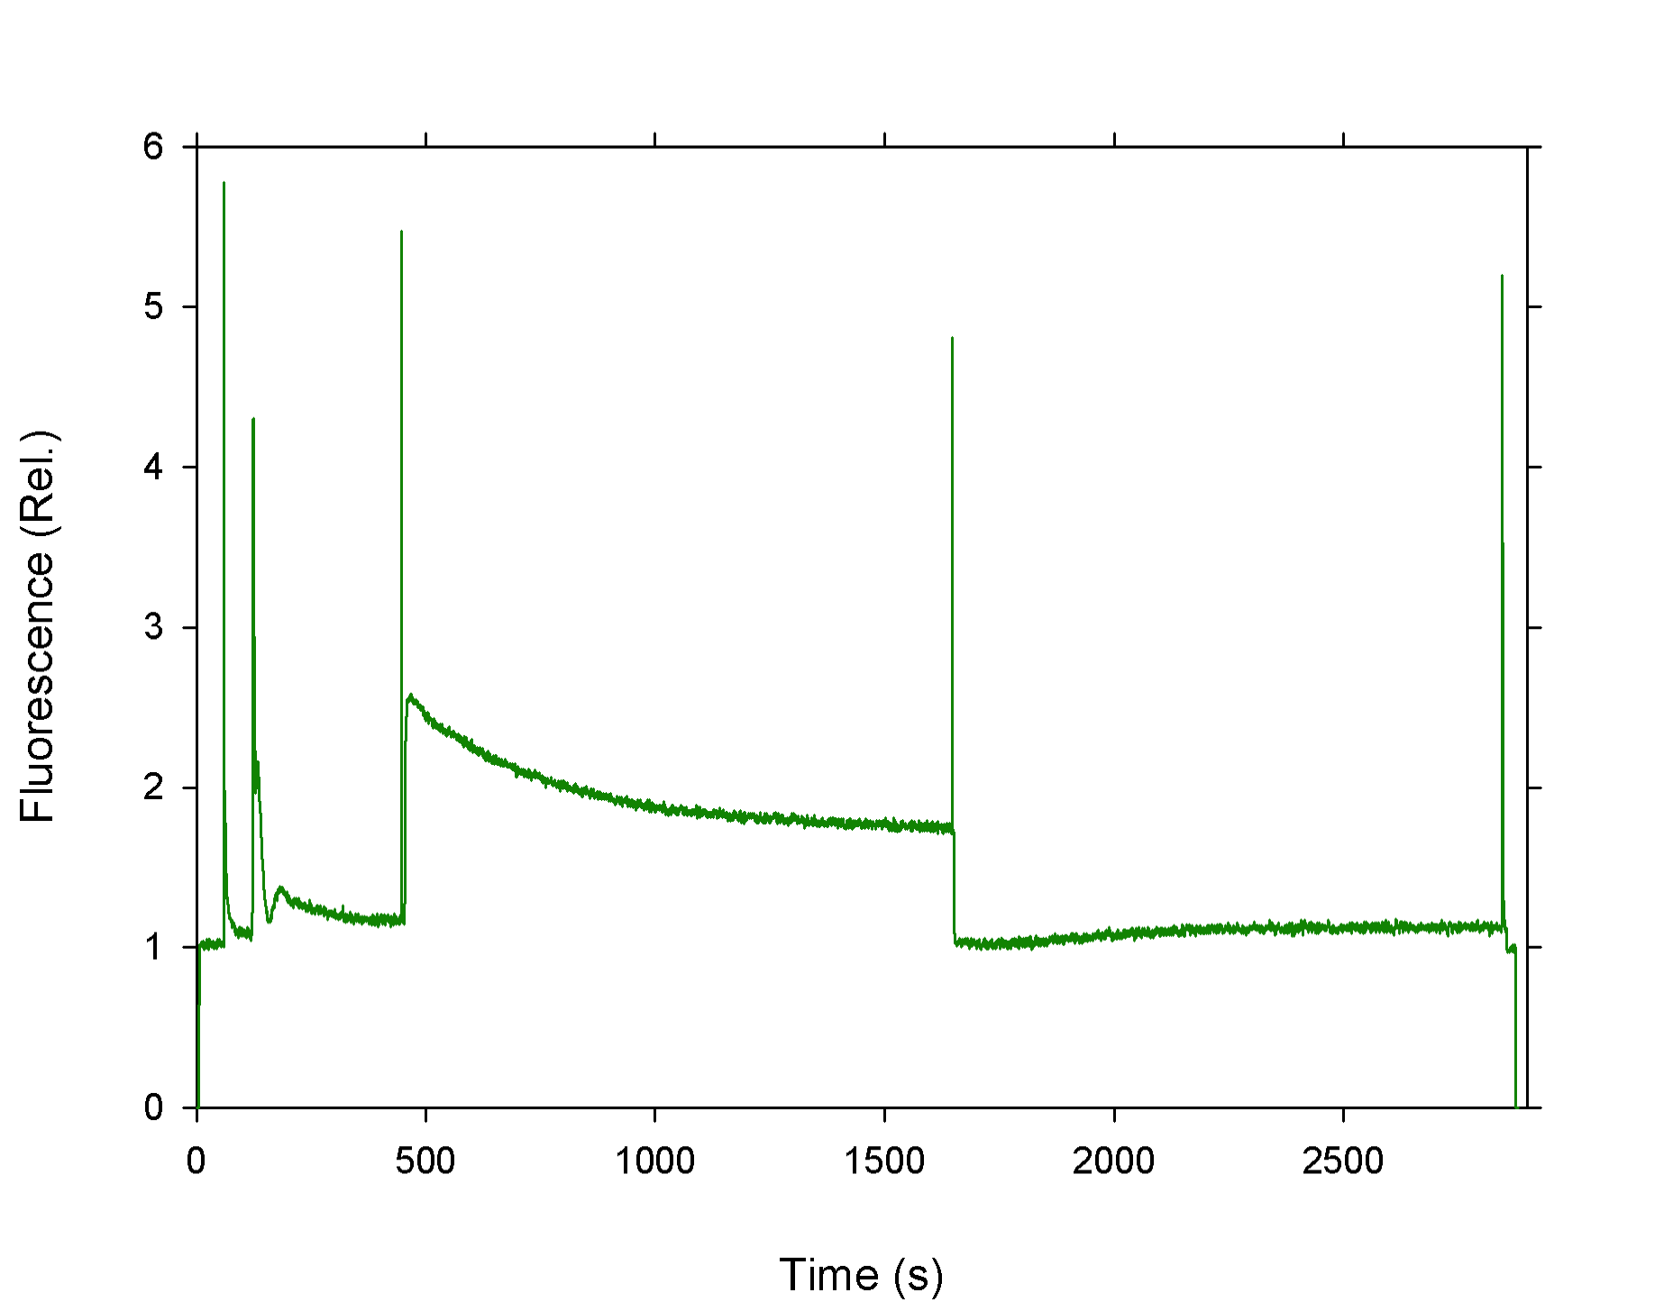
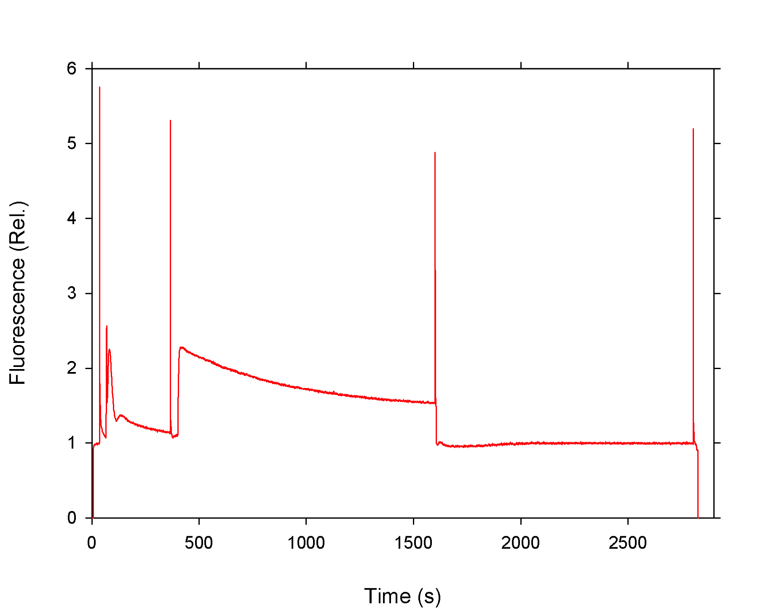
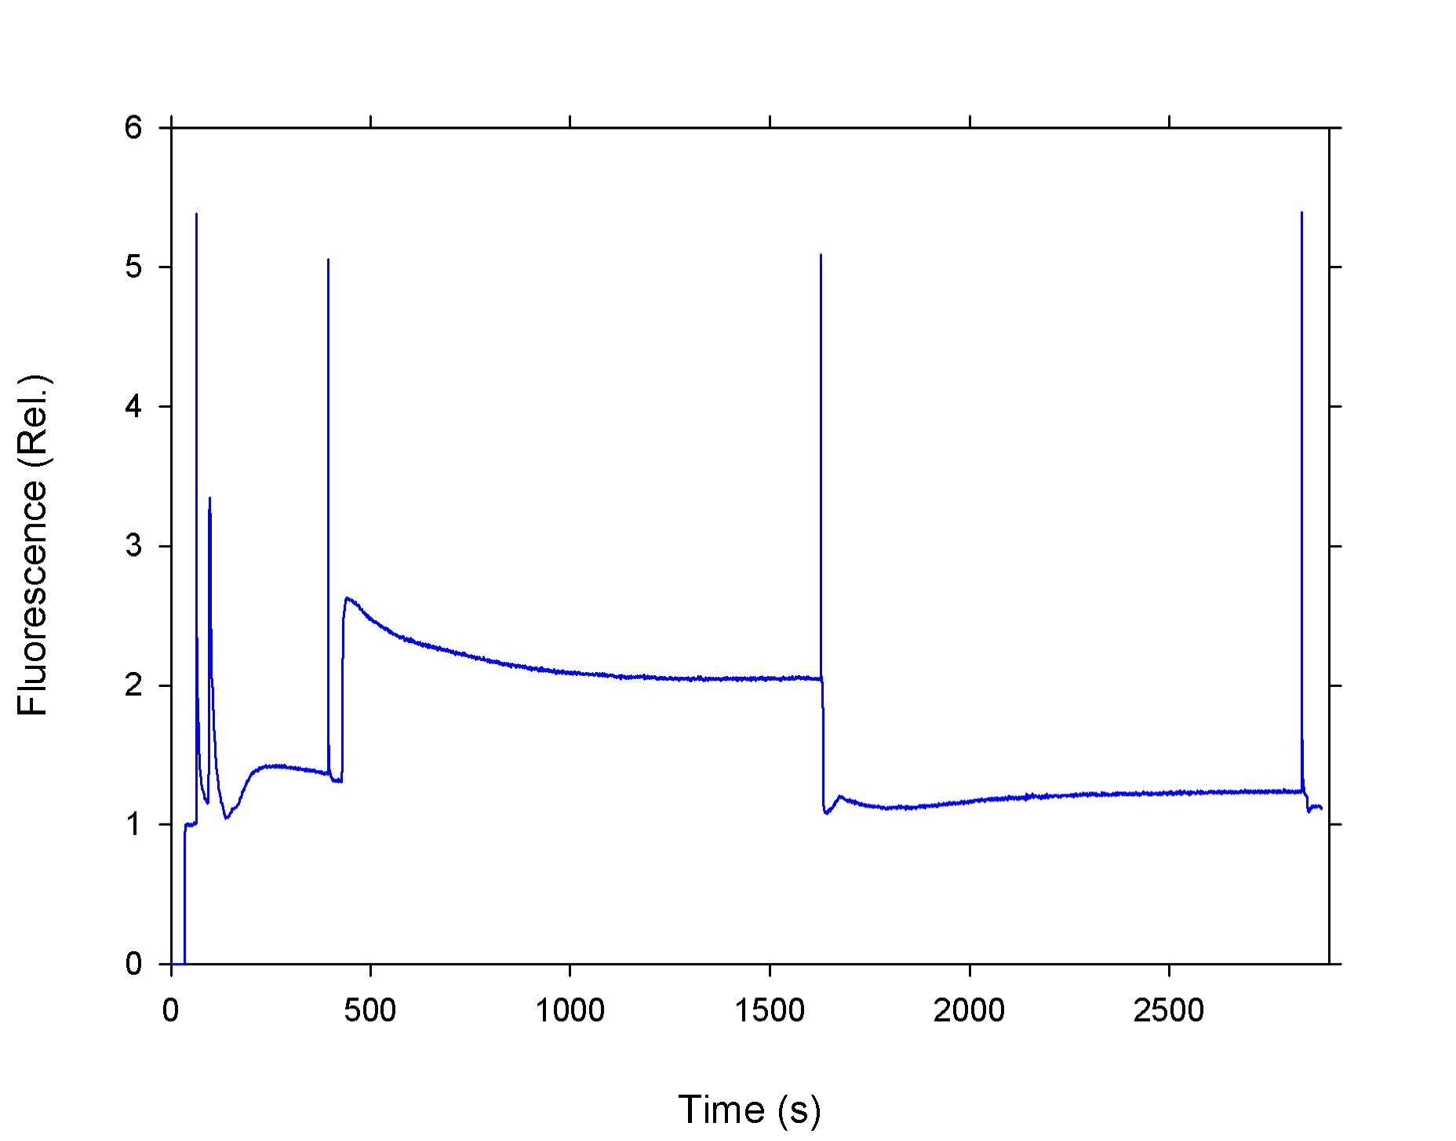
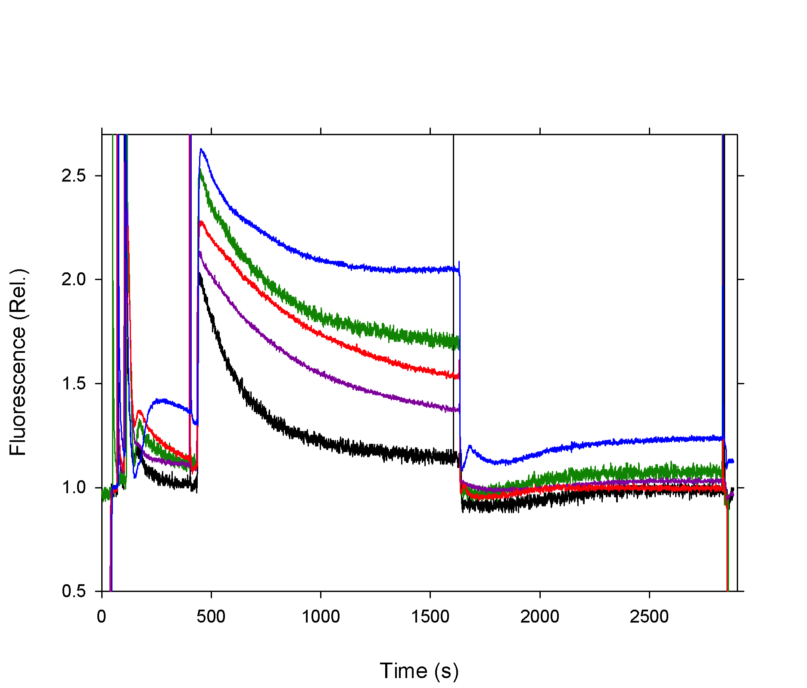
Figure 1.
a
b
WT
ΔLhca1
Far-Red Light
Far-Red Light
Red Light
Red Light
c
d
ΔLhca2
ΔLhca3
Far-Red Light
Far-Red Light
Red Light
Red Light
e
f
ΔLhca4
ΔLhca4
ΔLhca2
ΔLhca3
ΔLhca1
Far-Red Light
WT
Far-Red Light
Red Light
Red Light
g
Pro-Q Phospho Stain
WT
ΔLhca1
ΔLhca2
ΔLhca3
ΔLhca4
I II
I II
I II
I II
I II
pCP43
pD1/D2
pLHCII

Slide 2
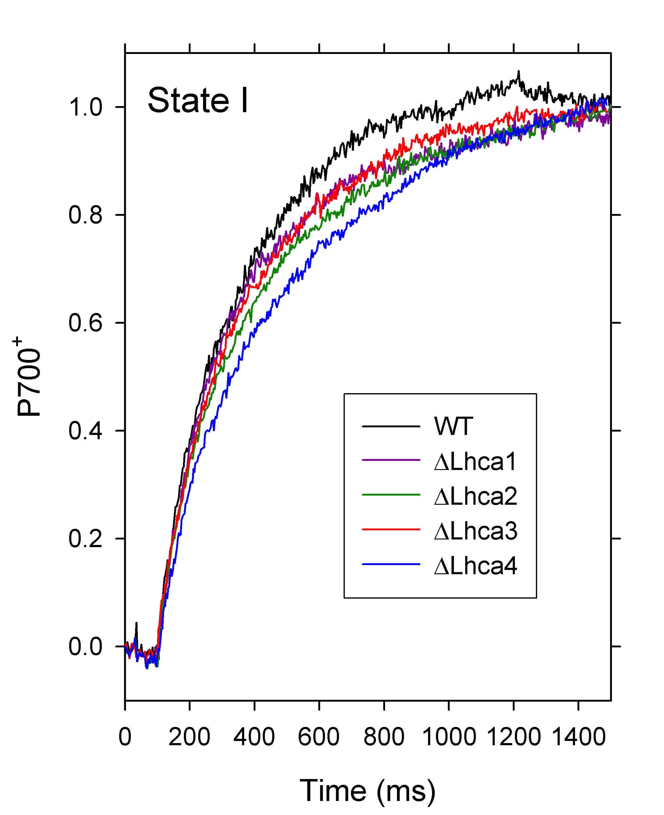
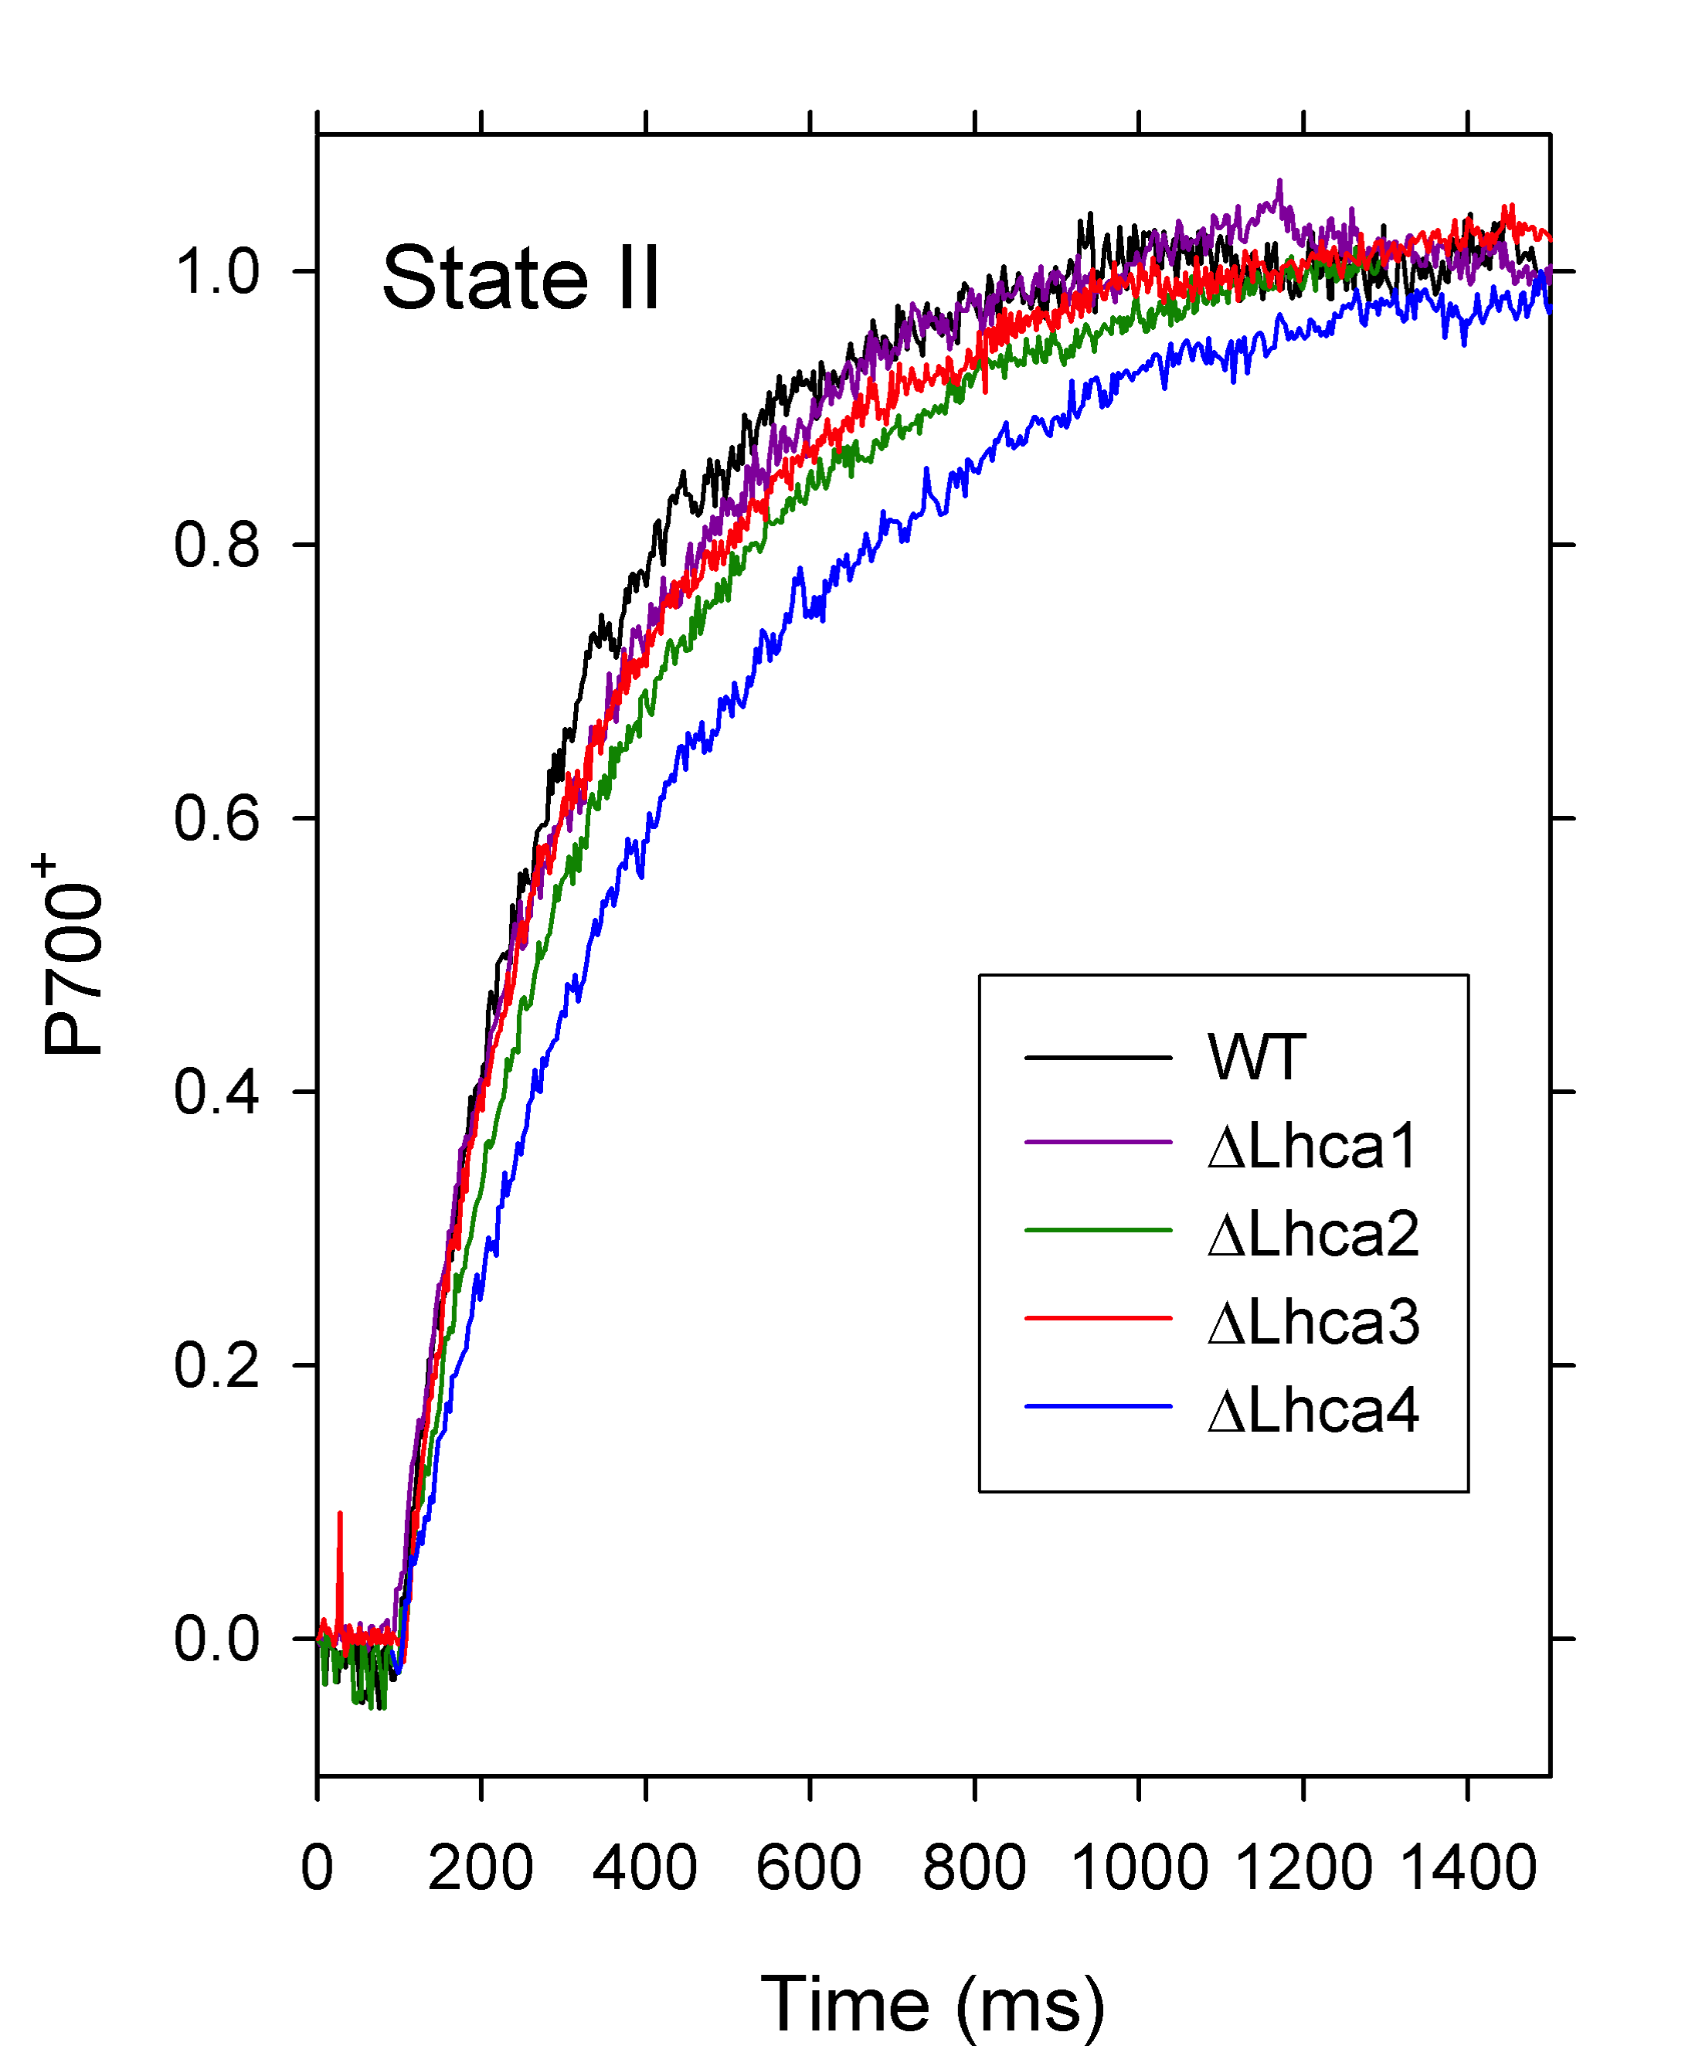
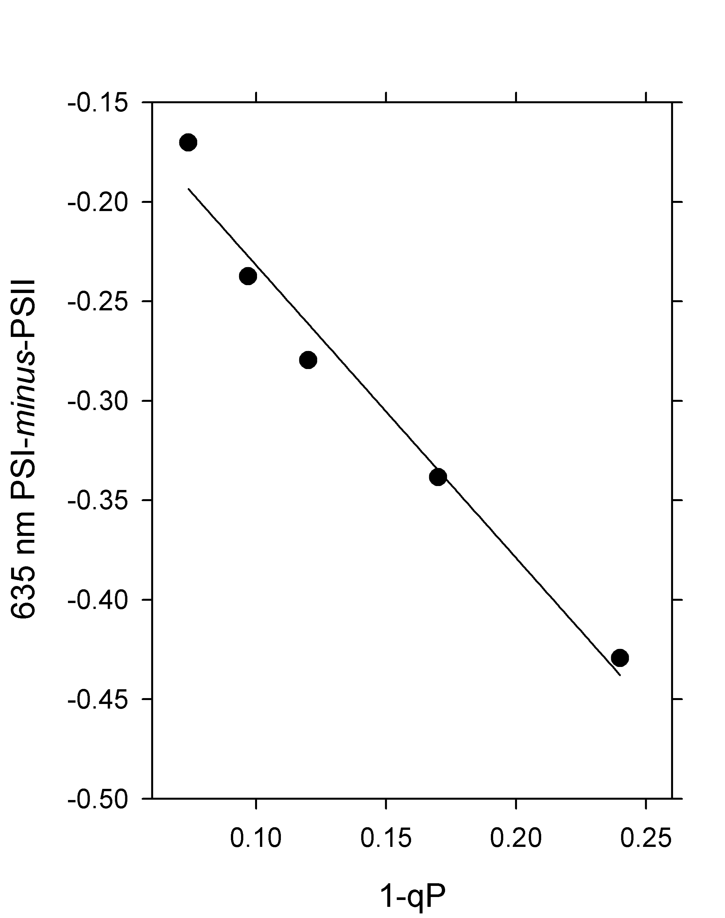
Figure 2.
a
b
c
d
WT
ΔLhca1
WT
ΔLhca2
ΔLhca1
ΔLhca2
ΔLhca3
ΔLhca3
ΔLhca4
ΔLhca4
e
f

Slide 3
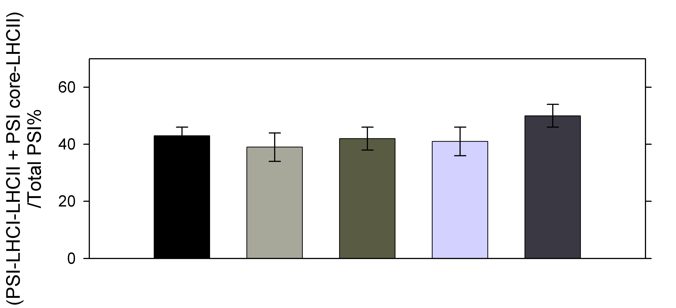
Figure 3.
a
BN-PAGE 1% Digitonin
WT
ΔLhca1
ΔLhca3
ΔLhca2
ΔLhca4
I II
I II
I II
I II
I II
Megacomplexes
1. PSI-LHCI-LHCII
2. PSI-LHCI
3. ATPase
*
^
4b. LHCII-PSI core
4. PSI core
2b. *PSI-LHCI lacking Lhca2/3
or ^PSI-LHCI lacking Lhca1/4
5. PSII core
6. Cytb6f
7. LHCII trimer
b
WT
ΔLhca1
ΔLhca3
ΔLhca2
ΔLhca4
c
d
ΔLhca4
ΔLhca4
WT
WT

Slide 4
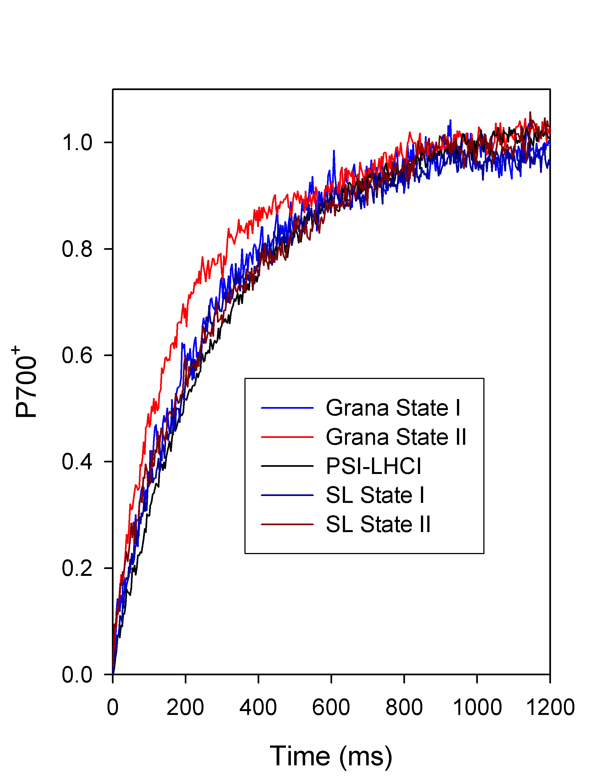
Figure 4.
a
b
Stromal
Lamellae
Stromal
Lamellae
Grana
Grana
c
d
SL II-minus-SL I
G II-minus-G I
G II-minus-
PSI-LHCI
-LHCII
SL I-
minus-
PSI-LHCI
G I-minus-
PSI-LHCI

